Slide 1
Nubis Project Walk Through
June 01 2015
Irc: #nubis-users
https://github.com/Nubisproject/nubis-docs/blob/master/presentations/IT_Walk_Through_20150601.odp
https://github.com/Nubisproject/nubis-docs/blob/master/presentations/IT_Walk_Through_20150601_Links.odp

Slide 2
Goals
Enable you to deploy a demo application
Empower you to develop your own deployments
This is a workshop, not a presentation. Prepare to execute commands.

Slide 3
What we will cover
System Components Review
AWS Account Setup
Prerequisites
Work Flow
Clone a Project
Customizing the Application
Building Images
Application Deploy
Consul Integration
Application Promotion
Jenkins Integration

Slide 4
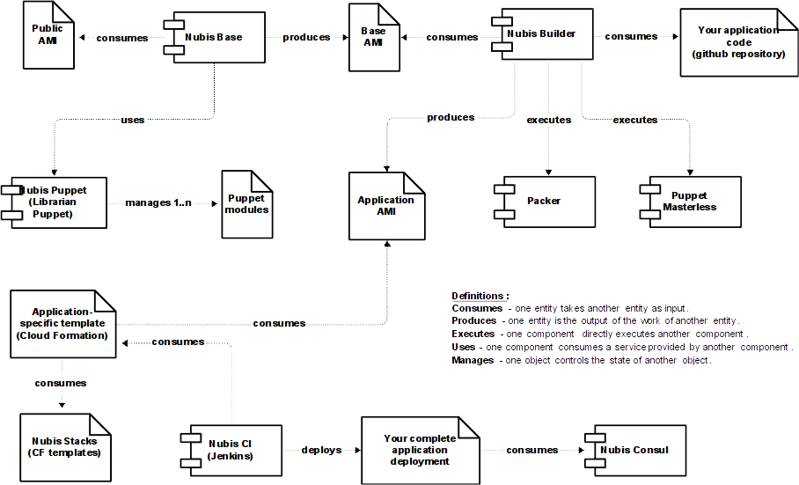
System Components Review

Slide 5
AWS Account Setup
You should already have:
AWS web console access credentials
AWS API Access Keys
AWS EC2 SSH Key Pair
https://github.com/Nubisproject/nubis-docs/blob/master/PREREQUISITES.md#aws-credentials

Slide 6
Prerequisites
You should already have:
GitHub Account
GitHub SSH Keys
Git installed locally
AWS CLI tools installed locally
Nubis Builder
        jq
        Packer
https://github.com/Nubisproject/nubis-docs/blob/master/PREREQUISITES.md#github-account
https://github.com/Nubisproject/nubis-builder#dependencies

Slide 7
Work Flow
GitHub Fork
git clone
Make Changes
nubis-builder build
aws cloudformation create-stack
nubis-consul get-and-update
git add
git commit
git push
GitHub Pull Request

Slide 8
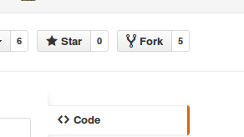
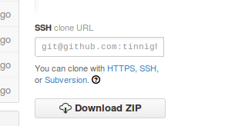
Clone the Project
Fork the repository on GitHub (Requires GitHub user)
        https://github.com/Nubisproject/nubis-dpaste
Clone the repository locally (Requires GitHub SSH keys set up)
        git clone git@github.com:YOU/nubis-dpaste.git
git submodule update --init --recursive

Slide 9
Edit Your Project
Puppet
Packer
Cloudformation
Application Code
Etcetera

Slide 10
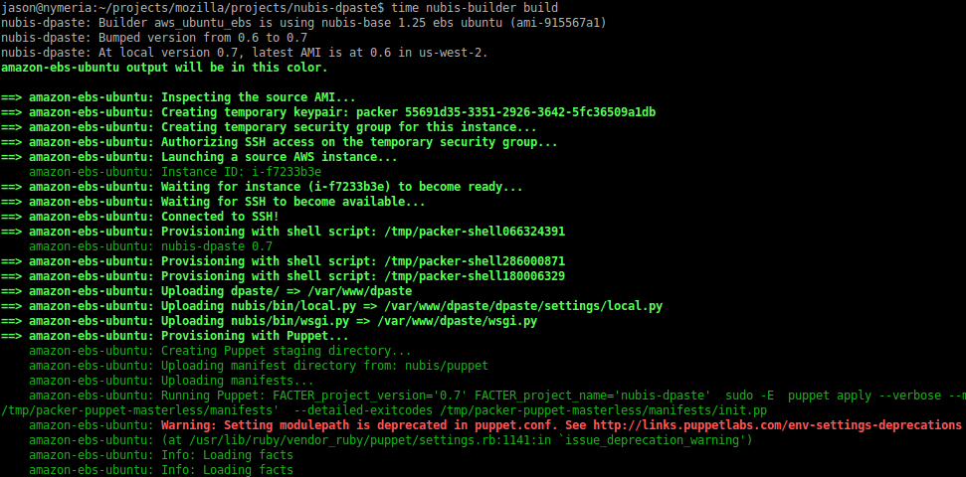
Build Your Machine Image
nubis-builder build

Slide 11
Deploy With Cloudformation
Edit parameters.json
In nubis-builder/nubis/cloudformation/¹
Edit parameters.json (copy parameters.json-dist)
      KeyName: Your AWS SSH Key
      TechnicalOwner: Your LDAP email address
      AmiId: ami-7bbb844b
Create Stack
aws cloudformation create-stack \
--template-body file://nubis/cloudformation/main.json \
--parameters file://nubis/cloudformation/parameters.json \
--stack-name nubis-xxx²
Replace nubis-xxx with a unique name for your stack.
https://github.com/tinnightcap/nubis-dpaste/blob/master/nubis/cloudformation/README.md#set-up
https://github.com/tinnightcap/nubis-dpaste/blob/master/nubis/cloudformation/README.md#create

Slide 12
Update Consul
nubis-consul \
--stack-name nubis-xxx \
--settings nubis/cloudformation/parameters.json \
get-and-update
Remember to replace nubis-xxx with your unique name.
https://github.com/tinnightcap/nubis-dpaste/blob/master/nubis/cloudformation/README.md#update-consul

Slide 13
Login
You need your AWS ssh key added to the jumphost
      Email it to gozer ~or~
      Email it to dcurado
ssh -A -t \
ec2-user@jumphost.sandbox.nubis.allizom.org \
"ssh -A -t ubuntu@$(nubis-consul \
--stack-name nubis-xxx \
--settings nubis/cloudformation/parameters.json \
get-ec2-instance-ip)"
Remember to replace nubis-xxx with your unique name.
https://github.com/tinnightcap/nubis-dpaste/blob/master/nubis/cloudformation/README.md#login

Slide 14
Application Promotion
Or, How do I get my application into production?
File a bug
        Ping Richard Weiss (irc: r2)
Meetings ensue
We create your projects Jenkins instance

Slide 15
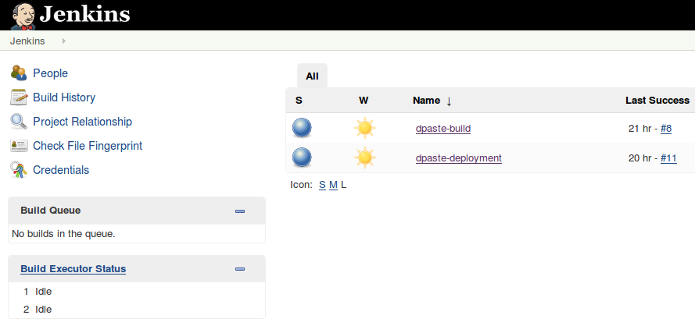
Jenkins Integration
Automatically builds upon GitHub merge
Automatically deploys to stage
Push button deploy to prod
(tests to come)

Slide 16
Delete Stack
Stacks cost money, so please clean up your unused resources
aws cloudformation delete-stack \
--stack-name nubis-xxx
nubis-consul \
--stack-name nubis-xxx \
--settings nubis/cloudformation/parameters.json \
delete
Remember to replace nubis-xxx with your unique name.
https://github.com/tinnightcap/nubis-dpaste/blob/master/nubis/cloudformation/README.md#delete

Slide 17
Q&A

