Slide 1
New Operating Principles
Nubis Training
September 2016
irc #nubis-users

Slide 2
New Operating Principles
New way of thinking

Slide 3
New Operating Principles
Twelve Factor Review
Codebase
        One codebase tracked in VCS, many deploys
Dependencies
        Explicitly declare and isolate dependencies
Config
        Store config in the environment
Backing services
        Treat backing services as attached resources
Build, release, run
        Strictly separate build and run stages
Processes
        Execute the app as one or more stateless processes

Slide 4
New Operating Principles
Twelve Factor Review
Port binding
        Export services via port binding
Concurrency
        Scale out via the process model
Disposability
        Max robustness; fast startup and graceful shutdown
Dev/prod parity
        Keep dev, staging, and prod as similar as possible
Logs
        Treat logs as event streams
Admin processes
        Run admin/management tasks as one-off processes

Slide 5
New Operating Principles
Agile Development
Customer satisfaction by early and continuous delivery of valuable software
Welcome changing requirements, even in late development
Working software is delivered frequently (weeks rather than months)
Close, daily cooperation between business people and developers
Projects are built around motivated individuals, who should be trusted
Face-to-face conversation is the best form of communication

Slide 6
New Operating Principles
Agile Development
Working software is the principal measure of progress
Sustainable development, able to maintain a constant pace
Continuous attention to technical excellence and good design
Simplicity—the art of maximizing the amount of work not done—is essential
Best architectures, requirements, and designs emerge from self-organizing teams
Regularly, the team reflects on how to become more effective, and adjusts accordingly

Slide 7
New Operating Principles
Symantic versioning
MAJOR
        Release that is substantially different or is not backwards compatible
MINOR
        Includes all changes not covered under MAJOR (most typical release)
PATCH
        Specific to fixing regressions or emergency, security related, update

Slide 8
New Operating Principles
Symantic versioning
Example Release Numbering:
v1.2.0 (Normal Release)
        v1.2.0-dev
        v1.2.0-dev_githash
        v1.2.0_githash
v1.2.1 (Patch / Security Release)
        v1.2.1-dev
        v1.2.1_githash
v1.3.0 (Normal Release)
        v1.3.0-dev

Slide 9
New Operating Principles
Code Reviews

Slide 10
New Operating Principles
Decentralization

Slide 11
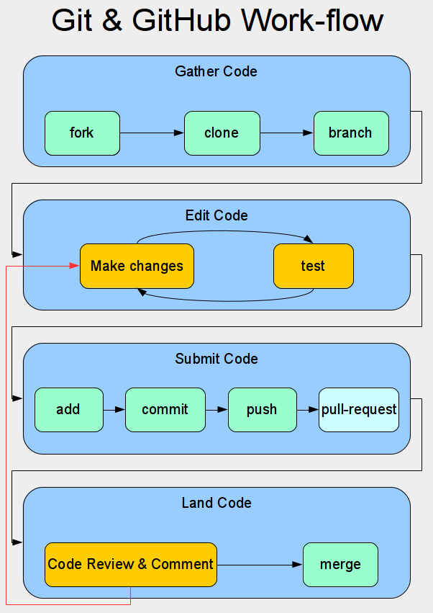
New Operating Principles

Slide 12
New Operating Principles
System level configuration
Packer
Puppet (masterless)
Consul and Confd

Slide 13
New Operating Principles
Image Upgrades

Slide 14
New Operating Principles
To Autoscale or Not to Autoscale

Slide 15
New Operating Principles
Tainted Instances

Slide 16
New Operating Principles
Security Requirements
Network security
User Management (including removal)
Password policies
Segmented privilege levels (least access)
Log integrity
Intrusion detection
Data Ex-filtration
System and package updates
Zero Day vulnerability patching
Long lived access credentials
System access
Monitoring
Auditing

Slide 17
New Operating Principles
Q & A

