Slide 1
Nubis Overview
September 2016
irc #nubis-users

Slide 2
What is Nubis?
Standardized Design
Security Compliance
Reduced Time-to-Market

Slide 3
What can Nubis do for me?
Super Amazing information

Slide 4
What does Nubis provide?
Nubis Accounts
Nubis Deployments

Slide 5
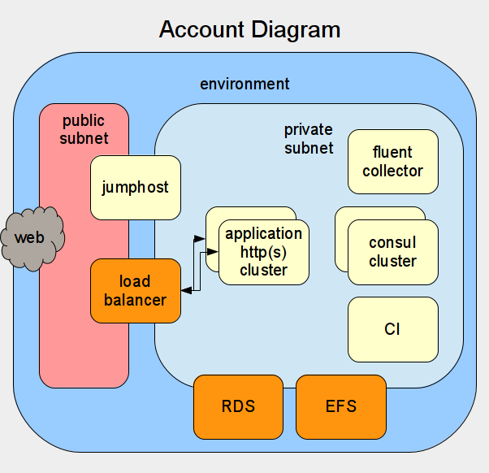
Nubis Accounts

Slide 6
Nubis Accounts
Accounts
Multiple Environments

Slide 7
Nubis Accounts
Quarterly Updates
Distribution Upgrades
Package Updates
New Services
Application Image Updates

Slide 8
Nubis Accounts
Security Updates

Slide 9
Nubis Accounts
Included Services
Proxies
NATs
Consul Integration
Fluent Integration
Jumphosts

Slide 10
Nubis Accounts
User Management
MFA
aws-vault
LDAP Integration

Slide 11
Nubis Accounts
Security Integration
InfoSec Security Audit Role
Network Security Monitoring (NSM)
Integrated IP Blacklisting
Log Integration with Mozilla Investigator (MIG)
CloudTrail Integration

Slide 12
Nubis Accounts
Additional Services
Cloud Health Integration
Billing Support
Tainted Resources
Platform Monitoring
High Availability

Slide 13
What does Nubis provide?
Nubis Accounts
Nubis Deployments

Slide 14
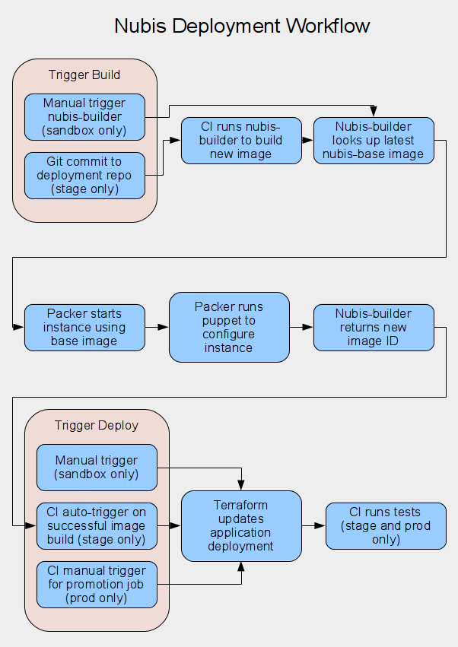
Nubis Deployments

Slide 15
Nubis Deployments
Overview
Environments and how to use them
        Sandbox environment
        Staging environment
        Production environment

Slide 16
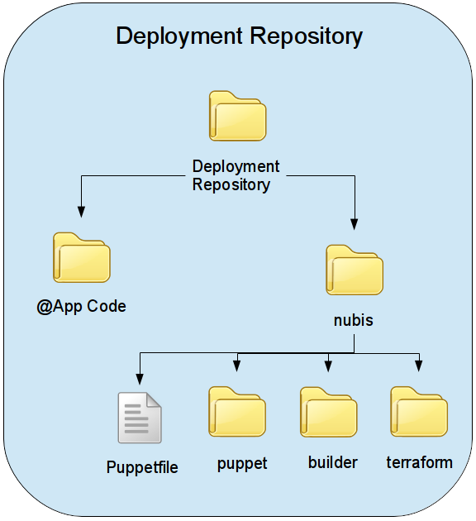
Nubis Deployments

Slide 17
Nubis Deployments
Terraform Modules

Slide 18
Nubis Deployments
Recommended Practices

Slide 19
Nubis Deployments
Architectural Design Services
Example Deployments
nubis-skel
AWS Solutions Architect

Slide 20
Nubis Deployments
Community Support
#nubis-users
nubis-users@googlegroups.com

Slide 21
Nubis Deployments
CI System

Slide 22
Nubis Deployments
Rolling Back

Slide 23
Nubis Deployments
Custom Monitors

Slide 24
Nubis Deployments
nubis-base

Slide 25


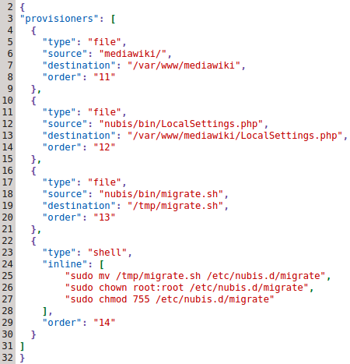
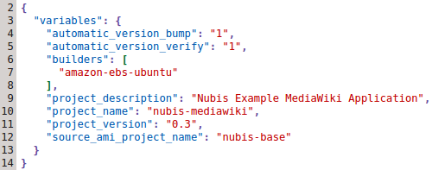


Nubis Builder

Slide 26
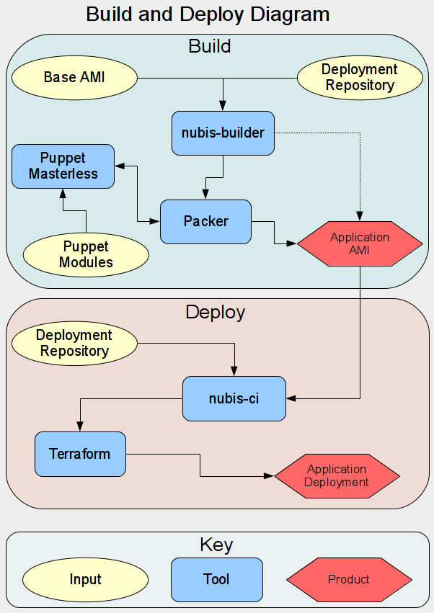
Nubis Deployments

Slide 27
Nubis Overview
Q & A

