Slide 1
Nubis Project Overview
May 12 2015
irc: #nubis-users
https://github.com/Nubisproject/nubis-docs/blob/master/presentations/IT_Overview_20150512.odp

Slide 2
Goals
Introduce
Empower
Inspire

Slide 3
What we will cover
Why we are here
Users & Use Cases
Design Principles
System Components
Git & GitHub
Deployment Repo
Environment Layout
Work Flow Patterns
Puppet
Nubis Builder
Cloudformation
Putting it all together
Demonstration
Q&A

Slide 4
Why we are here
Introduction to the Nubis Project
Walk through the tool chain
Demonstrate application deployment
Answer questions
Prepare you for assimilation

Slide 5
Users & Use Cases
IT Workloads
Active Development
Web Properties
Legacy (unsupported) apps
Future expansion

Slide 6
Design Principles
Open by default
Dynamic discovery
Auto scaling by default
Immutable servers
Reusable by design
Decoupled by default
Isolated by default
Deployments are the norm
Bit for bit repeatability
Testing from the start
Monitor the things that actually matter

Slide 7
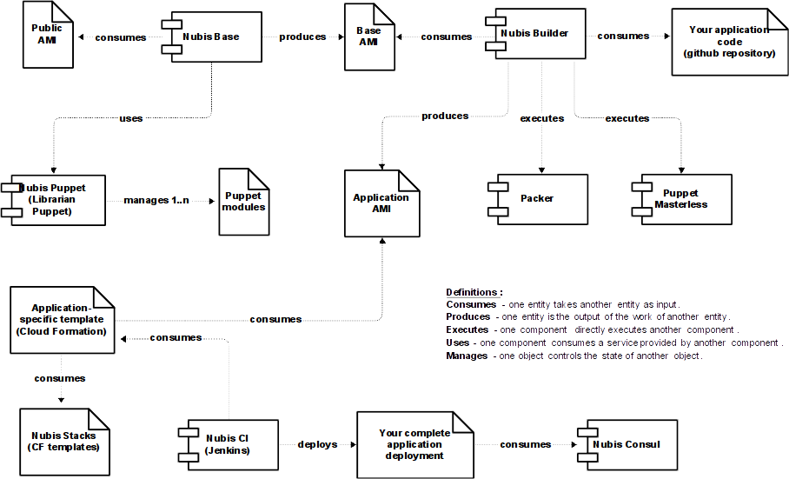
System Components

Slide 8
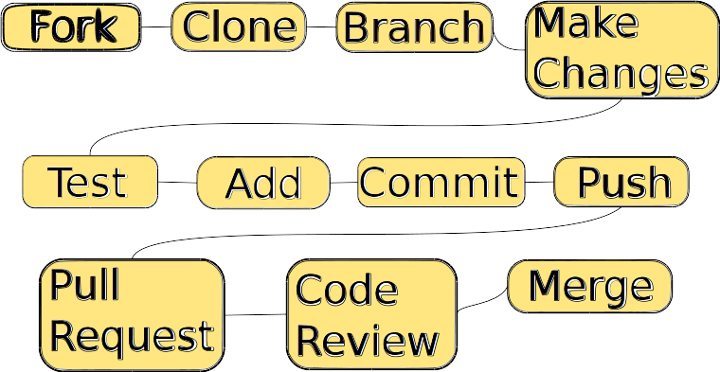
Git & GitHub

Slide 9


Deployment Repository

Slide 10
Environment Layout
Sandbox
Dev
Prod
Isolated
Identical
Reusable

Slide 11
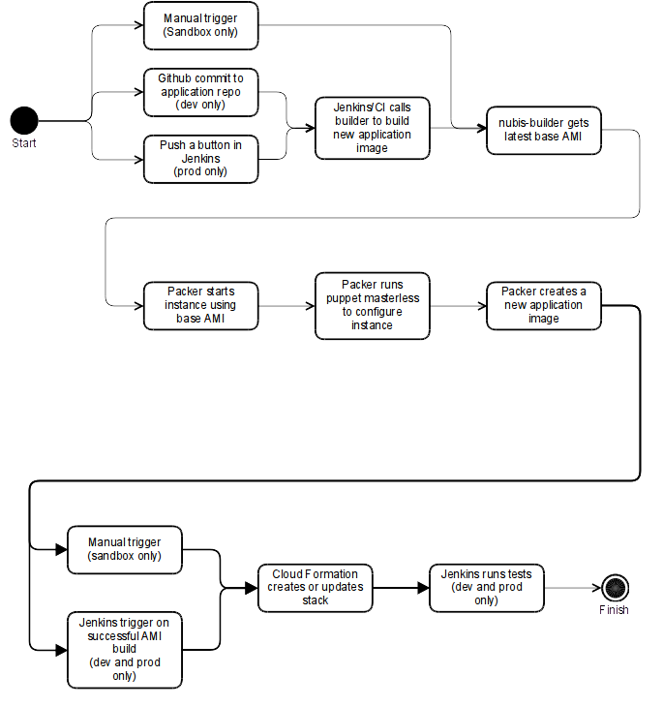
Work Flow Patterns

Slide 12


Puppet Modules

Slide 13

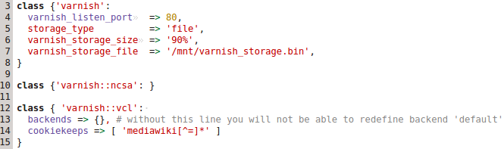
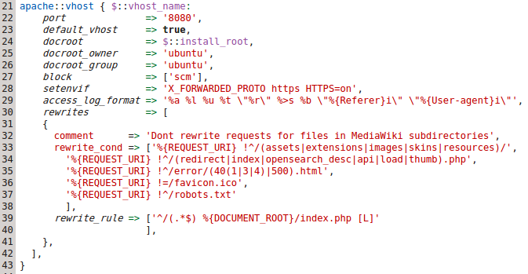
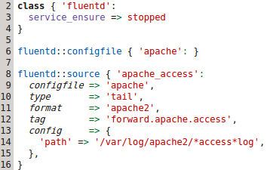
Puppet Usage

Slide 14
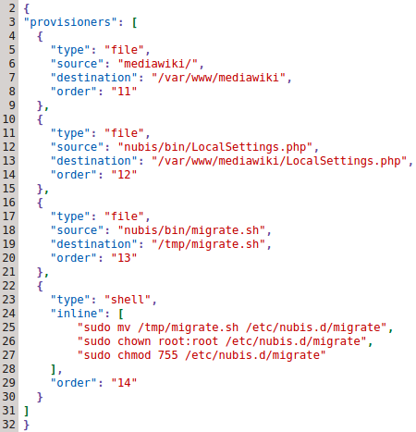
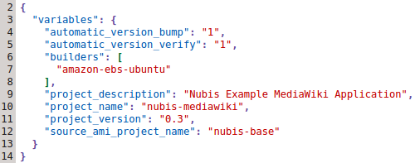


Nubis Builder

Slide 15
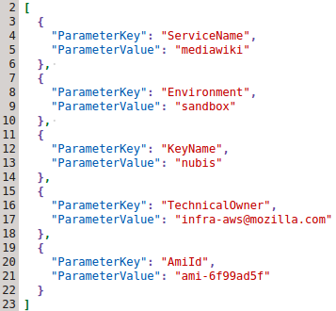
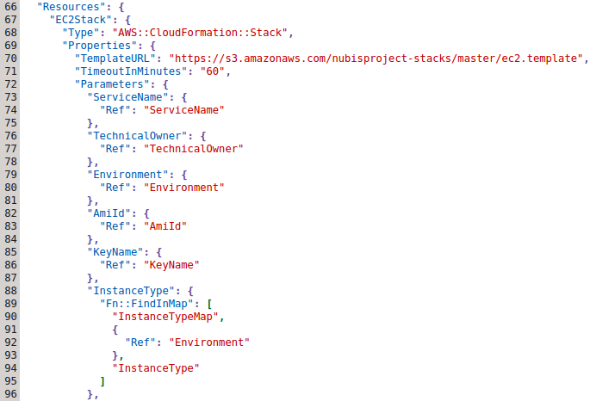

CloudFormation
Nested Stacks

Slide 16
Putting it all together
Create deployment repository
Build ami (nubis-builder build)
Deploy into sandbox (cloudformation)
Rework till just right
Fill out form for deployment into dev
Test, test, test
Deploy to prod
Rejoice, your assimilation is complete

Slide 17
Demonstration
gozer time

Slide 18
Q&A

Slide 19
Links
Nubis Project on GitHub
Nubis Documentation
nubis-mediawiki example application
Packer
CloudFormation
Puppet Forge
irc.mozilla.org #nubis-users
nubis-users@mozilla.com
https://github.com/Nubisproject/nubis-docs/blob/master/presentations/IT_Overview_20150512.odp

