Slide 1
Welcome to the Web Application Development with Python L-4 Training Program

Slide 2
MD. SHAKIL Asst. Trainer Web Application Development with Python Daffodil International Professional Training Institute Cell: +880 1793-299882 Email: shakil.eub.cse@gmail.com

Slide 3
RAJESH KUMAR DAS Lead Trainer Web Application Development with Python Daffodil International Professional Training Institute

Slide 4

Lecture
About Each Other
Course Overview
00

Slide 5

Introduce Yourself
Name
Address
Educational Qualification
Why in this course?

Slide 6


Slide 7
About Course
Course Name: Web Application Development with Python
Level : 04
Total Classes: 72
Unit of Competencies: 08
Course Duration: 3 months
Total Nominal Learning Hours: 360 Hours

Slide 8
Tools & Technologies
Programming Languages
Python
UI Design
HTML, CSS, Bootstrap
Frameworks
Django
DRF
Code Editor
VS Code
Version Control
Git & Github
Database
SQLite3

Slide 9

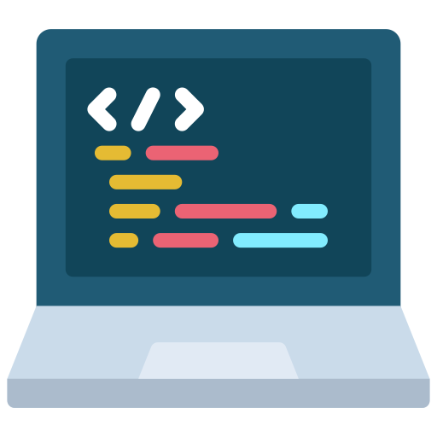

Assessment Events
Written
Demonstration
Oral Testing

Slide 10
Event wise Tasks
Written - 30
Demonstration - 7
Oral Testing - 10

Slide 11
Unit of Competencies
Enable Django Framework Environment
01
Develop dynamic web pages
02
Use Django Model
03
Process Forms
04

Slide 12
Unit of Competencies
Customize UI
05
Apply User Management
06
Create API using Django REST Framework
07
Create Final project
08

Slide 13

What is the outcome of this Course?

Slide 14
Thanks All

