Slide 1




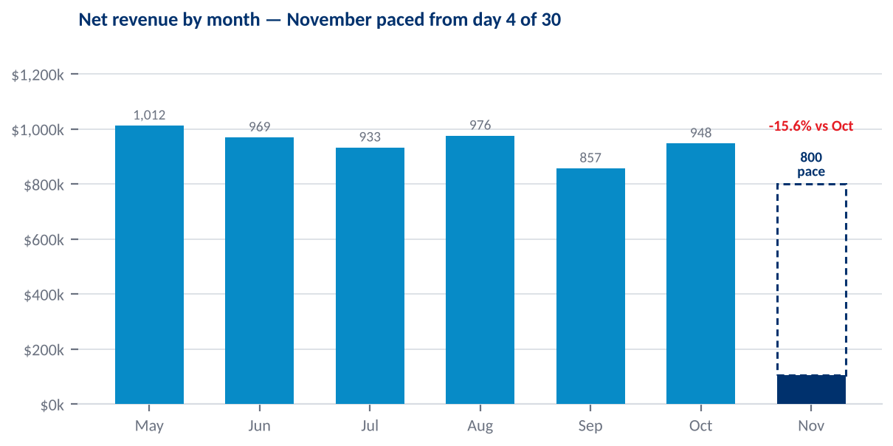
Executive Performance Summary
Operations week Oct 29–Nov 4 · Data complete through Nov 4
All markets. Net revenue excludes the Fleet channel. Week runs Thursday–Wednesday.
NET REVENUE
AVERAGE TICKET
REV-PRODUCING JOBS / TECH DAY
SERVICE CALL RATE
TECHNICIAN EFFICIENCY
$210,454
$513
3.18
5.5%
63%
-2.1% WoW
+5.5% WoW
-3.6% WoW
-20.4% WoW
8-week norm $203,920
8-week norm $502
27 techs · 129 tech days
8-week norm 6.6%
2,942 invoiced ÷ 4,672 clocked hours
MARKET SCORECARD — WEEK OCT 29–NOV 4, SORTED BY REVENUE
Market | Revenue | WoW | Ticket | WoW | Rev jobs/day | Svc call % | Nov pace vs Oct
Dallas | $51,832 | +15% | $503 | +10% | 3.43 | 7.2% | +5%
Atlanta | $37,188 | +15% | $496 | +13% | 3.75 | 5.1% | -5%
Houston | $32,689 | -1% | $503 | +7% | 3.61 | 3.0% | -5%
Nashville | $27,422 | -7% | $473 | -6% | 3.05 | 4.9% | -30%
Austin | $25,557 | -2% | $691 | +28% | 3.08 | 2.6% | -43%
San Antonio | $11,717 | -34% | $451 | -8% | 2.17 | 7.1% | -23%
Orlando | $8,448 | -3% | $497 | -3% | 3.40 | 15.0% | -26%
Miami | $7,019 | +13% | $877 | +28% | 2.00 | 0.0% | +25%
Louisville | $5,164 | -51% | $397 | -39% | 2.60 | 7.1% | -8%
Tampa | $3,417 | -40% | $427 | +5% | 2.00 | 0.0% | -82%
Total | $210,454 | -2% | $513 | +6% | 3.18 | 5.5% | -16%
WHAT CHANGED THIS WEEK — AUTO-GENERATED
• Revenue bridge: -2.1% week over week splits -$8,021 capacity (-5 tech days) and $3,512 productivity ($1,631/day vs $1,604). Capacity is the larger driver.
• Month pace: $106,649 through day 4 of 30 paces to $799,865, -15.6% against Oct at $947,542. Straight-line pace — no LE loaded.
• Miami: average ticket up 67% — $877 vs $524.
• Austin: average ticket up 23% — $691 vs $561.

Slide 2
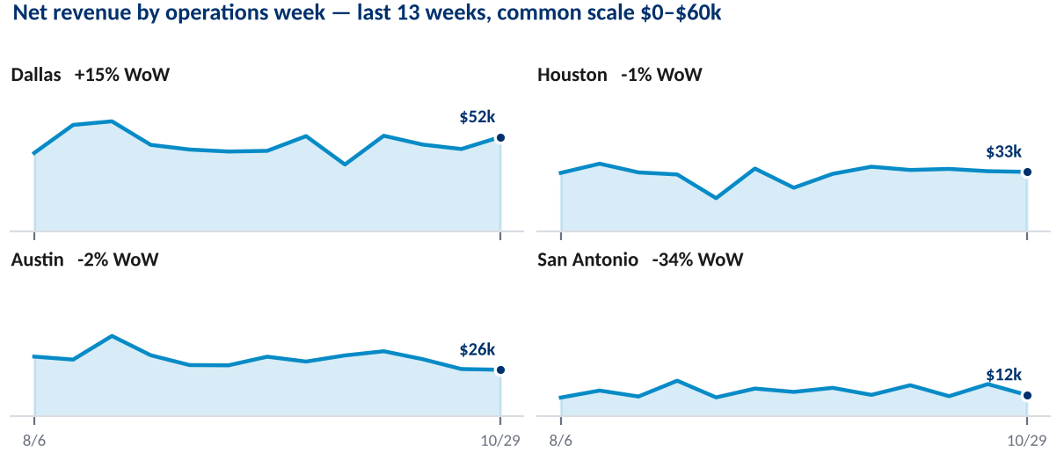
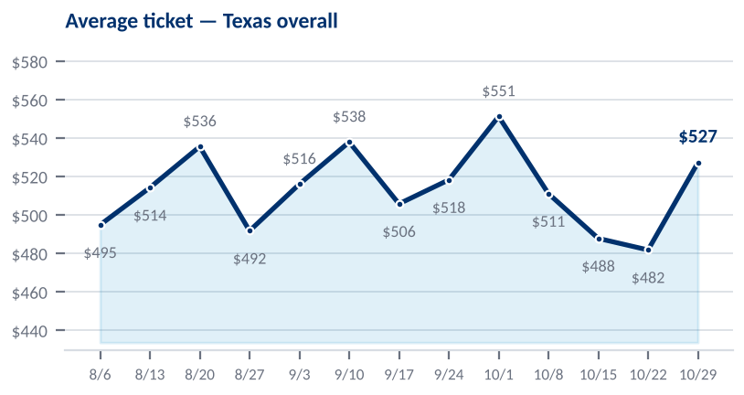
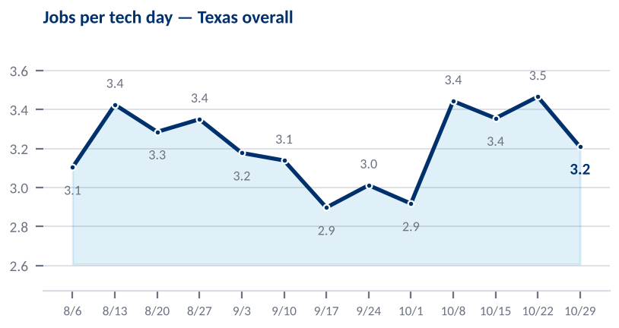
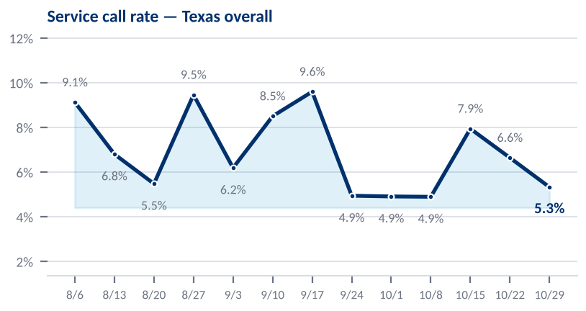
Texas Operations Review — Bob
Operations week Oct 29–Nov 4
Dallas, Houston, Austin, San Antonio. Roll-up view — the action plan for each market sits on its own slide behind this one.
TEXAS MARKET DETAIL
Market | Revenue | WoW | vs 8wk | Ticket | Ticket compl. | Rev jobs/day | Svc call %
Dallas | $51,832 | +15% | +13% | $503 | 110.7% | 3.43 | 7.2%
Houston | $32,689 | -1% | +7% | $503 | 130.5% | 3.61 | 3.0%
Austin | $25,557 | -2% | -17% | $691 | 148.5% | 3.08 | 2.6%
San Antonio | $11,717 | -34% | -16% | $451 | 94.6% | 2.17 | 7.1%
Region total | $121,795 | -0% | — | $527 | 120.0% | 3.21 | 5.3%
WHAT THE DATA SAYS — AUTO-GENERATED
• Region revenue $121,795, -0.1% week over week; 72 tech days worked vs 73 prior week ($1,692 per tech day).
• Austin: average ticket up 23% — $691 vs $561.
• San Antonio: jobs per tech day down 33% — 2.17 vs 3.24.
• Austin: revenue down 17% — $25,557 vs a $30,683 8-week norm.

Slide 3
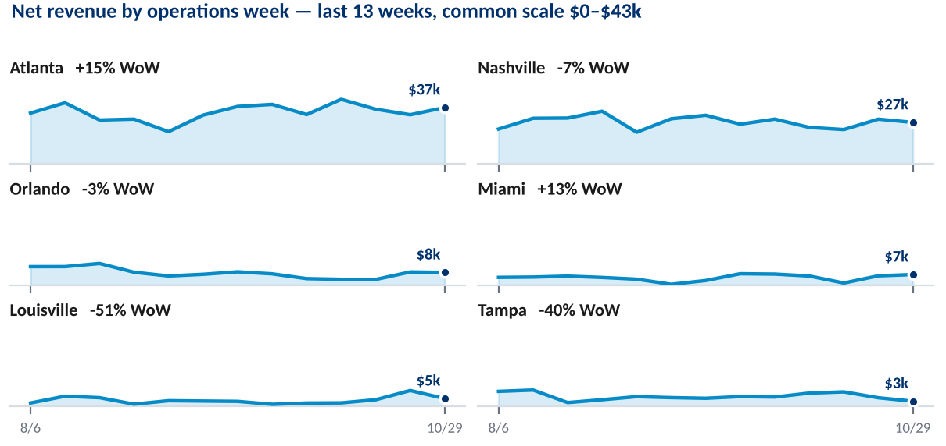
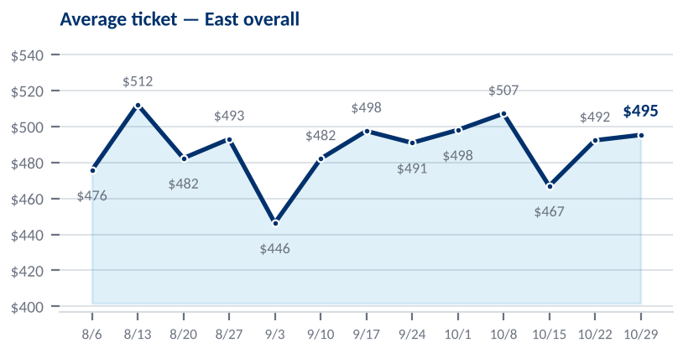
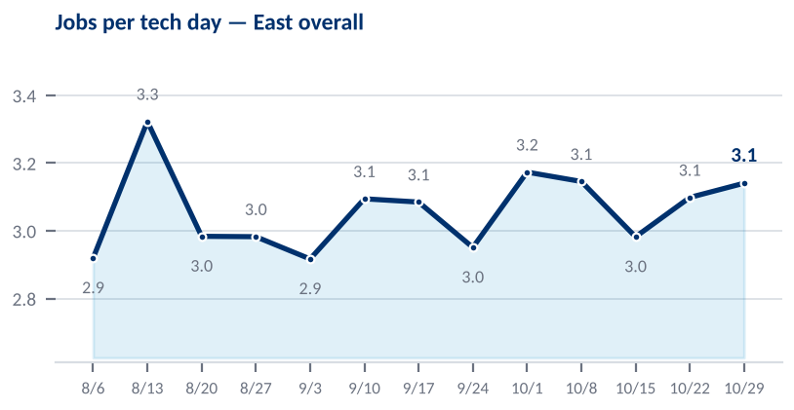
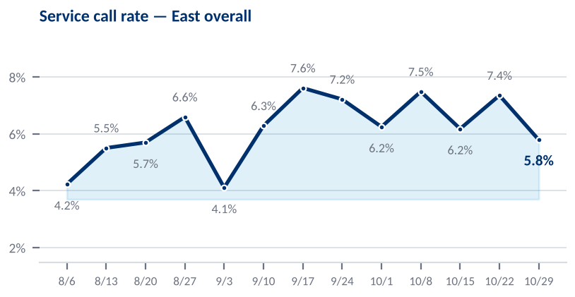
East Operations Review — Patrick
Operations week Oct 29–Nov 4
Atlanta, Nashville, Orlando, Tampa, Miami, Louisville. Roll-up view — the action plan for each market sits on its own slide behind this one.
EAST MARKET DETAIL
Market | Revenue | WoW | vs 8wk | Ticket | Ticket compl. | Rev jobs/day | Svc call %
Atlanta | $37,188 | +15% | +8% | $496 | 117.9% | 3.75 | 5.1%
Nashville | $27,422 | -7% | +2% | $473 | 128.6% | 3.05 | 4.9%
Orlando | $8,448 | -3% | +34% | $497 | 144.7% | 3.40 | 15.0%
Miami | $7,019 | +13% | +55% | $877 | 253.2% | 2.00 | 0.0%
Louisville | $5,164 | -51% | +32% | $397 | 142.9% | 2.60 | 7.1%
Tampa | $3,417 | -40% | -50% | $427 | 113.9% | 2.00 | 0.0%
Region total | $88,659 | -5% | — | $495 | 130.2% | 3.14 | 5.8%
WHAT THE DATA SAYS — AUTO-GENERATED
• Region revenue $88,659, -4.7% week over week; 57 tech days worked vs 61 prior week ($1,555 per tech day).
• Miami: average ticket up 67% — $877 vs $524.
• Orlando: jobs per tech day up 35% — 3.40 vs 2.51.

Slide 4
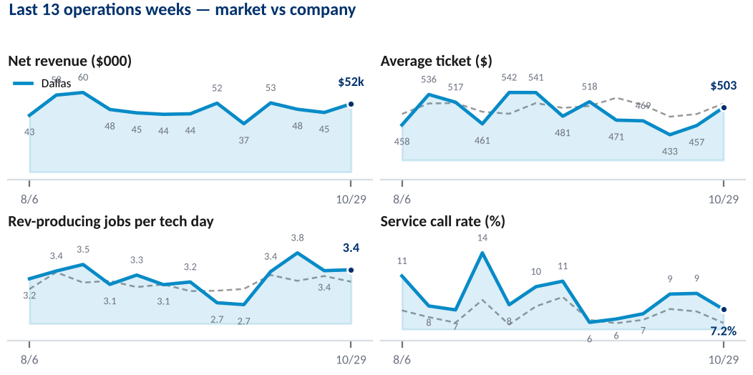
Dallas — Texas · Bob
Operations week Oct 29–Nov 4
Technician table covers the trailing 4 weeks (Oct 8–Nov 4) — a single week is too thin for a fair per-technician read.
NET REVENUE
AVERAGE TICKET
REV-PRODUCING JOBS / TECH DAY
SERVICE CALL RATE
$51,832
$503
3.43
7.2%
+14.6% WoW
+10.1% WoW
+0.6% WoW
-21.4% WoW
Nov pacing +4.6% vs Oct (day 4)
Ticket completion 110.7% · company $513
6 techs · 30 tech days
Company 5.5%
TECHNICIAN LEADERBOARD — TRAILING 4 WEEKS
TECHNICIAN | Days | Revenue | Rev jobs | Rev jobs/day | Booked ticket | Avg ticket | Ticket compl. | Svc call | Rotor attach | Inv. hours | Efficiency
Michael Herring | 21 | $42,051 | 76 | 3.6 | $454 | $553 | 121.8% | 0.0% | 67.1% | 166h | 86%
▼ Dustin Morgan | 20 | $33,990 | 74 | 3.7 | $482 | $459 | 95.3% | 9.8% | 56.8% | 112h | 68%
▼ Jesse Berrones | 21 | $29,835 | 67 | 3.2 | $412 | $445 | 108.0% | 13.0% | 47.8% | 107h | 61%
Pablo Chavez | 18 | $28,834 | 62 | 3.4 | $440 | $465 | 105.6% | 1.6% | 61.3% | 99h | 62%
▼ Eddie Catalan | 19 | $28,338 | 73 | 3.8 | $324 | $388 | 119.7% | 9.9% | 54.8% | 118h | 69%
▼ Jiovanny Perez | 19 | $27,354 | 61 | 3.2 | $426 | $448 | 105.2% | 14.1% | 59.0% | 86h | 52%
▲ Marcus Thompson | 3 | $6,876 | 11 | 3.7 | $585 | $625 | 106.8% | 0.0% | 72.7% | 21h | 67%
Dallas overall | 121 | $197,278 | 424 | 3.5 | $427 | $465 | 108.8% | 8.0% | 58.3% | 708h | 67%
▲ ▼ = moved against their own prior 8 weeks, not a peer ranking:
▼ Dustin Morgan — ticket $459 vs own $542 (-15%)
▼ Jesse Berrones — ticket $445 vs own $528 (-16%)
▼ Eddie Catalan — ticket $388 vs own $472 (-18%)
▼ Jiovanny Perez — ticket $448 vs own $522 (-14%)
▲ Marcus Thompson — ticket $625 vs own $436 (+44%); service call 0.0% vs own 8.5% (-8.5pp)
PTO in window — Pablo Chavez 10h, Eddie Catalan 8h, Jiovanny Perez 8h.
Shading ranks within this market. Volume columns and booked ticket are unshaded — booked ticket is the work dispatched, not the result.
KEY TAKEAWAYS
CURRENT PRIORITIES
ACTIONS UNDERWAY
SUPPORT / DECISIONS NEEDED
Bob: what is happening in Dallas, in two or three lines.
The one or two things being worked in Dallas this week, and why they come first here.
Specific action, owner, and the date it lands.
What is blocked, who needs to unblock it, and by when.

Slide 5
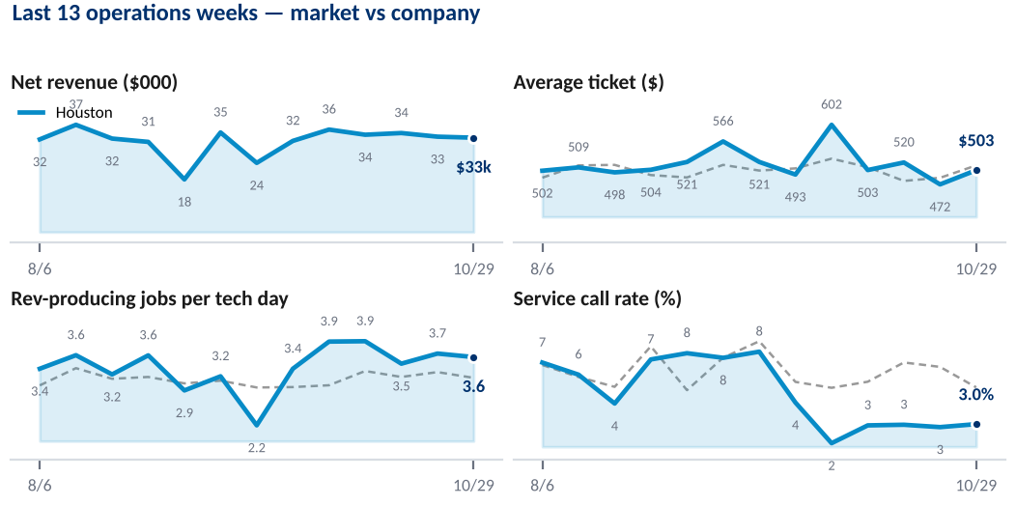
Houston — Texas · Bob
Operations week Oct 29–Nov 4
Technician table covers the trailing 4 weeks (Oct 8–Nov 4) — a single week is too thin for a fair per-technician read.
NET REVENUE
AVERAGE TICKET
REV-PRODUCING JOBS / TECH DAY
SERVICE CALL RATE
$32,689
$503
3.61
3.0%
-1.1% WoW
+6.5% WoW
-2.0% WoW
+7.5% WoW
Nov pacing -5.0% vs Oct (day 4)
Ticket completion 130.5% · company $513
3 techs · 18 tech days
Company 5.5%
TECHNICIAN LEADERBOARD — TRAILING 4 WEEKS
TECHNICIAN | Days | Revenue | Rev jobs | Rev jobs/day | Booked ticket | Avg ticket | Ticket compl. | Svc call | Rotor attach | Inv. hours | Efficiency
Tommy Moore | 24 | $46,717 | 91 | 3.8 | $416 | $513 | 123.4% | 5.2% | 69.2% | 150h | 70%
▲ Jaden Thagard | 24 | $43,613 | 81 | 3.4 | $416 | $538 | 129.5% | 1.2% | 70.4% | 156h | 68%
▼ Edgar Khachaturyan | 22 | $40,600 | 91 | 4.1 | $379 | $446 | 117.7% | 2.2% | 57.1% | 146h | 83%
▲ Sergio Nieto | 3 | $2,822 | 5 | 1.7 | $445 | $564 | 126.9% | 0.0% | 40.0% | 12h | 58%
Houston overall | 73 | $133,751 | 268 | 3.7 | $404 | $499 | 123.6% | 2.9% | 64.9% | 463h | 73%
▲ ▼ = moved against their own prior 8 weeks, not a peer ranking:
▲ Jaden Thagard — service call 1.2% vs own 8.3% (-7.0pp)
▼ Edgar Khachaturyan — ticket $446 vs own $536 (-17%)
▲ Sergio Nieto — ticket $564 vs own $454 (+24%); service call 0.0% vs own 15.0% (-15.0pp)
PTO in window — Edgar Khachaturyan 16h.
Shading ranks within this market. Volume columns and booked ticket are unshaded — booked ticket is the work dispatched, not the result.
KEY TAKEAWAYS
CURRENT PRIORITIES
ACTIONS UNDERWAY
SUPPORT / DECISIONS NEEDED
Bob: what is happening in Houston, in two or three lines.
The one or two things being worked in Houston this week, and why they come first here.
Specific action, owner, and the date it lands.
What is blocked, who needs to unblock it, and by when.

Slide 6
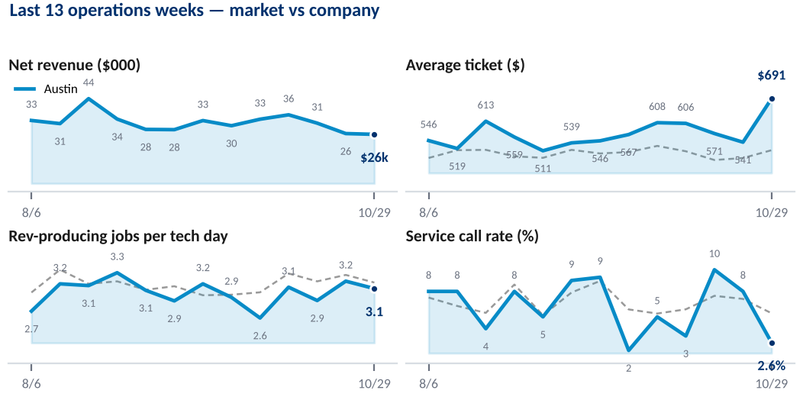
Austin — Texas · Bob
Operations week Oct 29–Nov 4
Technician table covers the trailing 4 weeks (Oct 8–Nov 4) — a single week is too thin for a fair per-technician read.
NET REVENUE
AVERAGE TICKET
REV-PRODUCING JOBS / TECH DAY
SERVICE CALL RATE
$25,557
$691
3.08
2.6%
-1.6% WoW
+27.7% WoW
-3.6% WoW
-65.8% WoW
Nov pacing -42.9% vs Oct (day 4)
Ticket completion 148.5% · company $513
3 techs · 12 tech days
Company 5.5%
TECHNICIAN LEADERBOARD — TRAILING 4 WEEKS
TECHNICIAN | Days | Revenue | Rev jobs | Rev jobs/day | Booked ticket | Avg ticket | Ticket compl. | Svc call | Rotor attach | Inv. hours | Efficiency
Richard Forcey | 20 | $39,250 | 67 | 3.4 | $494 | $586 | 118.7% | 6.9% | 76.1% | 113h | 65%
Przemyslaw Sadowski | 19 | $37,535 | 54 | 2.8 | $476 | $695 | 146.0% | 1.8% | 87.0% | 114h | 65%
Mario Gonzalez | 16 | $30,065 | 51 | 3.2 | $491 | $590 | 120.1% | 3.8% | 72.5% | 96h | 66%
Kevin Camacho | 10 | $11,796 | 27 | 2.7 | $402 | $437 | 108.7% | 15.6% | 59.3% | 36h | 35%
Austin overall | 65 | $118,647 | 199 | 3.1 | $476 | $596 | 125.3% | 6.1% | 75.9% | 360h | 60%
PTO in window — Mario Gonzalez 32h, Przemyslaw Sadowski 8h.
Shading ranks within this market. Volume columns and booked ticket are unshaded — booked ticket is the work dispatched, not the result.
KEY TAKEAWAYS
CURRENT PRIORITIES
ACTIONS UNDERWAY
SUPPORT / DECISIONS NEEDED
Bob: what is happening in Austin, in two or three lines.
The one or two things being worked in Austin this week, and why they come first here.
Specific action, owner, and the date it lands.
What is blocked, who needs to unblock it, and by when.

Slide 7
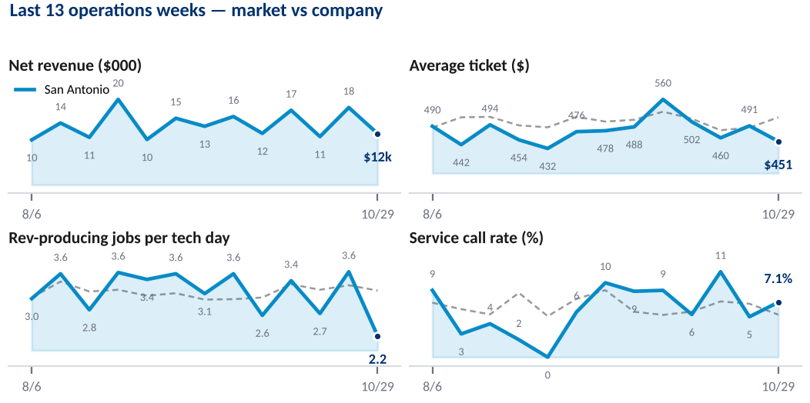
San Antonio — Texas · Bob
Operations week Oct 29–Nov 4
Technician table covers the trailing 4 weeks (Oct 8–Nov 4) — a single week is too thin for a fair per-technician read.
NET REVENUE
AVERAGE TICKET
REV-PRODUCING JOBS / TECH DAY
SERVICE CALL RATE
$11,717
$451
2.17
7.1%
-33.7% WoW
-8.2% WoW
-39.8% WoW
+35.7% WoW
Nov pacing -22.7% vs Oct (day 4)
Ticket completion 94.6% · company $513
3 techs · 12 tech days
Company 5.5%
TECHNICIAN LEADERBOARD — TRAILING 4 WEEKS
TECHNICIAN | Days | Revenue | Rev jobs | Rev jobs/day | Booked ticket | Avg ticket | Ticket compl. | Svc call | Rotor attach | Inv. hours | Efficiency
Joseph Gonzalez | 19 | $31,282 | 66 | 3.5 | $427 | $474 | 111.0% | 4.3% | 51.5% | 109h | 65%
▼ Scott Andrews | 16 | $17,103 | 35 | 2.2 | $448 | $489 | 109.1% | 10.3% | 54.3% | 61h | 45%
▼ Lee Bradley | 6 | $9,098 | 19 | 3.2 | $531 | $479 | 90.3% | 9.5% | 73.7% | 29h | 66%
San Antonio overall | 41 | $57,483 | 120 | 2.9 | $449 | $479 | 106.6% | 7.0% | 55.8% | 199h | 57%
▲ ▼ = moved against their own prior 8 weeks, not a peer ranking:
▼ Scott Andrews — service call 10.3% vs own 4.3% (+6.0pp)
▼ Lee Bradley — service call 9.5% vs own 2.9% (+6.7pp)
PTO in window — Joseph Gonzalez 6h.
Shading ranks within this market. Volume columns and booked ticket are unshaded — booked ticket is the work dispatched, not the result.
KEY TAKEAWAYS
CURRENT PRIORITIES
ACTIONS UNDERWAY
SUPPORT / DECISIONS NEEDED
Bob: what is happening in San Antonio, in two or three lines.
The one or two things being worked in San Antonio this week, and why they come first here.
Specific action, owner, and the date it lands.
What is blocked, who needs to unblock it, and by when.

Slide 8
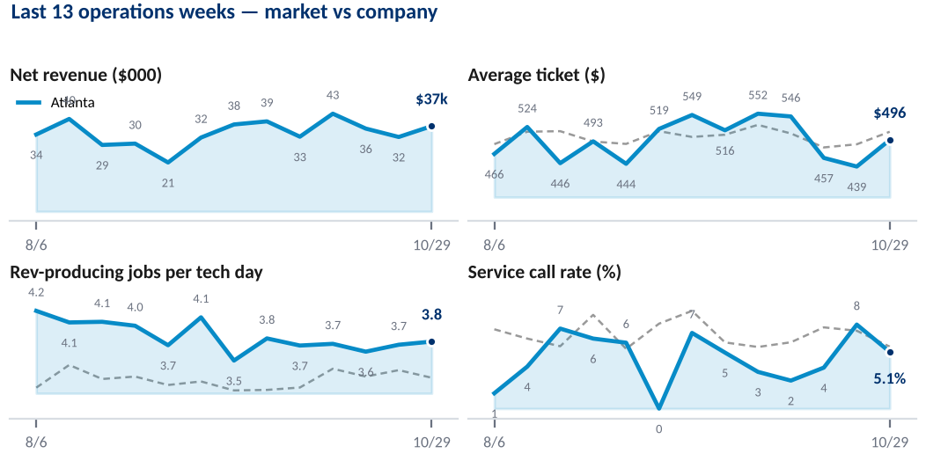
Atlanta — East · Patrick
Operations week Oct 29–Nov 4
Technician table covers the trailing 4 weeks (Oct 8–Nov 4) — a single week is too thin for a fair per-technician read.
NET REVENUE
AVERAGE TICKET
REV-PRODUCING JOBS / TECH DAY
SERVICE CALL RATE
$37,188
$496
3.75
5.1%
+14.6% WoW
+13.1% WoW
+1.4% WoW
-32.5% WoW
Nov pacing -4.9% vs Oct (day 4)
Ticket completion 117.9% · company $513
4 techs · 20 tech days
Company 5.5%
TECHNICIAN LEADERBOARD — TRAILING 4 WEEKS
TECHNICIAN | Days | Revenue | Rev jobs | Rev jobs/day | Booked ticket | Avg ticket | Ticket compl. | Svc call | Rotor attach | Inv. hours | Efficiency
Josh Horowitz | 24 | $47,711 | 100 | 4.2 | $429 | $477 | 111.1% | 4.8% | 73.0% | 162h | 83%
Jay Johnson | 20 | $39,442 | 77 | 3.9 | $435 | $512 | 117.7% | 3.8% | 64.9% | 127h | 66%
Dominique Simpson | 19 | $35,421 | 72 | 3.8 | $482 | $492 | 102.1% | 7.7% | 58.3% | 106h | 63%
Jerrik Jordan | 20 | $25,771 | 57 | 2.9 | $418 | $452 | 108.3% | 1.7% | 59.6% | 96h | 54%
Atlanta overall | 83 | $148,345 | 306 | 3.7 | $441 | $485 | 109.9% | 4.7% | 65.0% | 490h | 67%
PTO in window — Dominique Simpson 8h.
Shading ranks within this market. Volume columns and booked ticket are unshaded — booked ticket is the work dispatched, not the result.
KEY TAKEAWAYS
CURRENT PRIORITIES
ACTIONS UNDERWAY
SUPPORT / DECISIONS NEEDED
Patrick: what is happening in Atlanta, in two or three lines.
The one or two things being worked in Atlanta this week, and why they come first here.
Specific action, owner, and the date it lands.
What is blocked, who needs to unblock it, and by when.

Slide 9
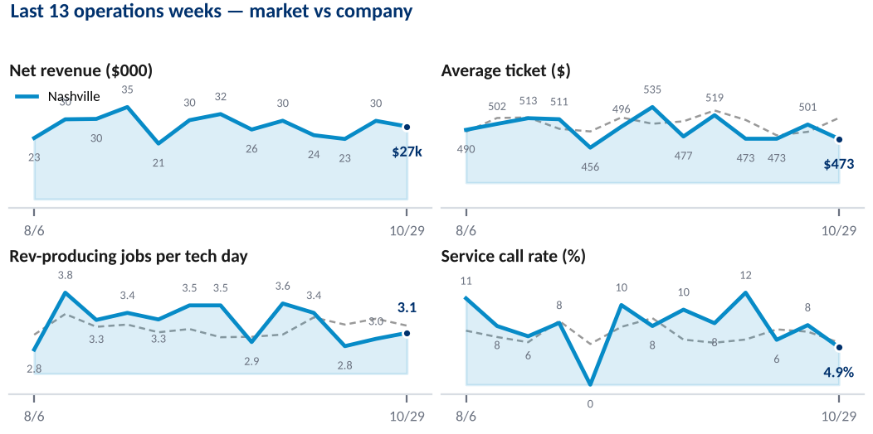
Nashville — East · Patrick
Operations week Oct 29–Nov 4
Technician table covers the trailing 4 weeks (Oct 8–Nov 4) — a single week is too thin for a fair per-technician read.
NET REVENUE
AVERAGE TICKET
REV-PRODUCING JOBS / TECH DAY
SERVICE CALL RATE
$27,422
$473
3.05
4.9%
-7.2% WoW
-5.6% WoW
+3.5% WoW
-37.0% WoW
Nov pacing -30.3% vs Oct (day 4)
Ticket completion 128.6% · company $513
4 techs · 19 tech days
Company 5.5%
TECHNICIAN LEADERBOARD — TRAILING 4 WEEKS
TECHNICIAN | Days | Revenue | Rev jobs | Rev jobs/day | Booked ticket | Avg ticket | Ticket compl. | Svc call | Rotor attach | Inv. hours | Efficiency
▼ Kemper Stanley | 21 | $30,229 | 64 | 3.0 | $377 | $472 | 125.4% | 11.1% | 56.2% | 97h | 60%
Austin Lane | 20 | $29,724 | 58 | 2.9 | $364 | $512 | 141.0% | 3.3% | 75.9% | 123h | 74%
Mike Nethken | 20 | $27,844 | 59 | 3.0 | $391 | $472 | 120.6% | 6.3% | 66.1% | 102h | 61%
Clint Hyde | 10 | $15,977 | 35 | 3.5 | $463 | $456 | 98.6% | 10.3% | 65.7% | 60h | 71%
Nashville overall | 71 | $103,774 | 216 | 3.0 | $391 | $480 | 122.8% | 7.7% | 65.7% | 382h | 66%
▲ ▼ = moved against their own prior 8 weeks, not a peer ranking:
▼ Kemper Stanley — ticket $472 vs own $538 (-12%); service call 11.1% vs own 5.6% (+5.5pp)
PTO in window — Clint Hyde 48h.
Shading ranks within this market. Volume columns and booked ticket are unshaded — booked ticket is the work dispatched, not the result.
KEY TAKEAWAYS
CURRENT PRIORITIES
ACTIONS UNDERWAY
SUPPORT / DECISIONS NEEDED
Patrick: what is happening in Nashville, in two or three lines.
The one or two things being worked in Nashville this week, and why they come first here.
Specific action, owner, and the date it lands.
What is blocked, who needs to unblock it, and by when.

Slide 10
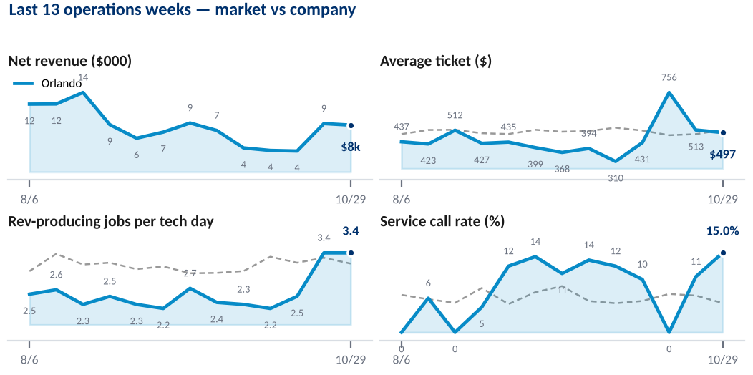
Orlando — East · Patrick
Operations week Oct 29–Nov 4
Technician table covers the trailing 4 weeks (Oct 8–Nov 4) — a single week is too thin for a fair per-technician read.
NET REVENUE
AVERAGE TICKET
REV-PRODUCING JOBS / TECH DAY
SERVICE CALL RATE
$8,448
$497
3.40
15.0%
-3.1% WoW
-3.1% WoW
+0.0% WoW
+42.5% WoW
Nov pacing -25.6% vs Oct (day 4)
Ticket completion 144.7% · company $513
1 techs · 5 tech days
Company 5.5%
TECHNICIAN LEADERBOARD — TRAILING 4 WEEKS
TECHNICIAN | Days | Revenue | Rev jobs | Rev jobs/day | Booked ticket | Avg ticket | Ticket compl. | Svc call | Rotor attach | Inv. hours | Efficiency
Dillan Thompson | 12 | $20,950 | 39 | 3.2 | $385 | $537 | 139.7% | 11.4% | 74.4% | 81h | 51%
▼ Marvin Cisneros | 4 | $3,882 | 9 | 2.2 | $450 | $431 | 95.9% | 10.0% | 22.2% | 14h | 72%
Orlando overall | 16 | $24,832 | 48 | 3.0 | $397 | $517 | 130.4% | 11.1% | 64.6% | 95h | 54%
▲ ▼ = moved against their own prior 8 weeks, not a peer ranking:
▼ Marvin Cisneros — service call 10.0% vs own 2.1% (+7.9pp)
Shading ranks within this market. Volume columns and booked ticket are unshaded — booked ticket is the work dispatched, not the result.
KEY TAKEAWAYS
CURRENT PRIORITIES
ACTIONS UNDERWAY
SUPPORT / DECISIONS NEEDED
Patrick: what is happening in Orlando, in two or three lines.
The one or two things being worked in Orlando this week, and why they come first here.
Specific action, owner, and the date it lands.
What is blocked, who needs to unblock it, and by when.

Slide 11
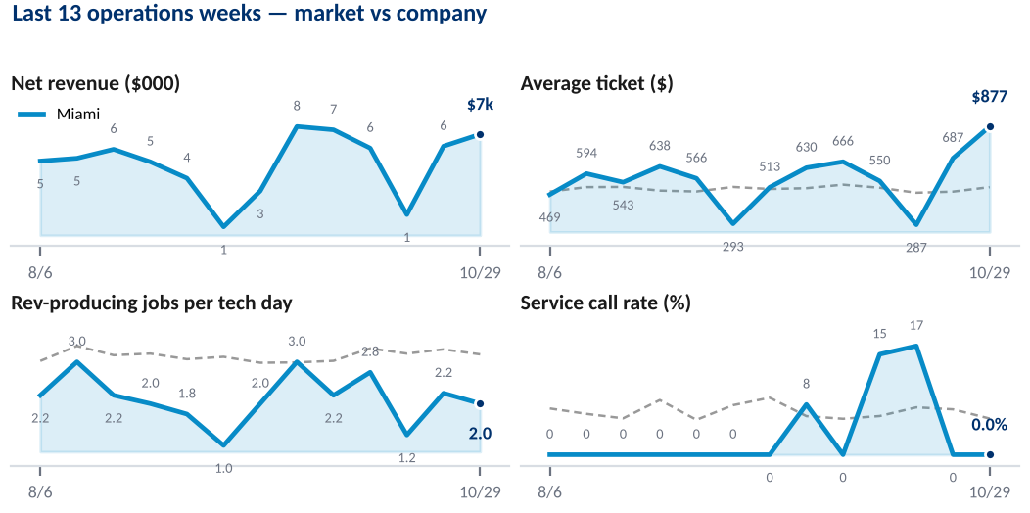
Miami — East · Patrick
Operations week Oct 29–Nov 4
Technician table covers the trailing 4 weeks (Oct 8–Nov 4) — a single week is too thin for a fair per-technician read.
NET REVENUE
AVERAGE TICKET
REV-PRODUCING JOBS / TECH DAY
SERVICE CALL RATE
$7,019
$877
2.00
0.0%
+13.5% WoW
+27.6% WoW
-11.1% WoW
no prior-week base
Nov pacing +24.9% vs Oct (day 4)
Ticket completion 253.2% · company $513
1 techs · 4 tech days
Company 5.5%
TECHNICIAN LEADERBOARD — TRAILING 4 WEEKS
TECHNICIAN | Days | Revenue | Rev jobs | Rev jobs/day | Booked ticket | Avg ticket | Ticket compl. | Svc call | Rotor attach | Inv. hours | Efficiency
▼ Chris Abreu | 16 | $20,694 | 33 | 2.1 | $344 | $627 | 182.2% | 8.3% | 72.7% | 63h | 42%
Miami overall | 16 | $20,694 | 33 | 2.1 | $344 | $627 | 182.2% | 8.3% | 72.7% | 63h | 42%
▲ ▼ = moved against their own prior 8 weeks, not a peer ranking:
▼ Chris Abreu — service call 8.3% vs own 1.5% (+6.8pp)
Shading ranks within this market. Volume columns and booked ticket are unshaded — booked ticket is the work dispatched, not the result.
KEY TAKEAWAYS
CURRENT PRIORITIES
ACTIONS UNDERWAY
SUPPORT / DECISIONS NEEDED
Patrick: what is happening in Miami, in two or three lines.
The one or two things being worked in Miami this week, and why they come first here.
Specific action, owner, and the date it lands.
What is blocked, who needs to unblock it, and by when.

Slide 12
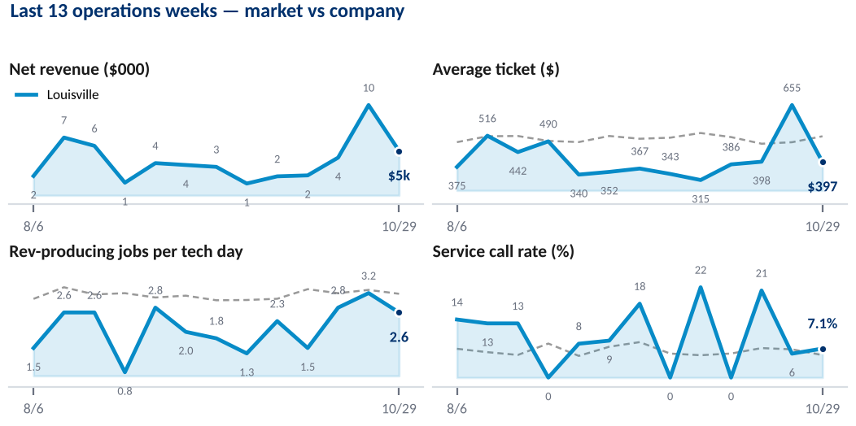
Louisville — East · Patrick
Operations week Oct 29–Nov 4
Technician table covers the trailing 4 weeks (Oct 8–Nov 4) — a single week is too thin for a fair per-technician read.
NET REVENUE
AVERAGE TICKET
REV-PRODUCING JOBS / TECH DAY
SERVICE CALL RATE
$5,164
$397
2.60
7.1%
-50.7% WoW
-39.3% WoW
-18.8% WoW
+21.4% WoW
Nov pacing -7.9% vs Oct (day 4)
Ticket completion 142.9% · company $513
1 techs · 5 tech days
Company 5.5%
TECHNICIAN LEADERBOARD — TRAILING 4 WEEKS
TECHNICIAN | Days | Revenue | Rev jobs | Rev jobs/day | Booked ticket | Avg ticket | Ticket compl. | Svc call | Rotor attach | Inv. hours | Efficiency
▲ Preston Holmes | 18 | $22,333 | 46 | 2.6 | $372 | $485 | 130.4% | 9.8% | 71.7% | 80h | 51%
Louisville overall | 18 | $22,333 | 46 | 2.6 | $372 | $485 | 130.4% | 9.8% | 71.7% | 80h | 51%
▲ ▼ = moved against their own prior 8 weeks, not a peer ranking:
▲ Preston Holmes — ticket $485 vs own $401 (+21%)
Shading ranks within this market. Volume columns and booked ticket are unshaded — booked ticket is the work dispatched, not the result.
KEY TAKEAWAYS
CURRENT PRIORITIES
ACTIONS UNDERWAY
SUPPORT / DECISIONS NEEDED
Patrick: what is happening in Louisville, in two or three lines.
The one or two things being worked in Louisville this week, and why they come first here.
Specific action, owner, and the date it lands.
What is blocked, who needs to unblock it, and by when.

Slide 13
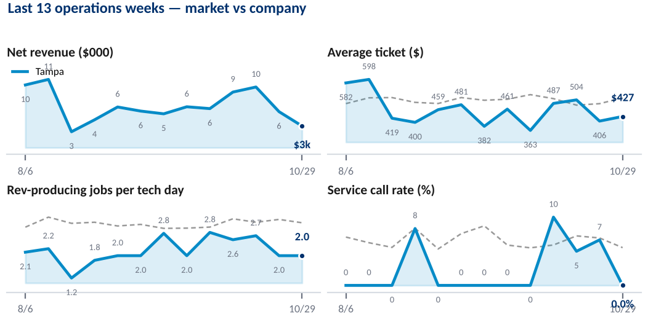
Tampa — East · Patrick
Operations week Oct 29–Nov 4
Technician table covers the trailing 4 weeks (Oct 8–Nov 4) — a single week is too thin for a fair per-technician read.
NET REVENUE
AVERAGE TICKET
REV-PRODUCING JOBS / TECH DAY
SERVICE CALL RATE
$3,417
$427
2.00
0.0%
-39.9% WoW
+5.2% WoW
+0.0% WoW
-100.0% WoW
Nov pacing -82.4% vs Oct (day 4)
Ticket completion 113.9% · company $513
1 techs · 4 tech days
Company 5.5%
TECHNICIAN LEADERBOARD — TRAILING 4 WEEKS
TECHNICIAN | Days | Revenue | Rev jobs | Rev jobs/day | Booked ticket | Avg ticket | Ticket compl. | Svc call | Rotor attach | Inv. hours | Efficiency
CB Berrians | 13 | $16,901 | 33 | 2.5 | $424 | $512 | 120.8% | 5.7% | 48.5% | 63h | 46%
▼ Kado Torres | 12 | $10,546 | 26 | 2.2 | $429 | $406 | 94.5% | 7.1% | 46.2% | 40h | 42%
Tampa overall | 25 | $27,446 | 59 | 2.4 | $426 | $465 | 109.1% | 6.3% | 47.5% | 102h | 44%
▲ ▼ = moved against their own prior 8 weeks, not a peer ranking:
▼ Kado Torres — service call 7.1% vs own 0.0% (+7.1pp)
Shading ranks within this market. Volume columns and booked ticket are unshaded — booked ticket is the work dispatched, not the result.
KEY TAKEAWAYS
CURRENT PRIORITIES
ACTIONS UNDERWAY
SUPPORT / DECISIONS NEEDED
Patrick: what is happening in Tampa, in two or three lines.
The one or two things being worked in Tampa this week, and why they come first here.
Specific action, owner, and the date it lands.
What is blocked, who needs to unblock it, and by when.

Slide 14
Method & definitions
• Operations week. Thursday through Wednesday. The deck is generated Thursday night for the Friday review, covering the week that closed the previous Wednesday.
• Net revenue. Recognised on invoice creation, dated to service date. Fleet channel and the job_0 field are excluded. Source: fact_nubrakes_channel_market_kpi_daily.
• Average ticket. Net revenue ÷ jobs completed, same period.
• Booked ticket. Booked revenue ÷ revenue-producing jobs — the value of the work dispatched to a technician, before they touch it. Left unshaded on the leaderboard because ranking it would score the schedule, not the person. Average ticket ÷ booked ticket is exactly ticket completion, so the three columns read left to right as handed, closed, and the spread between them.
• Ticket completion. Invoiced revenue ÷ booked revenue, both from the technician feed. Above 100% means work found on site beyond what was booked; below means jobs closing short of their quote.
• Rotor attach. Jobs with a rotor attached ÷ revenue-producing jobs — the basis the rotor attachment dashboard has always used. The new ops feed also carries a rotor-eligible count, and attach measured against that runs about 7 points higher because eligibility screens jobs out first. Eligibility itself varies sharply by market (57% to 97% of jobs), so the eligible basis is not comparable across markets. Switch with ROTOR_DENOMINATOR in compute.py.
• Technician efficiency. Invoiced hours ÷ clocked hours. Clocked hours are not in the published feed and reach Ops on Friday afternoon, after this deck ships, so the figure shows a dash until a file is supplied. Drop data/clocked_hours.csv with columns technician, week_start, clocked_hours and the column fills itself.
• Rev-producing jobs per tech day. Completed jobs that carry an invoice, ÷ technician days worked. Jobs without an invoice are excluded throughout the deck. A partial day counts as a full day, so this is a productivity measure, not a capacity one. Source: fact_technician_operations_daily, which supersedes the older technician feed — its revenue ties to the channel feed to the dollar each week, where the older one drifts up to 2%.
• Service call rate. Service calls ÷ (service calls + revenue-producing jobs). A rising rate means more dispatches that do not convert to repair revenue.
• Revenue bridge. Week-over-week revenue change split into capacity (change in tech days worked, held at last week's revenue per day) and productivity (change in revenue per tech day, at this week's days). The two components sum to the total.
• Outliers. A market-metric is flagged when it sits more than 1.5 standard deviations from its trailing 8-week mean AND clears a materiality floor ($4,000 revenue, $25 ticket, 0.25 jobs per tech day, 3pp service call rate). Both gates must clear, so a large swing on a small base does not dominate the read-out.
• Month pace. Month-to-date revenue ÷ elapsed days × days in month, against last month's actual. Taken through the freshest day in the feed, which runs ahead of the reported operations week. This is a straight-line extrapolation, not a Finance estimate. When an LE is loaded, pace is measured against it instead.
• Labor %. The P&L Cost of Sales labor line ÷ net revenue, by market by month. Labor dollars come from the EGP model's financial_model tab (G/L basis); the denominator is the channel feed, which matches the model's net sales to the dollar. Salaried ops-admin pay sits in Market G&A and SG&A and is not separable, so this is store and technician labor.
• Technician leaderboard. A trailing four weeks, not one — a single week leaves a technician with too few jobs to rank fairly. Shaded columns rank technicians within their own market; volume columns (days, revenue, jobs, invoiced hours) are left unshaded because ranking them just re-ranks headcount.
• The ▲ and ▼ markers. A technician whose trailing four weeks have moved against their OWN prior eight — average ticket by more than 12%, or service call rate by more than 5 points, in either direction. The same bar applies both ways, so a recovery is not held to a stricter standard than a slide. Shading answers who is weakest in this market; the marker answers what has changed for that person. A strong technician having a bad month earns a ▼; a consistently weak one does not, and a weak one who is turning it around earns a ▲. Where someone has moved both ways at once the marker shows the adverse direction, because that is what needs a conversation, and the footnote lists both. Every marker carries its reason under the table.
• Profitability and labor. The Profitability & Unit Economics slide is out of the weekly deck for now. The EGP model and the monthly labor file are still loaded, so it can be restored without rework.
• Technician history. The technician feed begins 16 March 2026, so tech-day, ticket-completion and rotor-attach metrics carry no year-over-year comparison until March 2027. Revenue history runs to October 2024.
Generated 2026-11-05 17:53:02 · feeds current through Nov 4

