Slide 1
Customer – Transactions Activity & Spending Patterns
DS 5500 : Check-in 02
Omkar Sonar
9th February 2026

Slide 2
Context
Initial –
Bank transactions generally record everything and though they are masked or concise, a bank employee would be able to decode a person's habits and most of their routine based on their bank transactions. Analyzing the different kinds of transactions and deducing patterns in them can also help us in finding anomalies based on unusual activity. This could indicate account takeover or card fraud. The primary goal is to demonstrate how customer data and their transaction behavior can help us in surfacing this suspicious activity. As more progress is made on this data, the scope is subject to change based on the initial findings.
Now –
a customer intelligence system that segments customers by their transaction behavior and predicts spending patterns. This would enable more personalized service, targeted product offerings, and deeper understanding of customer needs.
This can complement the conversation/recommendation engine.

Slide 3
Insights from Stakeholder meeting
To identify customers who may be struggling financially before their situation worsens with the goal of helping them
Determine which customers are good candidates for the bank's rewards program (Buoy Local)
Promote local businesses to relevant customer segments (goes along with #2)
Deliver personalized cashback incentives aligned with actual spending habits

Slide 4
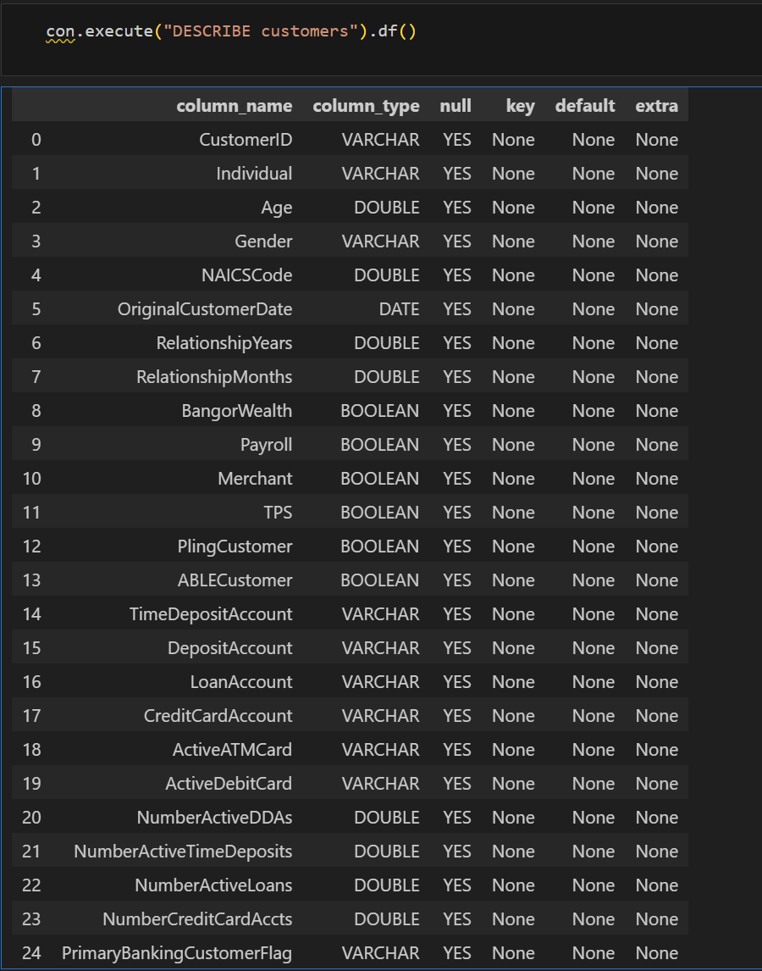
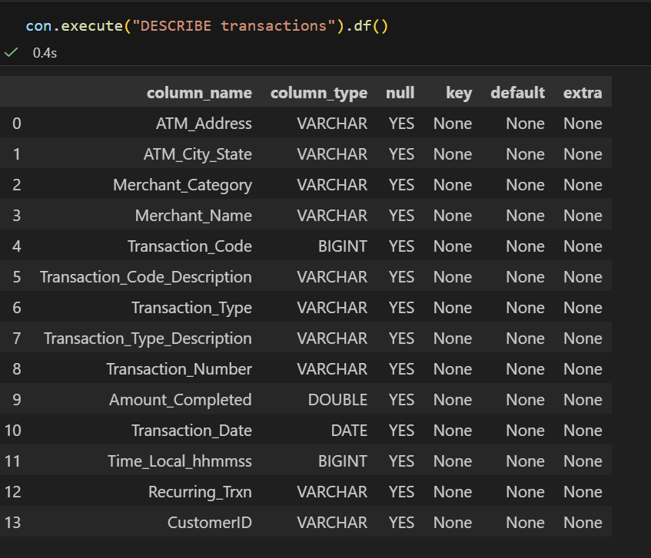
About Data
Customer Demographics ~276K records
Transactions ~8M records

Slide 5
EDA So Far…
Customers overview
Age Distribution (avg - 41.9)
Relationship with Bank (avg - 13.3 years)
Various products/holdings (debit card – 65%, credit card – 2%)
Gender Distribution
Types of Accounts
Primary Bank Ratio
Transactions data range - primarily Nov onwards (10 transactions Sept/Oct)
Amount distribution (avg - $49.5)
Weekly/Hourly Classification (maximum on Fridays | general peak time 12 to 1 PM)
Merchant Categories (Top 3 : 5411 (grocery), 5814 (fast food), 5541 (service stations)
Transaction types
Transactions per customers (avg – 64 per customer)

Slide 6
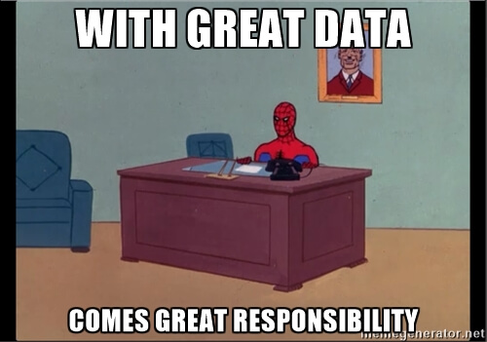
Status
Actions –
First Stakeholder meeting done and initial feedback gathered
Data Cleaning : Files processed
Main challenge was loading the csv file correctly into the database because of extra commas in the csv file
Questions regarding the data sent to Sean and got feedback
Duplicate customerID – need to ignore (feedback from Sean)
Non-individual type customers with gender value – (validated)
ATM_City_State is NULL for 90 records (originally 928 due to incorrect parsing of the file) and 1.17% are $0 transactions (send output to Sean)

