Slide 1
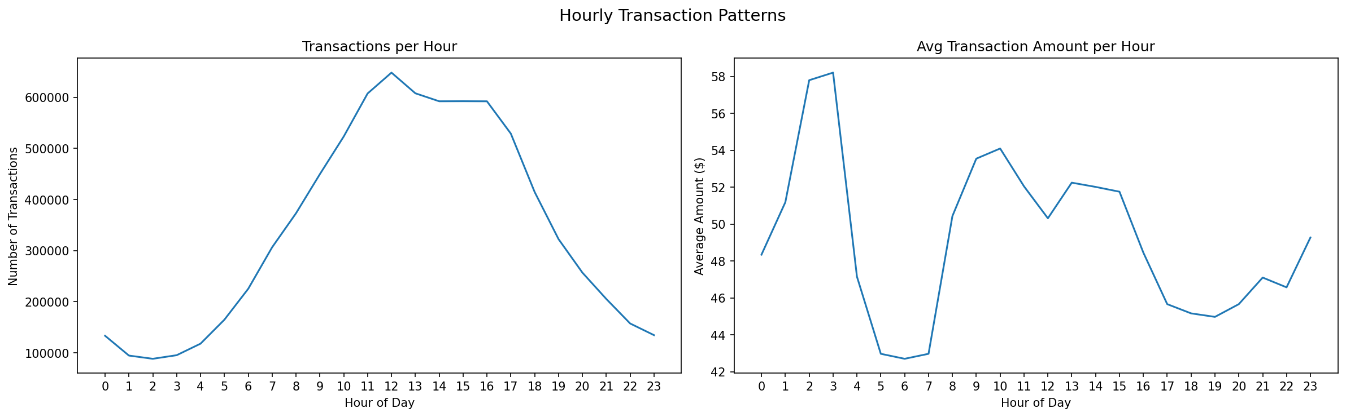
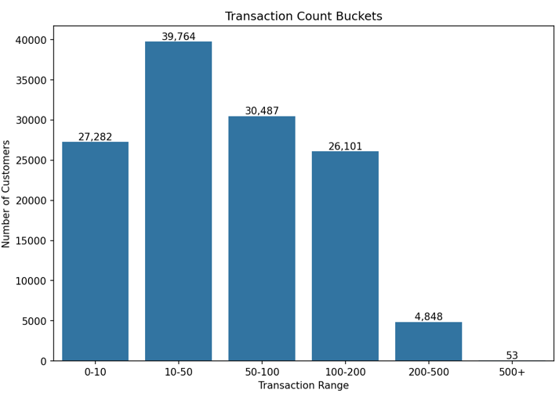
FinSights
DS 5500 : Check-in 03
Omkar Sonar
23rd February 2026

Slide 2
Quick Refresher
Total Customers → 68,857
Transactions → 8.2 M
Observation window → 65 days
Features built so far → ~40
Primary Business Use Cases
Identifying good candidates for the bank's rewards program
Personalized cashback incentives
Promote local businesses

Slide 3
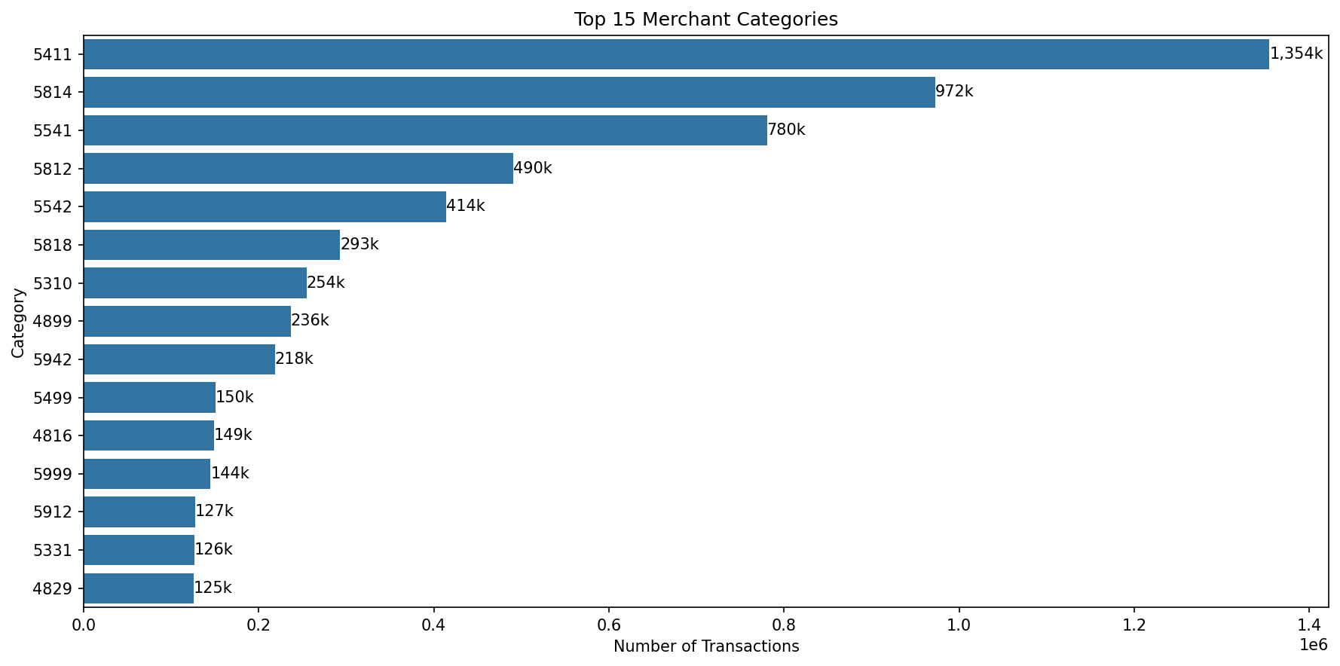
Merchant Segmentation via MCC Codes
What are MCC Codes?
4-digit identifiers assigned to every merchant describing the type of business
Grocery → 5411,5499,5422,5441,5451,5462
Dining → 5812,5814,5813,5811
Gas → 5541,5542,5983
Retail → 5310,5311,5331,5399,5300,5999
….

Slide 4
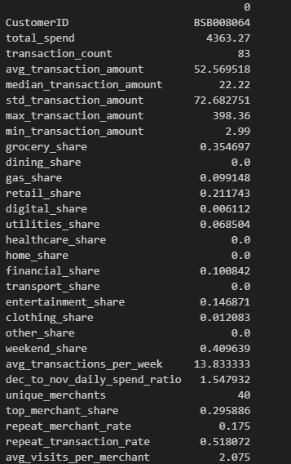
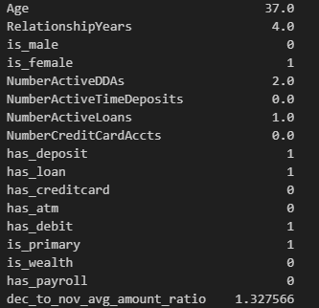
Feature Engineering
This was done on the basis of temporal features (when customers spend), merchant categories, customer demographics, spending trends. Not all features will be useful but this will help us in identifying the customer segments.

Slide 5
Insights from Stakeholder
Current direction of the project was appreciated
Discussion on grouping with ATM_Address and ATM_City_State (find out local merchants)

