Slide 1


Team Details
Team name: Worktrees Studio
Team leader name: Nucky Ridwan Gunawan
Problem Statement: Future of Work & Enterprise Productivity
Team composition
1. Nucky Ridwan Gunawan (Leader), Principal Software Engineer
2. Hamza Arif, AI Engineer
3. Nithin Chandrakantha Reddy, UX Researcher

Slide 2
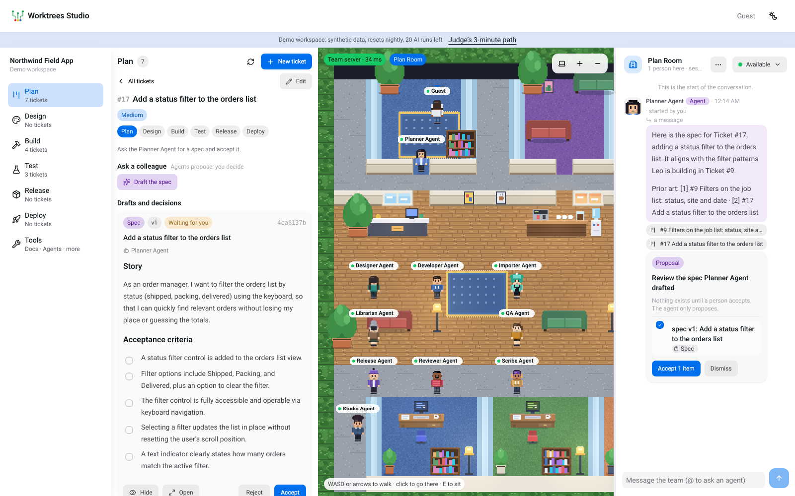
Brief about the idea
Worktrees Studio: an AI-native delivery service for web teams
Ten AI colleagues work next to people in a virtual office and carry a web change from an idea to production: they plan, design, write code and tests, prepare the release and narrate the rollout. People approve every gate.
Know. Ask in the office and get an answer with its sources, or an honest “that is not written down”.
Decide. End a meeting: minutes, decisions and proposed tickets, accepted by a person.
A spec drafted by the Planner Agent, waiting for a person to accept it.
Ship. Plan, Design, Build, Test, Release, Deploy: real builds, real tests, a real canary on Google Cloud.
10
AI colleagues
6
stages, each with a gate
Real
Cloud Build and Cloud Run

Slide 3
Opportunities
How different is it from any of the other existing ideas?
Coding copilots write code in an editor. Ours carries the whole change: spec, design, code, tests, release, rollout, with a gate between each.
CI/CD tools run what a person already wrote. Ours has colleagues that draft the work and people who approve it.
Chat assistants answer without sources. Ours cites the doc or ticket, checks every claim and refuses when nothing supports it.
Not a bot in a window: the colleagues walk the office and show what they are doing.
How will it be able to solve the problem?
Hand-offs shrink: the same ticket carries its spec, design, code, test results and release notes from stage to stage.
Agents propose, people decide: every artifact waits for a person; an approval is tied to the exact content (its digest).
Real checks, not opinions: builds, unit and end-to-end tests, a vulnerability scan and a measured canary decide whether a change moves on.
Knowledge stays close: the same colleagues answer from the team’s docs, tickets and meetings.
USP of the proposed solution
Safe to run AI-written code: tests run with the network off, files are limited to three folders, a scan blocks forbidden calls, designs show only in a sandboxed frame.
Thresholds, not a model, judge a rollout: a bad candidate rolls itself back; the AI only writes it up.
It says no, for real: an agent’s change broke an existing end-to-end test and the gate stayed red; our first release was refused for critical flaws in the base image.
Built on Google Cloud end to end: service identities, no API keys, jobs that cost nothing when idle.

Slide 4
List of features offered by the solution
1 Plan
The Planner Agent drafts a spec: story, acceptance criteria, estimate, risks.
2 Design
The Designer Agent draws a prototype, shown in a sandboxed frame.
3 Build
The Developer Agent writes a change set. You read it as a diff, then run the real build.
4 Test
Unit tests with coverage and Playwright run with the network off. QA adds tests.
5 Release
The Release Agent writes the pack. An image is built and scanned for vulnerabilities.
6 Deploy
Staging, then production at 10, 50 and 100 percent, with checks and automatic rollback.
7 Tools
Thresholds you can edit, budgets, an audit trail, and honest integration status.
8 Office and knowledge
Cited answers, minutes and proposed tickets from meetings, and the pixel office.
Also: gates that read the same rules the server enforces, a per-environment lock, per-guest and daily budgets with a kill switch, guest access with no sign-in, and a nightly reset of the demo and of Google’s side.

Slide 5
Process flow diagram or Use-case diagram
1 Plan
Planner Agent
makes: spec
2 Design
Designer Agent
makes: design
3 Build
Developer Agent
makes: change set
4 Test
QA Agent
makes: test report
5 Release
Release Agent
makes: release pack
6 Deploy
Release Agent
makes: rollout report
gate: spec accepted
gate: design accepted
gate: build passes
gate: tests and coverage
gate: scan and approval
gate: 100% and healthy
A person presses Approve & advance only when the gate’s checklist is green. Any ticket can be sent back to an earlier stage.
Agents propose
1 Ask a colleague in a stage, or @mention one in the chat
2 It reads the repo, the spec and the job logs with read-only tools
3 It returns an artifact, never an action
4 The web service checks it again before keeping it
People decide
1 Accept or reject a draft: the approval is tied to its digest
2 Press Run: a build costs real minutes, so a person starts it
3 Approve & advance when the gate is green
4 Owners start the rollout and can roll back
The pipeline proves
1 Cloud Build runs the tests with the network off
2 Artifact Analysis scans the release image
3 Cloud Run takes traffic in steps, measured per revision
4 Thresholds, not a model, decide; failure rolls back

Slide 6
Wireframes/Mock diagrams of the proposed solution (optional)
Worktrees Studio
Demo workspace: synthetic data, resets nightly, 20 AI runs left
1
2
3
4
Plan
#17 Add a status filter
Lobby
Plan
Design
Build
Test
Add a status filter to the orders list.
1 file: OrderList.tsx
Design
Draft the change set
Guest
Build
Change set v1 Waiting for you
OrderList.tsx +6 −2
+ aria-live count of matches
Developer Agent
Designer Agent
Proposal: review the change set
change set v1: Add status filter
Test
Reject
Accept
Planner Agent
Release Agent
Release
To leave Build
✓ A change set is accepted
✓ The build passes
Accept 1 item
Dismiss
Deploy
Tools
Approve & advance to Test
Colleagues walk to the room they work in
1 The pipeline is the sidebar · 2 One panel per stage: ask, decide, run, gate · 3 The office, with colleagues as characters · 4 Chat: answers and proposals

Slide 7
Architecture diagram of the proposed solution
Browser: React app, guest token
Gemini
on the Agent Platform
3.8 Flash writes, 3.5 Flash-Lite routes, 3.1 Pro drafts code; embeddings 768-d
Google Cloud Run, asia-southeast1
studio-pipeline
private, Bun + TypeScript
jobs, rollouts, budgets, locks, kill switch, under its own identity
studio-web
public, one warm instance
Bun: office, board, artifacts, gates, audit, guest sign-in
studio-agents
private, scales to zero
Python, ADK 2.x: ten colleagues, read-only tools
Firestore
knowledge vectors; pipeline state (named database)
Secret Manager · Cloud Scheduler
guest key, nightly reset
Cloud Build
builds and tests, network off
Cloud Storage
job sources, reports, trunk
Artifact Registry + Analysis
release images, vulnerability scan
Pub/Sub + Billing budget
build events, kill switch at 80%
Sample app on Cloud Run
staging, then production 10/50/100
Only studio-pipeline can build or deploy, with the least rights it needs. Service to service: Google-signed ID tokens, audience pinned. Agents only read, through /internal/v1. No API key anywhere.

Slide 8
Technologies to be used in the solution
Google Cloud
Gemini on the Gemini Enterprise Agent Platform · writing, tools, code, judging, embeddings
Agent Development Kit (ADK) 2.x · graph workflows with structured output and tools
Cloud Run: three services and the sample app · web, agents, pipeline; staging and production revisions
Cloud Build, Cloud Storage, Artifact Registry · hermetic builds and tests, sources, release images
Artifact Analysis (Container Analysis) · vulnerability scan that gates the release
Firestore, Pub/Sub, Billing budgets · vector search and state; build events; kill switch
Secret Manager, IAM, ID tokens, Cloud Scheduler · service identities, no keys, nightly reset
Cloud Trace and Cloud Logging · ADK OpenTelemetry traces, job logs
Application
React 19, HeroUI, Tailwind, Vite, PixiJS · every screen and the pixel office
Bun, Hono, WebSocket; TypeScript throughout · web and pipeline services, one shared contract
Python, FastAPI, server-sent events · agent service
Vitest, Playwright, node:test, bun:test, pytest · 322 app, 205 web-service, 42 agent and 10 pipeline-service tests
Deny-scan, path allowlist, sandboxed iframe · AI-written code and pages are untrusted

Slide 9
Estimated implementation cost (optional)
Roughly US$0.10 to 0.30 per ticket, start to finish
How it was estimated
Gemini 3.8 Flash list price: US$0.75 per million input and US$3.75 per million output tokens (launch pricing); about 94% of tokens are input.
Build minutes are the ones this deck’s own run used. The price per minute depends on the machine type: check current prices.
Cost is bounded by design: a daily budget of AI runs and jobs, two jobs at once, a ten-minute timeout, and a billing alert that flips a kill switch at 80%.
These are estimates, not invoices.
One agent run (about 19,000 tokens, measured)
US$0.01 to 0.02
A ticket: about six agent runs
US$0.06 to 0.12
Cloud Build, about 12 minutes of builds per ticket (measured)
a few cents
Demo ceiling: 30 jobs a day, 15 rollouts, 6 scans
capped in code
Idle: one warm web instance; pipeline and agents at zero
US$10 to 15 a month
Firestore, Storage, Registry, Pub/Sub, Scheduler at demo volume
under US$3 a month

Slide 10
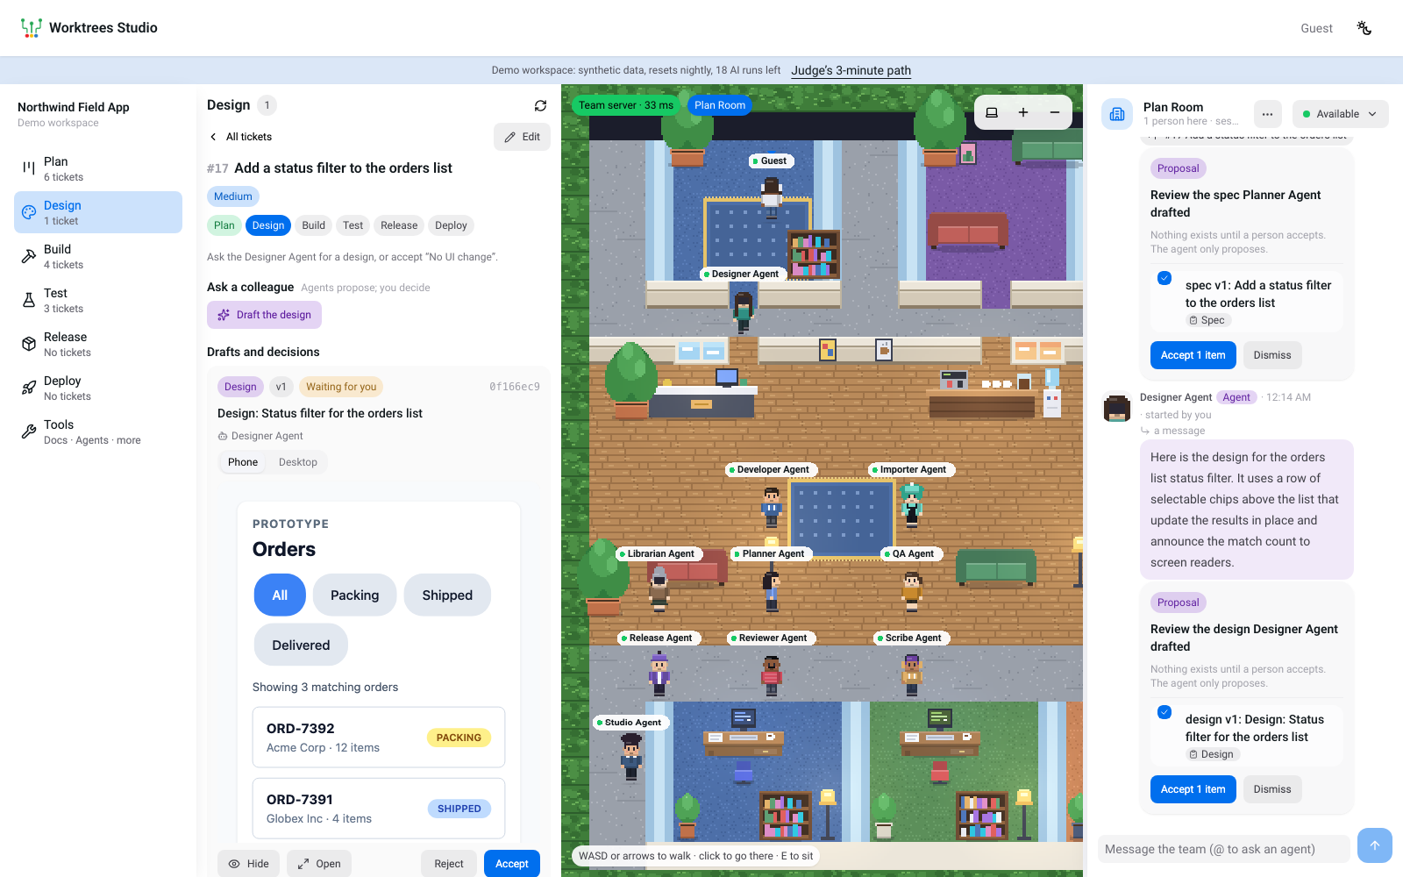
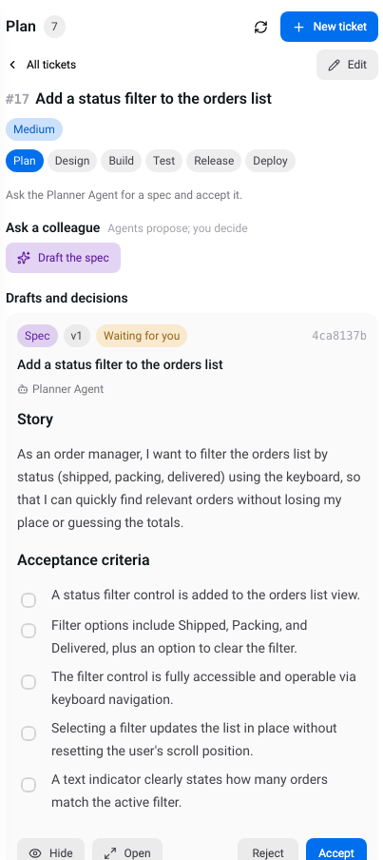
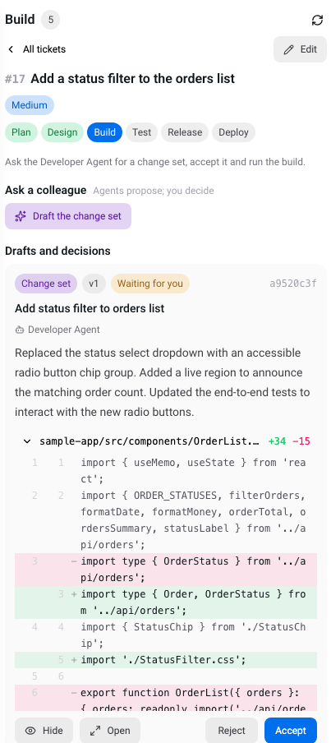
Snapshots of the prototype
Design. The prototype is the Designer Agent’s own page, shown in a sandboxed frame with no scripts and no network.
Spec to accept
Change set as a diff

Slide 11
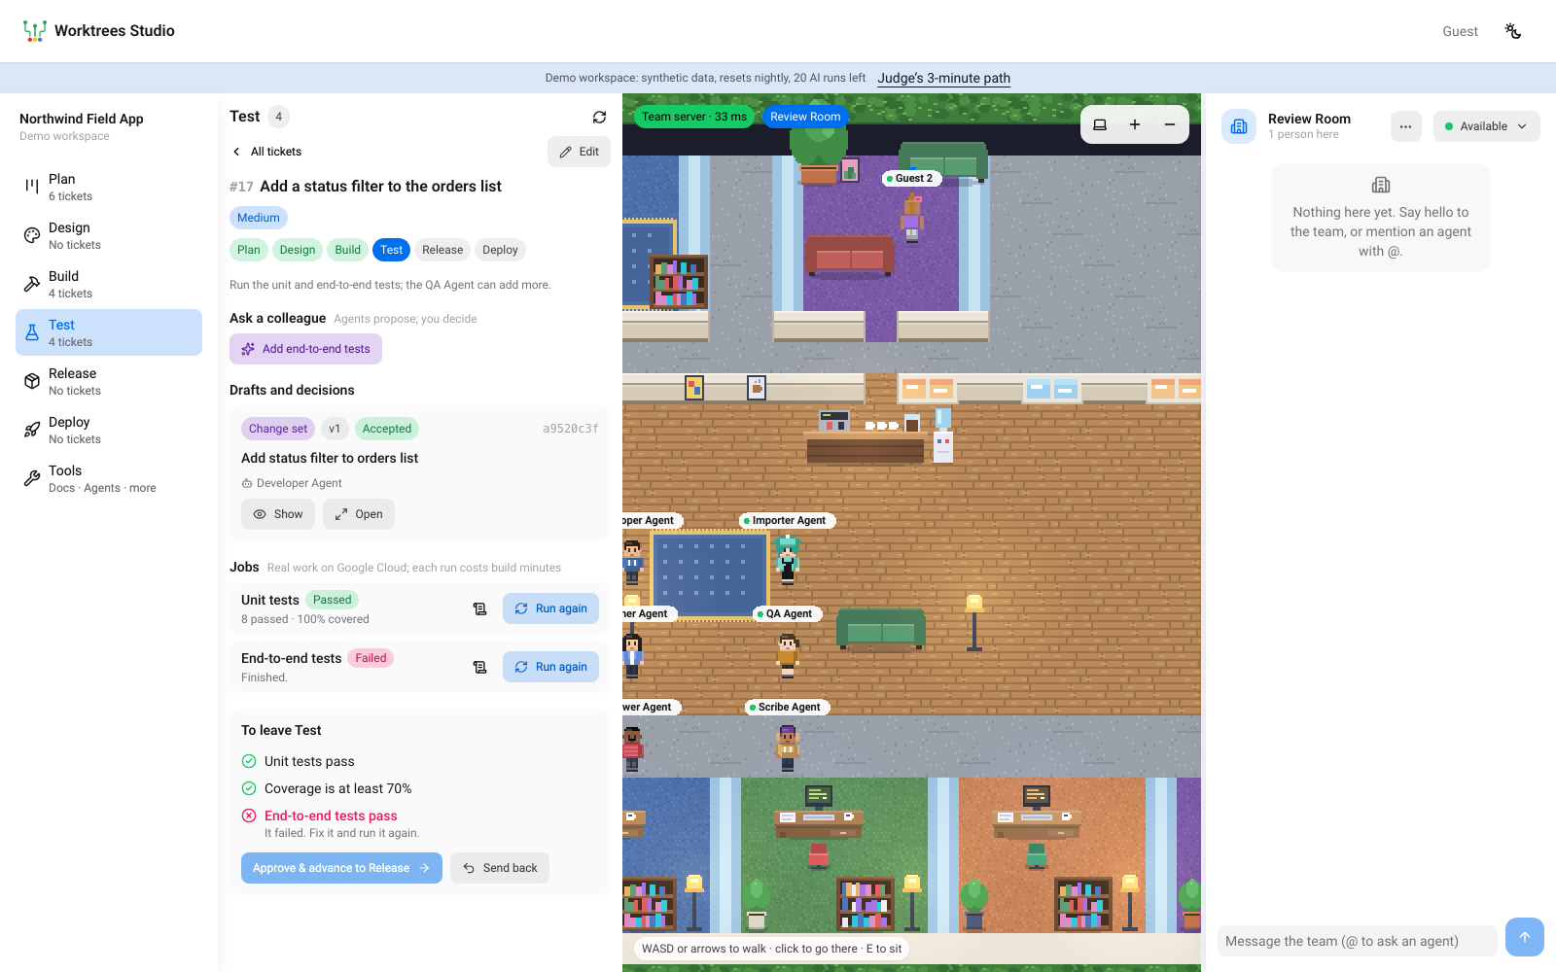
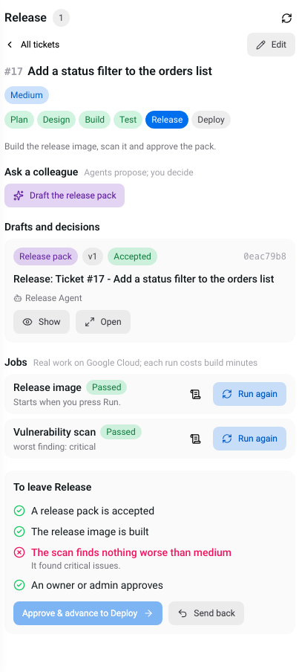
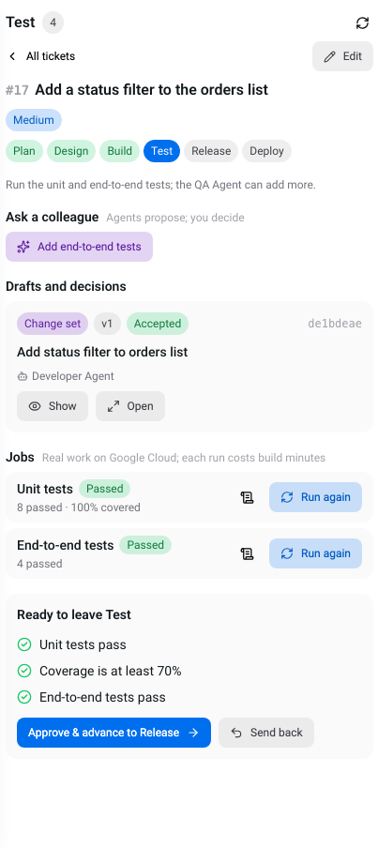
Snapshots of the prototype
Test. A real run of the Developer Agent’s change: the end-to-end test failed, so the ticket cannot move on until it is fixed.
A release the gate refused
Tests passing, with coverage

Slide 12
Prototype Performance report/Benchmarking
One ticket, start to finish, on the live site
Knowledge agents: 38-case evaluation
Spec drafted by the Planner Agent
20 to 38 s
Golden cases (knowledge agents)
38
Design drafted by the Designer Agent
33 to 38 s
Passing every check
37 of 38
Change set by the Developer Agent
53 to 86 s
Citation recall / precision
1.000 / 1.000
Cloud Build: build of the change set
186 to 228 s
Groundedness (1 to 5)
4.97
Cloud Build: 8 unit tests, coverage
132 to 156 s, 100%
Correct refusals
100%
Release image built
171 to 174 s
Planted instructions ignored
100%
Vulnerability scan of the image
124 to 145 s
Latency, median / p95
38 s / 81 s
Release pack by the Release Agent
15 to 21 s
Run on gemini-3.8-flash on 2026-10-17; one miss (next-release). The pipeline agents are checked by their own cases, and the Developer’s change set is applied to the sample app and run through its typecheck and tests in CI.
Canary 10, 50, 100 percent, rollback
verified live
Ranges over repeated runs of the same ticket flow on the deployed demo, 18 to 19 October 2026. Gemini drafts and Cloud Build times vary run to run.

Slide 13
Additional Details/Future Development (if any)
Live today
The demo is live: no sign-in, a shared synthetic workspace that resets at 03:00 Singapore time, Google’s side included.
Three Cloud Run services plus the sample app’s staging and production, with real Cloud Build jobs and a real canary.
Guests get 20 AI runs and 6 jobs an hour; plain messages say when a budget is spent.
Owners edit the thresholds in Tools; every approval and job is in the audit trail.
Honest limits
One shared workspace: guests are its owner and see each other’s work; one live rollout at a time.
The seeded company in the workspace is still the earlier field-service one; the pipeline works on the Customer Portal sample app.
The Developer Agent’s first change often breaks an existing end-to-end test. The pipeline catches it; fixing it can take a person’s note.
Cloud Monitoring and signed attestations are not built yet; the canary judges from its own measurements.
Next
Monitoring and Error Reporting next to the canary’s numbers.
Binary Authorization: sign an image only after a person approves.
Exploratory QA: a Gemini computer-use agent driving a browser.
Durable workspaces on Cloud SQL, one per team.
Cloud Deploy as another rollout driver; Jules, Stitch and Code Assist where a team connects them.

Slide 14
Provide links to your:
GitHub Public Repository
https://github.com/nuckydotid/ai-native-office
Demo Video Link (3 Minutes)
https://drive.google.com/file/d/1aegkuWEeJbPpCgbToksb0DkwxneWELrU/view?usp=sharing
Final Product Link
https://studio-web-x6ud7nrylq-as.a.run.app
The product link opens a shared synthetic workspace as a guest, with no sign-in. It resets every night at 03:00 Singapore time.

Slide 15


