Slide 1
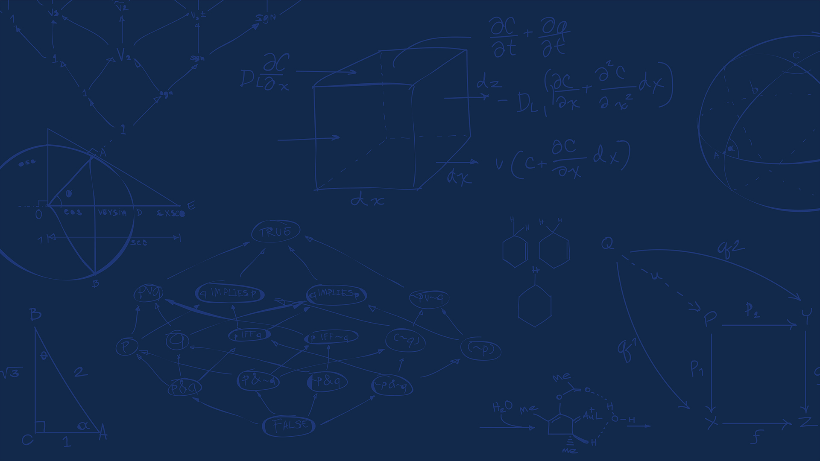
CS 555 Mini-App Presentation
The S_{N} Method for Solving the Linear Boltzmann Equation
05/06/2025

Slide 2
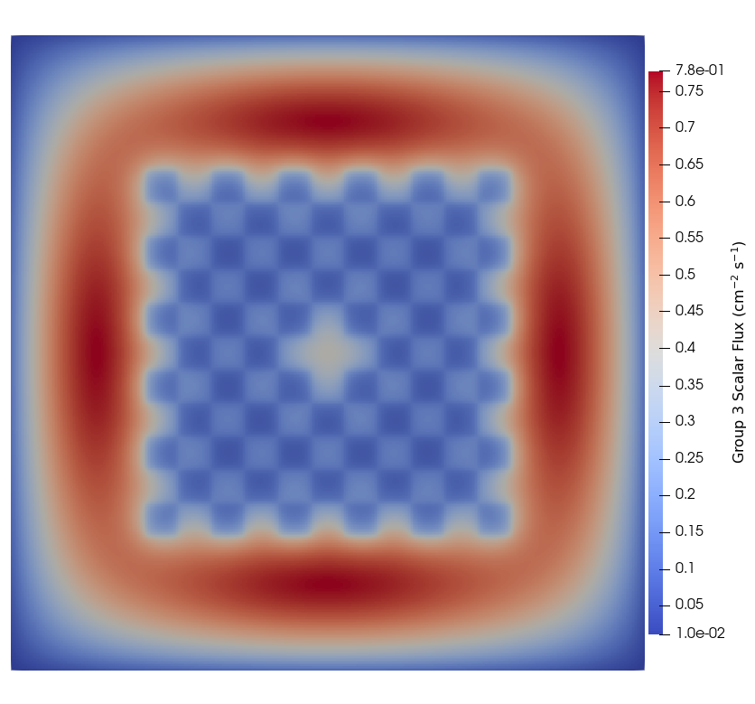
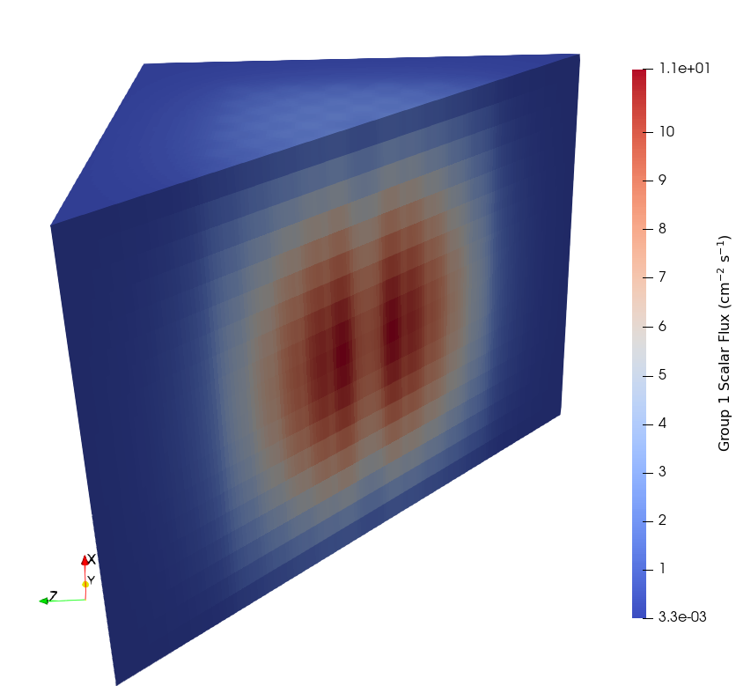



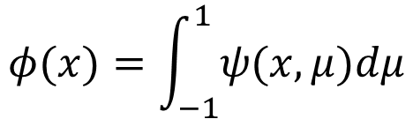

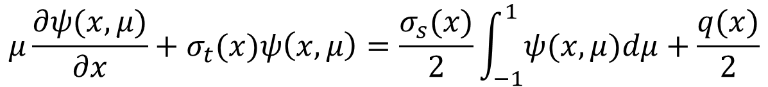
The Linear Boltzmann Equation
$$μ\frac{∂ψ(x, μ)}{∂x}+σ_{t}(x)ψ\left(x,μ\right)=\frac{σ_{s}(x)}{2}\int_{−1}^{1}{ψ(x,μ)dμ}+\frac{q(x)}{2}$$
$$x∈[−L,L]$$
$$μ∈[−1,1]$$
Self-advection
Total removal
Scattering source
External source
$$ψ(x,μ)=0, μ<0 and x=L$$
$$ψ\left(x,μ\right)=0, μ>0 and x=−L$$
$$φ(x)=\int_{−1}^{1}{ψ(x,μ)dμ}$$
NUCLEAR, PLASMA & RADIOLOGICAL ENGINEERING
GRAINGER ENGINEERING

Slide 3
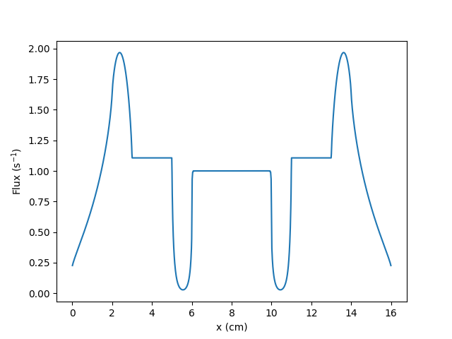
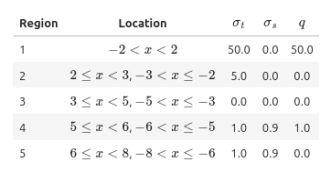
The Test Problem: 1D Reed Benchmark
NUCLEAR, PLASMA & RADIOLOGICAL ENGINEERING
GRAINGER ENGINEERING

Slide 4
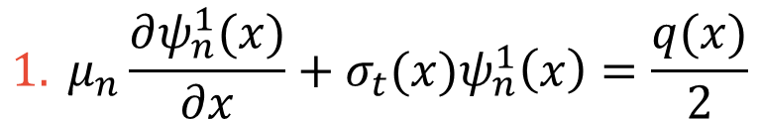
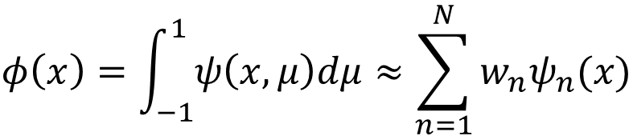
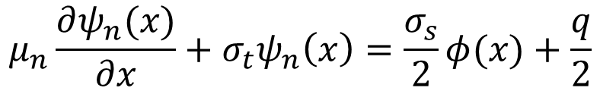
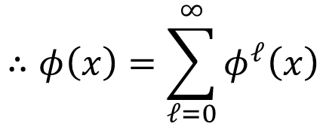

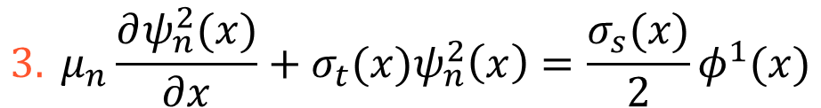

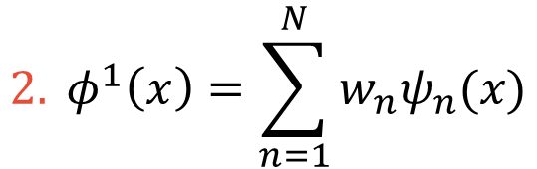
The S_{N} Method with Richardson Iteration
The S_{N} method:
$$μ→μ_{n}$$
$$ψ\left(x,μ_{n}\right)=ψ_{n}(x)$$
$$φ\left(x\right)=\int_{−1}^{1}{ψ\left(x,μ\right)dμ}≈\sum_{n=1}^{N}{w_{n}ψ_{n}(x)}$$
$$μ_{n}\frac{∂ψ_{n}(x)}{∂x}+σ_{t}ψ_{n}\left(x\right)=\frac{σ_{s}}{2}φ(x)+\frac{q}{2}$$
Richardson iteration:
$$1. μ_{n}\frac{∂ψ_{n}^{1}(x)}{∂x}+σ_{t}(x)ψ_{n}^{1}\left(x\right)=\frac{q(x)}{2}$$
$$∴φ\left(x\right)=\sum_{ℓ=0}^{∞}{φ^{ℓ}\left(x\right)}$$
$$2. φ^{1}\left(x\right)=\sum_{n=1}^{N}{w_{n}ψ_{n}(x)}$$
$$3. μ_{n}\frac{∂ψ_{n}^{2}(x)}{∂x}+σ_{t}(x)ψ_{n}^{2}\left(x\right)=\frac{σ_{s}(x)}{2}φ^{1}(x)$$
NUCLEAR, PLASMA & RADIOLOGICAL ENGINEERING
GRAINGER ENGINEERING

Slide 5
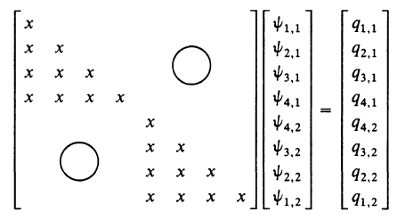


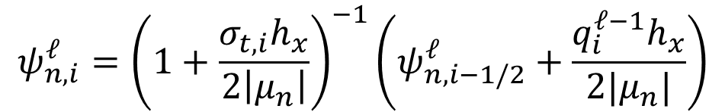
Spatial Discretization and Solution Procedure
Discretized with diamond differencing and upwinding:
$$ψ_{n,i}^{ℓ}={\left(1+\frac{σ_{t,i}h_{x}}{2\left|μ_{n}\right|}\right)}^{−1}\left(ψ_{n,i−1/2}^{ℓ}+\frac{q_{i}^{ℓ−1}h_{x}}{2|μ_{n}|}\right)$$
$$μ_{n}>0$$
$$ψ_{n,i+1/2}^{ℓ}=2ψ_{n,i}^{ℓ}−ψ_{n,i−1/2}^{ℓ}$$
Resulting system of equations is block lower triangular per direction!
BC
1
2
3
…
I
Block structure of the 1D S_{N} equations.
(Lewis and Miller, Chapter 3)
NUCLEAR, PLASMA & RADIOLOGICAL ENGINEERING
GRAINGER ENGINEERING

Slide 6
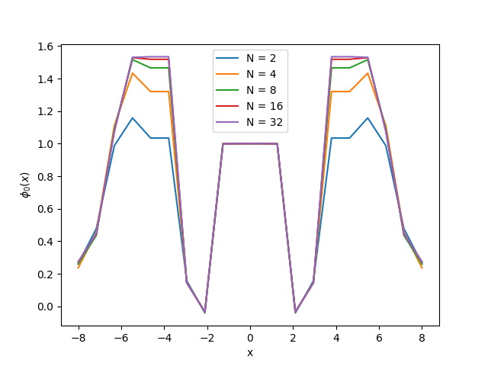
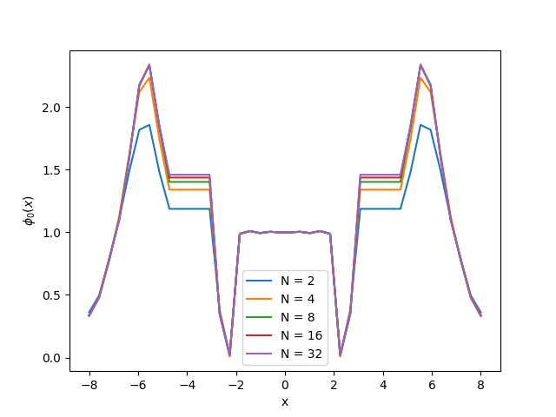
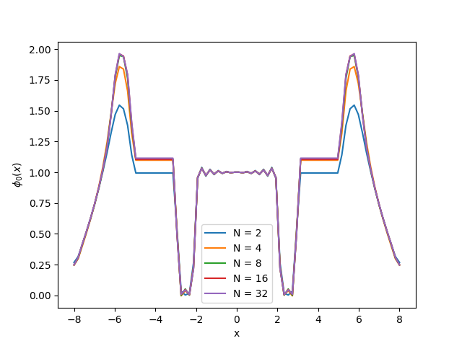
Results: Low to Moderate Space-Angle Refinement
20 grid points
40 grid points
80 grid points
NUCLEAR, PLASMA & RADIOLOGICAL ENGINEERING
GRAINGER ENGINEERING

Slide 7

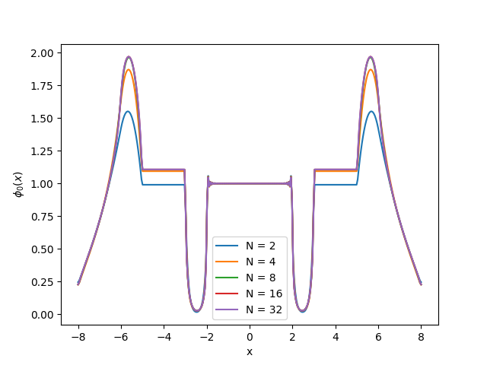
Results: Resolved Space-Angle Refinement
160 grid points
320 grid points
NUCLEAR, PLASMA & RADIOLOGICAL ENGINEERING
GRAINGER ENGINEERING

Slide 8
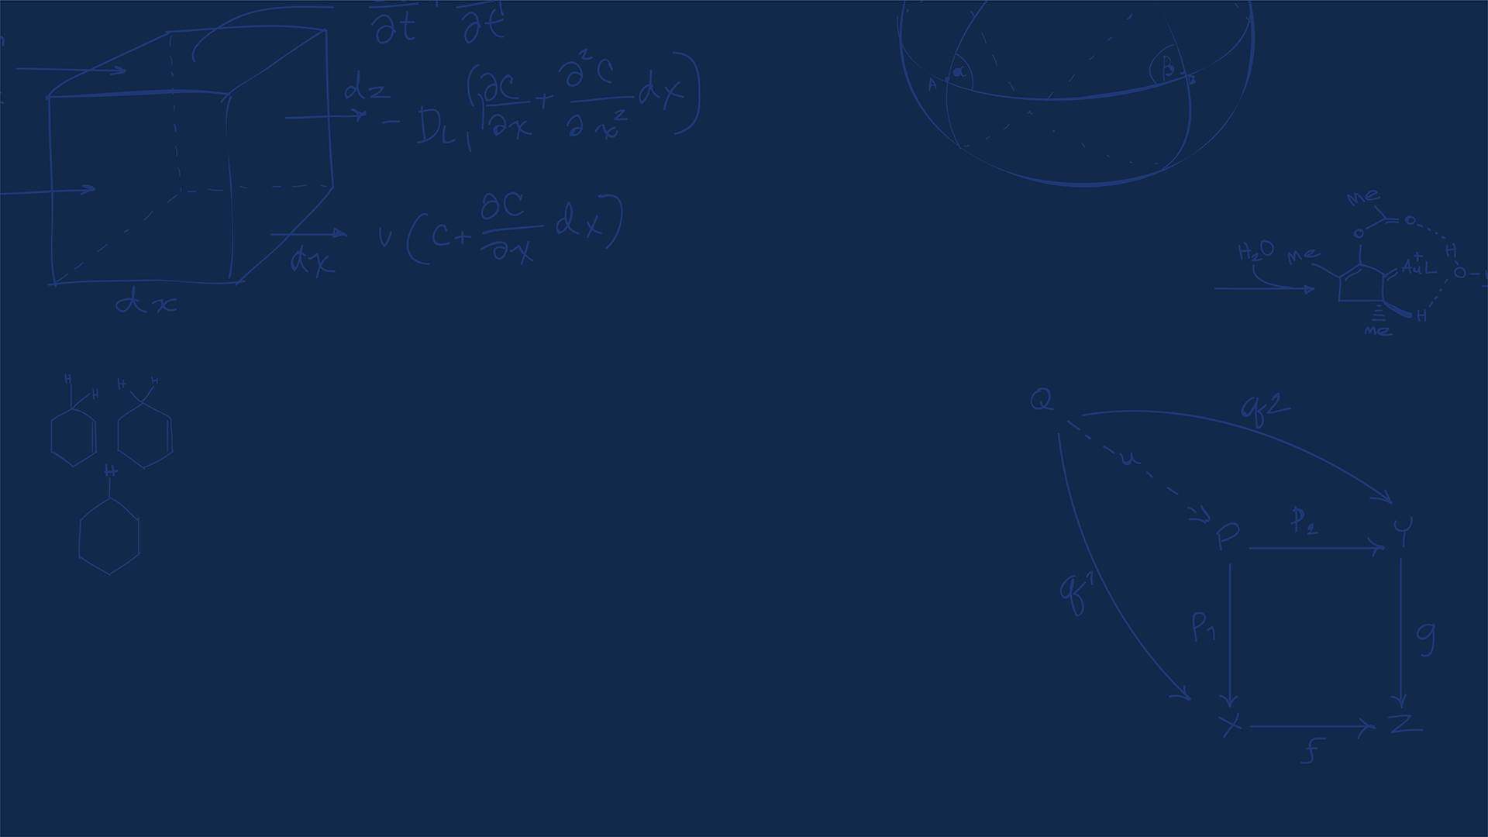
Thank You!
Any Questions?
NUCLEAR, PLASMA & RADIOLOGICAL ENGINEERING
GRAINGER ENGINEERING

