Slide 1
Pandas module
NDS

Slide 2
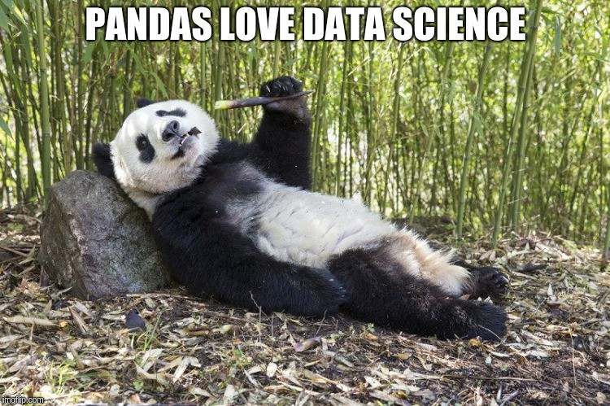

Slide 3
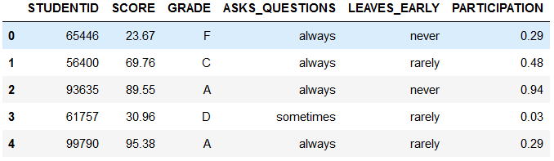
What is a DataFrame?
It’s basically a table with data…
Different data types can exist in a DataFrame
index

Slide 4
One dimentional ndarray
0 | Ana
1 | Maria
2 | Joana
Axis label

Slide 5
