Slide 1
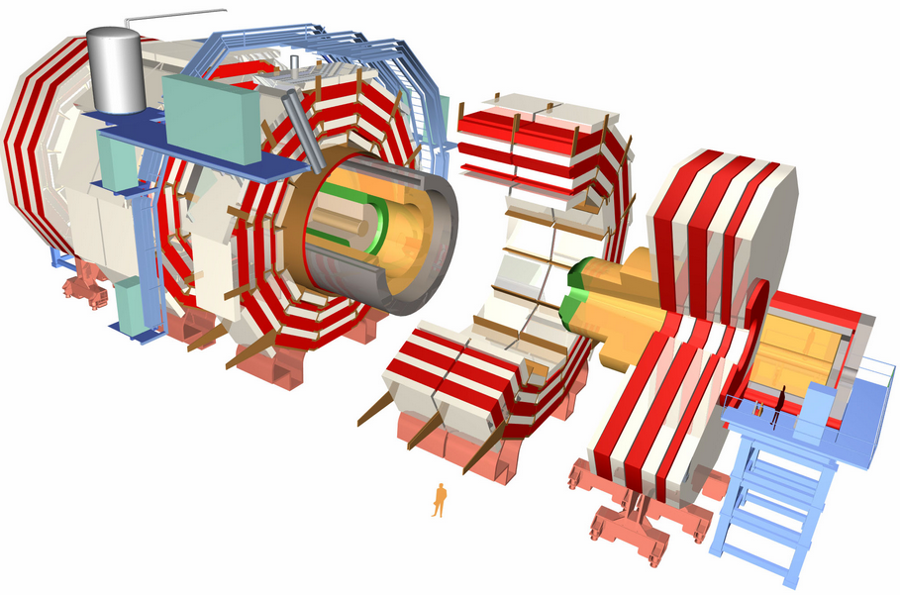
Muon Spectrometers
ECAL (Electromagnetic Calorimeter)
Tracker
HCAL (Hadronic Calorimeter)

