Slide 1


Transformer Architecture, Attention and Decoding
Dr. Sabyasachi Mukhopadhyay
Outreach Teaching Fellow, Dept. of CSE
IIT Kharagpur
Notes:
Welcome. Ask everyone to keep the chat window and menti.com open in a second tab. Today merges the second half of Lecture 3 (self-attention mechanics, training tricks, positional encoding, multi-head attention) with Lecture 4 (decoder, decoding, pretrained model families).

Slide 2
Before We Begin: You Used Transformers Today
Transformers are not lab curiosities. They are already in your pocket.
1
2
3
4
Google Search
Google Translate
Auto-captions
ChatGPT / Gemini / Claude
Type a vague question and still get the right page. The engine has to understand what you mean, not just match words.
English to Hindi with the verb moved to the end. Word order and context both matter.
YouTube and meeting apps subtitle speech live. Audio is just another sequence of tokens.
Drafts your email, explains your code, and occasionally your excuse for a late assignment.
Inside: BERT (encoder-only), since 2019
Inside: encoder-decoder Transformer
Inside: Whisper-style encoder-decoder
Inside: decoder-only Transformer
Today's journey
Self-attention
➜
Deep stacks
➜
Position
➜
Multi-head
➜
Decoder
➜
Generation
➜
Pretrained models
Our story today: how the attention block from last lecture grows into the full Transformer, and into the very models you just saw.
Notes:
Open with the four everyday examples, then walk the 'Today's journey' strip left to right. Point out the 'Inside' labels: they preview Part 7 (encoder-only reads, decoder-only writes, encoder-decoder does both).

Slide 3
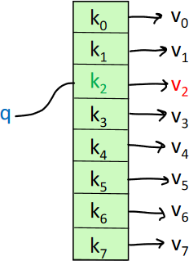
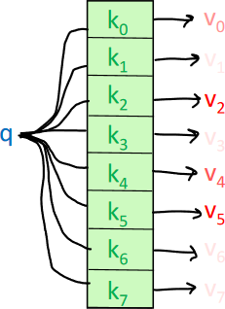
Attention as a Fuzzy Hashtable
Compare a query against keys, then return a weighted mix of values
Hashtable: exact match
Self-attention: soft match
Each query maps to exactly one key
Returns one value, v₂
Like looking up a roll number in a register
Query matches every key to some degree
Returns a weighted sum of all values
Like a search engine ranking every page by relevance
Key idea: attention is a differentiable lookup. Because the weights are soft, gradients flow through every key, so the model can learn what to look for.
PART 1 · SELF-ATTENTION, REVISITED
Notes:
0:06–0:09. Contrast exact lookup (Python dict: one key matches) with attention (every key matches a little). Real-world hook: a Python dict is like an exact-match roll number lookup; Google-style search is fuzzy, every page gets a relevance score and results are blended by relevance.

Slide 4
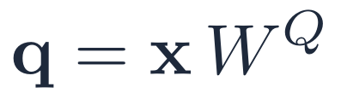


Query, Key, Value: A Library Analogy
Every token plays all three roles at once
Query
Key
Value
What am I looking for?
What do I offer to be found by?
What do I hand over if chosen?
The slip you hand the librarian: “books on monsoon forecasting”.
The label on each book's spine that the slip is matched against.
The book's actual contents, which you read once the match is made.
In “The animal didn't cross… because it was tired”
“it” asks: which noun am I?
In “The animal didn't cross… because it was tired”
“animal” advertises: I am a noun, living thing.
In “The animal didn't cross… because it was tired”
“animal” passes on its meaning.
Why three matrices? the same word needs to ask (Q), be found (K) and contribute (V) differently. Separate learned projections give it three different “faces”.
PART 1 · SELF-ATTENTION, REVISITED
Notes:
0:09–0:11. Library analogy: Query = the question on your slip, Key = the label on each book's spine, Value = the book's contents. Match the slip against spines, then read (weighted) contents. In self-attention every word writes a slip, labels its own spine, and offers its own contents.

Slide 5
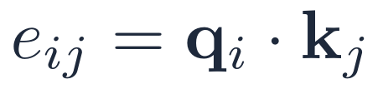
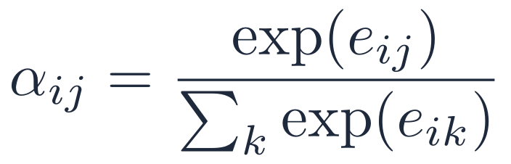
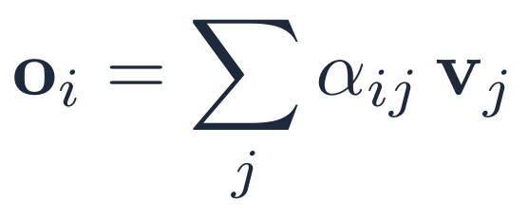
Recipe for Self-Attention
Four steps per token, the same weights for every position
Project
For each word xᵢ, compute its query, key and value.
1
Score
Compare query i with every key j.
2
Normalise
Softmax turns scores into weights that sum to 1.
3
Mix
Take the weighted sum of the values.
4
Analogy: a WhatsApp group of 10 people. Each person reads every message (score), decides how much each one matters to them (softmax), and forms their own summary (weighted sum).
PART 1 · SELF-ATTENTION, REVISITED
Notes:
0:11–0:13. Walk through the four steps for one token i. Emphasise that W^Q, W^K, W^V are shared across positions, so the cost does not depend on which word you are, only on sequence length.

Slide 6
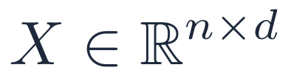

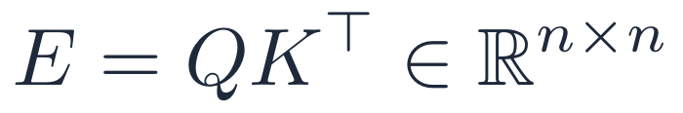
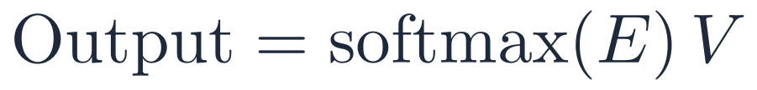
Vectorised Self-Attention: One Line of Matrix Algebra
The whole sequence is processed in parallel on a GPU
1
Stack tokens
The famous equation
2
Project
n × n score matrix: every token sees every token in one step
No recurrence: a 1,000-word paragraph is one matrix multiply, not 1,000 steps
√dₖ keeps scores well-scaled (Part 2)
3
All scores at once
4
Weights and output
Trade-off: the n × n matrix makes cost grow with the square of length, which is why long-context models (100K+ tokens) need clever engineering.
PART 1 · SELF-ATTENTION, REVISITED
Notes:
0:13–0:15. Stack all n tokens into X (n×d). Then the four steps become three matrix multiplies and a softmax. This is why Transformers train fast: no loop over time steps, unlike an RNN. The √dₖ term is previewed here and explained in Part 2.

Slide 7
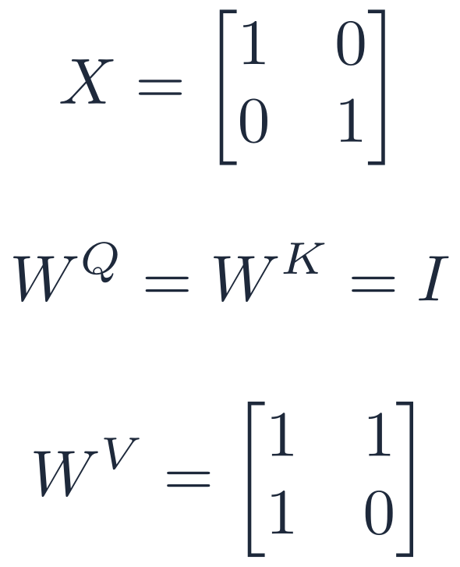
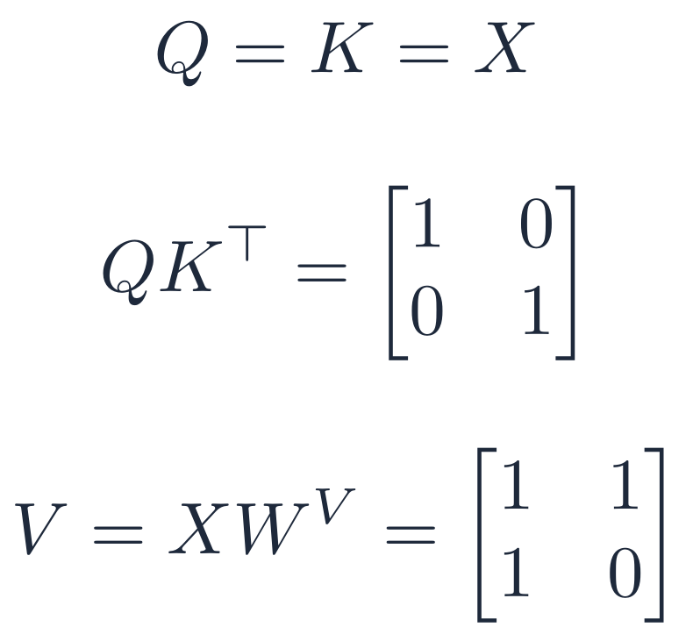
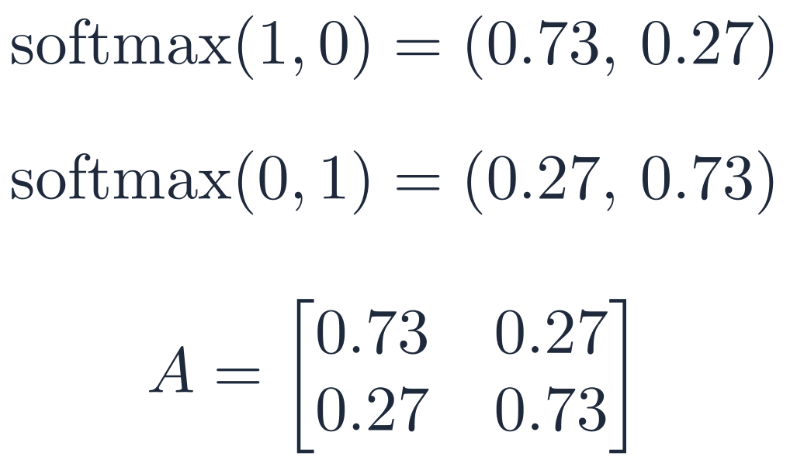
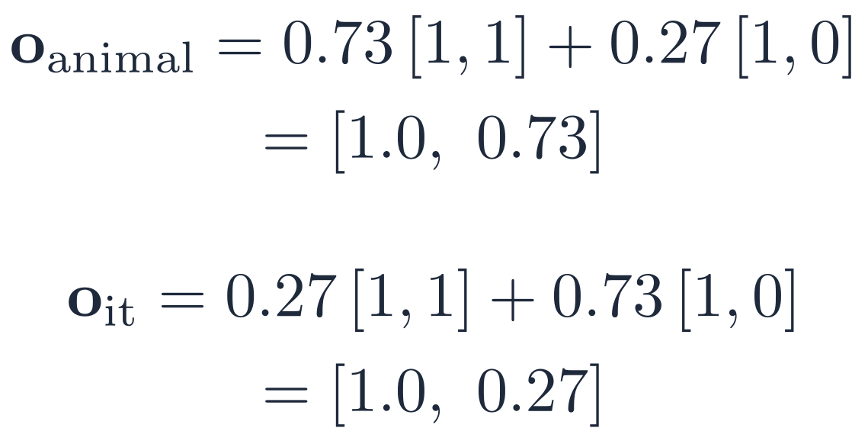
Tiny Self-Attention: Step by Step
Two tokens, x₁ = “animal”, x₂ = “it”, d = 2 (√dₖ scaling omitted to keep the numbers simple)
1 · Inputs
2 · Scores
3 · Softmax (row-wise)
4 · Output = AV
➜
➜
➜
Read the result: “it” started as [0, 1] but its output now carries 0.27 of “animal” in the second slot. That borrowed meaning is exactly what lets the model resolve the pronoun.
Try changing the value matrix on paper after class: the attention weights stay the same, only what gets mixed changes.
PART 1 · SELF-ATTENTION, REVISITED
Notes:
0:15–0:18. Do this live with them. Q = K = X (W^Q = W^K = I). Scores = QKᵀ = [[1,0],[0,1]] for X = [[1,0],[0,1]]. softmax([1,0]) = [0.73, 0.27]. V = X·W^V = [[1,1],[1,0]]. Output for 'it' = 0.27·[1,1] + 0.73·[1,0] = [1.0, 0.27]: its second component is non-zero only because it borrowed from 'animal'.

Slide 8
The Feed-Forward Layer: Adding Thinking Time
Attention mixes information; the FFN transforms it
The problem
Classroom analogy
Self-attention only re-averages value vectors. A weighted average of linear projections is still linear in the values, so stacking it adds little expressive power.
Attention
Group discussion: every student hears everyone and collects relevant points.
1
2
Feed-forward
Silent thinking: each student, alone, turns those notes into their own understanding.
The fix
Apply the same small MLP to every token independently after attention, with a ReLU in the middle.
3
Repeat × N
Discuss, think, discuss, think… six times in the original Transformer.
Size check: in the original model d = 512 and the FFN hidden layer has 2,048 units (4×). Roughly two-thirds of a Transformer's parameters live in these FFN layers.
PART 2 · MAKING IT DEEP
Notes:
0:20–0:23. Problem: self-attention is a weighted average of value vectors, so on its own it can only re-average. Fix: a position-wise two-layer MLP. Hidden size is typically 4× the model size (2,048 for d = 512). Analogy: group discussion (attention) followed by each person thinking alone (FFN).

Slide 9

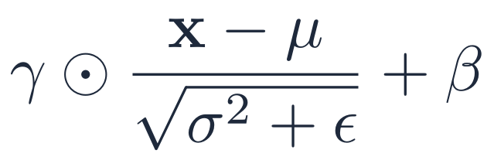
Where Is the Non-Linearity in a Transformer?
Most of the block is matrix multiplication; only three places bend the function
Input x
Q, K, V proj.
Softmax
Σ · V
Output proj.
Add & Norm
FFN (ReLU)
Add & Norm
›
›
›
›
›
›
›
■ linear (matrix multiply) ■ contains a non-linearity
1 · Softmax
2 · ReLU in the FFN
3 · LayerNorm
Turns scores into a probability distribution, letting a token focus sharply on a few others. Without it attention is just a fixed linear blend.
The only true element-wise non-linearity. It lets each FFN neuron act as a pattern detector that fires or stays silent.
Technically non-linear (divides by a data-dependent σ), but its job is to keep activations well-scaled, not to add expressive power.
Takeaway: remove softmax and ReLU and a 96-layer Transformer collapses into one big linear map, no smarter than linear regression.
PART 2 · MAKING IT DEEP
Notes:
0:23–0:26. Go along the pipeline. Linear: QKV projections, weighted sum, output projection, residual adds. Non-linear: softmax (inside attention), ReLU/GELU (inside FFN), LayerNorm (division by data-dependent σ, but its job is normalisation). Modern LLMs often use GELU or SwiGLU instead of ReLU, same role.

Slide 10
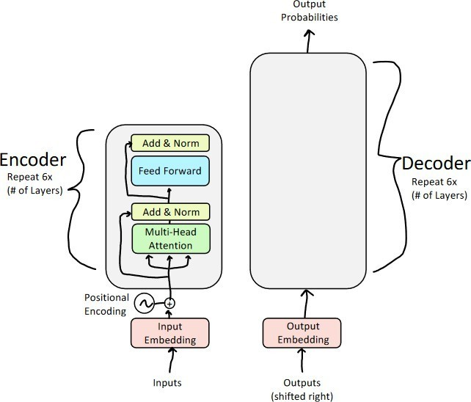

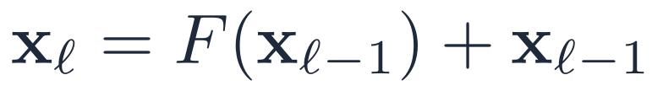

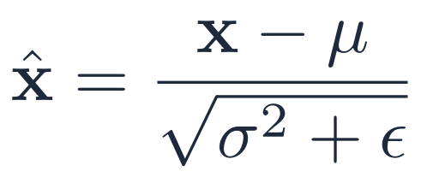

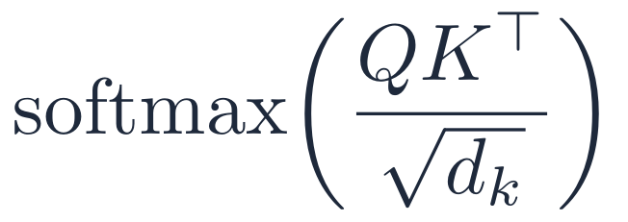
How Do We Train a 6-Layer (or 96-Layer) Stack?
Three training tricks that make deep Transformers stable
#1 Residual connections
A highway bypass: if a layer is useless, the signal (and the gradient) can skip it on the express lane.
#2 Layer normalisation
Grading on a curve: every layer receives inputs with mean 0 and variance 1, whatever happened upstream.
#3 Scaled dot product
Turning down the volume: long vectors produce huge scores, so we divide before the softmax.
Encoder block, repeated 6× in the original paper
Same tricks everywhere: ResNet (2015) brought residual connections to vision; every LLM today, from GPT to LLaMA, still uses all three.
PART 2 · MAKING IT DEEP
Notes:
0:26–0:28. Overview slide. Each trick fixes one failure mode: residuals fix vanishing gradients, LayerNorm fixes drifting activation scales, √dₖ scaling fixes softmax saturation. Use the analogies on the cards; details on the next two slides.

Slide 11
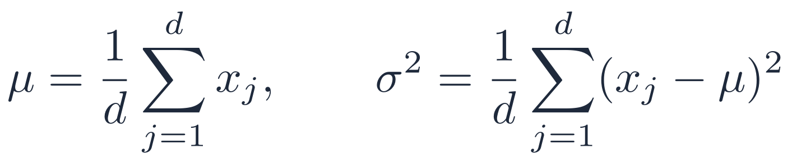
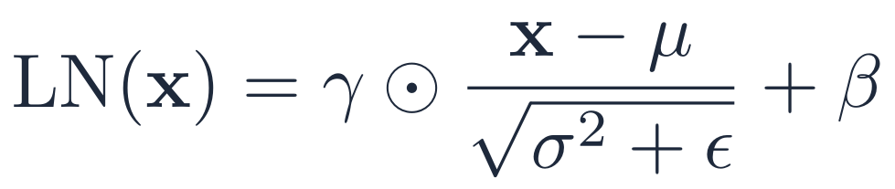
Tricks #1 and #2: Residual Connections and LayerNorm
Keep the gradient flowing and the activations in range
Residual connection
Layer normalisation
Problem: deep nets are surprisingly bad at learning the identity map, and gradients shrink layer by layer.
Fix: pass the input straight through and let the layer learn only the correction F(x).
Effect: a gradient always has a direct path back to early layers.
Per token, across features: each word's vector is rescaled on its own, so batch size does not matter.
γ, β are learned: the model can undo the scaling if that helps.
Analogy: editing a draft. You keep the original and add tracked changes, instead of rewriting from scratch.
Analogy: converting marks from different boards to percentiles before comparing students.
Exam tip: the original Transformer applies LayerNorm after the residual add (post-norm); GPT-2 onwards mostly apply it before each sublayer (pre-norm) for stabler deep training.
PART 2 · MAKING IT DEEP
Notes:
0:28–0:31. Residual: networks find it hard to learn the identity function; adding x back means a layer only learns the correction F(x). LayerNorm: normalise each token's vector across its features, then rescale with learned γ, β. Original paper: post-norm (after the residual add). Most modern LLMs use pre-norm (before the sublayer), which trains more stably at depth.

Slide 12
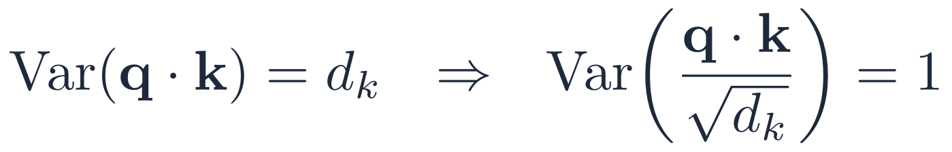
Trick #3: Why Divide by √dₖ?
Large dot products push softmax into saturation, where gradients vanish
Quick statistics
See the difference
Assume each component of q and k has mean 0, variance 1
Then q · k = Σᵢ qᵢkᵢ has mean 0, variance dₖ
So typical scores grow like √dₖ
Unscaled scores [8, 0]
token 1
1.00
token 2
0.0003
Almost one-hot: gradient ≈ 0, learning stalls
Scaled scores [1, 0]
With dₖ = 64 (as in the original paper), unscaled scores are around ±8. Dividing by √64 = 8 brings them back to about ±1.
token 1
0.73
token 2
0.27
A real blend: gradients flow to both tokens
Analogy: a microphone too close to the speaker clips every word to maximum volume. Stepping back (dividing by √dₖ) lets you hear the differences again.
PART 2 · MAKING IT DEEP
Notes:
0:31–0:34. Derivation: if q and k components are independent with mean 0 and variance 1, then q·k = Σ qᵢkᵢ has mean 0 and variance dₖ, so standard deviation √dₖ. For dₖ = 64 typical scores are about ±8. softmax([8, 0]) ≈ [0.9997, 0.0003], almost one-hot, gradient almost 0. Dividing by √dₖ = 8 brings scores back to about ±1: softmax([1, 0]) = [0.73, 0.27], a healthy blend.

Slide 13
Positional Encoding: Giving Every Word a Seat Number
Self-attention sees a set of words. Position must be added explicitly
Same words, very different news
Intuition for sinusoidal PE: a clock
“Kohli hit the ball” → a boundary
Second hand
fast
Minute hand
medium
Hour hand
slow
“The ball hit Kohli” → a physio visit
Each hand alone repeats, but together they give every moment a unique reading. Each pair of PE dimensions is a hand turning at its own frequency, so every position gets a unique fingerprint.
Without positions, attention sees the same bag of words {Kohli, hit, the, ball} and produces the same output for each word.
Fix: add a position vector pᵢ to each word embedding before attention: xᵢ = embed(wordᵢ) + pᵢ
Analogy: in a cinema everyone watches the same film (content), but your seat number (position) still decides whether you see the hero or a pillar.
PART 3 · POSITIONAL ENCODING
Notes:
0:38–0:41. Self-attention is permutation-equivariant: shuffle the inputs and the outputs shuffle the same way, with identical values. So 'Kohli hit the ball' and 'The ball hit Kohli' look like the same bag of words. Fix: add a position vector pᵢ to each embedding. Clock intuition: each pair of dimensions is a hand turning at its own speed.

Slide 14
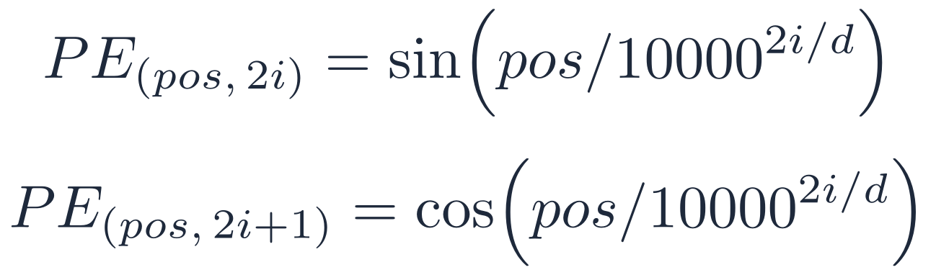
Worked Example: “bank” at Position 3 vs Position 7
Same word, same embedding, two different final vectors (d = 5 for clarity)
dim | speed | embed(“bank”) | p₃ | x at pos 3 | p₇ | x at pos 7
0 | fast | 0.8 | 0.1411 | 0.9411 | 0.6570 | 1.4570
1 | fast | 0.9 | -0.9900 | -0.0900 | 0.7539 | 1.6539
2 | medium | 0.2 | 0.0753 | 0.2753 | 0.1749 | 0.3749
3 | medium | 0.4 | 0.9972 | 1.3972 | 0.9846 | 1.3846
4 | slow | 0.6 | 0.0019 | 0.6019 | 0.0044 | 0.6044
What changed?
Dim 1 swings from −0.09 to 1.65
Dim 4 barely moves: 0.602 → 0.604
Fast dims tell nearby positions apart; slow dims keep coarse order
Formula used (d = 5)
Key takeaway: attention now sees where each token sits. The position signal is inside the vector before Q, K and V are even computed.
PART 3 · POSITIONAL ENCODING
Notes:
0:41–0:44. Point out: fast dimensions (first pair) swing a lot between positions 3 and 7, slow dimensions barely move. The position is baked into the vector before Q, K, V are computed. Real models use d = 512 or more.

Slide 15
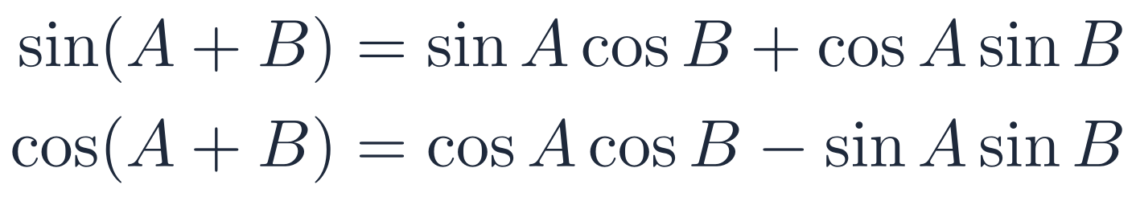
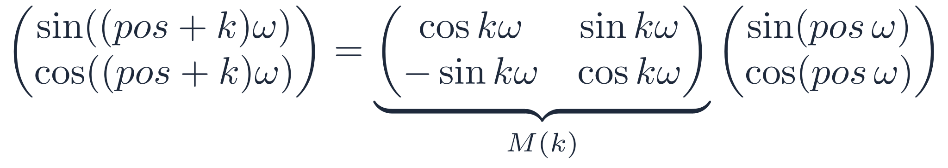
Why Relative Offsets Are Linear
Moving k positions forward is a fixed rotation, whatever the starting position
Derivation
Result: a 2D rotation
Let A = pos·ω and B = k·ω. The new (sin, cos) pair is then a linear function of the old pair, with coefficients that depend only on k.
Checked numerically: M(4)·PE(3) = PE(7) and M(4)·PE(50) = PE(54). Same offset, same matrix.
Why it matters: an attention head can learn “look 4 tokens back” once, and that single rule works at every position, like a clock hand that always advances the same angle per hour.
Clock picture: each dimension pair is a point on a circle; moving forward k positions turns it by the angle kω.
PART 3 · POSITIONAL ENCODING
Notes:
0:44–0:47. Use the angle-addition formulas. Each (sin, cos) pair is a point on a circle; advancing k positions rotates it by kω. So PE(pos+k) = M(k)·PE(pos) where M(k) depends only on k. This means an attention head can learn 'look 4 tokens back' once and it works at every position. RoPE (next slide) builds directly on this idea.

Slide 16
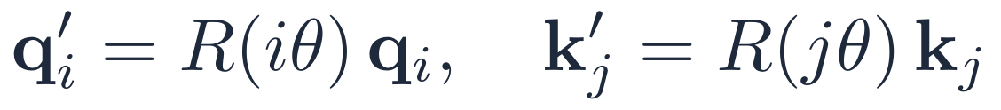
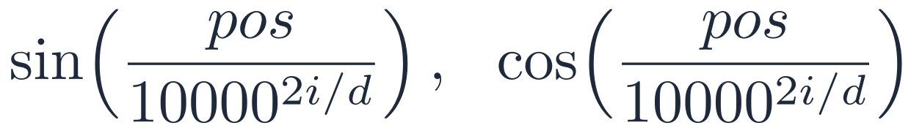
Beyond sin/cos: How Today's LLMs Encode Position
Four schemes, and which famous models use them
RoPE · Rotary
LLaMA, Mistral, Qwen, Gemma
ALiBi · Linear bias
BLOOM, MPT
Rotates Q and K by their position. The dot product then depends only on i − j.
No rotation at all: just subtracts a distance penalty from the score. Simple and extrapolates well.
Learned embeddings
BERT, GPT-2
Sinusoidal (2017)
Original Transformer
One trainable vector per slot. No built-in notion of relative distance, and no positions beyond training length.
Fixed, parameter-free, relative offsets are rotations. The ancestor of RoPE.
Property | sin/cos | RoPE | ALiBi | Learned
Relative offsets built in | ✓ | ✓✓ | ~ | ✗
Works beyond training length | ✓ | ✓ (with tricks) | ✓ | ✗
PART 3 · POSITIONAL ENCODING
Notes:
0:47–0:50. RoPE: rotate q and k by their position angle; the dot product then depends only on i − j. Used by LLaMA, Mistral, Qwen, Gemma. ALiBi: subtract m·|i−j| from the score; used by BLOOM and MPT. Learned: a trainable vector per slot (BERT, GPT-2); cannot extrapolate past the trained length. Real-world note: context-window extensions in modern LLMs are mostly tricks on top of RoPE.

Slide 17
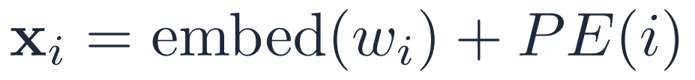
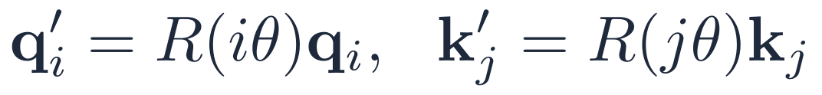
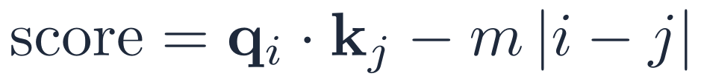
Where Each Scheme Injects Position
Three different points in the same forward pass
Token embedding
Compute Q, K, V
Q · Kᵀ
Softmax
Output
➜
➜
➜
➜
▲
▲
▲
sin/cos & learned
RoPE
ALiBi
sin/cos & learned PE
RoPE
ALiBi
At the token embedding
On Q and K, before the dot product
On the score, after the dot product
Position is mixed into the input vector itself, so Q, K, V and even the FFN only ever see the blended vector.
Embeddings and V are untouched. Relative position appears directly inside q′·k′.
Q, K, V are computed normally; only the final number gets a distance penalty.
Earliest · most indirect
Middle · most elegant
Latest · simplest
Remember: only sin/cos and learned PE touch V. RoPE and ALiBi leave the value vectors as pure content.
PART 3 · POSITIONAL ENCODING
Notes:
0:50–0:52. Earliest: sin/cos and learned PE are added to the embedding, so Q, K and V all carry position. Middle: RoPE rotates only Q and K, never V. Latest: ALiBi only edits the final score. This slide sets up Quiz 2.

Slide 18
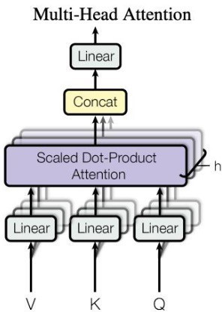
Why Multiple Heads?
One attention head captures one type of relationship. Language has many
“The animal didn't cross the street because it was too tired.”
H1 · Coreference
H2 · Verb–object
Example: “it” → “animal”
Example: “cross” → “street”
H3 · Meaning
H4 · Position
Example: “tired” → “animal”
Example: nearby tokens
Vaswani et al., 2017
Numbers to remember: the original Transformer uses h = 8 heads with d = 512, so each head works in dₖ = 512 / 8 = 64 dimensions.
PART 4 · MULTI-HEAD ATTENTION
Notes:
1:00–1:03. Welcome back. One head forms one weighted average per token, so it can only follow one relationship at a time. With h heads, each in a smaller space dₖ = d/h, we get h different views for about the same cost. Point to the diagram: h parallel scaled dot-product attentions, concatenated, then a final linear layer W^O.

Slide 19
Multi-Head Attention: The Selection Committee
Same input, several experts, each asking a different question
Head 1
Batting coach
Head 2
Bowling coach
Chief selector = output matrix
Looks at: Technique, shot selection
Looks at: Pace, variations
Each head writes its own report. The reports are concatenated, then the output matrix blends them into one decision.
Another real example: a hospital tumour board. Radiologist, pathologist, oncologist and surgeon study the same patient; each notices what the others miss.
≈ “it” → “animal” (who is who)
≈ “cross” → “street” (verb to object)
Head 3
Fitness trainer
Head 4
Captain
Looks at: Yo-Yo test, injuries
Looks at: Team fit, temperament
≈ “tired” → “animal” (meaning)
≈ nearby words (local order)
Why it matters: one head can form only one weighted average. Many heads track grammar, meaning and position at the same time, in parallel, for almost the same cost (each head uses dₖ = d / h).
PART 4 · MULTI-HEAD ATTENTION
Notes:
1:03–1:06. Cricket analogy: BCCI selection committee. Each coach studies the same player but looks at different things; the chief selector (W^O) combines their reports. Second example for non-cricket fans: a hospital tumour board.

Slide 20
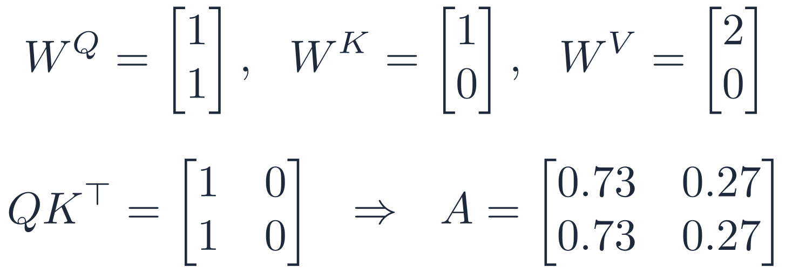
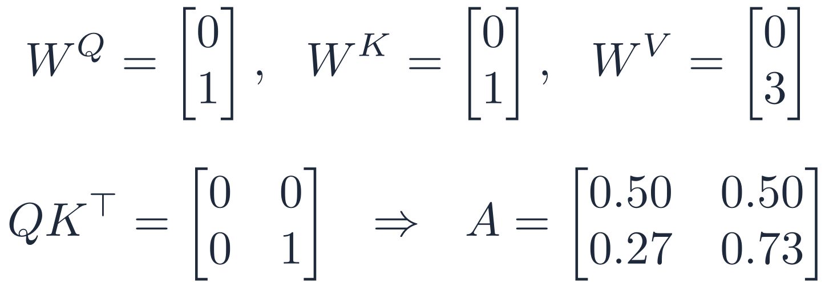
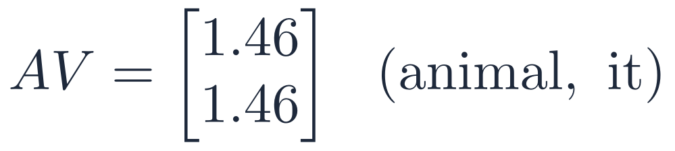
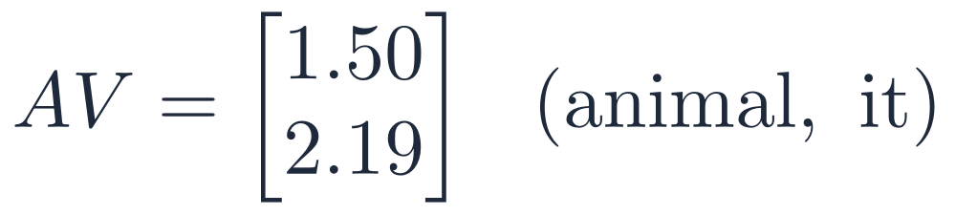
2-Head Attention: A Concrete Calculation
Input X is the identity, so Q, K and V equal the projection matrices; each head has dₖ = 1, so √dₖ = 1
HEAD 1 · coreference
HEAD 2 · self / context
Both tokens attend to “animal”: “it” is linked to “animal”.
“it” attends mostly to itself: it keeps its own identity.
Together: Head 1 says “it” = “animal”; Head 2 keeps “it” as its own entity. The output matrix fuses both views.
PART 4 · MULTI-HEAD ATTENTION
Notes:
1:06–1:09. Same input, different projection matrices, different attention patterns. Head 1: both rows of A are identical [0.73, 0.27], so both tokens lean on 'animal' (coreference). Head 2: rows differ, 'it' attends mostly to itself (keeps its identity). Concatenate the two 1-D outputs to get a 2-D vector per token, then multiply by W^O.

Slide 21
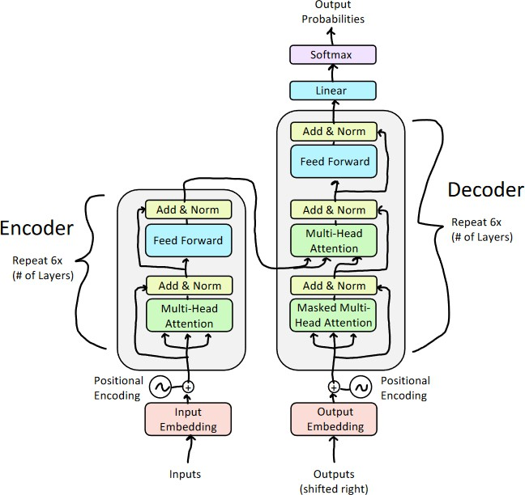
The Transformer Decoder: Three Sublayers
Masked self-attention, cross-attention, then feed-forward
Masked self-attention
1
Each target token looks only at earlier target tokens. No peeking at the future.
Like writing an exam answer: you can reread what you've written, not what you haven't.
Cross-attention
2
Q from the decoder; K and V from the encoder output. Reads the source sentence.
Like a translator glancing back at the original page for every word.
Feed-forward + Add & Norm
3
Same position-wise MLP and stabilising tricks as the encoder.
Silent thinking after the discussion, as in Part 2.
Big picture: the encoder reads the whole input once; the decoder writes the output one token at a time, consulting the encoder at every step.
PART 5 · THE DECODER
Notes:
1:12–1:15. Point to the right-hand stack of the diagram. Compared with the encoder, the decoder adds two things: a causal mask in its self-attention, and a cross-attention layer that reads the encoder's output. Each sublayer is wrapped in Add & Norm, as in Part 2.

Slide 22
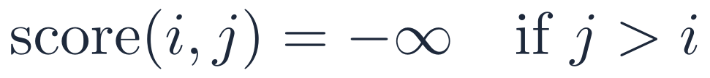
Masked Self-Attention: No Peeking at the Future
During training the whole target is visible, so we must hide it ourselves
KEY →
QUERY ↓
<start>
Je
t'aime
<EOS>
How the mask works
<start>
✓ attend
✕ masked
✕ masked
✕ masked
Je
✓ attend
✓ attend
✕ masked
✕ masked
softmax(−∞) = 0, so future tokens get exactly zero weight
Lets us train on the whole sentence in parallel without cheating
At inference there is no future anyway, but the same rule keeps training and generation consistent
t'aime
✓ attend
✓ attend
✓ attend
✕ masked
<EOS>
✓ attend
✓ attend
✓ attend
✓ attend
Real world: your phone's keyboard suggests the next word using only what you've already typed. A model trained with the answer visible would fail the moment it had to predict for real.
PART 5 · THE DECODER
Notes:
1:15–1:18. During training we feed the whole target sentence at once (teacher forcing) for speed. Without a mask, the model could simply copy the next word. The causal mask sets future scores to −∞, so after softmax their weight is exactly 0. Real-world: phone keyboard next-word prediction only ever sees what you have typed so far.

Slide 23

Cross-Attention: The Bridge Between Encoder and Decoder
Q comes from the decoder; K and V come from the encoder
Q
K
V
EN: “The cat sat on the mat.” → FR: “Le chat s'est assis sur le tapis.”
1
Query
Decoder token “chat” asks: which source words do I need?
Query
from the decoder
Key
from the encoder
Value
from the encoder
Match
Score that query against every encoder key.
2
3
Aggregate
Weighted sum of encoder values: mostly the meaning of “cat”.
Same formula as self-attention; only the sources of Q, K and V change.
Real world: a live interpreter at a UN session listens to the speaker (encoder) while producing the translation (decoder), constantly checking which part of the speech they are translating.
PART 5 · THE DECODER
Notes:
1:18–1:21. Self-attention: Q, K, V from the same sequence. Cross-attention: two sequences interact. The decoder token asks the question (Q), the encoder's words offer keys and values. Real-world: a human interpreter at a UN meeting listening to the speaker while producing the translation.

Slide 24
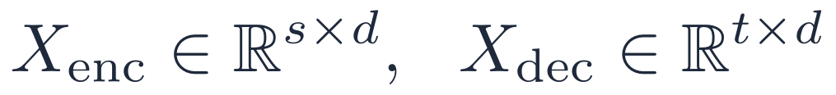
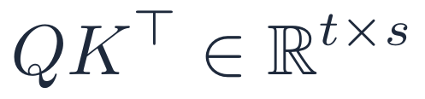
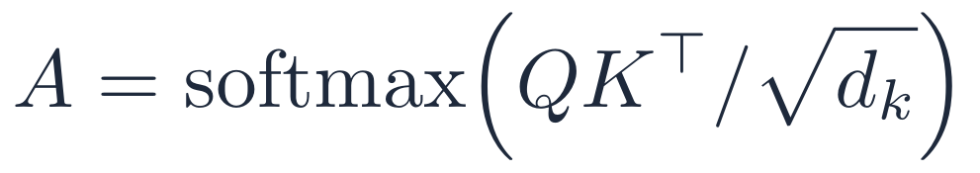
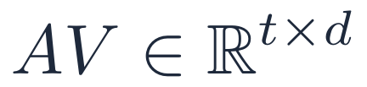
Cross-Attention as a Matrix
Each French word (row) spreads its attention over the English words (columns)
FR ↓ / EN → | cat | sat | on | the | mat
chat | 0.60 | 0.10 | 0.10 | 0.10 | 0.10
assis | 0.10 | 0.70 | 0.05 | 0.05 | 0.10
sur | 0.10 | 0.10 | 0.60 | 0.10 | 0.10
le | 0.05 | 0.05 | 0.10 | 0.65 | 0.15
tapis | 0.05 | 0.20 | 0.05 | 0.05 | 0.65
Inputs
1
2
Project
3
Scores
4
Weights (row-wise)
5
Output: source meaning per target word
Matrix shape t × s: 5 target words × 5 source words (lengths need not match)
Real world: engineers inspect these heat-maps to debug word order, e.g. English (subject-verb-object) vs Hindi or Bengali (subject-object-verb), where the diagonal bends.
PART 5 · THE DECODER
Notes:
1:21–1:23. Read the matrix row by row. 'chat' puts 0.60 on 'cat', 'assis' 0.70 on 'sat', 'tapis' 0.65 on 'mat'. Note the shape is t × s (target length × source length), not square. Real-world: these alignment heat-maps are how translation engineers debug word-order errors, for example between English (SVO) and Hindi or Bengali (SOV).

Slide 25
Autoregressive Generation: The Decoder Loop
One token per step: predict, append, repeat
1
Start
2
Forward pass
3
Linear + softmax
Feed <BOS> as the first decoder input.
Masked self-attn → cross-attn → FFN.
Project to the vocabulary; get probabilities.
4
Choose a token
5
Append and repeat
6
Stop
Greedy, beam search, or sampling.
Add the token to the input; go back to step 2.
At <EOS> or the maximum length.
Real world: the “typing” effect in ChatGPT or Gemini is this loop running live: every new word is one full pass through the decoder. Longer answers take proportionally longer.
PART 6 · GENERATING TEXT
Notes:
1:28–1:31. This is literally what happens when ChatGPT 'types' an answer: each word appears after one full forward pass. Six steps; steps 2–5 repeat until <EOS> or max length.

Slide 26
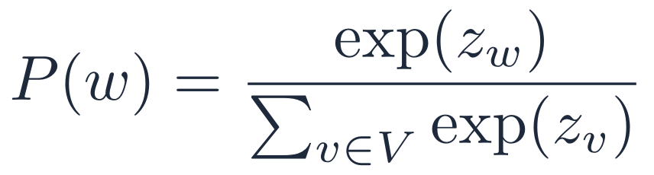
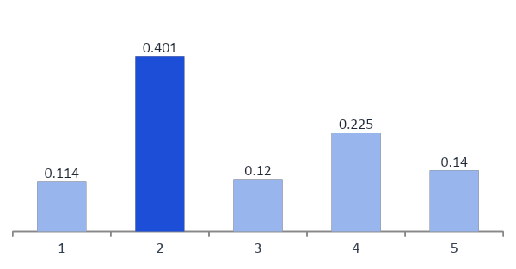
Linear + Softmax: From a Vector to a Word
Worked example: hidden size 4, vocabulary of 5 words
Step 1 · Linear projection
Step 2 · Softmax
One column of the vocabulary matrix per word.
word | the | cat | sat | bank | <EOS>
logit | -0.09 | 1.17 | -0.04 | 0.59 | 0.12
Logits are raw, unbounded scores, one per vocabulary word.
Result: “cat” wins with 40.1%. Greedy decoding picks it; sampling picks it 40% of the time. Real vocabularies hold 30,000 to 200,000 tokens.
PART 6 · GENERATING TEXT
Notes:
1:31–1:34. h (1×4) times W_vocab (4×5) gives 5 raw logits, one per vocabulary word. Softmax converts them to probabilities summing to 1. Highest here is 'cat' at 40.1%. Real vocabularies have 30,000 to 200,000 tokens, so this projection is one of the largest matrices in the model.

Slide 27
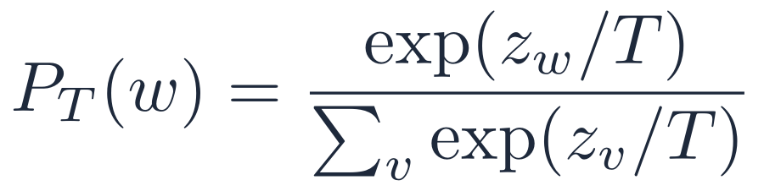
Choosing the Next Token: Greedy, Beam or Sampling?
Same probabilities, very different outputs
Greedy
Beam search (k beams)
Temperature sampling
Pick the single most likely word every step.
Keep the k best partial sentences; extend all of them; keep the best k again.
Divide logits by T, then sample. T < 1 sharpens; T > 1 flattens.
Fast and repeatable, but can loop: “I think I think I think…”
Finds higher-probability sentences than greedy; standard in translation.
Varied, creative output; a higher T means more surprise and more risk.
Good for: short factual answers
Good for: Google Translate-style tasks
Good for: chat, stories, brainstorming
T → 0: approaches greedy (all mass on the top word). T = 1: the model's own distribution. T > 1: flatter, more random.
Real world: the “temperature” slider in the OpenAI and Gemini APIs is exactly this T. Code assistants usually run cold (low T); creative-writing apps run warmer.
PART 6 · GENERATING TEXT
Notes:
1:34–1:37. Greedy: always the argmax; fast and deterministic, but can be repetitive. Beam search: keep the k best partial sentences; standard for translation where there is one 'right' answer. Temperature sampling: divide logits by T before softmax; T < 1 sharpens, T > 1 flattens. Real-world: the 'temperature' setting in the OpenAI or Gemini API is exactly this. Top-p (nucleus) sampling keeps the smallest set of words whose probabilities add up to p.

Slide 28
Step by Step: “I love you” → “Je t'aime”
The loop in action, and the code that runs it
Encoder runs once on “I love you” → enc_out, reused at every step
def generate(model, src, max_len=50, bos=1, eos=2):
enc_out = model.encoder(src) # encode once
tgt = torch.tensor([[bos]]) # start: <BOS>
for _ in range(max_len):
mask = causal_mask(tgt.size(1))
out = model.decoder(tgt, enc_out, mask)
nxt = out[:, -1].argmax(-1, keepdim=True) # greedy
tgt = torch.cat([tgt, nxt], dim=-1) # append
if nxt.item() == eos: break # stop
return tgt
input: <BOS>
predict: Je
Step 1
input: <BOS> Je
predict: t'aime
Step 2
input: <BOS> Je t'aime
predict: <EOS> → stop
Step 3
Mask size: 1×1 → 2×2 → 3×3
Notice: the encoder runs once, outside the loop; only the decoder repeats. That is why encoder-decoder models are efficient when the input is long and fixed.
PART 6 · GENERATING TEXT
Notes:
1:37–1:40. Left: the trace. Encoder runs once. Mask grows 1×1, 2×2, 3×3. Each predicted token is appended. Right: the actual PyTorch-style loop. Point out enc_out is computed outside the loop, the causal mask is rebuilt each step, [:, -1, :] takes only the last position's logits, and argmax = greedy.

Slide 29
The Pretrain → Fine-Tune Paradigm
Learn language once on huge data, then adapt cheaply to any task
Raw text
billions of tokens, no labels
Pretraining
predict next word or masked word
Pretrained model
general language knowledge
Fine-tune or prompt
small labelled set
Task model
e.g. a radiology report classifier
➜
➜
➜
➜
✗ Train from scratch
✓ Pretrain once, reuse
⚡ Why it works
★ Pretraining = learning attention
Needs millions of labelled examples per task. Expensive and brittle.
Learn grammar, facts and reasoning once; adapt to any task cheaply.
Language has shared structure that transfers across tasks.
BERT and GPT pretraining is learning good Q, K, V and FFN weights.
Real world: a hospital can adapt a general model with a few thousand of its own radiology reports, instead of collecting millions of labels from scratch.
PART 7 · PRETRAINED FAMILIES
Notes:
1:40–1:43. Stage 1: self-supervised pretraining on billions of tokens (next-token prediction or masked-word prediction): no labels needed. Stage 2: fine-tune on a small labelled set, or simply prompt. Pretraining is literally learning good W^Q, W^K, W^V and FFN weights. Real-world: a hospital can fine-tune a general model on a few thousand radiology reports instead of training from scratch.

Slide 30
Three Families of Pretrained Transformers
Which parts of the original architecture each one keeps
Encoder-only
Decoder-only
Encoder-decoder
BERT, RoBERTa, DistilBERT
GPT, LLaMA, Claude, Gemini
T5, BART, Whisper, IndicTrans2
Self-attention (both directions)
Masked self-attention
Masked self-attention
FFN
FFN
Cross-attention
FFN
Every token sees every other token. Trained by filling in masked words.
Each token sees only earlier tokens. Trained to predict the next word.
Encoder reads the input; decoder writes the output while reading it via cross-attention.
Reads: classify, search, extract
Writes: chat, code, drafting
Reads then writes: translate, summarise
e.g. Google Search query understanding
e.g. ChatGPT, GitHub Copilot
e.g. Whisper subtitles, IndicTrans2
Warm-up link: remember reading vs writing? Encoder-only reads, decoder-only writes, encoder-decoder reads then writes.
PART 7 · PRETRAINED FAMILIES
Notes:
1:43–1:46. Encoder-only (BERT): bidirectional, no mask, outputs embeddings; trained with masked language modelling. Decoder-only (GPT, LLaMA, Claude): causal mask, no encoder, trained with next-token prediction. Encoder-decoder (T5, BART, original Transformer, Whisper): cross-attention bridges a separate input and output. Link back to the warm-up: reading, writing, or both.

Slide 31






Where Transformers Run Today
The same building blocks, deployed at planetary scale
Chat assistants
Web search
Speech
ChatGPT, Gemini, Claude. GPT literally stands for Generative Pre-trained Transformer.
Google Search has used BERT (encoder-only) to understand queries since 2019.
OpenAI Whisper, an encoder-decoder Transformer, powers transcription and auto-subtitles.
Biology
Indian languages
Medical imaging
AlphaFold 2 uses attention to predict protein structures; it was recognised in the 2024 Nobel Prize in Chemistry.
AI4Bharat's IndicTrans2 translates across all 22 scheduled Indian languages and supports the Bhashini mission.
Vision Transformers cut an X-ray or a pathology slide into patches and treat them like words.
Takeaway: text, speech, proteins and pixels all become sequences of tokens. Attention does not care what the tokens are.
PART 7 · PRETRAINED FAMILIES
Notes:
1:46–1:49. All six are real deployments: GPT = Generative Pre-trained Transformer; Google has used BERT in Search since 2019; Whisper is an encoder-decoder speech model; AlphaFold 2's attention-based model was recognised in the 2024 Nobel Prize in Chemistry (Hassabis and Jumper); AI4Bharat's IndicTrans2 covers all 22 scheduled Indian languages and supports Bhashini; Vision Transformers split an image into patches and treat them as tokens.

Slide 32
Choosing the Right Architecture
Start from the task shape: scoring, generating, or transforming text?
 | Encoder-only | Decoder-only | Encoder-decoder
Primary task | Understanding, scoring | Open-ended generation | Sequence transformation
Inference cost | Lowest | Highest | Moderate
Latency | One pass, very fast | Grows with output length | Parallel encode, sequential decode
Pick it when… | You classify, rank or embed text | You need flexible, creative output | Input and output are distinct sequences
Indian example | Flagging fraud SMS for a bank | A customer-support chatbot | Hindi ↔ Bengali translation
Rule of thumb: don't let the output format decide alone. Ask what the input looks like, how much each request may cost, and whether the output is free-form or tied to the input.
PART 7 · PRETRAINED FAMILIES
Notes:
1:49–1:51. Architecture is a product and cost decision. Encoder-only: one forward pass, cheapest, ideal for scoring millions of items. Decoder-only: most flexible, most expensive because cost grows with output length. Encoder-decoder: parallel encode, sequential decode; best when input and output are clearly different sequences.

Slide 33
Why Decoder-Only Became the Industry Standard
One stack, one objective, one growing sequence
1
Next-word prediction does almost everything
At scale, it implicitly learns classification, translation, summarisation and reasoning.
Chinchilla, 2022
70B
parameters on 1.4 trillion tokens beat the 280B Gopher model
2
Prompting replaced fine-tuning
One model handles a new task through a prompt: no labels, no architecture change.
Rule of thumb: about 20 training tokens per parameter
3
Simpler, cleaner scaling
One repeated block made scaling laws predictable (Kaplan 2020; Chinchilla 2022).
Honest caveat
Encoder models are not dead. For classification, embeddings, search and ranking, BERT-style models remain cheaper and often better.
4
No fixed input/output split
Chat, multi-turn dialogue and step-by-step reasoning are one growing sequence.
5
Cross-attention's edge faded
Re-using an encoded source helps only when there is a fixed source; open chat has none.
Bottom line: decoder-only won on flexibility; encoder-only still wins on cost for understanding tasks.
PART 7 · PRETRAINED FAMILIES
Notes:
1:53–1:55 (if short of time, summarise this slide in 30 seconds). Five reasons. Chinchilla (DeepMind, 2022): 70B parameters on 1.4 trillion tokens outperformed the 280B Gopher model, showing data scale matters as much as size; rule of thumb ≈ 20 training tokens per parameter. Caveat: encoder-only models remain the cheaper, better choice for classification, search and embeddings.

Slide 34

Six Things to Remember from Today
If you remember nothing else, remember these
1
Attention is a soft lookup: softmax(QKᵀ/√dₖ)V, all tokens in parallel.
One to take home
2
Depth needs tricks: FFN for non-linearity; residuals, LayerNorm and √dₖ for stable training.
Why did the RNN fail its exam?
It studied the whole syllabus, but only remembered the last chapter.
The Transformer topped the class. It paid attention to everything, all at once.
3
Order must be added: sin/cos, learned, RoPE or ALiBi, each at a different point in the pipeline.
4
Many heads, many views: h heads in dₖ = d/h dimensions, combined by an output matrix.
5
The decoder writes: causal mask + cross-attention + an autoregressive loop.
6
Pick the family by task: encoder reads, decoder writes, encoder-decoder transforms.
Next lecture: how these pretrained models are adapted in practice: fine-tuning, parameter-efficient methods such as LoRA, and prompting.
PART 8 · WRAP-UP
Notes:
1:57–1:58. Read the six quickly. End with the joke on the right.

Slide 35
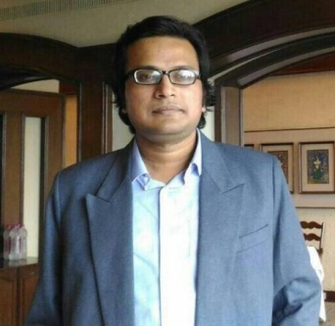



Thank You
Questions are welcome on the course forum
Sabyasachi Mukhopadhyay
Sombit Bose
Anurup Naskar
Shrimon Mukherjee
Instructor
Teaching Assistant
Teaching Assistant
Teaching Assistant
Teaching Assistants: IIT Kharagpur
PART 8 · WRAP-UP
Notes:
End of session.

