Slide 1


P(A∩B)
∑
Probability
P(A∪B)
From Zero to Hero
∩
A Comprehensive Journey Through Probability Theory
∪
P(A|B)
Notes:
Good morning, everyone. We're starting a comprehensive journey today, moving you from a beginner to a hero in probability theory. Probability is the language of uncertainty, and mastering it is essential for everything from data science to making informed life decisions. This presentation is structured to build your knowledge step-by-step, starting with the absolute basics and progressing to powerful concepts like Bayes' theorem. We'll use clear examples and practical Python code along the way. Think of this as laying the concrete foundation for all your future statistical and data analysis work. Let's get started on this exciting path to mastery.

Slide 2

Course Agenda
Comprehensive Coverage from Fundamentals to Applications
01
03
05
Probability Fundamentals
Probability Rules
Bayes' Theorem
Random experiments and outcomes
Addition rule (general & special)
Derivation and interpretation
Sample space and events
Multiplication rule
Prior and posterior probabilities
Axioms of probability
Complement rule
Real-world applications
Calculating probabilities
Worked examples
Medical testing examples
02
04
06
Types of Events
Conditional Probability
Python Applications
Mutually exclusive
events
Definition and formula
Monte Carlo simulation
Exhaustive
events
Tree diagrams
Probability calculations
Independent
events
Law of total probability
Data analysis with Python
Pairwise vs. mutual independence
Practical applications
Practice problems
Notes:
Here's our roadmap for the next hour or so, broken down into six key modules. We'll begin by establishing the fundamental concepts: what probability is, and the basic components like random experiments and sample spaces. Then, we'll dive into classifying events, which is crucial for knowing which rules to apply later. Modules three and four cover the core rules—addition, multiplication, and the all-important conditional probability. Finally, we'll reach the pinnacle with Bayes' Theorem, which is how we update our beliefs with new evidence, and we'll wrap up by showing you how to implement all of this using Python. We're building a tower of knowledge, so pay close attention to the foundational concepts in the first few sections.

Slide 3

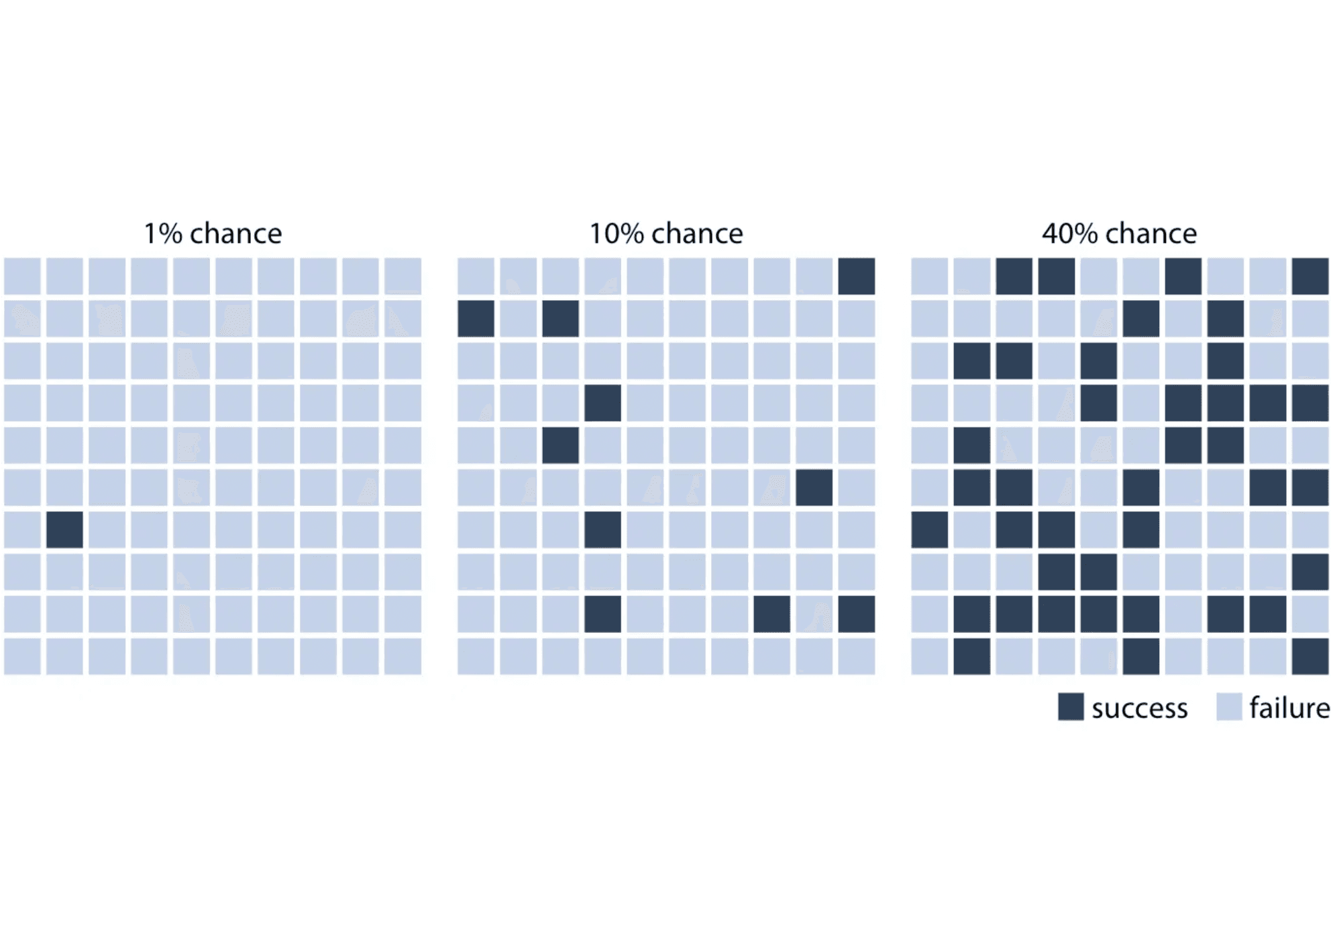
What is Probability?
Probability is a numerical measure of the likelihood that a particular event will occur. It quantifies uncertainty and helps us make informed decisions in the face of randomness.
Key Characteristics:
Quantifies Uncertainty:
Converts qualitative statements like "likely" or "unlikely" into
precise numbers
Predictive Power:
Helps forecast outcomes of random phenomena
Decision Making:
Foundation for statistical inference, risk assessment, and data science
Real-World Examples:
Weather: 70% chance of rain tomorrow
0 ≤ P(Event) ≤ 1
Games: Probability of rolling a 6 on a die = 1/6
P = 0 means impossible event P = 1 means certain event P = 0.5 means equally likely to occur or not
Medicine: 95% success rate for a procedure
Finance: Risk of investment loss
Notes:
So, what exactly is probability? Simply put, it's a number that quantifies uncertainty. Instead of saying something is "very likely," we assign a precise value between zero and one. Zero means an event is impossible, one means it's certain, and 0.5 means it's a fifty-fifty chance. This simple scale is incredibly powerful because it allows us to apply mathematics to the messy, unpredictable world around us. Think about the weather forecast: a 70% chance of rain isn't a guarantee, but it's a precise measure of the likelihood, allowing you to decide whether or not to take an umbrella. This concept of quantifying uncertainty is the core idea we'll build upon. Now that we know what probability is, let's look at where it comes from: the random experiment.

Slide 4

Random Experiments
A random experiment is a process or action that leads to one of several possible outcomes, where the exact outcome cannot be predicted with certainty in advance, even though all possible outcomes are known.
Key Characteristics:
Repeatability:
The experiment can be repeated under identical conditions
Well-defined outcomes:
All possible results are known beforehand
Uncertainty:
The specific outcome of any single trial cannot be predicted
Randomness:
The outcome is determined by chance, not by a deterministic process
Classic Examples of Random Experiments
Coin Toss
Dice Roll
Card Draw
Experiment:
Experiment:
Experiment:
Flip a fair coin once
Roll a standard six-sided die
Draw one card from a shuffled deck
Possible Outcomes:
Possible Outcomes:
Possible Outcomes:
• Heads (H)
• 1, 2, 3, 4, 5, or 6
• Any of 52 cards
• Tails (T)
• 4 suits: ♠ ♥ ♦ ♣
• 13 ranks each
Notes:
Before we can calculate a probability, we need a process that generates outcomes, and that process is called a random experiment. The key word here is "random." This doesn't mean chaotic; it means the outcome of any single trial cannot be predicted with certainty. Think of tossing a coin or rolling a die. You know all the possible results—Heads or Tails, 1 through 6—but you can't predict the result of the next toss. Crucially, a random experiment must be repeatable under the same conditions. This repeatability is what allows patterns to emerge over many trials, which is where probability theory really shines. Understanding the experiment is the first step, and the next step is listing all its possible results.

Slide 5

Sample Space
The sample space (denoted as S or Ω) is the set of all possible outcomes of a random experiment. It represents every distinct result that could occur when the experiment is performed.
S = {all possible outcomes}
Examples of Sample Spaces
1. Tossing a Coin
2. Rolling a Die
When you flip a fair coin, there are two possible outcomes: heads or tails.
A standard six-sided die can land on any face numbered 1 through 6.
S = {H, T}
S = {1, 2, 3, 4, 5, 6}
Number of outcomes: n(S) = 2
Number of outcomes: n(S) = 6
3. Tossing Two Coins
4. Drawing a Card Suit
When flipping two coins, we record the outcome of each coin in order.
Drawing one card from a deck and noting only its suit.
S = {♠, ♥, ♦, ♣}
S = {HH, HT, TH, TT}
Number of outcomes: n(S) = 4
Number of outcomes: n(S) = 4
Notes:
The sample space is perhaps the most fundamental concept in probability. It's simply the complete list of every single possible outcome of a random experiment. We denote it with the letter S or the Greek letter Omega. Defining the sample space correctly is critical because every event we care about must be a subset of this space. Look at the examples: for a single coin toss, S is just Heads and Tails. For two coins, we list all four ordered pairs. If you miss an outcome, your probability calculations will be wrong. So, always start by asking: what are all the possible, distinct results? Once we have this universal set, we can start defining the specific scenarios we're interested in, which we call events.

Slide 6

Events and Outcomes
Core Definitions
Examples
An outcome is a single result of a random experiment. It is the most basic, indivisible result that can occur.
Experiment: Rolling a Six-Sided Die
An event is a set of one or more outcomes from the sample space. Events are subsets of the sample space and represent specific conditions we're interested in.
Sample Space:S = {1, 2, 3, 4, 5, 6} Simple Event: Getting a 4 → E = {4} Compound Event: Getting an even number → E = {2, 4, 6}
Types of Events
Experiment: Flipping Two Coins
Simple Event
Sample Space:S = {HH, HT, TH, TT} Simple Event: Both heads → E = {HH} Compound Event: Exactly one head → E = {HT, TH}
Contains exactly one outcome from the sample space. Cannot be broken down further.
Compound Event
Experiment: Drawing a Card
Contains two or more outcomes. Formed by combining simple events using operations like union or intersection.
Simple Event: Drawing Ace of Spades Compound Event: Drawing any Ace → 4 outcomes Compound Event: Drawing a face card → 12 outcomes
Certain Event
The entire sample space. Always occurs with probability 1.
Key Insight: Every simple event is also an event, but not every event is simple. Events can be combined using set operations (union ∪, intersection ∩, complement ') to form new events.
Impossible Event
The empty set (∅). Never occurs with probability 0.
Notes:
Now that we've established the sample space—the universe of all possibilities—we need to focus on the specific outcomes we care about. This is where the concept of an event comes in. An outcome is the most basic, single result of a random experiment, like rolling a three on a die. Think of it as an atom in our probability universe. An event, on the other hand, is a collection of one or more of these outcomes. It's a subset of the sample space. For example, the event "rolling an even number" is the set of outcomes {2, 4, 6}. This distinction is crucial because probability is always calculated for an event, not just a single outcome. We classify events based on how many outcomes they contain. A simple event has just one outcome, like rolling a four. A compound event has multiple outcomes, like rolling an even number. We also have the certain event, which is the entire sample space—it must happen—and the impossible event, the empty set, which can never happen. Understanding events as sets allows us to use set theory operations like union and intersection to combine events, which we'll need for the addition and multiplication rules later. But first, we need the fundamental rules that govern all probability. Let's move on to the axioms.

Slide 7

Axioms of Probability
The Mathematical Foundation of Probability Theory
1
Non-Negativity
P(A) ≥ 0
The probability of any event A is always non-negative. Probabilities cannot be negative numbers. This ensures that probability represents a meaningful measure of likelihood.
Example: The probability of rolling a 7 on a standard die is 0 (impossible), but never negative. P(rolling 7) = 0, not -0.5.
2
Normalization (Certainty)
P(S) = 1
The probability of the entire sample space S (the set of all possible outcomes) is exactly 1. This means that something from the sample space must occur with certainty.
Example: When rolling a die, one of {1, 2, 3, 4, 5, 6} must occur. P(getting 1 or 2 or 3 or 4 or 5 or 6) = 1.
3
Additivity (Mutually Exclusive Events)
P(A ∪ B) = P(A) + P(B) if A ∩ B = ∅
For mutually exclusive events (events that cannot occur simultaneously), the probability of their union equals the sum of their individual probabilities.
Example: P(rolling 2 or 5) = P(rolling 2) + P(rolling 5) = 1/6 + 1/6 = 2/6 = 1/3. These events cannot happen together in a single roll.
Notes:
Every mathematical theory needs a foundation, and for probability, that foundation is built on three simple, yet powerful, axioms established by Andrey Kolmogorov. These three rules are the bedrock; everything else in probability theory is derived from them. The first axiom, Non-Negativity, is straightforward: the probability of any event must be zero or positive. You can't have a negative chance of something happening. This ensures that probability is a meaningful measure of likelihood. The second axiom, Normalization, tells us that the probability of the entire sample space—the certainty that something will happen—must equal one. If you roll a die, you are 100% certain to get a result between one and six. The third axiom, Additivity, is the most important for calculations. It states that if two events are mutually exclusive—meaning they cannot happen at the same time—then the probability that either one occurs is simply the sum of their individual probabilities. For example, rolling a two and rolling a five are mutually exclusive events on a single roll, so we can just add their probabilities. But be careful: this only works for mutually exclusive events. If events overlap, we need a different rule, which we'll cover soon. These three axioms are all we need to build the entire structure of probability. Now let's see how we use them to calculate actual probabilities.

Slide 8
Calculating Probability
Three Fundamental Approaches
Classical Approach
Empirical Approach
Subjective Approach
P(A) = n(A) / n(S)
P(A) = f / n
P(A) = Expert judgment
Formula:
Formula:
Formula:
When to Use:
When to Use:
When to Use:
When all outcomes are equally likely and can be counted. Based on theoretical analysis, not experiments.
Based on observed data from experiments or historical records. Used when theoretical probability is unknown.
Based on personal belief, intuition, or expert opinion. Used for unique, non-repeatable events.
Key Requirements:
Key Requirements:
Key Requirements:
• Finite sample space • All outcomes equally probable • Known before experiment
• Large number of trials (n) • Frequency count (f) • Converges to true probability
• No historical data • Expert knowledge • Must still follow axioms
Example:
Example:
Example:
Rolling a fair die: P(rolling 4) = 1/6 P(even number) = 3/6 = 1/2
Manufacturing defects: 50 defective in 1000 items P(defective) = 50/1000 = 0.05
Stock market prediction: "70% chance stock rises" Based on analyst expertise
Notes:
With the axioms in place, we can now look at the three main ways we calculate probability in practice. The first is the Classical Approach, which is what we use when all outcomes are equally likely, like with a fair coin or a fair die. Here, probability is simply a matter of counting: the number of favorable outcomes divided by the total number of possible outcomes. This is the approach we'll use for most of our initial examples. The second is the Empirical Approach, which relies on observation. When we can't assume outcomes are equally likely—maybe we have a biased coin or we're looking at real-world data like manufacturing defects—we run an experiment many times and calculate the probability based on the observed frequency. The more trials we run, the closer our empirical probability gets to the true probability. Finally, we have the Subjective Approach. This is used for unique events that can't be repeated, like predicting the outcome of an election or a stock market crash. Here, the probability is based on expert judgment and intuition, but it still must adhere to the three axioms. For our purposes today, we'll focus heavily on the Classical Approach, as it allows us to build strong intuition. Let's start with the classic example: rolling dice.

Slide 9

Example: Rolling Dice
Single Die
Two Dice
Example 1: Rolling a 4
Example 4: Sum Equals 7
Event A: Getting a 4 = {4}
Event D: Sum = 7
P(A) = n(A) / n(S) = 1 / 6
Favorable outcomes: {(1,6), (2,5), (3,4), (4,3), (5,2), (6,1)}
P(rolling 4) = 1/6 ≈ 0.167
P(D) = 6 / 36 = 1/6
P(sum = 7) = 1/6 ≈ 0.167
Example 2: Rolling an Even Number
Event B: Even number = {2, 4, 6}
Example 5: Both Dice Show Same Number
P(B) = n(B) / n(S) = 3 / 6 = 1/2
Event E: Doubles
P(even) = 1/2 = 0.5
Favorable outcomes: {(1,1), (2,2), (3,3), (4,4), (5,5), (6,6)}
P(E) = 6 / 36 = 1/6
Example 3: Rolling Greater Than 4
P(doubles) = 1/6 ≈ 0.167
Event C: Number > 4 = {5, 6}
P(C) = n(C) / n(S) = 2 / 6 = 1/3
Example 6: Sum Greater Than 10
P(greater than 4) = 1/3 ≈ 0.333
Event F: Sum > 10
Sum = 11: {(5,6), (6,5)} → 2 outcomes Sum = 12: {(6,6)} → 1 outcome Total: 3 outcomes
P(F) = 3 / 36 = 1/12
P(sum > 10) = 1/12 ≈ 0.083
Notes:
The dice example is the perfect way to apply the Classical Approach because we assume the die is fair, meaning all six outcomes are equally likely. For a single die, calculating the probability of rolling a four is easy: one favorable outcome out of six total, giving us one-sixth. The probability of a compound event, like rolling an even number, requires us to count the favorable outcomes: two, four, and six. That's three outcomes out of six, or one-half. Now, let's step it up to two dice. The sample space immediately gets much larger: six times six, giving us 36 total possible outcomes. The key here is to remember that each of those 36 pairs is equally likely. When we ask for the probability that the sum is seven, we have to systematically count all the pairs that add up to seven: one-six, two-five, and so on. There are six such pairs, so the probability is six out of 36, or one-sixth. Notice that the probability of rolling a seven with two dice is the same as rolling a four with one die. This counting method is the heart of classical probability. Next, we'll look at another common example: drawing cards.

Slide 10
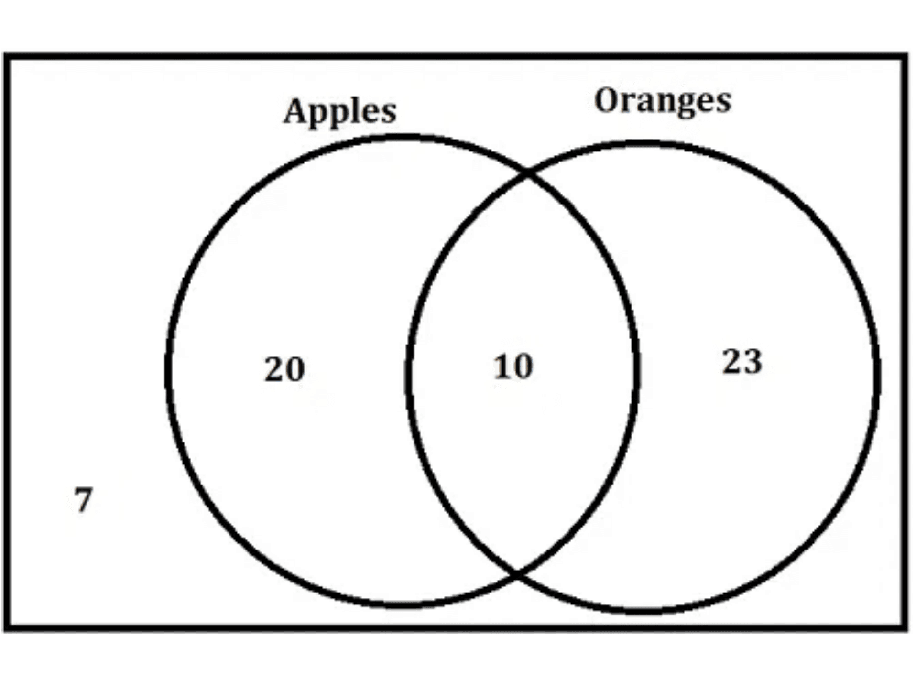
Example: Drawing Cards
Standard Deck: 52 cards | 4 suits (♠ ♥ ♦ ♣) | 13 ranks each | 26 red, 26 black
Example 1: Drawing a Heart
Event: Drawing any heart from the deck
Favorable outcomes: 13 hearts in deck
P(Heart) = 13/52 = 1/4
P(Heart) = 0.25 or 25%
Example 2: Drawing an Ace
Event: Drawing any Ace (A♠, A♥, A♦, A♣)
Favorable outcomes: 4 Aces in deck
P(Ace) = 4/52 = 1/13
P(Ace) = 1/13 ≈ 0.077 or 7.7%
Example 4: Drawing Red OR Face Card
Venn diagram illustrating overlapping events: When calculating P(A OR B), we must subtract the intersection to avoid double-counting outcomes that belong to both events.
Red cards: 26 | Face cards: 12 | Red face cards: 6
Using Addition Rule:
P(Red ∪ Face) = P(Red) + P(Face) - P(Red ∩ Face)
= 26/52 + 12/52 - 6/52 = 32/52 = 8/13
P(Red OR Face) = 8/13 ≈ 0.615 or 61.5%
Notes:
Drawing cards is another excellent example for the Classical Approach, but it introduces the complexity of overlapping events. Our sample space is 52 cards, and since we assume the deck is well-shuffled, each card has an equal probability of one-fifty-second. The probability of drawing a heart is simply 13 out of 52, or one-quarter, because there are 13 hearts. Similarly, the probability of drawing an Ace is four out of 52. Now, consider the event "drawing a Red card OR a Face card." We have 26 red cards and 12 face cards. If we just add 26 plus 12, we get 38. But wait, we've double-counted the red face cards—the Jack, Queen, and King of Hearts and Diamonds. That's six cards we counted twice. This is where the Addition Rule comes in, which we'll formalize later. We must subtract the intersection, the six red face cards, to correct for the double-counting. So, the total number of favorable outcomes is 26 plus 12 minus six, which is 32. The probability is 32 out of 52. This example clearly shows why we need rules to handle events that are not mutually exclusive. Now that we've seen how to calculate probabilities, let's categorize the relationships between events.

Slide 11

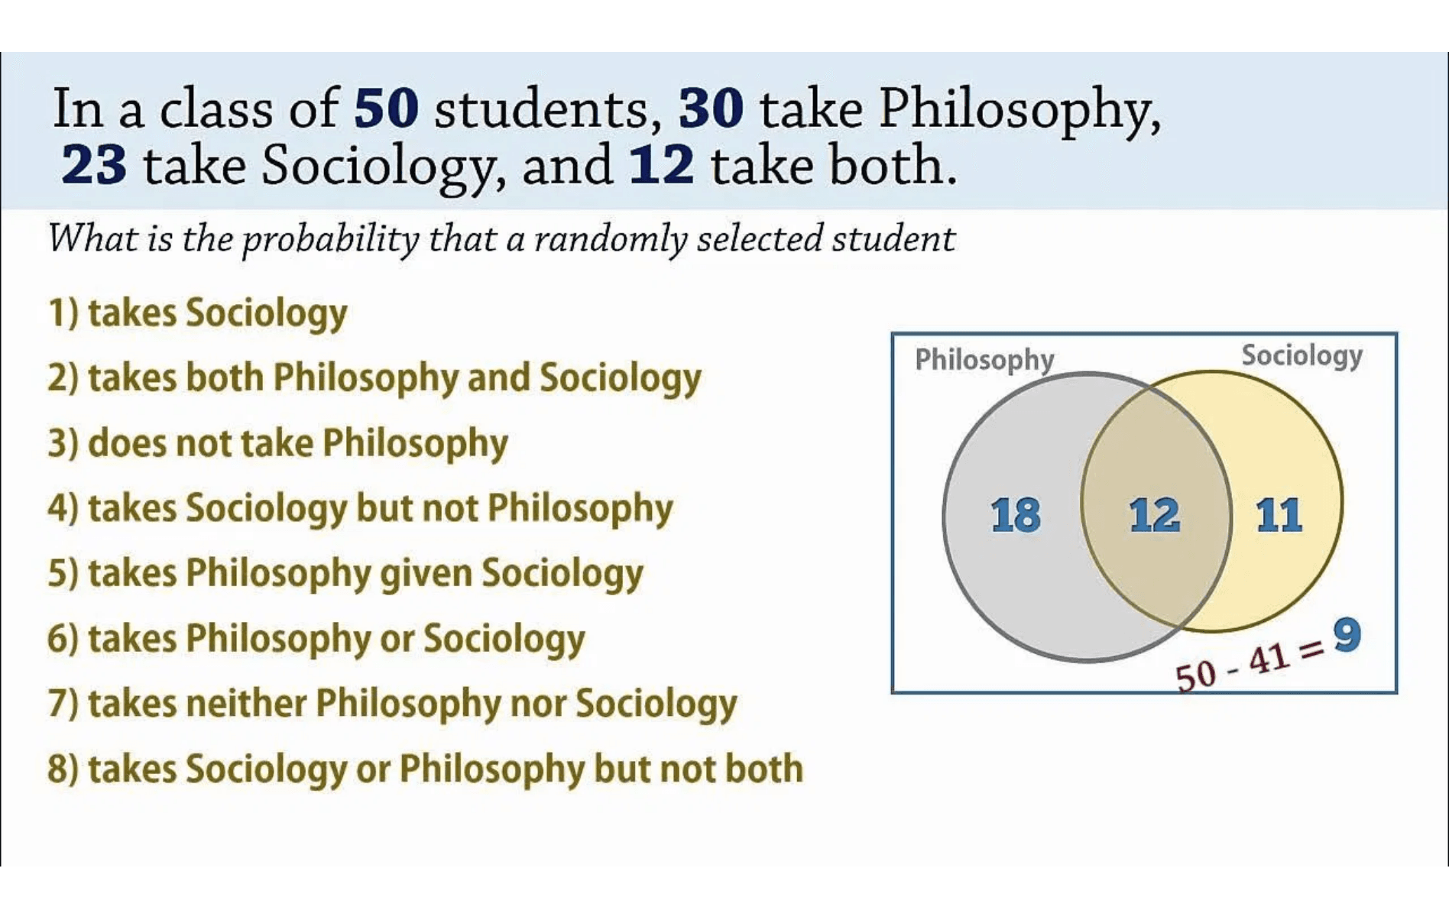
Types of Events: Overview
01 • Mutually Exclusive Events
Cannot Occur Together
Two or more events are mutually exclusive (or disjoint) if they cannot happen at the same time. The occurrence of one event prevents the others from occurring.
A ∩ B = ∅ (empty intersection) P(A ∩ B) = 0
02 • Exhaustive Events
Cover All Possibilities
A set of events is exhaustive if their union equals the entire sample space. At least one of the events must occur. Together, they account for all possible outcomes.
A₁ ∪ A₂ ∪ ... ∪ Aₙ = S P(A₁ ∪ A₂ ∪ ... ∪ Aₙ) = 1
Key Distinctions
Mutually Exclusive: Events cannot overlap (no intersection)
03 • Independent Events
Exhaustive: Events must cover everything (union = sample space)
No Influence on Each Other
Independent: Events don't influence each other (probability relationship)
Two events are independent if the occurrence of one does not affect the probability of the other. Knowledge about one event provides no information about the other.
Note: Events can be both mutually exclusive AND exhaustive (partition)
P(A ∩ B) = P(A) × P(B) P(A|B) = P(A)
Notes:
We've spent time mastering the fundamental rules of probability, specifically the addition and multiplication rules. Now we need to understand the relationships between events, because these relationships dictate which version of the rules we use. This slide introduces the three core classifications for event relationships: mutually exclusive, exhaustive, and independent. Mutually exclusive events are those that cannot happen at the same time, like rolling a 1 and a 6 on a single die. Exhaustive events are a set of events where at least one of them must happen, covering the entire sample space. Independent events are those where the outcome of one has absolutely no bearing on the outcome of the other. The key distinction is that mutually exclusive events are about overlap—or the lack thereof—while independent events are about influence. We'll dive into each of these three in detail, starting with mutually exclusive events, which are the simplest to visualize.

Slide 12

Mutually Exclusive Events
Two events A and B are mutually exclusive (or disjoint) if they cannot occur together in one trial.
Examples
Example 1: Rolling a Die
Example 2: Drawing a Card
A ∩ B = ∅
Event A: roll a 2 Event B: roll a 5 Mutually exclusive: one roll can't be both. P(A ∪ B) = 1/6 + 1/6 = 1/3
Event A: draw a heart Event B: draw a club A card can't be both heart and club. P(A ∪ B) = 13/52 + 13/52 = 1/2
Intersection is empty; there are no outcomes common to both A and B.
Key Properties
No overlap:
no shared outcomes
Example 3: Coin Toss
Counter-Example: NOT Mutually Exclusive
Addition rule:
P(A ∪ B) = P(A) + P(B)
Event A: heads Event B: tails Mutually exclusive and exhaustive. P(A ∪ B) = 1/2 + 1/2 = 1
Conditional:
P(A|B) = 0; P(B|A) = 0
Event A: even {2,4,6} Event B: ≥ 5 {5,6} Overlap: A ∩ B = {6} ≠ ∅
Independence:
not independent (unless impossible)
Venn: two non-overlapping circles; separate regions in the sample space.
Notes:
Let's focus on the first type: mutually exclusive events. The concept is simple: if one event happens, the other absolutely cannot. Think of it as a hard barrier between the events. Mathematically, this means their intersection is the empty set, and the probability of both happening is zero. This is a powerful condition because it simplifies the addition rule dramatically. If A and B are mutually exclusive, the general addition rule P(A or B) simplifies to just P(A) plus P(B), because we don't have to worry about subtracting any overlap. A common mistake is confusing mutually exclusive with independent. They are actually opposite. If two events are mutually exclusive, they are highly dependent: if I know A occurred, I know for sure B did not, so P(B|A) is zero. We'll look at some clear examples next to solidify this distinction.

Slide 13
Mutually Exclusive: Examples
Worked Examples from Different Contexts
01
02
Rolling a Single Die
Drawing a Card from a Deck
Consider rolling a standard six-sided die once.
Draw one card from a standard 52-card deck.
Events: A: Rolling a 2; B: Rolling a 5.
Events: C: Heart (13 cards); D: Spade (13 cards).
P(A) = 1/6, P(B) = 1/6
P(C) = 13/52 = 1/4, P(D) = 13/52 = 1/4
P(A ∪ B) = P(A) + P(B) = 1/6 + 1/6 = 1/3
P(C ∪ D) = 1/4 + 1/4 = 1/2
Why mutually exclusive? A die cannot show both 2 and 5 in a single roll. A ∩ B = ∅
Why mutually exclusive? A single card cannot be both a Heart and a Spade simultaneously. Different suits are disjoint.
03
04
Traffic Light Status
Student Grade Categories
Observing the status of a traffic light at a random moment.
A student receives one final grade in a course.
Events: R: Red; G: Green; Y: Yellow.
Events: A: 90–100; B: 80–89; F: below 60.
Suppose: P(R) = 0.5, P(G) = 0.4, P(Y) = 0.1
Suppose: P(A) = 0.25, P(B) = 0.35, P(F) = 0.05
P(R ∪ G ∪ Y) = 0.5 + 0.4 + 0.1 = 1.0
P(A ∪ F) = 0.25 + 0.05 = 0.30
Why mutually exclusive? The light can only display one color at any given time. These events form a partition of the sample space.
Why mutually exclusive? A student cannot receive multiple letter grades for the same course. Grade ranges do not overlap.
Notes:
These examples show how mutually exclusive events appear in different contexts. When rolling a die, rolling a 2 and rolling a 5 are mutually exclusive because only one face can land up. We simply add their probabilities to find the chance of rolling either a 2 or a 5. Similarly, when drawing a card, a card cannot be both a heart and a spade, so those events are mutually exclusive. The traffic light example is a great real-world case of a partition: the light must be one of the three colors, and it can only be one at a time. The key takeaway here is that whenever you can definitively say that two events cannot co-occur, you can use the simplified addition rule. This is a huge time-saver in probability problems. Now that we've covered events that cannot overlap, let's look at events that must cover everything.

Slide 14

Exhaustive Events
A set of events is exhaustive (or collectively exhaustive) if their union equals the sample space. This means that at least one of the events must occur when the experiment is performed.
Examples
Coin toss:
A={H}, B={T}; A ∪ B = S; exhaustive and a partition; P(A ∪ B)=1.
Die roll:
A ≤ 3, B ≥ 4; A ∪ B = {1..6} = S; exhaustive and mutually exclusive;
P(A)+P(B)=1.
A₁ ∪ A₂ ∪ ... ∪ Aₙ = S
Card suits:
Spades, Hearts, Diamonds, Clubs cover S; exhaustive and mutually
exclusive; sum of probabilities = 1.
Key Properties
Overlapping case:
A={2,4,6}, B={3,4,5,6} → not exhaustive (missing 1); add C={1} to make exhaustive.
Complete coverage: every outcome belongs to at least one event; Probability sum: P(A₁ ∪ A₂ ∪ ... ∪ Aₙ) = 1; Certainty: at least one exhaustive event occurs; Can overlap: exhaustive events need not be mutually exclusive.
Special Case: Partition
When events are both mutually exclusive AND exhaustive, they form a partition of the sample space.
Notes:
The second major classification is exhaustive events. Where mutually exclusive events focus on what *cannot* happen together, exhaustive events focus on what *must* happen. A set of events is exhaustive if, when you combine them all, they cover every single possible outcome in the sample space. In other words, when you run the experiment, one of those exhaustive events is guaranteed to occur. The probability of their union is always one. The most powerful scenario is when events are both mutually exclusive and exhaustive. We call this a partition of the sample space. A partition is like slicing a pie: every slice is separate, and all the slices together make up the whole pie. This concept of partitioning is absolutely critical because it forms the basis for the Law of Total Probability, which we'll cover later. For now, let's look at some examples of exhaustive events, including those that overlap.

Slide 15

Exhaustive Events: Examples
Practical Examples Including Partitions
01
02
Rolling a Die: Odd vs. Even
Card Deck: Color Classification
Consider rolling a standard six-sided die.
Drawing one card from a standard 52-card deck.
Events:
Events:
Event A: Odd numbers {1, 3, 5}; Event B: Even numbers {2, 4, 6}
Event R: Red cards (Hearts, Diamonds); Event B: Black cards (Spades, Clubs)
A ∪ B = {1, 2, 3, 4, 5, 6} = S
R ∪ B = All 52 cards = S
P(A) = 3/6 = 1/2; P(B) = 3/6 = 1/2
P(R) = 26/52 = 1/2; P(B) = 26/52 = 1/2
Exhaustive: Covers all outcomes; Mutually Exclusive: A ∩ B = ∅; Result:Forms a partition
Exhaustive: Every card is either red or black; Mutually Exclusive: No card is both; Result:Forms a partition
03
04
Age Groups in Population
Overlapping Exhaustive Events
Randomly selecting a person from a population.
Rolling a die with overlapping events.
Events:
Events:
C: Child (0–17); A: Adult (18–64); S: Senior (65+)
Event X: Numbers ≤ 4 {1, 2, 3, 4}; Event Y: Numbers ≥ 3 {3, 4, 5, 6}
C ∪ A ∪ S = Entire population = S
X ∪ Y = {1, 2, 3, 4, 5, 6} = S
P(C) = 0.22; P(A) = 0.63; P(S) = 0.15
P(X) = 4/6 = 2/3; P(Y) = 4/6 = 2/3; X ∩ Y = {3, 4} ≠ ∅
Exhaustive: Everyone falls into one category; Mutually Exclusive: Age ranges don't overlap; Result:Forms a partition
Exhaustive: Covers all outcomes; NOT Mutually Exclusive: Events overlap at {3, 4}; Result:Exhaustive but NOT a partition
Notes:
These examples illustrate the concept of exhaustiveness, particularly the power of a partition. In the die roll example, the events "Odd" and "Even" are exhaustive because every number is either odd or even. Since they don't overlap, they form a perfect partition. The same logic applies to the card colors and the age groups. However, look at the last example: rolling a number less than or equal to 4, and rolling a number greater than or equal to 3. These events are still exhaustive because their union covers all six outcomes. But they are not mutually exclusive because 3 and 4 are in both sets. This shows that exhaustive events can overlap. The key is simply that they leave no outcome uncovered. Next, we move to the third and often most confusing classification: independent events.

Slide 16

Independent Events
Two events A and B are independent if the occurrence of one event does not affect the probability of the other event occurring. Knowledge about one event provides no information about the other.
Intuitive Understanding
Independence means one event does not change the chance of the other—e.g., a coin flip does not affect a die roll.
Examples
Mathematical Conditions
P(A ∩ B) = P(A) × P(B)
Example 1: Two Coin Flips
Event A: first coin shows heads; Event B: second coin shows heads. P(A)=1/2, P(B)=1/2, P(A ∩ B)=1/4 = P(A)×P(B). The first flip doesn't affect the second—independent.
P(A|B) = P(A)
Key Properties
Example 2: Die Roll and Coin Flip
Symmetric:
If A is independent of B, then B is independent of A
Event A: roll a 6 on a die; Event B: flip heads on a coin. P(A)=1/6, P(B)=1/2, P(A ∩ B)=1/12 = P(A)×P(B). Separate experiments—independent.
Multiplication rule:
P(A ∩ B) = P(A) × P(B) simplifies calculations
Different from mutual exclusivity:
Independent events CAN occur together
⚠ Common Misconception
Independent ≠ Mutually Exclusive. If A and B are mutually exclusive (and not impossible), then P(A|B)=0 ≠ P(A); they are not independent.
Notes:
We've spent time classifying events by whether they cover the sample space or overlap. Now we introduce a critical concept: independence. Two events are independent if knowing one occurred gives you absolutely no information about whether the other occurred. Think of it this way: the outcome of a coin flip doesn't change the probability of the next coin flip. Mathematically, this means the conditional probability P(A given B) is simply P(A). The most practical definition is the multiplication rule: P(A and B) equals P(A) times P(B). This simplifies calculations dramatically, but only if the events are truly independent. Remember the common mistake: independent events are almost never mutually exclusive. If two events are mutually exclusive, they are highly dependent because if one happens, the other absolutely cannot happen. We'll look at some concrete examples next to solidify this distinction.

Slide 17
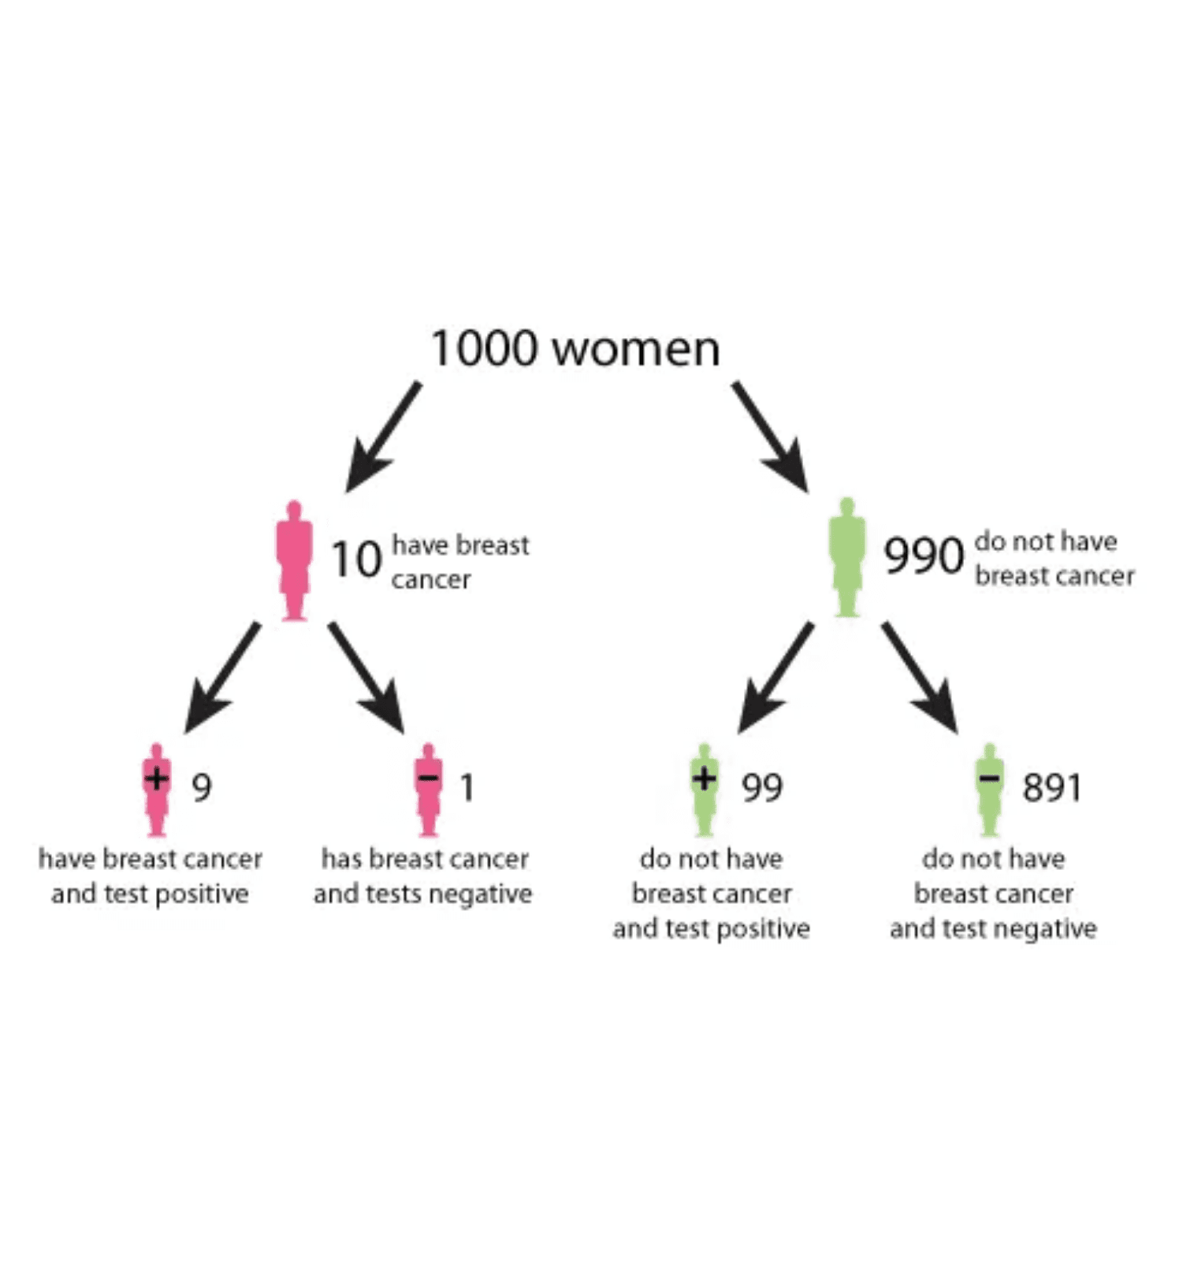
Independent Events: Examples
Worked Examples with Verification
01
03
Two Coin Tosses
Rolling Two Dice
Events: A: first coin heads; B: second heads.
Events: A: first die shows 4; B: second shows 5.
P(A)=1/2, P(B)=1/2; P(A ∩ B)=1/4.
P(A)=1/6, P(B)=1/6; P(A ∩ B)=1/36.
Verification: P(A)×P(B)=1/4 = P(A ∩ B) — Independent.
Verification: P(A)×P(B)=1/36 = P(A ∩ B) — Independent.
02
04
Coin Toss and Die Roll
Two Draws (with replacement)
Tree diagram of independent stages: probabilities multiply along each path.
Events: A: coin heads; B: die shows 6.
Events: A: first card is Ace; B: second is Ace.
P(A)=1/2, P(B)=1/6; P(A ∩ B)=1/12.
P(A)=4/52=1/13, P(B)=1/13; P(A ∩ B)=1/169.
Verification: P(A)×P(B)=1/12 = P(A ∩ B) — Independent.
Verification: P(A)×P(B)=1/169 = P(A ∩ B) — Independent.
Notes:
Let's walk through a few classic examples where independence holds true. The first three examples—two coin tosses, a coin toss and a die roll, and rolling two separate dice—all involve physically separate random experiments. Because the experiments are physically isolated, we assume independence. Notice how the verification works: we calculate the joint probability P(A and B) by counting the outcomes, and then we check if that joint probability equals the product of the marginal probabilities P(A) times P(B). In all these cases, the product rule holds. The fourth example, drawing cards with replacement, is key. If you replace the card, the deck resets, and the second draw is independent of the first. If you don't replace the card, the events become dependent, which we'll see later. The tree diagram visualizes how we multiply probabilities along the branches to find the probability of a sequence of independent events. This simple multiplication is the hallmark of independence.

Slide 18

Pairwise Independent Events
A collection of events is pairwise independent if every pair of events is independent; the occurrence of one does not affect the probability of the other.
Two Fair Coin Tosses
Sample Space: S = {HH, HT, TH, TT} (each outcome 1/4) Define Events: A = First coin is H: {HH, HT} → P(A) = 1/2 B = Second coin is H: {HH, TH} → P(B) = 1/2 C = Exactly one H: {HT, TH} → P(C) = 1/2 Pairwise Independence: P(A ∩ B)=1/4, P(A ∩ C)=1/4, P(B ∩ C)=1/4 = 1/2 × 1/2 ✓ Mutual Independence: P(A ∩ B ∩ C)=0 ≠ P(A)P(B)P(C)=1/8 ✗
Pairwise condition for events A₁, A₂, ..., Aₙ: P(Ai ∩ Aj) = P(Ai) × P(Aj) for all pairs i ≠ j
Key Properties
Pairwise condition:
Requires independence between every pair only.
Not mutual independence:
Pairwise independence does not imply mutual independence; mutual independence needs extra conditions.
Pairwise vs. Mutual Independence
Pairwise Independent
Mutually Independent
⚠ Critical Distinction
Checks only pairs of events
Checks all possible subsets
Events can be pairwise independent but NOT mutually independent. Mutual independence requires that all subsets (not just pairs) satisfy the independence condition.
Weaker condition
Stronger condition
P(Ai ∩ Aj) = P(Ai)P(Aj)
P(Ai ∩ Aj ∩ Ak) = P(Ai)P(Aj)P(Ak)
Notes:
Building on simple independence, we now introduce pairwise independence. When you have a collection of three or more events, we need a way to describe their collective independence. Pairwise independence is the weaker condition: it only requires that every pair of events in the collection is independent. For three events A, B, and C, we must check three pairs: A and B, A and C, and B and C. The critical distinction here is that pairwise independence is not enough to guarantee mutual independence. We saw a classic counterexample in the slide content: events A, B, and C can be pairwise independent, but if you know two of them, it might completely determine the third, violating the stronger condition. This means you can't use the simple product rule for all three events just because it works for all the pairs. We need a stronger definition, which we'll cover next, to ensure the product rule works for all subsets.

Slide 19

Mutually Independent Events
A collection of events A₁, A₂, ..., Aₙ is mutually independent (or collectively independent) if the probability of the intersection of any subset equals the product of their individual probabilities.
Mathematical Conditions
For three events A, B, C to be mutually independent: P(A ∩ B) = P(A) × P(B) P(A ∩ C) = P(A) × P(C) P(B ∩ C) = P(B) × P(C) P(A ∩ B ∩ C) = P(A) × P(B) × P(C) Note: all four must hold; pairwise independence alone is not sufficient.
Examples
Example 1: Three Coin Tosses
Events: A = first coin is H; B = second coin is H; C = third coin is H. Verification: P(A) = P(B) = P(C) = 1/2; P(A ∩ B) = P(A)×P(B) = 1/4; P(A ∩ C) = 1/4; P(B ∩ C) = 1/4; P(A ∩ B ∩ C) = 1/8 = 1/2 × 1/2 × 1/2. Result:Mutually independent.
Notes:
Mutual independence is the strongest form of independence, and it's what we usually mean when we say a set of events is independent. It requires that the product rule holds for every possible subset of the events, not just the pairs. For three events A, B, and C, this means four conditions must be met: the three pairwise conditions, plus the condition for the triple intersection: P(A and B and C) must equal P(A) times P(B) times P(C). If even one of these conditions fails, the events are not mutually independent. The three coin toss example is a perfect illustration of mutual independence because the physical setup guarantees that the outcome of one coin provides no information about the others, regardless of how many coins you look at. This stronger condition is what allows us to simplify complex probability calculations by multiplying all the individual probabilities together. This concept is vital for modeling systems where components operate completely separately. Now, let's switch gears and look at the rule for "or" probabilities.

Slide 20

Addition Rule of Probability
General Addition Rule
Special Case: Mutually Exclusive Events
P(A ∪ B) = P(A) + P(B) - P(A ∩ B)
Simplified Addition Rule
P(A ∪ B) = P(A) + P(B)
The probability that at least one of the events A or B occurs equals the sum of their individual probabilities minus the probability of their intersection.
Condition: A and B are mutually exclusive (i.e., A ∩ B = ∅, so P(A ∩ B) = 0). When events cannot occur together, there is no overlap to subtract—we simply add the individual probabilities.
Why Subtract the Intersection?
Extension to Multiple Events
When we add P(A) and P(B), we count the outcomes in the intersection A ∩ B twice—once in P(A) and once in P(B). To correct for this double counting, we must subtract P(A ∩ B) once.
For three events:P(A ∪ B ∪ C) = P(A) + P(B) + P(C) - P(A ∩ B) - P(A ∩ C) - P(B ∩ C) + P(A ∩ B ∩ C)
For mutually exclusive events:P(A₁ ∪ A₂ ∪ ... ∪ Aₙ) = P(A₁) + P(A₂) + ... + P(Aₙ)
When to Use
Key Takeaways
Use the general addition rule when finding the probability of A OR B occurring, especially when the events can occur together (i.e., they are not mutually exclusive).
General rule:
Always subtract intersection to avoid double counting
Special case:
For mutually exclusive events, intersection is zero
Union (∪):
Represents "OR" in probability
Notes:
We've covered the multiplication rule for "and" probabilities; now let's focus on the addition rule for "or" probabilities. The general addition rule calculates the probability that at least one of two events, A or B, occurs. The formula is P(A or B) equals P(A) plus P(B) minus P(A and B). The key insight here is why we subtract the intersection. If A and B can happen at the same time, we count the outcomes in the overlap region twice when we simply add P(A) and P(B). Subtracting P(A and B) corrects this double-counting, ensuring we only count each outcome once. This general rule always works. The simplified case is for mutually exclusive events, where the intersection is zero. Since P(A and B) is zero, the formula simplifies to just adding P(A) and P(B). This is a common point of confusion, so always check for overlap first. If there's overlap, use the general rule. If there's no overlap, use the simplified rule. This rule is essential for calculating probabilities in scenarios like risk assessment where we care if at least one failure occurs.

Slide 21
Addition Rule: Worked Examples
Applying General and Special Cases
01
02
Rolling a Die: Even OR Greater Than 4
Drawing Cards: Heart OR Ace
Problem: Roll a standard die. Find P(even OR greater than 4).
Problem: Draw one card. Find P(Heart OR Ace).
Events: A = Even {2,4,6} → P(A)=1/2; B = >4 {5,6} → P(B)=1/3 A ∩ B = {6} → P(A ∩ B)=1/6
Events: H = Heart (13) → P(H)=1/4; A = Ace (4) → P(A)=1/13 H ∩ A = Ace of Hearts (1) → P=1/52
Rule: General Addition (overlap)
Rule: General Addition (overlap)
P(A ∪ B) = P(A)+P(B)-P(A ∩ B)
P(H ∪ A) = P(H)+P(A) - P(H ∩ A)
= 1/2 + 1/3 - 1/6 = 2/3
= 13/52 + 4/52 - 1/52 = 16/52 = 4/13
Answer: P(even OR > 4) = 2/3 ≈ 0.667
Answer: P(Heart OR Ace) = 4/13 ≈ 0.308
03
04
Student Demographics: CS OR Math Major
Drawing Cards: Heart OR Spade
Problem: Class: 40% CS, 30% Math, 15% both. Find P(CS OR Math).
Problem: Draw one card. Find P(Heart OR Spade).
Events: C = CS → P=0.40; M = Math → P=0.30 C ∩ M = Both → P=0.15
Events: H = Heart (13) → P=1/4; S = Spade (13) → P=1/4 H ∩ S = ∅ → P=0
Rule: General Addition (overlap)
Rule: Special Addition (mutually exclusive)
P(C ∪ M) = P(C)+P(M) - P(C ∩ M)
P(H ∪ S) = P(H)+P(S)
= 0.40 + 0.30 - 0.15 = 0.55
= 13/52 + 13/52 = 26/52 = 1/2
Answer: P(CS OR Math) = 0.55 or 55%
Answer: P(Heart OR Spade) = 1/2 = 0.5
Notes:
We've established the general addition rule, so now let's see it in action with some practical examples. The key message here is always to check for overlap, or the intersection, between your events. Our first example is rolling a die and asking for an even number OR a number greater than four. The events overlap at the number six, so we must subtract that one-sixth probability to avoid double-counting. The second example, drawing a Heart OR an Ace, is a classic. The King of Hearts is the overlap, and we must subtract its probability, one-fifty-second, to get the correct result of four-thirteenths. The third example shows a real-world application with student majors, where the fifteen percent who are both CS and Math majors must be subtracted. Finally, the last example, drawing a Heart OR a Spade, is the special case. Since you can't draw a card that is both a Heart and a Spade, the intersection is zero, and we simply add the probabilities. This is the difference between the general and special addition rules. Now that we've mastered "or" probabilities, let's move on to "and" probabilities with the multiplication rule.

Slide 22

Multiplication Rule of Probability
General Multiplication Rule
Special Case: Independent Events
P(A ∩ B) = P(A) × P(B|A)
P(A ∩ B) = P(A) × P(B)
When events A and B are independent, P(B|A) = P(B), so the conditional probability simplifies to the unconditional probability.
The probability of both A and B occurring equals the probability of A times the conditional probability of B given A.
Extension to Multiple Events
Derivation
Three events:
P(A ∩ B ∩ C) = P(A) × P(B|A) × P(C|A ∩ B)
Starting from the definition of conditional probability:
n independent:
P(A₁ ∩ ... ∩ Aₙ) = P(A₁) × P(A₂) × ... × P(Aₙ)
P(B|A) = P(A ∩ B) / P(A) Multiply both sides by P(A): P(A ∩ B) = P(A) × P(B|A)
When to Use Which Formula?
This is the general multiplication rule, valid for all events (dependent or independent).
Dependent Events
Independent Events
P(A ∩ B) = P(A) × P(B|A)
P(A ∩ B) = P(A) × P(B)
Key Properties
One event affects the other
Events don't influence each other
Symmetric form:
P(A ∩ B) = P(B) × P(A|B) also holds
Example: Drawing cards without replacement
Example: Separate coin flips
Works for dependent events:
Accounts for how A affects B
Order matters:
P(B|A) may differ from P(A|B)
Must calculate P(B|A)
P(B|A) = P(B), simplifies calculation
Foundation for Bayes' theorem:
Combining both forms leads to Bayes' theorem
Notes:
The multiplication rule is the counterpart to the addition rule, and it calculates the probability that two events, A AND B, both occur. The general formula is P(A and B) equals P(A) times the conditional probability of B given A. This formula is derived directly from the definition of conditional probability, which we'll cover in more detail next. The crucial insight here is that this general rule works for all events, whether they are dependent or independent. When events are dependent, the probability of the second event, B, is affected by the occurrence of the first event, A. We account for this dependency using the conditional probability P(B given A). However, if the events are independent, the formula simplifies dramatically. If A and B are independent, then P(B given A) is just P(B), because A occurring doesn't change B's probability. So, for independent events, we simply multiply the marginal probabilities: P(A and B) equals P(A) times P(B). Knowing when to use the general rule versus the simplified independent rule is the most important part of applying the multiplication rule correctly. Let's look at some examples to make this distinction clear.

Slide 23
Multiplication Rule: Examples
Dependent and Independent Events
01
02
Drawing Cards Without Replacement
Three Independent Coin Tosses
Problem: Draw two cards from a deck without replacement. Find P(both are Aces).
Problem: Toss a fair coin three times. Find P(all three are heads).
Events: A, B, C = heads on first, second, third toss.
Events: A = first card is an Ace; B = second card is an Ace.
Rule: Special Multiplication Rule (independent events)
Rule: General Multiplication Rule (dependent events)
P(A) = P(B) = P(C) = 1/2
P(A) = 4/52; P(B|A) = 3/51 (3 Aces left in 51 cards)
P(A ∩ B ∩ C) = (1/2) × (1/2) × (1/2) = 1/8
P(A ∩ B) = P(A) × P(B|A) = (4/52) × (3/51) = 1/221
Answer: P(all heads) = 1/8 = 0.125
Answer: P(both Aces) = 1/221 ≈ 0.0045
03
04
Defective Products in Manufacturing
Rolling Two Dice: Specific Outcomes
Problem: A box has 20 items: 3 defective, 17 good. Draw two items without replacement. Find P(both defective).
Problem: Roll two fair dice. Find P(first die shows 6 AND second die shows 5).
Events: D₁ = first item is defective; D₂ = second item is defective.
Events: A = first die shows 6; B = second die shows 5.
Rule: General Multiplication Rule (dependent events)
Rule: Special Multiplication Rule (independent events)
P(D₁) = 3/20; P(D₂|D₁) = 2/19 (2 defective left in 19 items)
P(A) = 1/6; P(B) = 1/6
P(D₁ ∩ D₂) = (3/20) × (2/19) = 3/190
P(A ∩ B) = (1/6) × (1/6) = 1/36
Answer: P(both defective) = 3/190 ≈ 0.0158
Answer: P(6 on first, 5 on second) = 1/36 ≈ 0.0278
Notes:
These examples highlight the critical difference between dependent and independent events when using the multiplication rule. Our first example, drawing two Aces without replacement, is a dependent event. The probability of the second draw changes because the deck composition changes after the first Ace is removed. We use the general rule: four-fifty-seconds times three-fifty-firsts. Contrast that with the coin toss example. Tossing a coin three times results in three independent events. The first toss does not affect the second or the third. So, we use the simplified rule and just multiply the marginal probabilities: one-half times one-half times one-half. The third example, drawing defective products without replacement, is another dependent scenario, just like the cards. The pool of items shrinks and the proportion of defective items changes after the first draw. Finally, the last example, rolling two dice, is independent. The outcome of the first die has no influence on the second. So, we multiply one-sixth by one-sixth. Always ask yourself: Does the first event change the conditions for the second event? If yes, use the general rule. If no, use the simplified rule. This leads us directly to the concept that makes the general rule work: conditional probability.

Slide 24

Conditional Probability
Conditional probability is the probability of event A given event B. It describes how the likelihood of A changes when we know B occurred.
Intuitive Understanding
Think of conditional probability as updating beliefs with new information. Given B, we focus on outcomes where B happens and assess how likely A is within that set.
Mathematical Formula
P(A|B) = P(A ∩ B) / P(B)
Interpretation & Example
The fraction P(A ∩ B) / P(B) is the share of B-outcomes that also satisfy A. Example (cards): P(Ace|Red) = (2/52)/(26/52) = 1/13. Among 26 red cards, 2 are Aces.
Where: P(A|B) is “A given B”; P(A ∩ B) means both happen; P(B) > 0.
Key Properties
Range:
0 ≤ P(A|B) ≤ 1
When to Use Conditional Probability
Reduced sample space:
Consider only outcomes where B occurs
Sequential events:
One event follows another
Independence test:
If P(A|B) = P(A), then A and B are independent
Partial information:
You know some outcome occurred
Dependent events:
Events influence each other
Notes:
Conditional probability is perhaps the most powerful concept we'll cover, because it formalizes how we update our beliefs when we receive new information. We write it as P(A given B), and it asks: What is the probability of A, knowing that B has already occurred? The formula is P(A and B) divided by P(B). The intuition is simple: once we know B has happened, our entire sample space shrinks to only those outcomes in B. The conditional probability is then the fraction of that new, smaller sample space that also contains A. This is why the denominator is P(B). Conditional probability is the foundation for all reasoning under uncertainty. It's how we move from a prior belief to a posterior belief. For example, before you roll a die, the probability of rolling a six is one-sixth. But if I tell you the roll was an even number, your sample space shrinks to two, four, and six. The probability of rolling a six, given it was even, is now one-third. This updating of probability is what conditional probability is all about. This concept is essential for understanding the general multiplication rule and, later, Bayes' theorem. Let's look at some concrete examples.

Slide 25
Conditional Probability: Examples
Worked Examples in Various Contexts
01
02
Drawing Cards: Red Given Face Card
Medical Testing: Disease Given Positive Test
Problem: Draw one card from a standard deck. Find P(Red | Face Card). R: 26 red; F: 12 face cards.
Problem: Disease prevalence 1%; test TPR 95%, FPR 10%. Find P(Disease | Positive).
Given: F — Find: R
Given: + — Find: D
R∩F = 6 (red face cards); P(R|F) = (6/52)/(12/52) = 6/12 = 1/2
P(D∩+) = 0.01×0.95 = 0.0095; P(+) = 0.01×0.95 + 0.99×0.10 = 0.1085; P(D|+) = 0.0095/0.1085 ≈ 0.0876
Answer: P(Red | Face Card) = 1/2 = 0.5
Answer: P(Disease | Positive) ≈ 8.76%
03
04
Rolling Dice: Sum Given First Die
Quality Control: Defective Given Factory
Problem: Roll two dice. Find P(Sum = 8 | first die = 3).
Problem: A: 60% (2% defective), B: 40% (5% defective). Find P(A | Defective).
Given: first = 3 — Find: sum = 8
Need second die = 5; A∩B = {(3,5)} → P = 1/36; P(B) = 1/6; P(A|B) = (1/36)/(1/6) = 1/6
Given: defective (D) — Find: from Factory A
P(A∩D) = 0.60×0.02 = 0.012; P(D) = 0.60×0.02 + 0.40×0.05 = 0.032; P(A|D) = 0.012/0.032 = 0.375
Answer: P(Sum = 8 | First = 3) = 1/6 ≈ 0.167
Answer: P(Factory A | Defective) = 0.375 or 37.5%
Notes:
These examples show how conditional probability is applied in different contexts, from card games to medical diagnosis. In the card example, we want the probability of drawing a Red card given that we drew a Face card. We restrict our focus to the twelve face cards. Of those twelve, six are red, so the probability is six-twelfths, or one-half. The second example is a preview of Bayes' theorem, which we'll cover soon. It shows the counterintuitive result of medical testing: even with a positive test, the probability of actually having the disease is low because the disease is rare. The third example, rolling dice, is a simple application of the formula. The probability of the sum being eight, given the first die was three, means the second die must be five. Since the dice are independent, this probability is one-sixth. Finally, the last example is another application of Bayes' theorem, asking for the probability that a defective item came from Factory A. We use the formula to reverse the conditioning. In all these cases, we are restricting the sample space based on the given information, B, and then calculating the probability of A within that restricted space. This ability to update probabilities is the core skill we need to develop. Next, we'll look at how these rules are visualized using probability tree diagrams.

Slide 26

Probability Tree Diagrams
A probability tree diagram (or tree diagram) is a visual tool that displays all possible outcomes of a sequence of events and their associated probabilities. It uses a branching structure to represent multi-stage experiments.
Calculation Rules
Rule 1: Multiply along branches (product of probabilities)P(path) = P(stage 1) × P(stage 2) × ...
Rule 2: Add across branches (sum of paths)P(event) = P(path 1) + P(path 2) + ...
Components of a Tree Diagram
Rule 3: Use conditional probabilities for dependent events P(B|A) on later branches
• Branches: Lines representing possible outcomes at each stage
• Nodes: Points where branches split, representing decision or event points
When to Use Tree Diagrams
• Probabilities: Numbers on branches showing P(outcome)
Sequential events:
When events occur in stages or steps
• Outcomes: Labels on branches showing what happens (e.g., "Heads", "Tails")
Multiple outcomes:
When each stage has 2+ possible outcomes
Dependent events:
When later probabilities depend on earlier outcomes
How to Construct a Tree Diagram
Complex scenarios:
When tracking all possibilities becomes difficult
Start with a single point (root node) on the left
Draw branches for all possible outcomes of the first event
Key Advantages
Label each branch with its outcome and probability
Visual representation:
Shows all outcomes clearly
From each endpoint, draw branches for the second event
Organized structure:
Prevents missing cases
Continue for all stages of the experiment
Step-by-step:
Breaks complex problems into stages
Verify that probabilities at each node sum to 1
Error checking:
Probabilities at each node must sum to 1
Notes:
We've spent a lot of time on conditional probability and the multiplication rule. Now we need a visual tool to help us organize those complex, multi-stage problems. That's where probability tree diagrams come in. A tree diagram is essentially a map of a sequential experiment, showing every possible path and the probability of taking that path. It breaks down a complicated process into simple, manageable steps. The key is to remember the two calculation rules: you multiply probabilities along the branches to find the probability of a specific sequence of events, and you add the probabilities of the final outcomes if you want the total probability of a general event. This visual structure is especially helpful when events are dependent, because the probabilities on the later branches will be conditional on what happened earlier. Let's look at a couple of examples to see this in action.

Slide 27
Tree Diagrams: Examples
Multi-Stage Probability Problems with Detailed Solutions
01
02
Drawing Two Cards Without Replacement
Coin Toss and Die Roll Combination
Problem: A box has 3 red and 2 blue balls. Draw two without replacement. Find P(R-R) and P(one red, one blue).
Problem: Flip a fair coin. If heads, roll a die; if tails, flip again. Find P(H and 6) and P(two tails).
Tree Diagram:
Tree Diagram:
Start → Red (3/5) → Red(2/4) | Blue(2/4) → Blue (2/5) → Red(3/4) | Blue(1/4) Outcomes: R-R 6/20; R-B 6/20; B-R 6/20; B-B 2/20
Start → Heads (1/2) → Die: 1..6 (each 1/6) → Tails (1/2) → Flip: H/T (1/2 each) Key Paths: H→6 1/12; T→T 1/4
Calculations:
Calculations:
(a) P(R-R) = (3/5)×(2/4) = 3/10 (b) P(one red, one blue) = (3/5)×(2/4) + (2/5)×(3/4) = 3/5
(a) P(H and 6) = (1/2)×(1/6) = 1/12 (b) P(two tails) = (1/2)×(1/2) = 1/4
Answer: (a) 3/10 = 0.30 | (b) 3/5 = 0.60
Answer: (a) 1/12 ≈ 0.083 | (b) 1/4 = 0.25
Notes:
These two examples show the power of the tree diagram approach. In the first example, drawing two cards without replacement, the events are dependent. Notice how the probability changes from 3/5 to 2/4 for the second draw. That's the conditional probability P(R2|R1) built right into the diagram. We multiply along the path to get P(R-R) = 3/10. For the second part, P(one red, one blue), we have two paths that satisfy that condition: R-B and B-R. We calculate the probability of each path by multiplying, and then we add those path probabilities together. The second example, the coin toss and die roll, shows a branching structure where the number of branches changes at the second stage. Again, we multiply along the path for P(H and 6) and add paths for compound events. Tree diagrams are a fantastic way to ensure you don't miss any possible outcome in a sequential experiment. They naturally lead us to the next big concept, which is how we formalize this idea of adding up probabilities from different scenarios.

Slide 28

Law of Total Probability
Theorem Statement
Intuitive Understanding
If {B₁, B₂, ..., Bₙ} is a partition of the sample space S, then for any event A:
The Law of Total Probability lets us calculate P(A) by breaking it down into conditional pieces. Consider all scenarios (the Bᵢ), compute P(A) in each, then take a weighted average with weights P(Bᵢ).
P(A) = Σ P(A|Bᵢ) × P(Bᵢ)
What is a Partition?
When to Use This Law
A collection of events {B₁, B₂, ..., Bₙ} forms a partition of the sample space if:
Complex scenarios:
When direct calculation of P(A) is difficult
Multiple sources:
Mutually Exclusive:
When A can occur through different pathways
Bᵢ ∩ Bⱼ = ∅ for all i ≠ j
Exhaustive:
B₁ ∪ B₂ ∪ ... ∪ Bₙ = S
Natural partitions:
Non-empty:
P(Bᵢ) > 0 for all i
When the sample space naturally divides into cases
Bayes' setup:
The events divide the sample space into non-overlapping pieces that together cover everything.
Often used as a step in applying Bayes' theorem
Conditional info:
Why It Works (Proof Sketch)
Key Applications
Since {B₁, B₂, ..., Bₙ} partition S, event A can be written as A = (A ∩ B₁) ∪ (A ∩ B₂) ∪ ... ∪ (A ∩ Bₙ). Using the multiplication rule P(A ∩ Bᵢ) = P(A|Bᵢ) × P(Bᵢ), we get the total: P(A) = Σ P(A|Bᵢ)P(Bᵢ).
Manufacturing:
Quality control:
Multi-factory defect rates
Defects across lines
Medical testing:
Decision trees:
Disease probability by age
Multi-stage process probabilities
Risk analysis:
Reliability:
Scenario-based overall risk
Component-based failures
Notes:
The Law of Total Probability is the formal mathematical way of doing what we just did with the tree diagrams: breaking a complex problem into simpler, non-overlapping scenarios. The core idea is partitioning the sample space. Think of a partition as a set of buckets that are mutually exclusive—they don't overlap—and exhaustive—they cover everything. If we want to find the probability of event A, we just calculate the probability of A happening in each bucket, and then we add those up. The formula P(A) = the sum of P(A|Bᵢ) times P(Bᵢ) is just a weighted average. We're averaging the conditional probabilities of A, weighted by how likely each scenario Bᵢ is to occur. This law is incredibly useful because often we only know the conditional probabilities, not the overall probability. It's the essential stepping stone to understanding Bayes' Theorem, which we'll cover next. But first, let's see how this law simplifies real-world problems.

Slide 29
Law of Total Probability: Examples
Comprehensive Worked Examples with Partitions
01
02
Manufacturing Quality Control
Disease Testing Across Age Groups
Problem: A company has three factories. Factory A produces 50% of products with 2% defect rate. Factory B produces 30% with 3% defect rate. Factory C produces 20% with 5% defect rate. What is the overall probability that a randomly selected product is defective?
Problem: A population is divided into three age groups: Young (40%, disease rate 1%), Middle (35%, disease rate 3%), Senior (25%, disease rate 8%). What is the overall probability that a randomly selected person has the disease?
Step 1: Identify the Partition
Step 1: Identify the Partition
Partition by factory: P(A)=0.50, P(B)=0.30, P(C)=0.20.
Partition by age: P(Y)=0.40, P(M)=0.35, P(S)=0.25.
Step 2: Conditional Probabilities
Step 2: Conditional Probabilities
Let D = defective; P(D|A)=0.02, P(D|B)=0.03, P(D|C)=0.05.
Let D = disease; P(D|Y)=0.01, P(D|M)=0.03, P(D|S)=0.08.
Step 3: Apply Law of Total Probability
Step 3: Apply Law of Total Probability
P(D) = P(A)P(D|A) + P(B)P(D|B) + P(C)P(D|C)
P(D) = P(Y)P(D|Y) + P(M)P(D|M) + P(S)P(D|S)
P(D) = (0.50)(0.02) + (0.30)(0.03) + (0.20)(0.05) = 0.029
P(D) = (0.40)(0.01) + (0.35)(0.03) + (0.25)(0.08) = 0.0345
Answer: P(Defective) = 0.029 or 2.9%
Answer: P(Disease) = 0.0345 or 3.45%
Notes:
These examples show how the Law of Total Probability handles real-world complexity by breaking it down into manageable scenarios. In the manufacturing example, we don't know the overall defect rate directly. We only know the defect rate for each factory, and how much each factory contributes to the total production. The factories form our partition. We calculate the joint probability of being defective AND coming from Factory A, then B, then C, and sum them up. The overall defect rate is 2.9%. The second example, disease testing across age groups, is structured exactly the same way. The age groups partition the population. We calculate the weighted average of the disease rates, weighted by the proportion of people in each age group. This gives us the overall prevalence of 3.45%. Notice how the Law of Total Probability gives us the marginal probability P(A) by summing up the joint probabilities P(A ∩ Bᵢ). This powerful technique is used constantly in risk modeling and is the crucial denominator in Bayes' Theorem.

Slide 30

Bayes' Theorem
Theorem Statement
Intuitive Interpretation
P(A|B) = P(B|A) × P(A) / P(B)
Bayes' Theorem is about updating beliefs in light of new evidence. You start with an initial belief P(A) (the prior), observe evidence B, and update to a new belief P(A|B) (the posterior).
Bayes' Theorem allows us to "reverse" conditional probabilities: if we know P(B|A), we can find P(A|B). This is fundamental for updating beliefs based on new evidence.
The theorem tells us how to weight the evidence: stronger evidence (higher P(B|A)) leads to a larger update, but we also account for how common the evidence is overall (P(B)).
Derivation
Start with the multiplication rule in two forms:
P(A ∩ B) = P(A|B) × P(B)
Why Bayes' Theorem Matters
Diagnostic reasoning:
P(A ∩ B) = P(B|A) × P(A)
From symptoms to disease (medical diagnosis)
Since both equal P(A ∩ B), we can set them equal:
P(A|B) × P(B) = P(B|A) × P(A)
Inverse problems:
From effects to causes
Divide both sides by P(B) to isolate P(A|B):
Machine learning:
Bayesian inference and classification
P(A|B) = P(B|A) × P(A) / P(B)
Decision making:
Updating decisions with new information
Scientific method:
This is
Bayes' Theorem
.
Updating hypotheses based on experimental data
Risk assessment:
Revising risk estimates with evidence
Notes:
Bayes' Theorem is arguably the most important result in probability theory, because it formalizes how we update our beliefs when we get new information. We often know P(B|A)—the probability of evidence given a cause—but what we really want is P(A|B)—the probability of the cause given the evidence. Bayes' Theorem gives us the mathematical machinery to reverse that conditioning. The derivation is simple: it just comes from setting the two forms of the multiplication rule equal to each other. But the implications are profound. We start with a prior belief P(A), which is our initial guess. We observe evidence B, and the theorem tells us how to calculate the posterior probability P(A|B), which is our updated, more informed belief. The term P(B) in the denominator is calculated using the Law of Total Probability we just discussed. It acts as a normalizing constant, ensuring the result is a valid probability. This process of updating beliefs is the foundation of modern artificial intelligence and machine learning. Let's look at the classic example of medical testing to see why this is so important.

Slide 31
Marginal Probability
Marginal probability is the probability of a single event occurring, regardless of the outcomes of other events. It is obtained by "marginalizing out" (summing over) the other variables in a joint probability distribution.
Intuitive Understanding
Think of marginal probability as "ignoring" or "averaging over" other variables. When you have a joint distribution involving multiple events, the marginal probability of one event is what you get when you don't care about the values of the other events.
Mathematical Definition & Calculation
P(A) = Σ_{B} P(A, B)
Example: If you have data on both gender and major, the marginal probability of being a CS major is the total proportion of CS majors, regardless of gender.
P(B) = Σ_{A} P(A, B)
P(A_{i}) = Σ_{j} P(A_{i}, B_{j})
P(B_{j}) = Σ_{i} P(A_{i}, B_{j})
Simple Example with Table
Consider students classified by Gender (M/F) and Major (CS/Math):
CS Math | P(Gender)
M 0.30 0.20 | 0.50
F 0.25 0.25 | 0.50
----------------------
P(Major) 0.55 0.45 | 1.00
• P(CS) = 0.30 + 0.25 = 0.55; P(M) = 0.30 + 0.20 = 0.50.
Notes:
We're now moving into a section that clarifies the three fundamental types of probability. Let's start with marginal probability. Marginal probability is the simplest form; it's the probability of a single event occurring, completely ignoring all other variables. Think of it as the total count for one category. The term "marginal" comes from how we calculate it in a table: we sum across the rows or columns and write the total in the margin. Mathematically, we calculate P(A) by summing the joint probabilities P(A and B) over all possible values of B. For example, if we look at the table, the marginal probability of being a male student is 0.50, which is the sum of the joint probabilities of male and CS, and male and Math. We are essentially ignoring the major variable. This concept is crucial because marginal probabilities are often the starting point for more complex calculations, and they form the basis for the prior probabilities we use in Bayes' theorem. Next, we'll look at the probability that connects these single events: joint probability.

Slide 32

Joint Probability
Joint probability is the probability that two or more events occur simultaneously. It measures the likelihood of the intersection of events—that is, all events happening together.
Key Properties
Range:
0 ≤ P(A ∩ B) ≤ min(P(A), P(B))
Symmetry:
P(A ∩ B) = P(B ∩ A)
Mutually exclusive:
Common Notation
If A and B cannot occur together, P(A ∩ B) = 0
We denote the joint probability of events A and B as P(A ∩ B) — the probability that both A and B occur.
Relationship to Other Concepts
To Conditional Probability: P(B|A) = P(A ∩ B) / P(A)
Calculating P(A ∩ B)
To Addition Rule: P(A ∪ B) = P(A) + P(B) - P(A ∩ B)
Multiplication rule:
P(A ∩ B) = P(A) × P(B|A)
When to Use Joint Probability
P(A ∩ B) = P(B) × P(A|B)
Multiple conditions:
When you need all events to occur
Independent events:
AND scenarios:
"What's the probability of A AND B?"
P(A ∩ B) = P(A) × P(B)
Sequential stages:
Multi-stage experiments where all stages must succeed
Extension
For n independent events: P(A₁ ∩ A₂ ∩ ... ∩ Aₙ) = Π P(Aᵢ)
Notes:
If marginal probability is about a single event, joint probability is about two or more events happening at the same time. This is the probability of the intersection of events, the "and" scenario. We write it as P(A and B). Joint probability is the core of the multiplication rule we discussed earlier. The general rule tells us that P(A and B) equals P(A) multiplied by the conditional probability P(B given A). This relationship is foundational, linking joint and conditional probabilities. For independent events, the formula simplifies dramatically: we just multiply the marginal probabilities, P(A) times P(B). This is a huge time saver, but only if you are certain the events are independent. The key properties here are that joint probability is always less than or equal to the probability of either individual event, and if the events are mutually exclusive, the joint probability must be zero. Joint probability is what we need when we are looking for the likelihood of a specific combination of events, like a customer being both from the North region and buying a specific product. Now, let's see how we can organize and calculate all three types of probability using a simple tool.

Slide 33
Probability Tables
Contingency Tables for Organizing and Calculating Probabilities
A probability table (or contingency table) is a tabular representation that organizes joint probabilities of two or more categorical variables. It provides a structured way to display and calculate marginal, joint, and conditional probabilities.
1. Reading Marginal Probabilities
Definition:
Probability of one variable regardless of the other.
P(A) = sum of row or column
Examples from table:
Table Structure
• P(Male) = 0.20 + 0.15 + 0.10 =
0.45
• P(Female) = 0.25 + 0.20 + 0.10 =
0.55
• Rows: Categories of one variable • Columns: Categories of another variable • Cells: Joint probabilities P(Row ∩ Column) • Row margins: Marginal probabilities of row variable • Column margins: Marginal probabilities of column variable • Total: Sum of all probabilities = 1.00
• P(CS) = 0.20 + 0.25 =
0.45
2. Reading Joint Probabilities
Definition:
Probability of both events occurring together.
P(A ∩ B) = cell value
Examples from table:
Example: Student Classification
• P(Male ∩ CS) =
0.20
• P(Male ∩ Physics) =
0.10
Students classified by Gender (Male/Female) and Major (CS/Math/Physics):
• P(Female ∩ CS) =
0.25
3. Calculating Conditional Probabilities
CS Math Phys │ P(Gender)
────────────────────────────────────────
Male 0.20 0.15 0.10 │ 0.45
Female 0.25 0.20 0.10 │ 0.55
────────────────────────────────────────
P(Major) 0.45 0.35 0.20 │ 1.00
Definition:
Probability of one event given another.
P(A|B) = P(A ∩ B) / P(B)
Examples from table:
• P(CS | Male) = 0.20 / 0.45 =
0.444
• P(Female | Math) = 0.20 / 0.35 =
0.571
Notes:
Probability tables, also called contingency tables, are the best way to visualize and calculate marginal, joint, and conditional probabilities simultaneously. The structure is simple: the cells inside the table contain the joint probabilities, P(Row and Column). The totals in the margins—the row and column sums—are the marginal probabilities. For example, in our student classification table, the joint probability of a student being Male and a CS major is 0.20, right there in the cell. The marginal probability of being a Male student is the sum of that row, 0.45. The real power of this table comes when we calculate conditional probabilities. Remember the formula: P(A given B) is the joint probability P(A and B) divided by the marginal probability P(B). So, if we want P(CS given Male), we take the joint probability P(CS and Male), which is 0.20, and divide it by the marginal probability P(Male), which is 0.45. This gives us 0.444. This table structure is used constantly in data analysis and statistics because it clearly shows the relationships between two categorical variables. Next, we'll shift gears and look at how we can use Python to automate these calculations.

Slide 34

Python for Probability: Basics
Essential Libraries and Code Patterns
Essential Python Libraries
Basic Code Examples
random
Example 1: Simple Probability Calculation
Built-in random numbers, sampling, and simple simulations.
Calculate probability of rolling a 6 on a fair die:
numpy
# Theoretical probability outcomes = 6 favorable = 1 probability = favorable / outcomes print(f"P(rolling 6) = {probability:.4f}") # Output: P(rolling 6) = 0.1667
Fast arrays, random generation, and basic statistics for probability.
scipy.stats
Distributions and statistical tests for probability work.
Example 2: Random Sampling
Simulate coin flips and estimate probability:
Installation & Import
import random # Simulate 1000 coin flips flips = [random.choice(['H', 'T']) for _ in range(1000)] heads_count = flips.count('H') prob_heads = heads_count / 1000print(f"P(Heads) ≈ {prob_heads:.3f}")
# Install required packages pip install numpy scipy # Import librariesimport random import numpy as np from scipy import stats
Getting Started Tips
Example 3: Using NumPy for Efficiency
Set random seed
for reproducible results:
random.seed(42)
Generate and analyze random data efficiently:
Use numpy arrays
for efficient large-scale calculations
import numpy as np # Simulate 10000 die rolls rolls = np.random.randint(1, 7, size=10000) prob_six = (rolls == 6).sum() / 10000print(f"P(6) ≈ {prob_six:.4f}")
Verify results
by comparing simulation to theoretical values
Notes:
We've covered the theory, and now we'll look at the practical side of probability using Python. Python is an essential tool for any serious work in probability and data science. We rely heavily on libraries like the built-in random module, and especially NumPy, which provides fast, efficient ways to handle large sets of data and perform simulations. Scipy.stats is another powerful library that gives us access to various probability distributions. The basic code examples show how simple it is to translate theoretical concepts into code. Calculating the probability of rolling a six is just a simple division. More importantly, we can use Python to simulate random experiments, like flipping a coin a thousand times, and see how the empirical results converge to the theoretical probability of 0.5. This is a direct demonstration of the Law of Large Numbers. NumPy makes this even faster and more scalable. Simulating ten thousand die rolls and counting the number of sixes gives us a very accurate estimate of the true probability of one-sixth. Using Python allows us to move beyond simple textbook problems and start tackling real-world data and complex simulations.

Slide 35
Python Examples: Dice and Coins
Implementing Probability Calculations and Simulations
01
03
Single Die Roll Probability
Coin Flip Sequences
Problem: Calculate the probability of rolling an even number (2, 4, or 6) on a fair six-sided die. Verify with simulation.
Problem: What is the probability of getting exactly 3 heads in 5 coin flips? Use binomial probability and simulation.
import random import numpy as np favorable = 3 total = 6 prob_theoretical = favorable / total rolls = np.random.randint(1, 7, size=10000) even_rolls = np.isin(rolls, [2, 4, 6]).sum() prob_simulated = even_rolls / 10000print(f"Theoretical: {prob_theoretical:.4f}") print(f"Simulated: {prob_simulated:.4f}")
from scipy.stats import binom import numpy as np n = 5 k = 3 p = 0.5 prob_theoretical = binom.pmf(k, n, p) experiments = 10000 flips = np.random.choice([0, 1], size=(experiments, n)) heads_count = flips.sum(axis=1) exactly_3 = (heads_count == 3).sum() prob_simulated = exactly_3 / experiments print(f"Theoretical: {prob_theoretical:.4f}") print(f"Simulated: {prob_simulated:.4f}")
02
04
Sum of Two Dice
Conditional Probability: Coins
Problem: What is the probability that the sum of two dice equals 7? Calculate theoretically and verify with simulation.
Problem: Flip two coins. Given that at least one is heads, what is the probability that both are heads? P(HH | at least one H)
import numpy as np prob_theoretical = 6 / 36 die1 = np.random.randint(1, 7, size=10000) die2 = np.random.randint(1, 7, size=10000) sums = die1 + die2 count_seven = (sums == 7).sum() prob_simulated = count_seven / 10000print(f"Theoretical: {prob_theoretical:.4f}") print(f"Simulated: {prob_simulated:.4f}") print(f"Count of 7s: {count_seven}")
import numpy as np prob_theoretical = 1 / 3 experiments = 10000 coin1 = np.random.choice(['H', 'T'], size=experiments) coin2 = np.random.choice(['H', 'T'], size=experiments) at_least_one_h = (coin1 == 'H') | (coin2 == 'H') both_h = (coin1 == 'H') & (coin2 == 'H') prob_simulated = both_h[at_least_one_h].sum() / at_least_one_h.sum() print(f"Theoretical: {prob_theoretical:.4f}") print(f"Simulated: {prob_simulated:.4f}")
Notes:
We're now moving into practical Python examples for common probability scenarios like dice and coins. The first example shows how to calculate the probability of rolling an even number. We calculate the theoretical probability as 3 out of 6, or 0.5. Then, we use NumPy to simulate 10,000 rolls and count the even outcomes. Notice how close the simulated result is to the theoretical one. The second example is the sum of two dice, specifically the probability of rolling a 7. Theoretically, there are 6 ways to get a 7 out of 36 total outcomes, giving us 1/6. Again, the simulation confirms this. The third example introduces the binomial distribution for coin flips, asking for exactly 3 heads in 5 flips. We use the theoretical binomial formula and then simulate the flips to verify the result. Finally, we tackle a conditional probability problem: P(HH | at least one H). This is a classic problem where the answer is 1/3, not 1/4, because the condition restricts the sample space. The simulation code isolates the trials where the condition is met and then calculates the probability within that restricted set. This shows how simulation can help us understand and verify complex conditional probabilities. Next, we'll apply these simulation techniques to card problems.

Slide 36

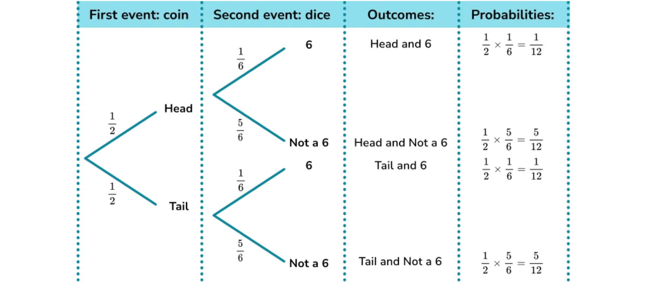
Python Examples: Card Problems
Practical Implementations for Card Probability
Example 1: Drawing Specific Cards
Sequential Card Drawing
Calculate probability of drawing an Ace from a standard deck:
When drawing cards in sequence (without replacement), we use tree diagrams to visualize outcomes and their probabilities. Each branch represents a possible draw, and probabilities change at each stage.
# Standard deck: 52 cards, 4 Aces total_cards = 52 aces = 4 prob_ace = aces / total_cards print(f"P(Ace) = {prob_ace:.4f}") # Output: P(Ace) = 0.0769
Example 2: Drawing Without Replacement
Probability of drawing 2 Aces in a row without replacement:
# First draw: P(Ace) = 4/52# Second draw: P(Ace|Ace) = 3/51 prob_first_ace = 4 / 52 prob_second_ace = 3 / 51 prob_two_aces = prob_first_ace * prob_second_ace print(f"P(2 Aces) = {prob_two_aces:.6f}") # Output: P(2 Aces) = 0.004525
Example 3: Simulating Card Draws
Monte Carlo simulation to estimate probability:
import random # Create deck suits = ['♠', '♥', '♦', '♣'] ranks = ['A','2','3','4','5','6','7','8','9','10','J','Q','K'] deck = [r+s for s in suits for r in ranks] # Simulate 10000 draws trials = 10000 hearts_count = 0for _ in range(trials): card = random.choice(deck) if'♥'in card: hearts_count += 1 prob_heart = hearts_count / trials print(f"P(Heart) ≈ {prob_heart:.3f}") # Output: P(Heart) ≈ 0.250
Key Insights for Card Problems
Without replacement:
Probabilities change as deck shrinks
With replacement:
Probabilities stay constant
Combinations:
Use math.comb(n, k)
Simulation:
Monte Carlo checks theory
Multiplication rule:
Multiply path probabilities
Notes:
Card problems are excellent for practicing probability because they clearly demonstrate the difference between dependent and independent events. The first example is straightforward: the probability of drawing an Ace is simply 4 out of 52. The second example is crucial because it involves drawing without replacement. When we calculate the probability of drawing two Aces in a row, the probability of the second draw changes because the deck now has 51 cards and only 3 Aces left. This is a dependent event, and we must use the general multiplication rule. The third example uses Monte Carlo simulation to estimate the probability of drawing a Heart. We create a full deck, simulate 10,000 draws, and count the Hearts. The result should be very close to the theoretical 13/52, or 0.25. The key insight here is that for card problems, you must always ask: is it with or without replacement? Without replacement means the events are dependent, and you must use conditional probability for the second draw. The image of the tree diagram reminds us that for sequential problems, we multiply probabilities along the branches to find the probability of a specific sequence of events. Now that we've seen the mechanics, let's review the most common pitfalls in probability.

Slide 37
Common Probability Mistakes
01
02
03
Confusing P(A|B) with P(B|A)
Ignoring Base Rates
Assuming Independence Incorrectly
Known as the prosecutor's fallacy. P(A|B) ≠ P(B|A) in general.
Ignoring the base rate (prior) skews conclusions, especially for rare events.
Treating dependent events as independent gives wrong results.
❌ WRONG: If 99% of criminals have tattoos, then 99% of tattooed people are criminals.
❌ WRONG: A 95% accurate test ⇒ 95% chance if positive.
❌ WRONG: Drawing 2 cards: P(2 Aces) = (4/52) × (4/52).
✓ CORRECT: Use Bayes' Theorem: P(A|B) = P(B|A) × P(A)/P(B).
✓ CORRECT: Include prior P(Disease). If disease is rare (e.g., 0.1%), many positives are false.
✓ CORRECT: After first draw: P(2 Aces) = (4/52) × (3/51). Use conditional probability.
04
05
06
Adding Non‑Mutually Exclusive Events
Gambler's Fallacy
Multiplying Without Checking Independence
Past outcomes don't change future odds in independent events.
Using simple addition can cause double counting when events overlap.
Using P(A ∩ B) = P(A) × P(B) when events are not independent.
❌ WRONG: After 5 heads, tails is "due".
❌ WRONG: P(King or Heart) = 4/52 + 13/52 = 17/52 (counts King of Hearts twice).
✓ CORRECT: Each flip is still 50–50; the coin has no memory.
❌ WRONG: P(Rain today AND tomorrow) = P(today) × P(tomorrow).
✓ CORRECT: General addition rule: P(A ∪ B) = P(A) + P(B) − P(A ∩ B); here 16/52.
✓ CORRECT: General multiplication rule: P(A ∩ B) = P(A) × P(B|A).
Notes:
Now that we've covered the core concepts, let's look at the common mistakes that trip up even experienced people. The first is confusing P(A|B) with P(B|A). This is the base rate fallacy in disguise, and it's a huge error in fields like medicine and law. Remember, the order matters. P(A|B) is rarely equal to P(B|A). The second mistake is ignoring base rates entirely. We saw this with the medical testing example: a rare disease remains rare, and the prior probability is essential for accurate conclusions. The third and fourth mistakes relate to the two fundamental rules: assuming independence when events are dependent, and adding probabilities when events overlap. If events are dependent, you must use conditional probability. If events are not mutually exclusive, you must subtract the intersection to avoid double-counting. Finally, the Gambler's Fallacy is a psychological trap. Independent events, like coin flips, have no memory. The probability of the next flip is always 50-50, regardless of what happened before. Avoiding these six pitfalls will dramatically improve your accuracy in solving probability problems. So, how do we make sure we avoid them? We use a systematic strategy.

Slide 38

Problem-Solving Strategy
A Systematic Approach to Probability Problems
Step-by-Step Process
Tips for Success
1
Read and Understand the Problem
Keywords:
"and" → multiply, "or" → add
Check independence:
Carefully read the problem. Identify what is asked. Mark key information and the question.
does one event affect the other?
2
Define the Sample Space and Events
Use complements:
P(A') = 1 − P(A)
List all outcomes (sample space S). Define events with set notation. Example: A = "even number".
Organize data:
tables or lists help
3
Identify the Problem Type
Common Pitfalls to Avoid
Is it marginal, joint, or conditional? Independent or dependent? Use addition or multiplication?
Confusing P(A|B) with P(B|A)
Assuming independence
incorrectly
4
Choose the Appropriate Formula/Rule
Adding probabilities
when you should multiply
Choose: Addition Rule, Multiplication Rule, Conditional Probability, Bayes' Theorem, or Total Probability.
Ignoring
"without replacement" effects
5
Calculate Step-by-Step
Final Verification Checklist
Show steps clearly. Break complex work. Label each probability. Use fractions or precise decimals.
✓ Is 0 ≤ P(event) ≤ 1?
✓ Did I answer the question asked?
6
Verify and Interpret
✓ Are my calculations correct?
Ensure the answer is between 0 and 1. Interpret in context: "The probability that... is..."
✓ Is the interpretation clear?
Notes:
To consistently solve probability problems correctly, you need a systematic approach. Don't jump straight to the formula. Start by reading the problem carefully and defining your sample space and events. This is Step 2, and it's the most critical step. If you define the sample space incorrectly, the rest of your calculation will be wrong. Next, identify the problem type. Are you looking for an "and" probability, an "or" probability, or a conditional probability? This determines which rule you need. Once you choose the appropriate formula, calculate step-by-step, labeling your probabilities clearly. This makes it easy to check your work. Finally, verify and interpret your answer. Does the result make sense in the context of the problem? The tips for success are practical reminders: "and" means multiply, "or" means add, and always check for independence. The common pitfalls listed here are the same ones we just discussed, serving as a final checklist before you commit to an answer. By following this six-step strategy, you can break down any complex probability problem into manageable pieces and significantly reduce your chance of error. Now, let's put this strategy into practice with some exercises.

Slide 39

Practice Problem 1
Comprehensive Problem: Card Drawing with Multiple Concepts
PROBLEM:
A standard deck of 52 cards contains 4 suits (Hearts, Diamonds, Clubs, Spades) with 13 cards each. You draw one card, note it, and return it to the deck (with replacement). Then you draw a second card.
(a) What is the probability that both cards are Hearts? (b) What is the probability that the first card is a King and the second card is a Heart? (c) What is the probability that you draw at least one Ace in the two draws?
Quick Solution
Key Insights
With replacement ⇒ independence. Use multiplication for "and" events and the complement for "at least one".
With replacement
makes events independent.
✓ FINAL ANSWERS:
Multiplication rule
applies for "and" events.
(a) P(Both Hearts) = (13/52)^2 = 1/16 = 0.0625 or 6.25% (b) P(King first, Heart second) = (4/52)×(13/52) = 1/52 ≈ 0.0192 or 1.92% (c) P(At least one Ace) = 1 − (48/52)^2 = 25/169 ≈ 0.1479 or 14.79%
Complement rule
handles "at least one" questions.
Notes:
Now that we've covered all the core concepts, let's put them to the test with a few practice problems. This first problem is a great comprehensive review because it requires you to use three different rules. We're drawing two cards with replacement, which is the critical phrase here. With replacement means the two draws are independent events. The first question asks for the probability that both cards are Hearts. Since the events are independent, we can use the simple multiplication rule: P(Heart) times P(Heart). That's 13 out of 52, or one-fourth, multiplied by itself, giving us 1/16. For part B, we're looking for a King first and a Heart second. Again, we multiply the individual probabilities: 4/52 times 13/52, which simplifies nicely to 1/52. Finally, part C asks for the probability of drawing at least one Ace. Remember our trick for "at least one" problems? We use the complement rule. The complement of "at least one Ace" is "no Aces." So we calculate 1 minus the probability of drawing no Aces on either draw. The probability of not drawing an Ace is 48/52. We multiply that by itself and subtract the result from one, giving us about 14.8%. This problem shows how independence simplifies the multiplication rule and how the complement rule makes "at least one" problems manageable. Let's move on to a problem that requires our most powerful tool: Bayes' theorem.

Slide 40

Practice Problem 3
Multi-Stage Problem: Law of Total Probability
PROBLEM
SOLUTION
A factory has three machines (M1, M2, M3) that produce electronic components. The machines produce different proportions of the total output and have different defect rates.
Step 1: Define Events
Let D = "component is defective" Let M1, M2, M3 = "component from Machine 1, 2, or 3"
A quality inspector randomly selects one component from the day's production. What is the probability that the selected component is defective?
Step 2: Identify Given Probabilities
Prior probabilities (machine selection): P(M1) = 0.30, P(M2) = 0.45, P(M3) = 0.25
Conditional probabilities (defect rates): P(D|M1) = 0.02, P(D|M2) = 0.03, P(D|M3) = 0.05
Given Information:
• Machine M1: produces 30% of output, 2% defect rate • Machine M2: produces 45% of output, 3% defect rate • Machine M3: produces 25% of output, 5% defect rate
Step 3: Apply Law of Total Probability
Since the machines partition the sample space (mutually exclusive and exhaustive), we use:
Tree Diagram Concept
P(D) = P(D|M1)·P(M1) + P(D|M2)·P(M2) + P(D|M3)·P(M3)
This problem uses a two-stage process: first selecting which machine produced the component, then determining if it's defective. Tree diagrams visualize such sequential events.
Step 4: Calculate
P(D) = (0.02)(0.30) + (0.03)(0.45) + (0.05)(0.25) = 0.006 + 0.0135 + 0.0125 = 0.032
✓ FINAL ANSWER
The probability that a randomly selected component is defective is P(D) = 0.032 or 3.2%.
Notes:
This problem involves a factory with three machines, each contributing a different proportion of the total output and having a different defect rate. We want to find the overall probability that a randomly selected component is defective. This is a perfect application of the Law of Total Probability because the three machines form a partition of the sample space. Every component must come from exactly one of the three machines. We use the formula: P(Defective) equals the sum of P(Defective given Machine) times P(Machine). We multiply the defect rate of each machine by its production proportion. For M1, that's 2% times 30%, which is 0.006. For M2, it's 3% times 45%, which is 0.0135. And for M3, it's 5% times 25%, which is 0.0125. Summing these three weighted probabilities gives us the final answer of 0.032, or 3.2%. This is essentially a weighted average of the defect rates, weighted by the output proportion of each machine. The Law of Total Probability allows us to combine conditional probabilities into a single marginal probability. Now that we've completed the practice problems, let's look at some resources for continuing your learning journey.

Slide 41
Additional Resources
Recommended Materials for Continued Learning
📚 Recommended Books
🐍 Python Libraries
Think Stats (Allen B. Downey)
NumPy
EDA with Python. Free: greenteapress.com/thinkstats
Numerical computing and random generation.
Introduction to Probability (Blitzstein & Hwang)
SciPy (scipy.stats)
Comprehensive textbook; companion to Harvard Stat 110.
Distributions and statistical functions.
Probability and Statistics for Engineers
Matplotlib & Seaborn
Practical with real-world engineering examples.
Plot probability distributions and results.
🌐 Online Courses & Tutorials
Pandas
Data manipulation; probability tables.
Khan Academy: Probability & Statistics
Free lessons with practice and videos.
📺 Video Resources
MIT OpenCourseWare: Probability
3Blue1Brown
Lecture notes and problem sets from MIT.
Visual explanations; Bayes' theorem.
Coursera: Introduction to Probability
StatQuest with Josh Starmer
University courses; certificates available.
Clear, entertaining stats/probability.
Khan Academy YouTube
Step-by-step series on probability.
Notes:
Learning probability is a marathon, not a sprint, and continued practice is key to mastery. We've compiled a list of excellent resources to help you continue your journey. For books, I highly recommend Think Stats by Allen B. Downey. It's free, it's practical, and it combines probability with Python programming, which is exactly the approach we've taken here. For a more rigorous mathematical treatment, the Blitzstein and Hwang textbook is a classic. If you prefer video lessons, Khan Academy and MIT OpenCourseWare offer fantastic, structured courses. Finally, remember that Python is your best friend for probability. The NumPy and SciPy libraries are essential for numerical calculations and statistical functions, and Matplotlib and Pandas help you visualize and manage your data. Don't just read about probability; use these tools to simulate experiments and verify your theoretical results. Next, we'll wrap up with a final summary and some next steps.

