Slide 1
Realization of Quantum Inspired Neural Network for Signature Verification Under the Supervision of: Dr. Ashish Patel
Submitted by:
Ameya Dhamnaskar
2014A3PS0187P
Arjun Gupta 2014B4A30754P
Sonali R. Medani
2014B2A30563P

Slide 2
Contents
Artificial Neural Network
Introduction to Quantum Neural Network
Implementation:
Pre-Processing
Feature Extraction
Architectural Algorithm
Conclusion

Slide 3
Artificial neural network
• Collection of connected nodes called artificial neurons.
• Neurons can transmit a signal from one to another.
• The artificial neuron that receives the signal can process it and then signal artificial neurons connected to it.
• The output of each artificial neuron is calculated by a non-linear function of the sum of its inputs.

Slide 4
• Artificial neurons have a weight that adjusts as learning proceeds.
• The weight increases or decreases the strength of the signal at a connection.
• Typically, artificial neurons are organized in layers. Different layers may perform different kinds of transformations on their inputs.
• Signals travel from the first (input), to the last (output) layer, possibly after traversing the layers multiple times.

Slide 5
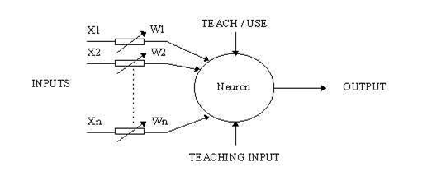
Neuron
The neuron has two modes of operation :
• Training mode
• Testing mode

Slide 6
Quantum Neural Network
Principles of quantum mechanics.
The performance of QNN depends on its:
Architecture
Hidden layers
The number of neurons in the hidden layer
Connection weights
Threshold values
The features of the input dataset.
Notes:
The connection weights of neurons in the neural network can be decided in several ways such as by random initialization, genetic algorithm, and quantum computing.

Slide 7
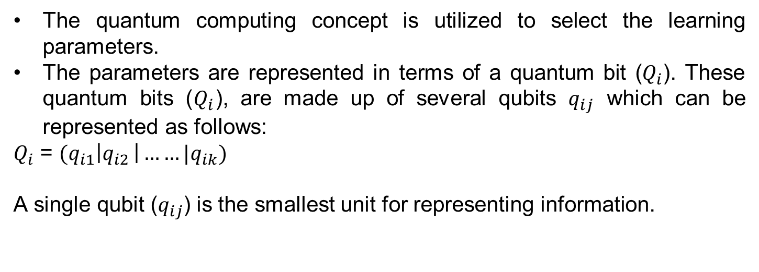
Quantum Computing
The quantum computing concept is utilized to select the learning parameters.
The parameters are represented in terms of a quantum bit ($Q_{i}$). These quantum bits ($Q_{i}$), are made up of several qubits $q_{ij}$ which can be represented as follows:
$Q_{i}$ = $(q_{i1}\left|q_{i2 }\right|……|q_{ik})$
A single qubit ($q_{ij}$) is the smallest unit for representing information.

Slide 8


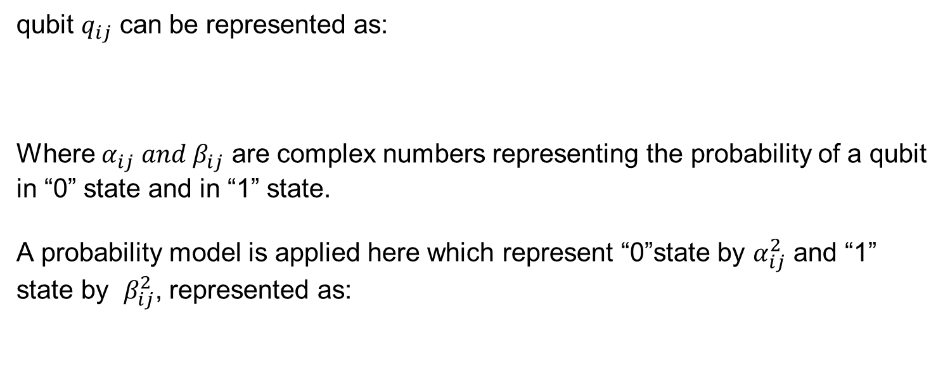
qubit $q_{ij}$ can be represented as:
Where $α_{ij} and β_{ij}$ are complex numbers representing the probability of a qubit in “0” state and in “1” state.
A probability model is applied here which represent “0”state by $α_{ij}^{2}$ and “1” state by $β_{ij}^{2}$, represented as:

Slide 9

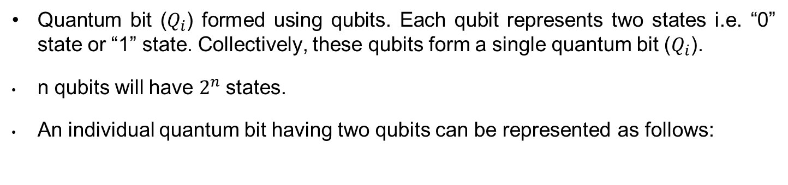
Quantum bit ($Q_{i}$) formed using qubits. Each qubit represents two states i.e. “0” state or “1” state. Collectively, these qubits form a single quantum bit ($Q_{i}$).
n qubits will have $2^{n}$states.
An individual quantum bit having two qubits can be represented as follows:

Slide 10
Preprocessing
Converting to black and white
Noise Removal
Image Resizing
Image Thinning
Image cropping

Slide 11
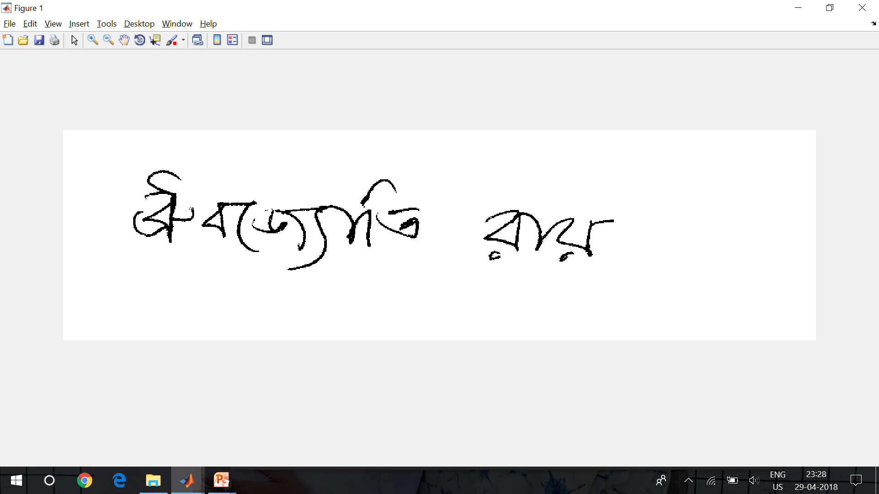
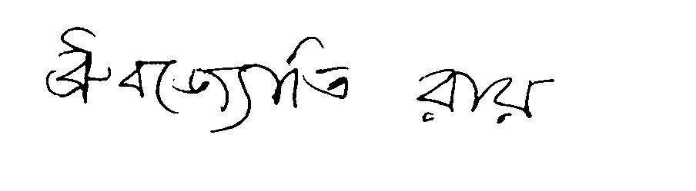
Noise Removal

Slide 12
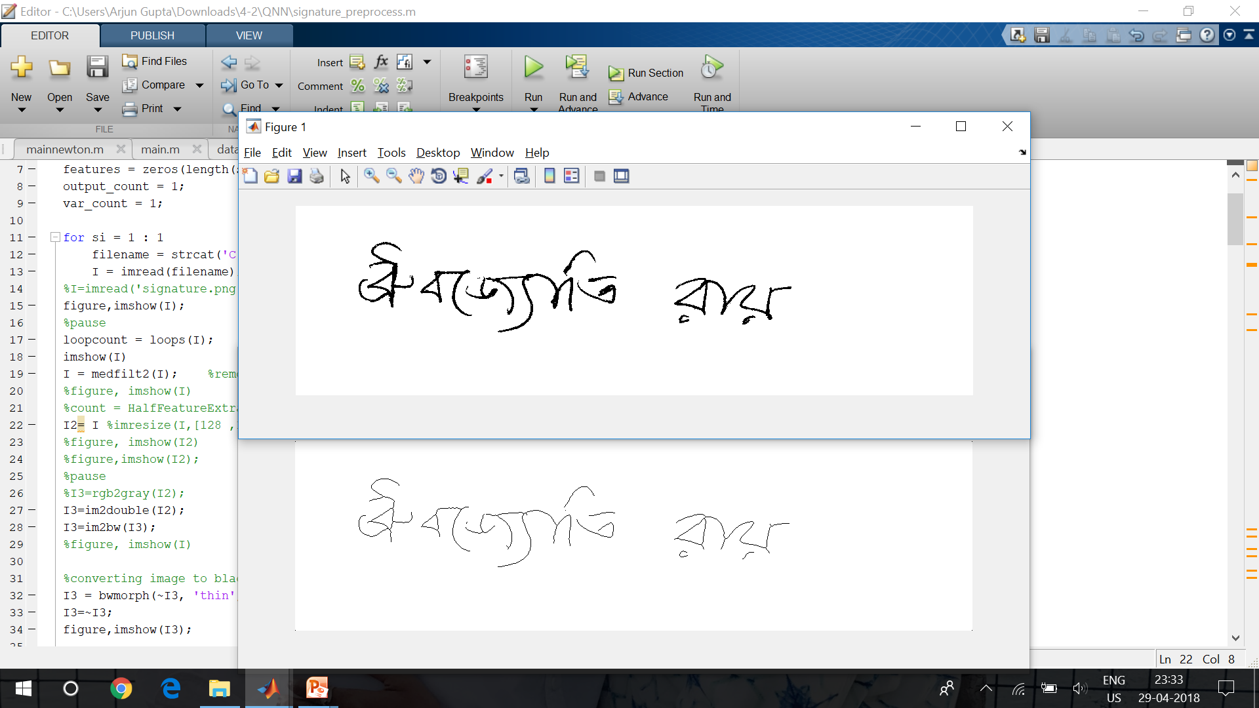
Image Thinning

Slide 13
Feature Extraction
Angle of the signature
Centre of mass coordinates
No. of loops
Most dense columns and rows
Density of 5 most dense patches

Slide 14
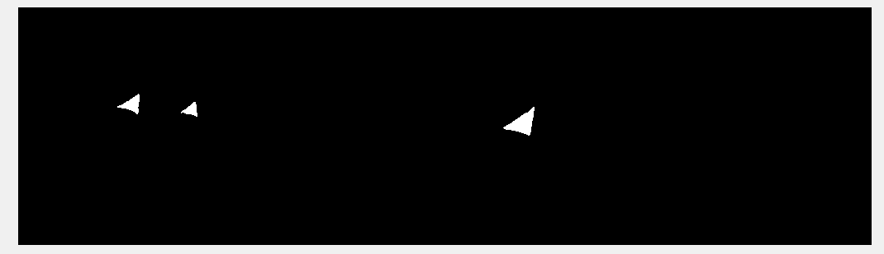
No. of Loops

Slide 15
Architectural Algorithm

Slide 16
Subneural: Virtual Two Class Network
The dataset is divided into two virtual classes.
Class A- dataset of signatures of person under consideration.
Class B- Sum of datasets of remaining person’s signature.

Slide 17
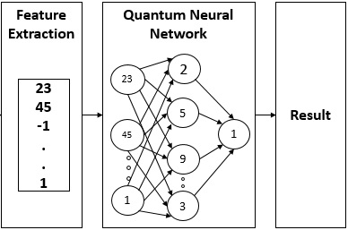
Architecture
A subneural network:

Slide 18
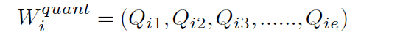

Deciding Connection Weights
Class A (Person to be classified) have c1 number of signatures,
Each signature is characterised by 45 features, then connection weights in terms of Quantum bits:
Converted in real values:

Slide 19

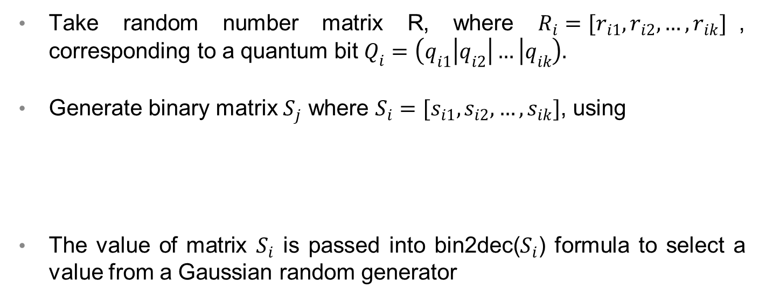
Convert Quantum to real Values
Take random number matrix R, where $R_{i}=[r_{i1}, r_{i2}, …, r_{ik}]$, corresponding to a quantum bit $Q_{i}=\left(q_{i1}\left|q_{i2}\right|… | q_{ik}\right).$
Generate binary matrix $S_{j}$ where $S_{i}=[s_{i1}, s_{i2}, …, s_{ik}]$, using
The value of matrix $S_{i}$ is passed into bin2dec($S_{i}$) formula to select a value from a Gaussian random generator

Slide 20
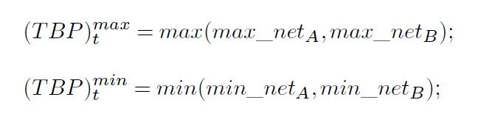
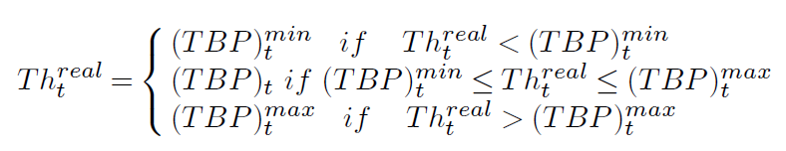
Boundary parameter and Threshold calculation

Slide 21
Weight Updation
With the same weight, the quantum threshold is updated to get a more accurate value of the quantum threshold (100 iterations)
In order to get a more appropriate value of weights, the quantum weights are updated using quantum update function (100 iterations).

Slide 22
Neuron Updation
If (F* < Total signatures):
Unlearnt sample remains, then new neuron is dynamically added, and the same process of learning is repeated.

Slide 23
Training for all classes
Once, learning of class A and class B data is done, the dataset of class A and B is modified.
The same training process is implemented with these new classes.

Slide 24
Conclusion
QNN for 37 persons, each having 8 signatures with 45 attributes, is implemented successfully using the proposed algorithm
Observations:
More number of features and better features results in increased accuracy.
As number of iterations for updation increases, accuracy increases.

Slide 25
Thank You.

