Slide 1

Sonia Gaied Fantar Habib Youssef
Jul 2009
Information Infrastructure Symposium,
（GIIS '09）

Slide 2

1' Video streaming forwarding in a smart city’s VANET
2018 IEEE 11th Conference on Service-Oriented Computing and Applications (SOCA)
2' Predictive Handoff Mechanism for Video Streaming in a Cloud-Based Urban Vanet
2017 IEEE/ACS 14th International Conference on Computer Systems and Applications (AICCSA)
3' Peer-to-Peer Full-Text Keyword Search of the Web
2015 International Conference on Networked Systems
4' Applying Information Retrieval to Distributed Hash Table (DHT) Systems
2011 11th Annual International Conference on
5' Exploiting locality using geographic coordinates and semantic proximity in Chord
2010 15th IEEE Symposium on Computers and Communications, ISCC
Sonia Gaied Fantar
Research Unit Prince
ISITC Hammam Sousse
University of Sousse
Tunisia
Assistante

Slide 3
218 Research items
Focus on：
Internet of things applications
Wireless mobile sensor networks
Mobility Management
……
Habib Youssef
Research Unit Prince
ISITC Hammam Sousse
University of Sousse
Tunisia
Professor (Full)

Slide 4




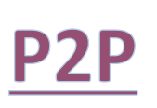




Slide 5

Wireless devices
→
Mobility Management
→
Client/Server paradigms (Traditional)
→
Shortcomings (single point of failure, congestion, bottlenecks)

Slide 6

File sharing applications
→
P2P
→
Locality-awareness
→
None of the popular P2P applications (such as Chord, CAN,
Tapestry, and Pastry) takes physical network topology into
consideration.
→
DHT-based P2P

Slide 7

DHT-based Chord
1 construct an overlay network over the physical network
2 where neighborhood relations are determined randomly
3 using a hashing scheme
→
a mismatch between the P2P overlay and the physical network
→
high latencies and communication overheads

Slide 8

m-Chord
MA-Chord
Ekta
two identifiers
for each mobile node (MN)
DHT-based
Based on Pastry
Random Landmarking
uses DSR route discovery phase
a permanent identifier:
do not depend on the location
a temporary identifier:
hashing IP address
fixed land mark keys
……
Clustering methods

Slide 9

GNP-based Chord
1 construct an overlay network over the physical network
2 where neighborhood relations are determined using Global Network Positionning (GNP) system
→
propose a topology-based nodeId assignment to solve the topology mismatch for Chord.
→
Comparison of simulation experiments
(GNP-based Chord vs DHT-based Chord)

Slide 10
MANETChordGNP
a Chord architecture designed for the use in MANETs

Slide 11

Physical locality
AODV routing protocol
Consideration
The functionality of a DHT(Chord)

Slide 12
Network coordinate systems
maps high-dimensional network measurements into a location in a geometric Euclidean space by associating eachnode with a virtual coordinate in that space.
General Network Positioning (GNP)
picks particular nodes to act as landmarks which serve as points of reference for other nodes that wish to embed themselves into the coordinate space.

Slide 13
utilizes the concept of coordinates based approaches to predict internet network distances
The first part
Landmarks（compute their own coordinates）→ reference →
be disseminated to any ordinary host（relative locations）→
update（input the old coordinates instead of random numbers）
The second part
（any end host）compute its own coordinates relative to those of the Landmarks

Slide 14
Node joining and leaving
In Chord,
A node's identifier is chosen by hashing the node's IP address.
In MANETChordGNP,
Each node in a MANETChordGNP networkassigns itself a temporary unique id (as a function of its geometric coordinates in the Internet), which defines its provisional logical position on the virtual overlay ring.

Slide 15

Two different routing tables:
AODV Routing Table:
It includes for specific physical destinations the next (physical) hop address as well as, for each such route a sequence number.
Chord Routing Table:
A routing table with 160 entries, called the finger table.
The node s is called the ith finger of node n, and denoted by n.finger[i] .node.
The first finger of n is its immediate successor on the circle.

Slide 16

Coordinates → Network distances
(are predicted by evaluating a distance function over peers' coordinates)
The process takes five steps:
1) The new Node n must find a Node n0 already in the MANETChordGNP.
2) Using the Chord routing mechanisms, Node n0 uses its finger table to find the successor of n.
3) n sets its successor to the value returned by n0.
4) Each node checking that its successors and predecessors have not changed.
5) Each node in the system is also responsible for maintaining its finger table.
It is important that the successor pointers are always up to date!

Slide 17

MANETChordGNP routes packets based on an overlay id.
→
The final (physical) target node is usually unknown.
→
Consulting its Chord routing table to determine the closest prefix match.
→
Consulting its AODV routing table for the physical route to execute this overlay hop.

Slide 18
MANETChordGNP integrates overlay and physical routing.
When a node receives a packet, it can principally be due to the following two situations:
1) The node could be the target.
2) The node could be an intermediate node on the physicalpath of an overlay hop that is being carried out.

Slide 19

In extreme cases ,
node movement can however cause loss of connectivity.
To the overlay layer this will appear like some nodes have left the
network or the network has split.
→
Recoverable Errors
→
the Chord protocol can handle on its own.

Slide 20
EXPERIMENTS

Slide 21

① Tool ：OverSim
The OverSim instances communicate with each other over the
802.11 interfaces to build a logical Chord ring.
the finger table is updated every 5s and stabilize runs every 10 s.
PING messages (used for GNP) are sent every 10 s.
The nodes move at a speed of 9 m/s.
② Comparisons ：
Chord vs MANETChordGNP

Slide 22

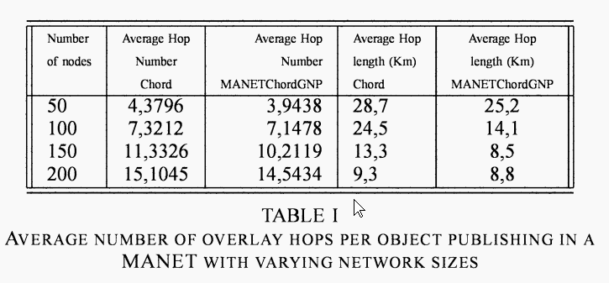
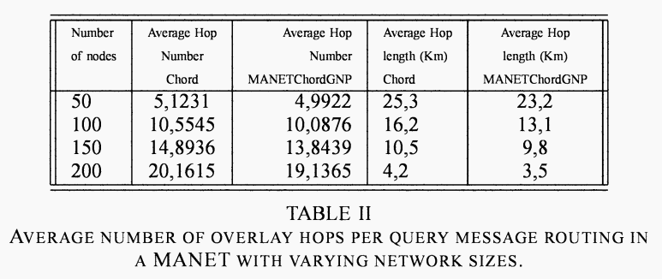

Slide 23

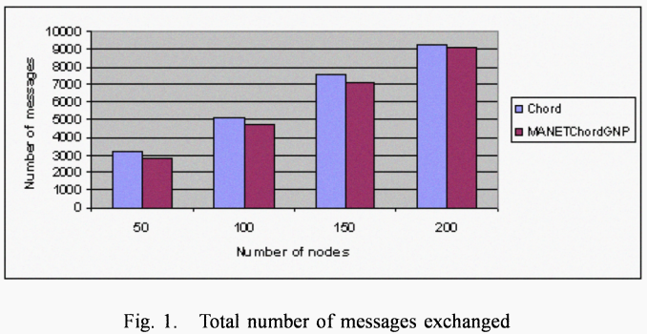
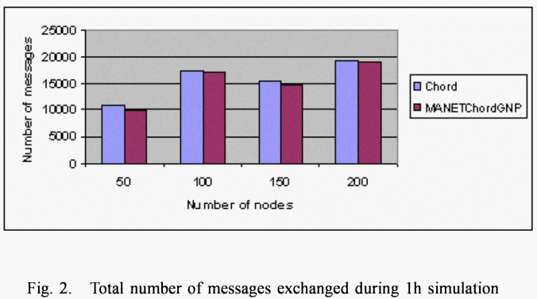

Slide 24

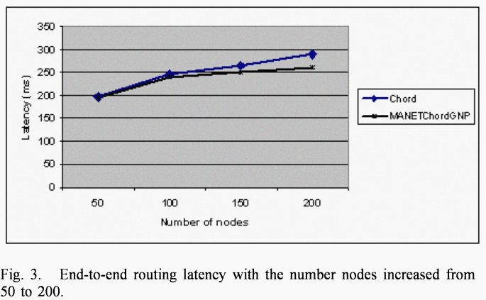

Slide 25

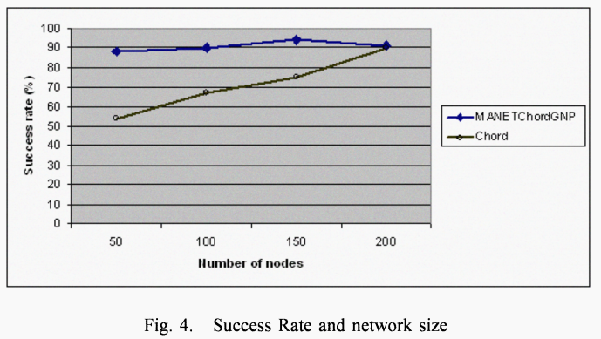

Slide 26


Similarities to my graduation design

Slide 27

希望大家批评指正
By JIE

Slide 28

移动自组织网络(Mobile Ad hoc Network，MANET)
是一种移动通信和计算机网络相结合的网络，是移动计算机网络的一种，用户终端可以在网内随意移动而保持通信。
移动自组织网络能够利用移动终端的路由转发功能，在无基础设施的情况下进行通信，从而弥补了无网络通信基础设施可使用的缺陷：
1）网络拓扑结构动态变化
2）自组织无中心网络
3）多跳网络
4）无线传输带宽有限
5）移动终端的局限性

Slide 29

无线自组网按需平面距离向量路由协议（Ad hoc On-Demand Distance Vector Routing，AODV）
是应用于无线自组织网络中进行路由选择的路由协议，它能够实现单播和多播路由。该协议是Ad Hoc网络中按需生成路由方式的典型协议。
反应式路由协议，也就是说当向目的节点发送包时，源节点才在网络中发起路由查找过程，找到相应的路由。
在AODV中，整个网络都是静止的除非有连接建立的需求。

Slide 30

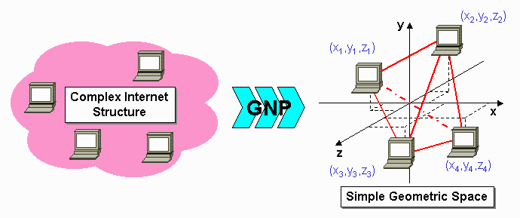
全球网络定位(Global Network Positioning)

Slide 31

DHT全称叫分布式哈希表(Distributed Hash Table)，
是一种分布式存储方法。
在不需要服务器的情况下，每个客户端负责一个小范围的路由，并负责存储一小部分数据，从而实现整个DHT网络的寻址和存储。
是结构化对等网络的关键技术。

Slide 32

P2P可以理解为对等计算或对等网络。
其可以定义为：网络的参与者共享他们所拥有的一部分硬件资源（处理能力、存储能力、网络连接能力、打印机等），这些共享资源通过网络提供服务和内容，能被其它对等节点（Peer）直接访问而无需经过中间实体。
在此网络中的参与者既是资源、服务和内容的提供者（Server），又是资源、服务和内容的获取者（Client）
非中心化 可扩展性 健壮性 高性价比 隐私保护 负载均衡

Slide 33

Chord在2001年由麻省理工学院提出，是主流DHT协议之一，其核心思想就是要解决在P2P应用中遇到的基本问题：如何在P2P网络中找到存有特定数据的节点。
Chord使用相容哈希作为哈希算法。在相容哈希协议中并没有定义具体的算法，在Chord协议中将其规定为SHA-1。
Chord在一致性哈希的基础上提供了优化的路由算法，每个节点维护少量的路由信息，通过这些路由信息，可以提高查询的效率。
在Chord中，每个节点同样需要存储m个其他节点的信息，这些信息的集合被称为查询表(Finger Table)，在查询的过程中，查询节点将请求发送到与键值最接近的节点上。
经过Chord的优化后，查询需要的跳数由O(N)减少到O(log(N))。

Slide 34

覆盖网络(overlay network )
是应用层网络，它是面向应用层的，不考虑或很少考虑网络层，物理层的问题。
覆盖网络允许对没有IP地址标识的目的主机路由信息：DHT可以路由信息到一个存储特定文件的结点，而这个结点的IP地址事先并不知道。
简单的说，Overlay是在传统物理网络上虚拟出的一个虚拟网络，可以看做是逻辑网络。

