Slide 1
Structured Query Language
Nook
Mycos Technologies

Slide 2
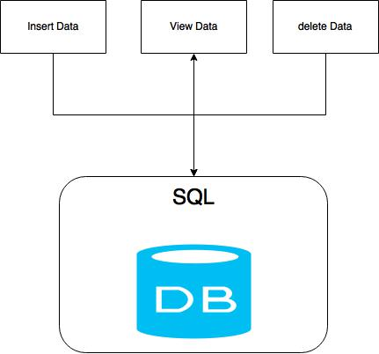
Intro
access and manipulate database
Notes:
NOTE: To change images on this slide, select a picture and delete it. Then click the Insert Picture icon
in the placeholder to insert your own image.

Slide 3
Type of SQL
Defining database schemas
Create Database
Create Table
Modify Table (Alter)
Delete Database or Table (drop)
Modify stored data but not the schema or database object.
SELECT DATA
INSERT UPDATE DELETE
DDL
Data Definition Language
DML
Data Manipulation Language
Notes:
NOTE: To change images on this slide, select a picture and delete it. Then click the Insert Picture icon
in the placeholder to insert your own image.

Slide 4
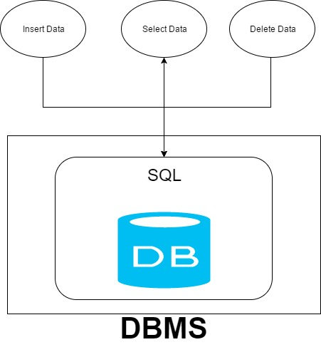


DBMS (database management system)
Microsoft SQL server Management Studio
Notes:
NOTE: To change images on this slide, select a picture and delete it. Then click the Insert Picture icon
in the placeholder to insert your own image.

Slide 5
SELECT (SQL Server)
SELECT [field, attribute]
FROM [table name]
JOIN [relation other table]
WHERE [condition]
AND, OR [more conditions]
GROUP BY [group data]
HAVING [condition for group]
ORDER BY [sort by ascending or descending]

Slide 6
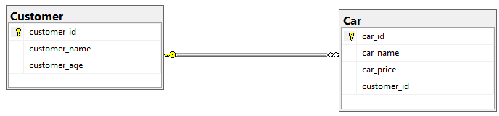
trainee database
1
N
From https://northwinddatabase.codeplex.com/

Slide 7
INSERT (SQL Server)
INSERT INTO [dbo].[Customer]
([customer_name]
,[customer_age])
VALUES
('Nook'
,22)
GO
INSERT Multi
INSERT INTO [dbo].[Customer]
([customer_name]
,[customer_age])
VALUES
('Nook', 22),
('Nick', 21),
('Nut', 20)
GO

Slide 8
UPDATE
UPDATE [dbo].[Customer]
SET customer_name = 'Kaka'
WHERE customer_name = 'Nook'
DELETE
DELETE FROM [dbo].[Customer]
WHERE customer_name = 'Kaka'

Slide 9
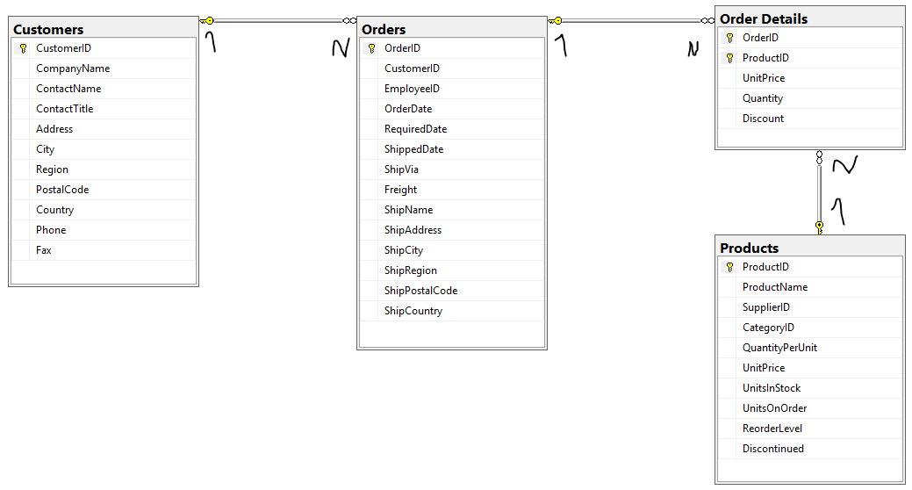
Northwind database
From https://northwinddatabase.codeplex.com/

Slide 10
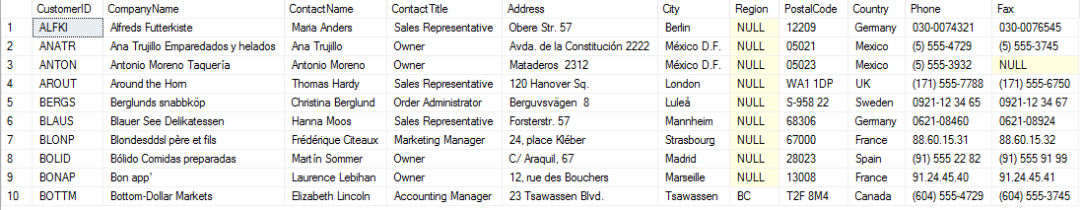
Select Example
SELECT TOP 10 *
FROM Customers

Slide 11
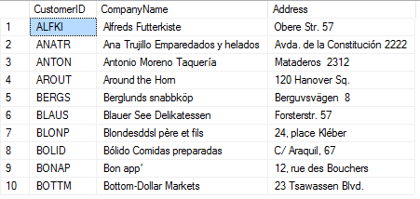
Example
SELECT TOP 10 CustomerID, CompanyName, Address
FROM Customers

Slide 12
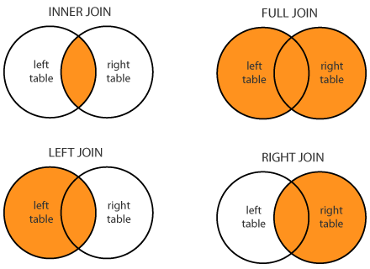
JOIN IN SQL Server
http://www.dofactory.com/Images/sql-joins.png

Slide 13
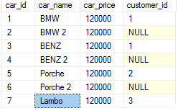
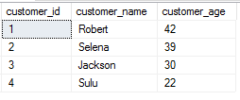
Data Example
Use trainee Database
Car Table
Customer Table
1
N

Slide 14
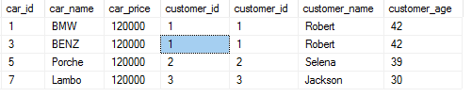
INNER JOIN (JOIN)
Car Table
Customer Table
1
N
SELECT * FROM Car
INNER JOIN Customer ON Car.customer_id = Customer.customer_id

Slide 15
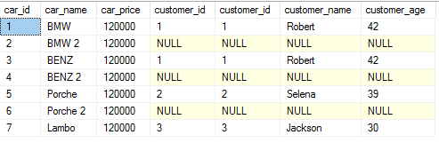
LEFT JOIN
Car Table
Customer Table
1
N
SELECT * FROM Car
LEFT JOIN Customer ON Car.customer_id = Customer.customer_id

Slide 16
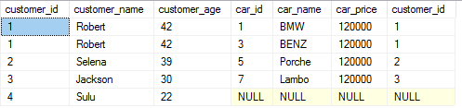
LEFT JOIN (Con.)
Car Table
Customer Table
1
N
SELECT * FROM Customer
LEFT JOIN Car ON Car.customer_id = Customer.customer_id

Slide 17
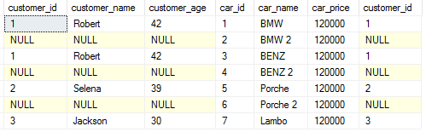
RIGHT JOIN
Car Table
Customer Table
1
N
SELECT * FROM Customer
RIGHT JOIN Car ON Car.customer_id = Customer.customer_id

Slide 18
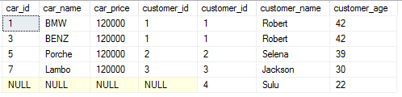
RIGHT JOIN (Con.)
Car Table
Customer Table
1
N
SELECT * FROM Car
RIGHT JOIN Customer ON Car.customer_id = Customer.customer_id

Slide 19
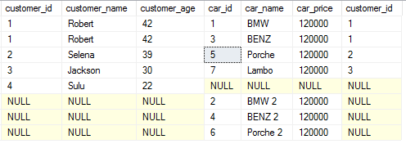
FULL OUTER JOIN
Car Table
Customer Table
1
N
SELECT * FROM Customer
FULL OUTER JOIN Car ON Car.customer_id = Customer.customer_id

Slide 20
WHEN NO JOIN ?
SELECT * FROM Customer, Car
Car Table
Customer Table

Slide 21
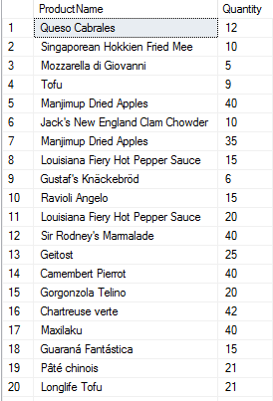

Aggregation
SELECT SUM([Order Details].Quantity) AS SumQuan
FROM Products
JOIN [Order Details]
ON [Order Details].ProductID = Products.ProductID
SELECT Products.ProductName, [Order Details].Quantity
FROM Products
JOIN [Order Details] ON [Order Details].ProductID = Products.ProductID
=
SUM

Slide 22
Aggregate Function
COUNT, MAX, MIN, SUM, AVG
GROUP BY
Use to group data, which group the data set by one or more columns.

Slide 23
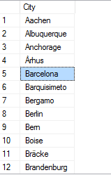
GROUP BY
SELECT City
FROM Customers
GROUP BY City
SELECT DISTINCT(City)
FROM Customers

Slide 24
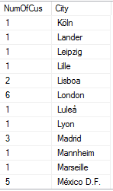
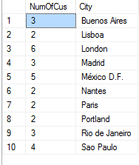
GROUP BY + Aggregate
GROUP BY + Aggregate + Conditions
SELECT COUNT(CustomerID) As NumOfCus, City
FROM Customers
GROUP BY City
SELECT COUNT(CustomerID) As NumOfCus, City
FROM Customers
GROUP BY City
HAVING COUNT(CustomerID) > 1

Slide 25
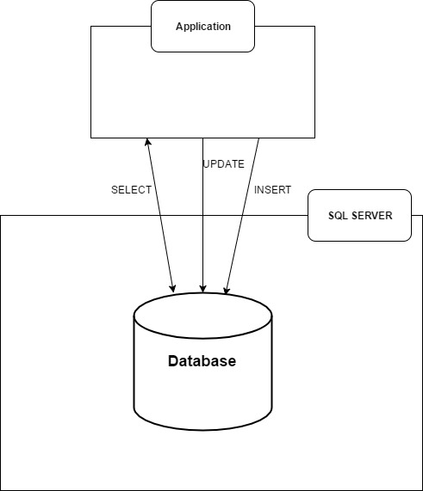
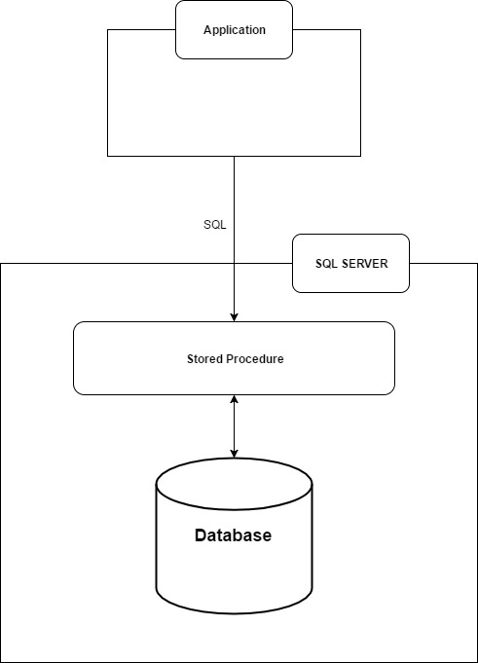
Stored Procedure
➔
➔

Slide 26
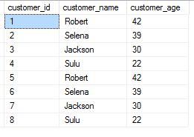
Stored Procedure (Example.)
CREATE PROCEDURE sp_getCustomer_all
AS
BEGIN
  SELECT *
  FROM Customer
END
Business Logic
IF ELSE
LOOP
EXEC sp_getCustomer_all

Slide 27
Stored Procedure (Example.)
CREATE PROCEDURE sp_manage_Customer
@customer_name AS NVARCHAR(50) = null
, @customer_age AS INT = null
, @manage_type AS TINYINT
-- manage_type 0 = INSERT, 1 = DELETE
AS
BEGIN
  IF (@manage_type = 0)
    BEGIN
    INSERT INTO [dbo].[Customer]
    ([customer_name]
    ,[customer_age])
    VALUES
    (@customer_name
    ,@customer_age)
    END
  ELSE IF (@manage_type = 1)
    BEGIN
    DELETE FROM [dbo].[Customer]
    WHERE [customer_name] = @customer_name
    END
END
GO
EXEC sp_manage_Customer 'Jacob', 24, 0
EXEC sp_manage_Customer 'Jacob', '', 1

Slide 28
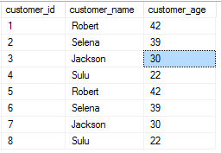
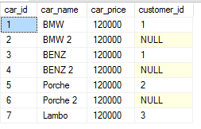
Stored Procedure (Example con.)
EXEC [dbo].[sp_getView] 0
CREATE PROCEDURE [dbo].[sp_getView]
@manage_type AS TINYINT
-- manage_type 0 = Customer, 1 = Car
AS
BEGIN
IF (@manage_type = 0)
BEGIN
SELECT * FROM Customer
END
ELSE IF (@manage_type = 1)
BEGIN
SELECT * FROM Car
END
END
EXEC [dbo].[sp_getView] 1

Slide 29
Assignment
Using trainee Database to query.
1.) Add new Customer data to Customer table. Insertion a Customer Name, Age with your self-information.
e.g. Nook, 22
2.) Delete cars data without owner.
** send with stored procedure file name “sp_manage_trainee.sql”

Slide 30
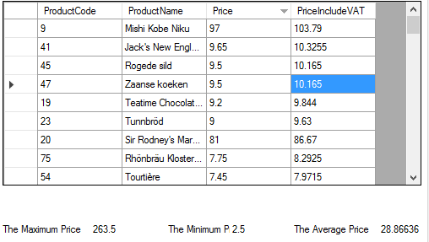
Assignment (con.)
Using NORTWIND Database to query.
In this assignment query from Product table.
1.) What SQL ?
What SQL ?
2) Max Price
3) Min Price
4) Average Price
** send with stored procedure file name “sp_select_product.sql”

Slide 31
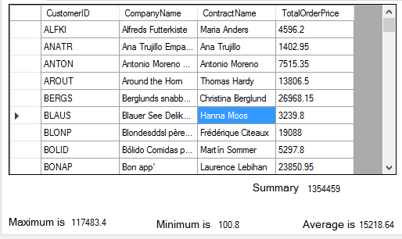
Advance Assignment
Using NORTWIND Database to query.
In this assignment query from Product table and relate table.
1.) What SQL ?
(TotalOrderPrice = Quantity * UnitPrice)
What SQL ?
2) Max TotalOrderPrice
3) Min TotalOrderPrice
4) Average TotalOrderPrice
5) Sum TotalOrderPrice
** send with stored procedure file name “sp_select_advance.sql”

Slide 32





Five pictures
Notes:
NOTE: To change images on this slide, select a picture and delete it. Then click the Insert Picture icon
in the placeholder to insert your own image.

