Slide 1
WEB API
Nook

Slide 2
Intro
Server side
- Database
- Http GET POST PUT DELETE
-
Client side
WEB, Mobile
- Ajax (XMLHttpRequest)
- CSS
- HTML

Slide 3
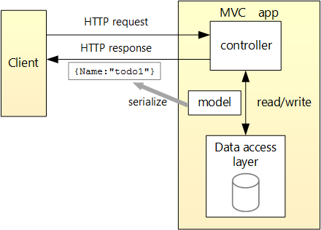
Intro (cont.)

Slide 4
Http method
GET
Redirect web
POST
Data is stored in request body package
PUT
The difference between POST and PUT is that PUT requests are idempotent
DELETE
The DELETE method deletes the specified resource.
GET /api/todo/{id}
have length restrictions
no restrictions on data length
POST /api/todo
calling a POST request repeatedly have side effects of creating the same resource multiple times
PUT /api/todo/{id}
DELETE /api/todo/{id}

Slide 5
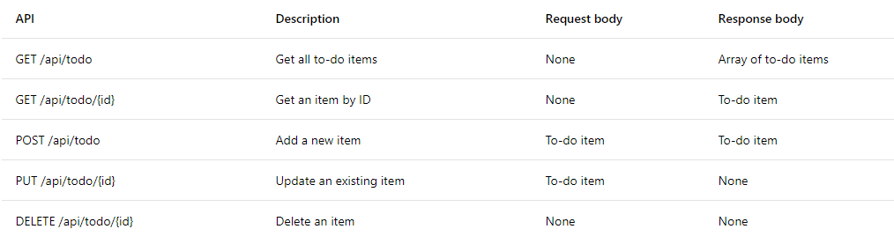
Http method (cont.)
request
WEB API
response

Slide 6
Http status response
200 is Ok, success and return data
204 success, is Ok but no data for return
400 Bad Request, package error server cannot receipt
401 Unauthorized, no authorize
403 Forbidden, authorize but no permission
404 Not Found, request with wrong URL
500 Internal Server Error, server error

Slide 7
END
https://docs.microsoft.com/en-us/aspnet/core/tutorials/first-web-api?view=aspnetcore-2.1#add-a-repository-class

