Slide 1
NON-IMMIGRATION CASES
YS, yield strategy – high growth yield at the cost of low growth rate
RS, rate strategy – high growth rate at the cost of low growth yield.
Use LHS to design an experiment for various parameter combinations
 | YS | RS
Umax | 1 | 2
Ys | 1 | 0.5
Ks | 1 | 2

Slide 2
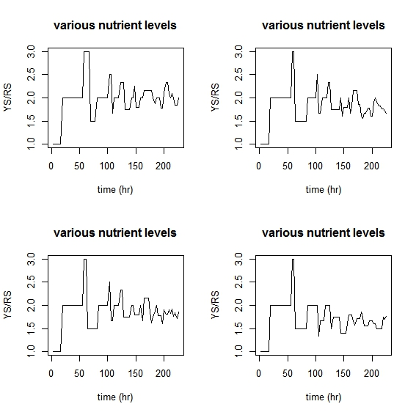

Slide 3
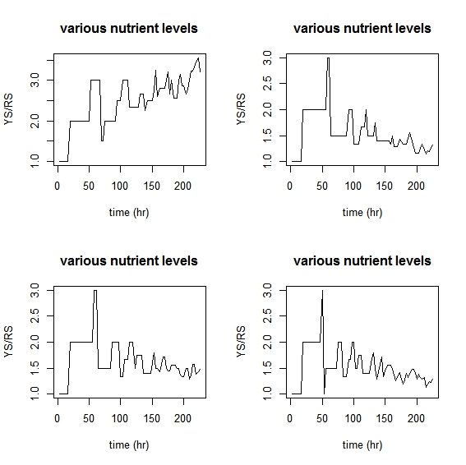

Slide 4
"Ks" "muAOB" "muNOB" "YAOB" "YNOB"
0.004537047 8.940191e-06 1.691726e-05 0.3342081 1.901506e-09
0.004597487 8.658336e-06 1.661435e-05 0.3381469 2.242592e-09
0.005016012 8.894099e-06 1.607562e-05 0.3444349 2.101491e-09
0.004448884 8.436421e-06 1.767823e-05 0.3463136 2.111887e-09
0.004473969 9.168767e-06 1.628882e-05 0.3750678 1.982032e-09
0.004709407 8.326612e-06 1.788353e-05 0.3941435 1.921420e-09
0.005327553 8.595797e-06 1.775388e-05 0.2988956 1.791347e-09
0.005520501 9.798590e-06 2.001919e-05 0.3234727 2.068810e-09

Slide 5
summary(mod1)
Data: X dimension: 4860 5
Y dimension: 4860 2
Fit method: kernelpls
Number of components considered: 4
VALIDATION: RMSEP
Cross-validated using 4860 leave-one-out segments.
Response: YS
(Intercept) 1 comps 2 comps 3 comps 4 comps
CV 8.622 8.622 8.618 8.378 8.35
adjCV 8.622 8.622 8.618 8.378 8.35
Response: RS
(Intercept) 1 comps 2 comps 3 comps 4 comps
CV 4.578 4.579 4.554 4.555 4.468
adjCV 4.578 4.579 4.554 4.555 4.468
TRAINING: % variance explained
1 comps 2 comps 3 comps 4 comps
X 99.97955 100.0000 100.000 100.000
YS 0.04069 0.1814 6.106 6.380
RS 0.02543 1.1384 1.203 4.938

Slide 6
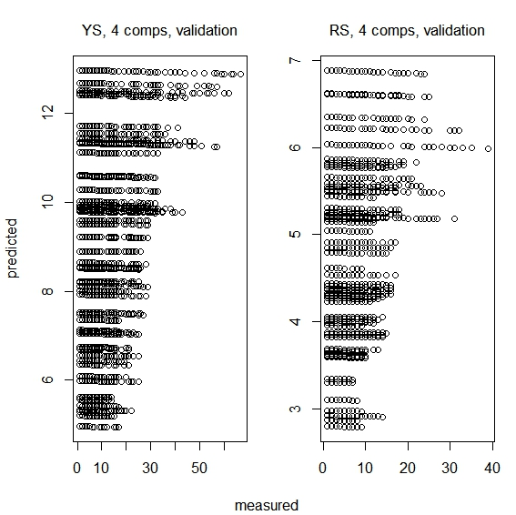

Slide 7
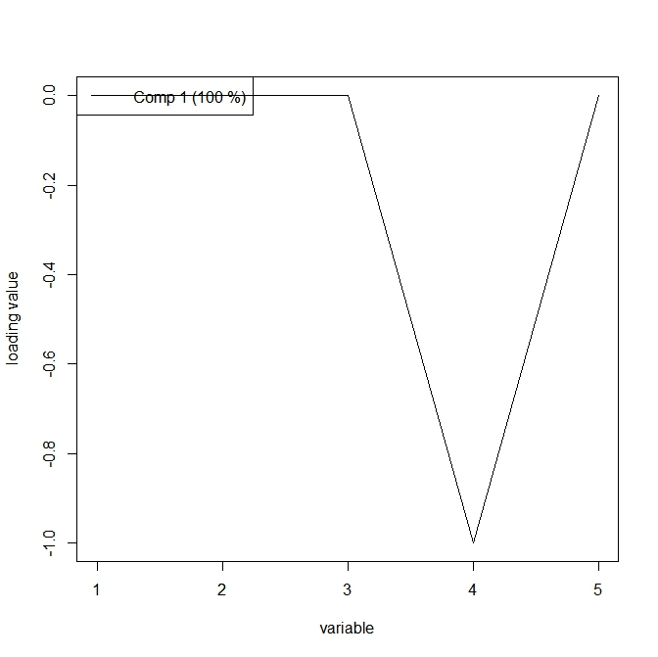

Slide 8
