Slide 1
NON-IMMIGRATION CASES
YS, yield strategy – high growth yield at the cost of low growth rate
RS, rate strategy – high growth rate at the cost of low growth yield.
Use LHS to design an experiment for various parameter combinations
 | YS | RS
Umax | 1 | 2
Ys | 1 | 0.5
Ks | 1 | 2

Slide 2
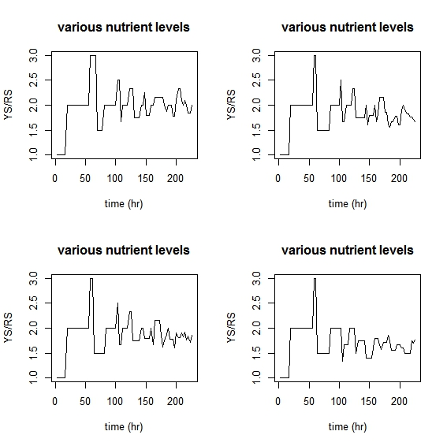

Slide 3
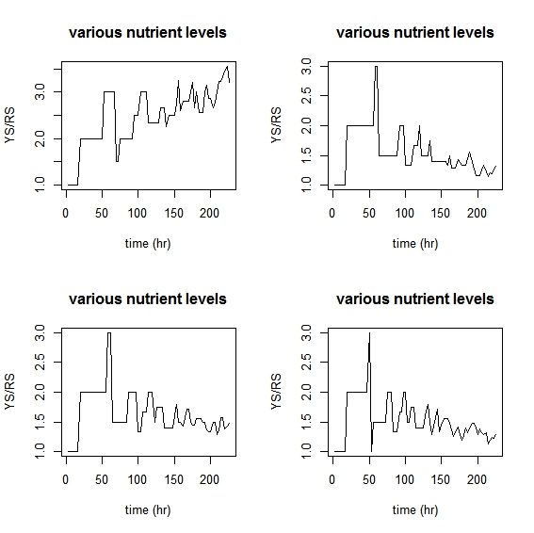

Slide 4
"Ks" "muAOB" "muNOB" "YAOB" "YNOB"
0.004537047 8.940191e-06 1.691726e-05 0.3342081 1.901506e-09
0.004597487 8.658336e-06 1.661435e-05 0.3381469 2.242592e-09
0.005016012 8.894099e-06 1.607562e-05 0.3444349 2.101491e-09
0.004448884 8.436421e-06 1.767823e-05 0.3463136 2.111887e-09
0.004473969 9.168767e-06 1.628882e-05 0.3750678 1.982032e-09
0.004709407 8.326612e-06 1.788353e-05 0.3941435 1.921420e-09
0.005327553 8.595797e-06 1.775388e-05 0.2988956 1.791347e-09
0.005520501 9.798590e-06 2.001919e-05 0.3234727 2.068810e-09

Slide 5
summary(mod1)
Data: X dimension: 4860 5
Y dimension: 4860 2
Fit method: kernelpls
Number of components considered: 4
VALIDATION: RMSEP
Cross-validated using 4860 leave-one-out segments.
Response: YS
(Intercept) 1 comps 2 comps 3 comps 4 comps
CV 8.622 8.622 8.618 8.378 8.35
adjCV 8.622 8.622 8.618 8.378 8.35
Response: RS
(Intercept) 1 comps 2 comps 3 comps 4 comps
CV 4.578 4.579 4.554 4.555 4.468
adjCV 4.578 4.579 4.554 4.555 4.468
TRAINING: % variance explained
1 comps 2 comps 3 comps 4 comps
X 99.97955 100.0000 100.000 100.000
YS 0.04069 0.1814 6.106 6.380
RS 0.02543 1.1384 1.203 4.938

Slide 6
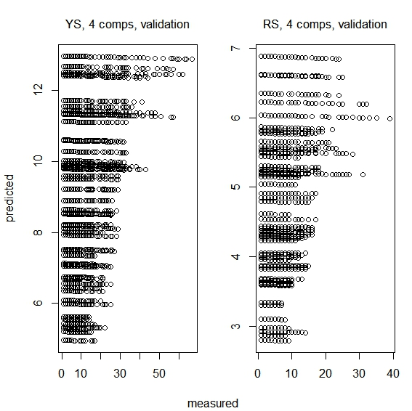

Slide 7
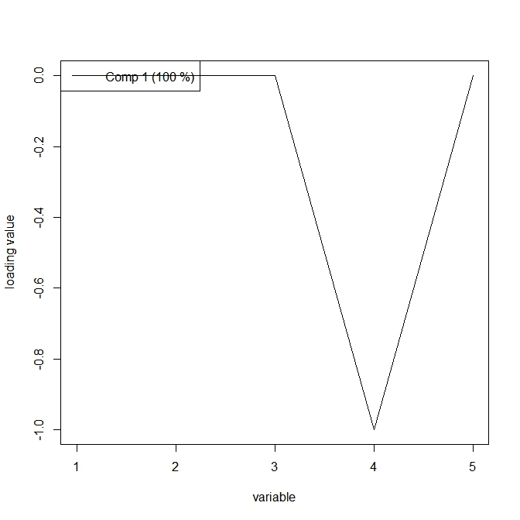

Slide 8
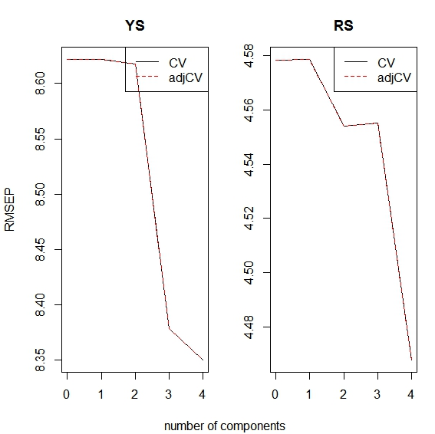

Slide 9
PCA has the ability of projecting the observations described by
<img src="https://s0.wp.com/latex.php?latex=p+&#038;bg=f9f9f9&#038;%23038;fg=555555&#038;%23038;s=1" alt="p " title="p " class="latex" /> variables into few orthogonal components defined at where the data
PCA has the ability of projecting the observations described by
<img src="https://s0.wp.com/latex.php?latex=p+&#038;bg=f9f9f9&#038;%23038;fg=555555&#038;%23038;s=1" alt="p " title="p " class="latex" /> variables into few orthogonal components defined at where the data
PCA has the ability of projecting the observations described by
<img src="https://s0.wp.com/latex.php?latex=p+&#038;bg=f9f9f9&#038;%23038;fg=555555&#038;%23038;s=1" alt="p " title="p " class="latex" /> variables into few orthogonal components defined at where the data
PCA & DLM on HETR and HETY
Apply Principal component analysis (PCA) for projecting the simulations described by variables into few orthogonal components
Decompose the simulation data spatially to reduce the dimension
Select the first few set of PCs or scores
Perform Bayesian dynamic linear model (DLM) for regressing the two input variables (O2 liquid; O2 gas) on the two outputs (HETY & HETR)

Slide 10
Output & input transformation
Y^{_{480 x51283 x 2}}
Y’^{_{480 x5 x 2}}
X^{_{480 x51283 x 2}}
X’^{_{480 x5 x 2}}

Slide 11
Importance of components:
PC1 PC2 PC3 PC4 PC5
Standard deviation 2.639e-05 8.556e-06 5.171e-06 3.698e-06 2.881e-06
Proportion of Variance 8.172e-01 8.591e-02 3.139e-02 1.605e-02 9.740e-03
Cumulative Proportion 8.172e-01 9.032e-01 9.345e-01 9.506e-01 9.603e-01
summary(myPCA2[[2]])
Importance of components:
PC1 PC2 PC3 PC4 PC5
Standard deviation 0.003014 0.001195 0.0007458 0.0005409 0.0004238
Proportion of Variance 0.739740 0.116210 0.0452900 0.0238200 0.0146300
Cumulative Proportion 0.739740 0.855950 0.9012500 0.9250700 0.9396900
PC6 PC7 PC8 PC9 PC10
Standard deviation 0.0003478 0.0002961 0.0002568 0.0002273 0.0002031
Proportion of Variance 0.0098500 0.0071400 0.0053700 0.0042000 0.0033600
Cumulative Proportion 0.9495400 0.9566800 0.9620500 0.9662600 0.9696100

Slide 12
DLM:
Given a Normal prior distribution θ0 ~Np(m0,C0)
Given a pair of equations for each time t >0
Yt=Ft θt+vt vt ~ Nm(0,Vt) - observation equation
θt=Gtθ{t-1} +wt wt ~ Np(0,Wt) - state equation
Ft and Gt are known matrices

Slide 13
