Slide 1
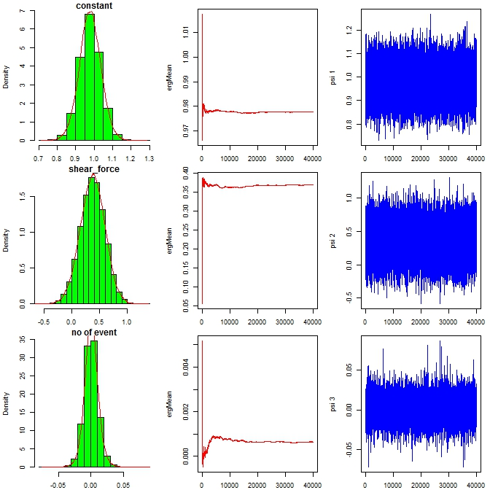
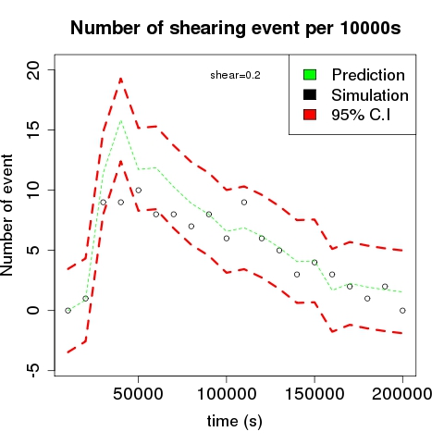
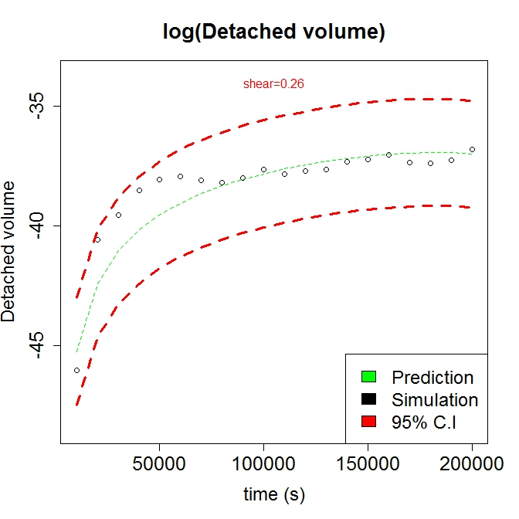
Statistical models for biofilm detachment
Fit a Bayesian Poisson regression to model the expected
number of shearing events per unit time
Use dynamic linear models to quantify the relationship
between the volume of detached clusters and shear stress
Diagnostic plots for testing the parameter convergence of MCMC.
Comparison between the LAMMPS and emulator expected number of shear events and log-transformed detached volume.

