Slide 1
The problem

Slide 2
What we have done so far…..
Evaluate the strategy for emulating high-level summary from the individual-based simulation of microbial communities using the NUFEB 1.1
Measure aggregated characteristics on the microscale simulation
Apply a dynamic Bayesian surrogate model (GP emulator) for modelling the interesting morphological characteristics that are essential for the design and performance of wastewater reactor.
Perform Bayesian sensitivity analysis to identify the most influential input parameters.
Quantify and model detachment patterns of a biofilm in response to hydrodynamic shear stress.

Slide 3
Future plans
Link fluids and emulator (Oluwole + Andrew)
Emulate pure culture/ complex system (NUFEB 2.1 + EPS model)
Continue with the NUFEB 2.0 parameter calibration using IdynoMICS and experimental data
Plan to properly investigate the use of emulators as an upscaling strategy to build mesoscale models.

Slide 4
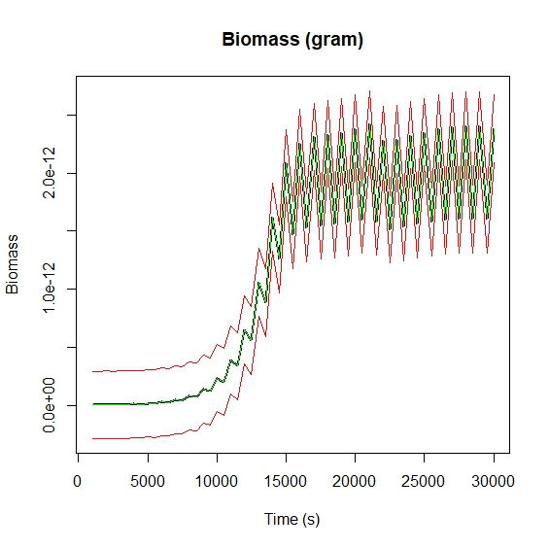
Preliminary results towards linking fluids and emulator
We build emulators for growth rate of biofilm height and total biomass as function of change in nutrient concentrations and boundary conditions

