Slide 1


Social Buzz :
Analyzing Data
of Top Content Categories
Notes:
Hello and welcome! My name is Nugi, and I’m going to present you the results of our analysis regarding the Social Buzz contents data.

Slide 2


Today's agenda
BUSINESS PROBLEM
TEAM INTRODUCTION
ANALYSIS PROCESS
INSIGHTS
CONCLUSION & QnA
Notes:
Here are the main points we are going to talk about in this presentation :
First, we’ll define the business problem we’re tackling.
Second, we will briefly introduce you to the data analytics team responsible for the task.
Third, we’ll describe of our analysis process.
Lastly, we’ll present you insight we extracted from our analysis.
To wrap up, we will summarize and open a question and answer session.

Slide 3


Problem
Maximizing user experience by leveraging data, specifically regarding the popularity of post categories
Notes:
Let’s discuss our problem statement.
You aim at of maximizing user experience and you want to leverage your data to meet that goal.
Social Buzz receive and store a lot of data in its operations. There are over a hundred thousand posts each day in your platform. This is a massive amount of data. You want to leverage this data.
The goal is to understand what your customers do and look for in you platform, so that you can accommodate that interest for your customers’ benefit.
In our current task, specifically you want to look at what peoples’ interest are in terms of categories of the posts.

Slide 4


The Analytics Team
Notes:
We have experienced and qualified people to tackle our business problem.
First, we have Andrew Fleming whow is our Chief Technical Architect. His expertise really helped to guide the team to produce high quality analysis.
Next, we have Marcus Rompton, a senior data expert who has worked with the worlds biggest clients on solving their data problems. He was heavily involved in the data engineering side of this project.
And finally, there’s me, Nugroho Budianggoro, who was solely responsible for taking leadership guidance and delivering high quality insights from the raw datasets and turning these into business decisions.

Slide 5
Process
1
Understanding the context of the data
2
Processing the data
3
Analyzing the data
4
Visualizing the insights
Notes:
Here are our process steps we took from receiving the raw data to producing insights:
First, understanding the context of the data. We discussed with stakeholders regarding what information every variable in the data contains. We did this in order to determine which variables we need to include or exclude in our analysis, also to determine the appropriate way to process and interpret them.
Second, processing the data. The data processing we did was handling inconsistencies, handling null values, developing relational model between datasets, and transform variables to produce the right form for our analysis.
Third, analyzing the data. We applied critical thinking process to uncover insights. We combine different variables with different shape to find patterns and shapes.
Lastly, visualizing the insights. We curated the insight that are most meaningful and visualize them. We also added number details to present more complete situation of the data.

Slide 6
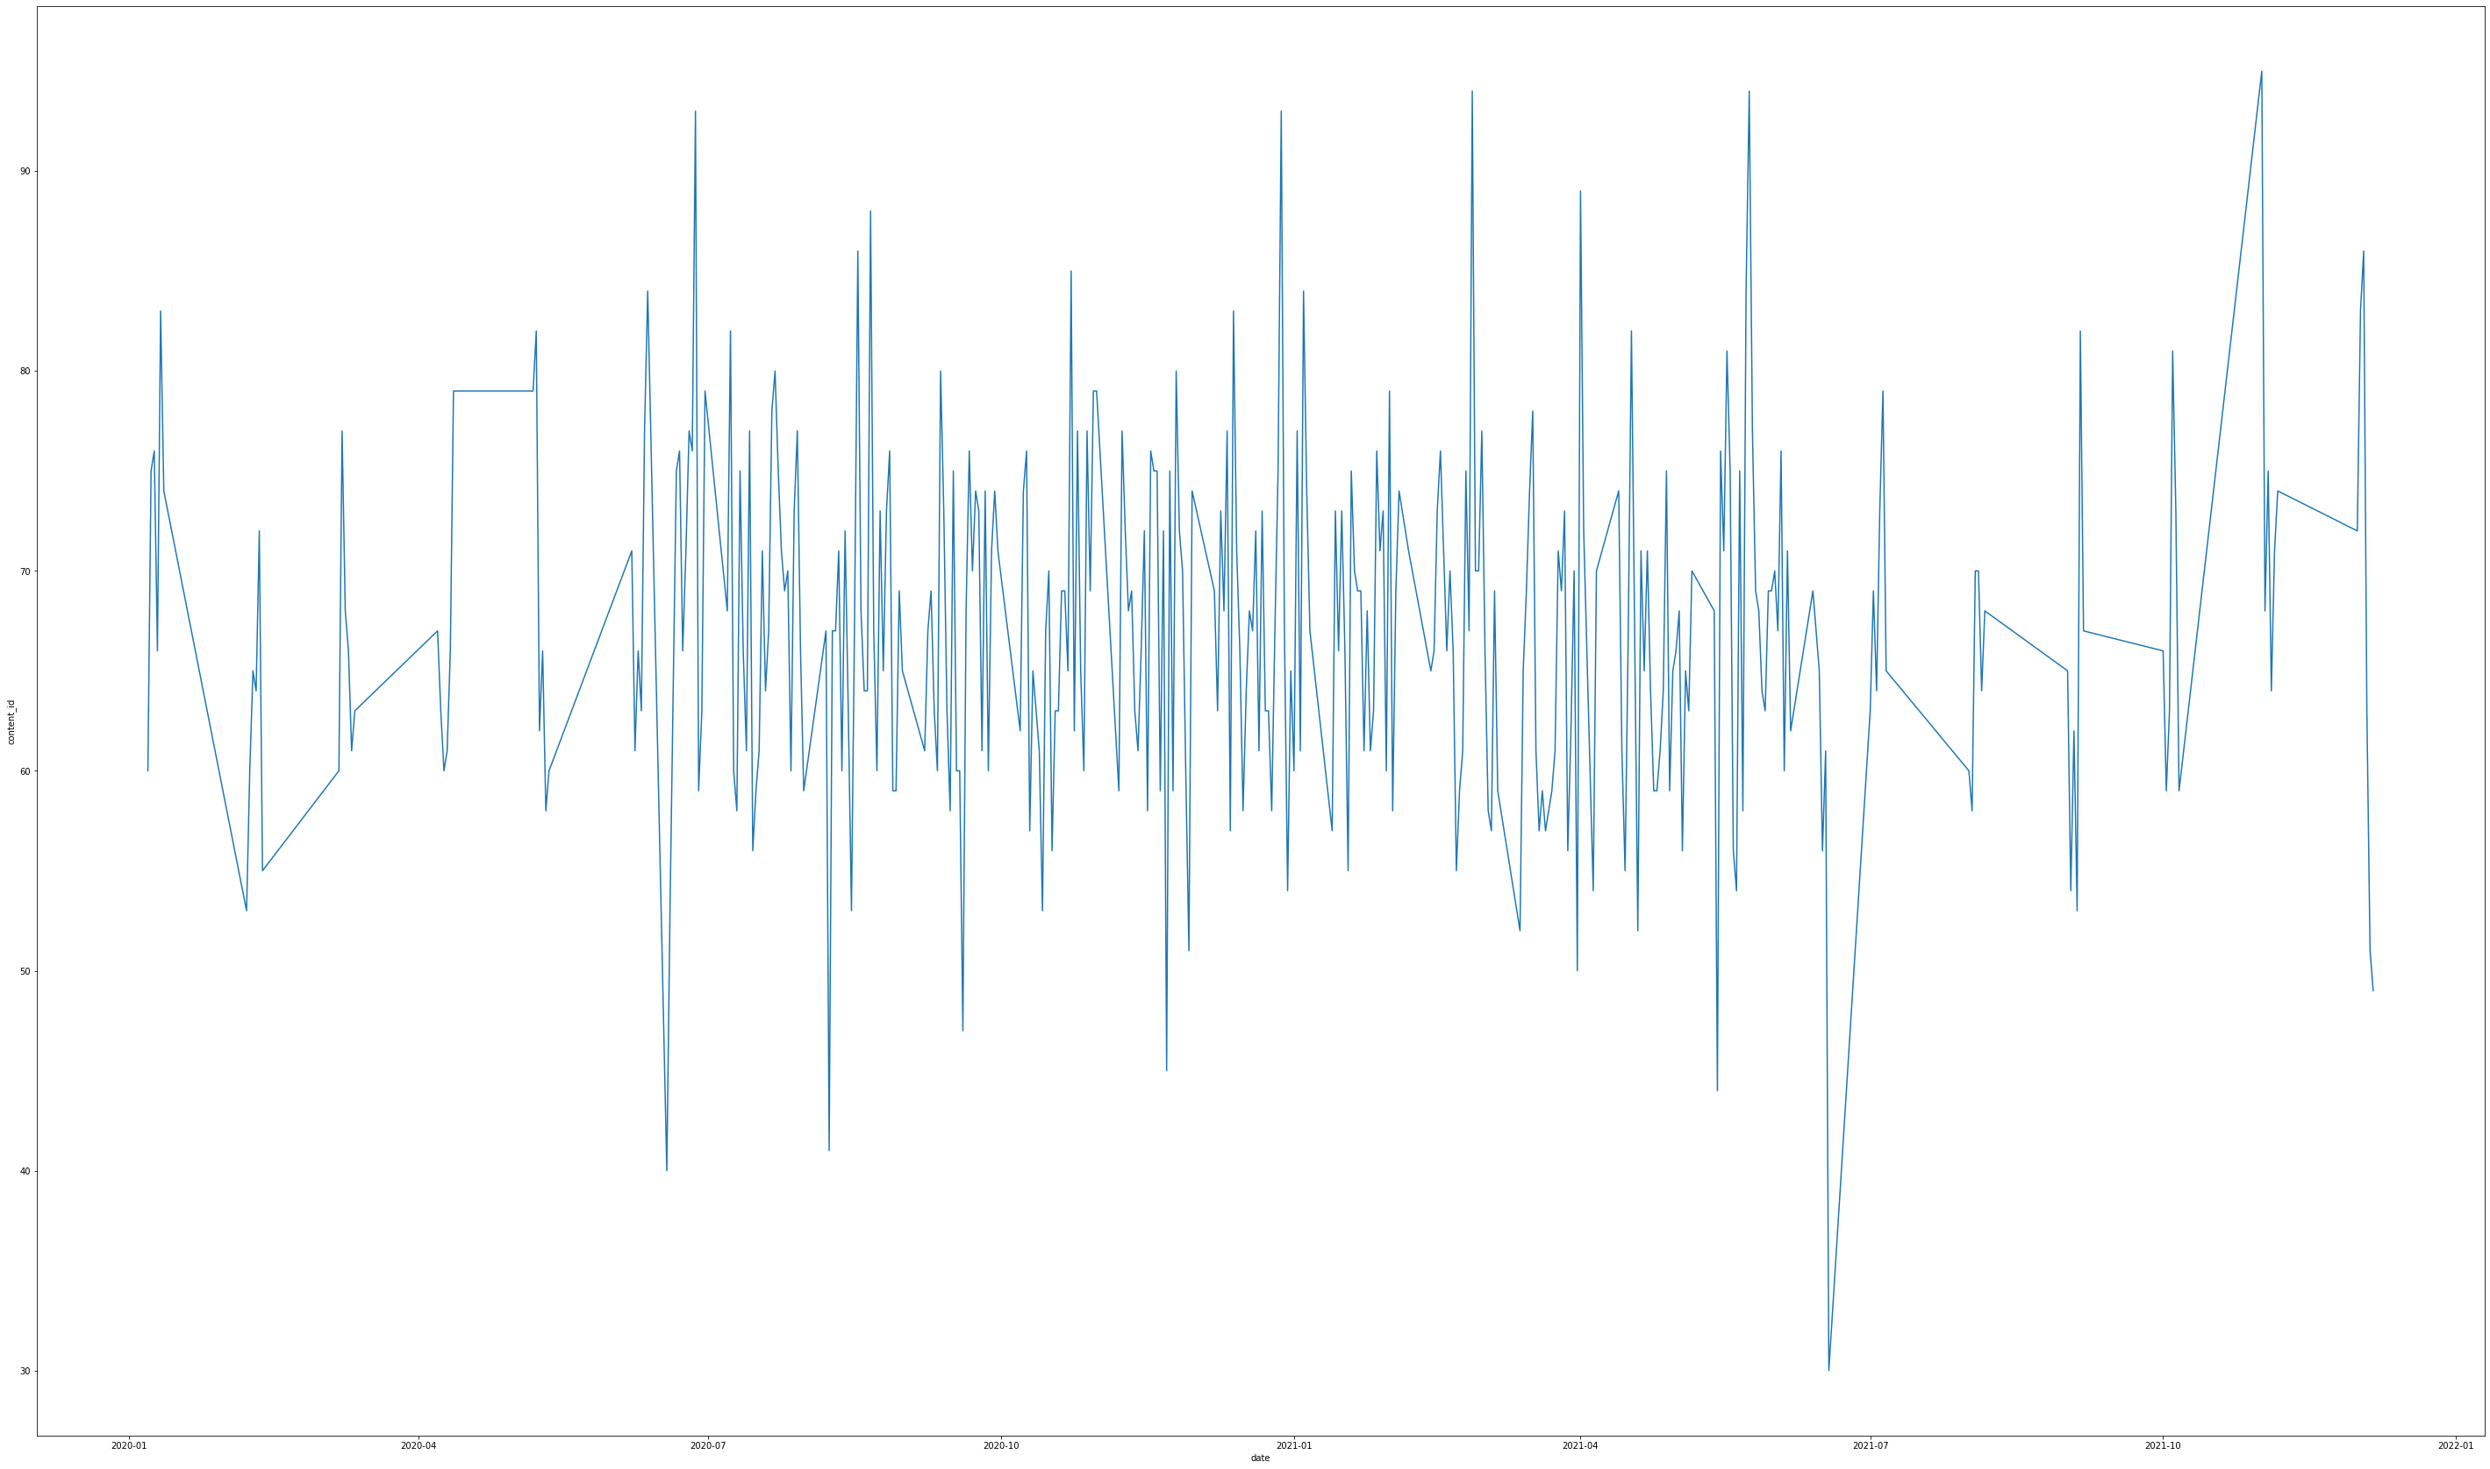
Insight 1 : Contents per day
Notes:
From our analysis you can see that the top 5 most popular categories of posts were food, culture, soccer, cooking and animals in descending order.
Food had an aggregate popularity score of almost 76000. It is very interesting to see both food and cooking within the top 5, it really shows what people enjoy consuming as content. But also interesting to see culture too. Clearly users favor "real-life" content on this platform.
Furthermore soccer is an interesting category because there is the European championships being played very soon. This presents a huge opportunity for you to differentiate your platform and to run specific content or events linked to this global spectacle.

Slide 7
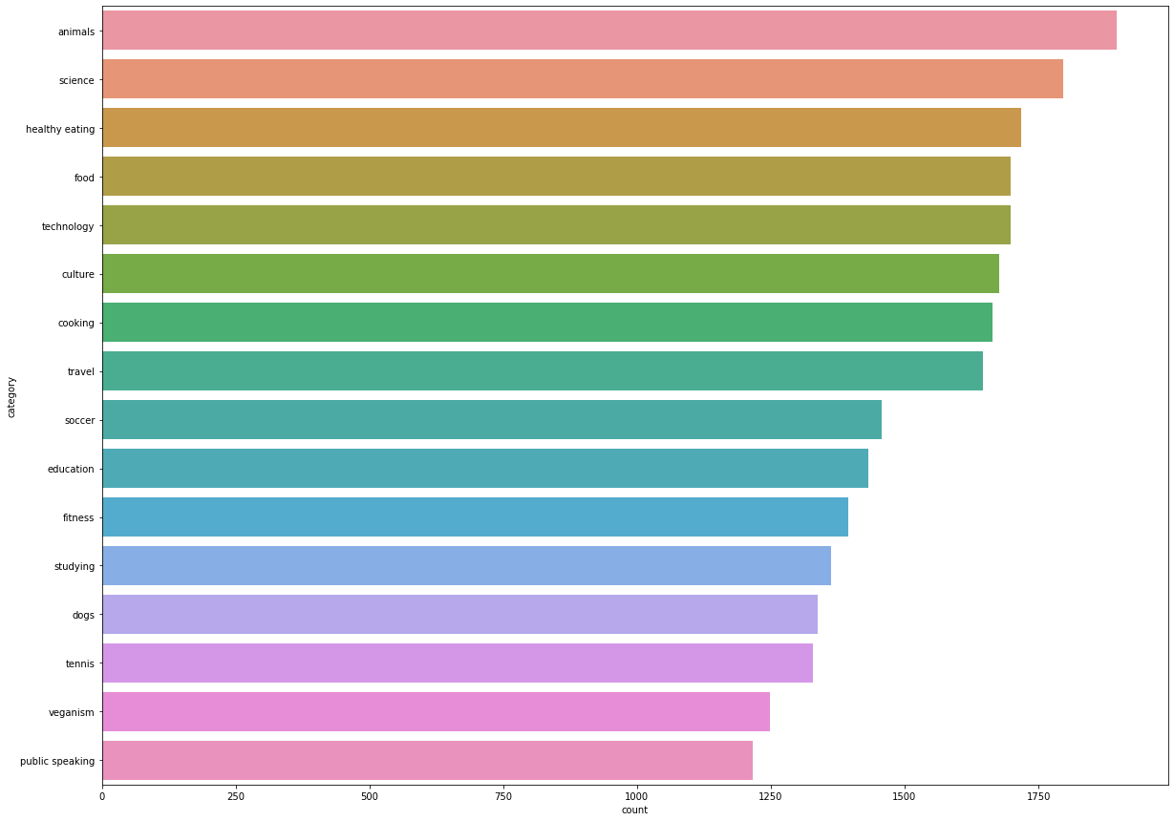
Insight 2 : Contents per category
Notes:
Here, we see that the category with the most contents are of ‘animals’ category with 1897 posts, and ‘science’ category with 1976 posts. Followed by ‘healthy eating’, ‘food’, and ‘technology’.

Slide 8
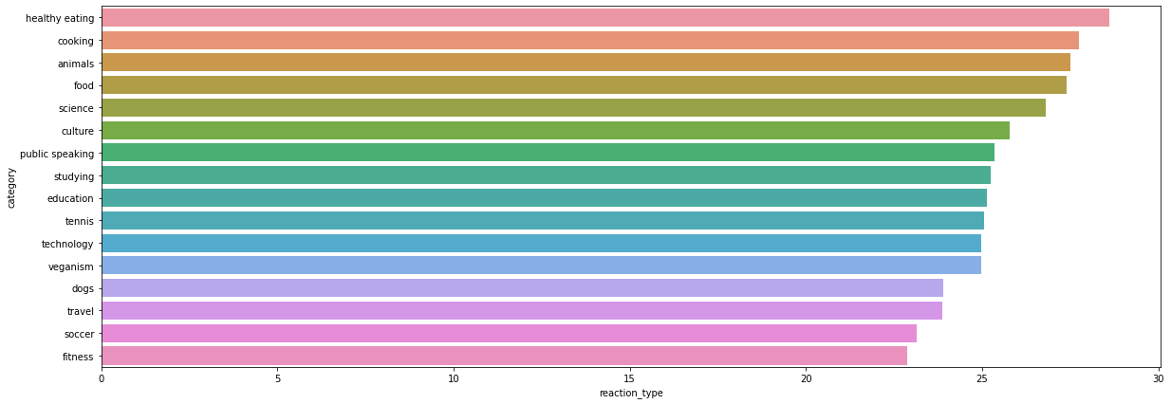
Insight 3 : Mean of reaction count per category
Notes:
Average reaction count per category was dominated by ‘healthy eating’ with 29 reactions per content. Followed by ‘cooking’ with 28 reactions per content and ‘animals’, ‘food’, ‘science’, each with 27 reactions per post. So, from comparison with the previous slide we see that category with the most content doesn’t necessarily have the average most reaction. Although these top categories were consistently among the top in each visualizations.

Slide 9
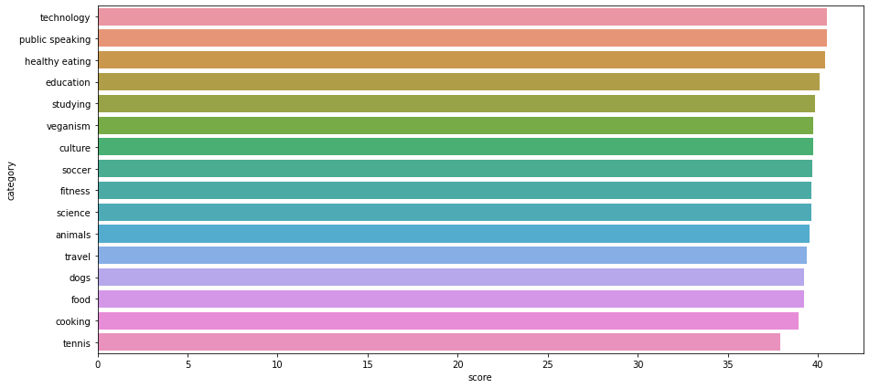
Insight 4 : Mean of content score per category
Notes:
The reactions sentiment were quantified by score. The higher the score, the more positive the sentiment. Here we see that the average score of contents for all categories were more or less uniform. With ‘technology’, ‘public speaking, ‘ healthy eating’, ‘education’ in the top with the average score of 40 for their contents.

Slide 10
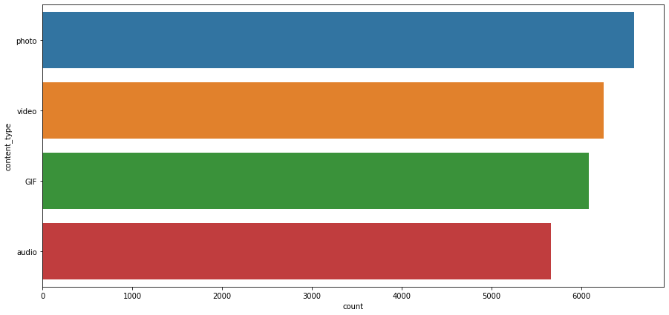
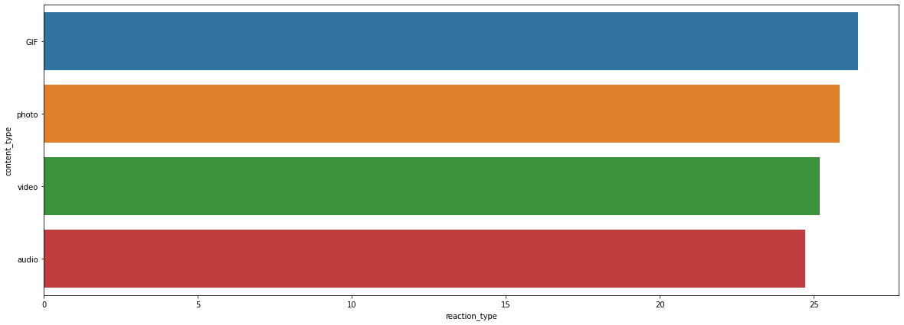
Insight 5 : Content count and reaction count per content type
Notes:
The most popular form of content in Social Buzz were photos with 6589 contents and videos with 6245 contents. The average most reactions per contents per content types were uniform, with GIF and photos having an average of 26 reactions, followed by video and audio with 25 reactions.

Slide 11
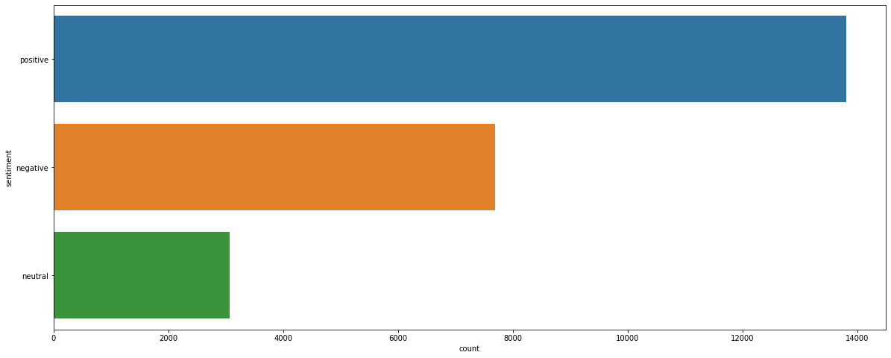
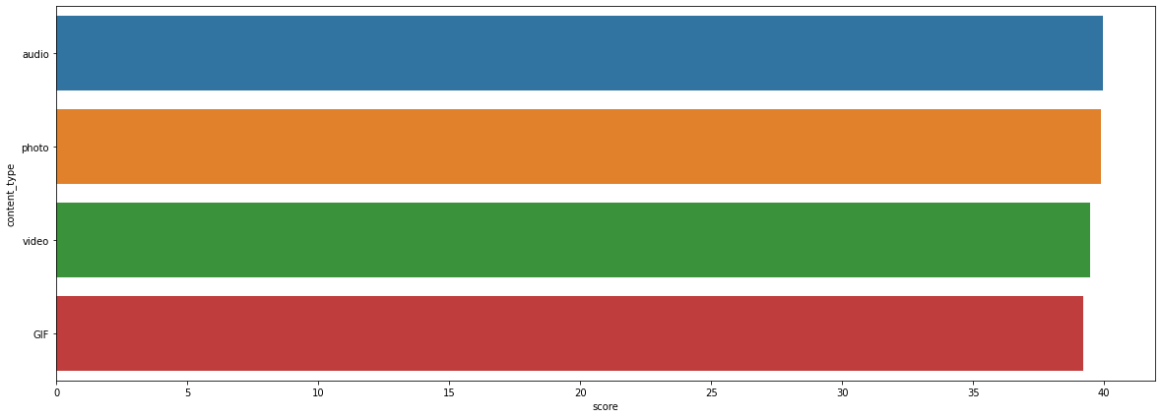
Insight 6 : Overall sentiments of contents and mean score of contents per content type
Notes:
The sentiments of reactions in Social Buzz were mostly positive with 13807 reactions, followed by negative in 7695 reactions. The mean of score of contents per content type were uniform in the range of 39 and 40.

Slide 12
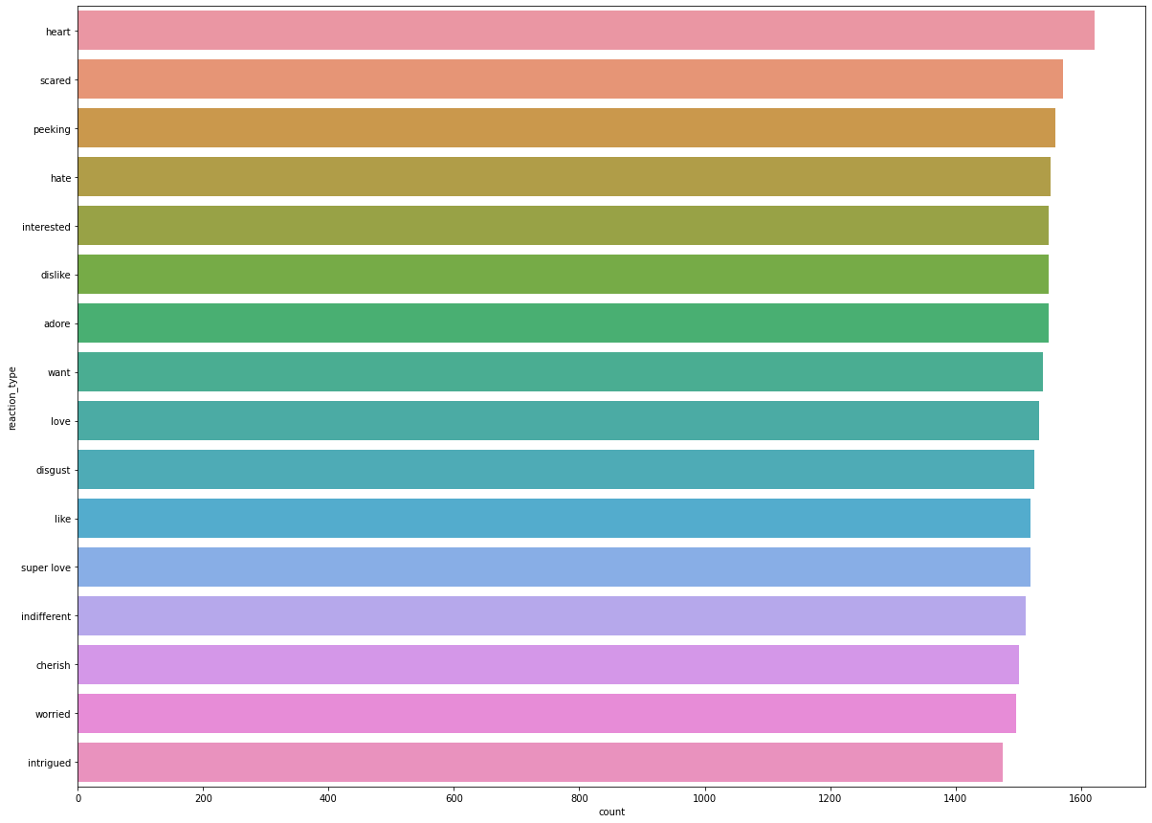
Insight 7 : Count of reaction types
Notes:
Reactions to the contents were dominated by ‘heart’ with 1622 reactions, followed by ‘scared’ with 1572 reactions, ‘peeking’ with 1559 reactions and ‘hate’ with 1552 reactions.

Slide 13
CONCLUSION
Process of data logging may be worth investigating further
Categories with the most content don’t necessarily have the most reaction, the categories ‘healthy eating’, ‘animals’, ‘food’, were consistently in the top ranks in those two categories
Most popular form of content were photos and videos, but the reaction counts per content were uniform in all of content types
Overall sentiments of the contents were dominated by ‘positive’ type, specifically the ‘heart’ reaction

Slide 14

Thank you!
ANY QUESTIONS?
The Python Notebook for this task can be found at :
https://github.com/nugi1209/Accenture_Data_Analytics_Virtual_Experience
OR
https://colab.research.google.com/drive/1xDjhMIO34kTTjZD7OUi_CA3Rq9h4CL44?usp=sharing
Notes:
Thank you very much for listening, please feel free to ask any questions that you may have!

