Slide 1
British Airways Customer Buying Behaviour Analysis
Task 2 British Airways Data Science Virtual Experience at The Forage
By NUGROHO BUDIANGGORO
22/04/2023
Code repository:
https://github.com/nug1209/British_Airways_Virtual-Experience

Slide 2
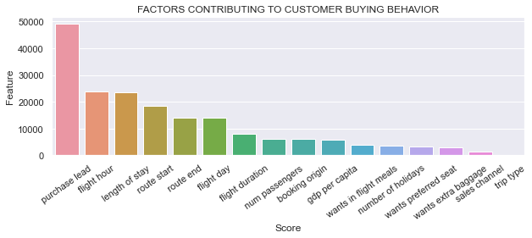
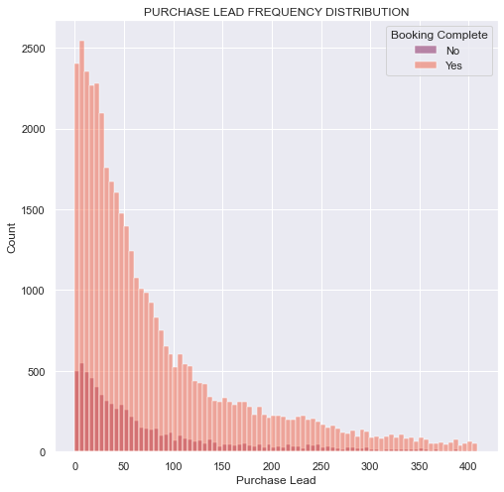
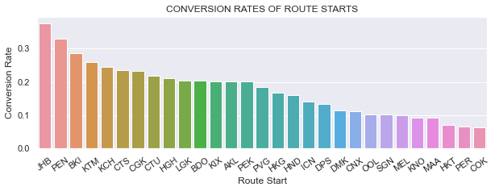
INSIGHTS
According to our model (XGBoost model with AUC 0.78) top factors that influence buying behavior are purchase lead, flight hour, length of stay and route start.
In 0 – 150 purchase lead range, the conversion rate may be higher in longer purchase lead.
Conversion rates are not uniform on route start data. The top 3 conversion rates are those from route starts JHB, PEN, BKI.
There are no clear pattern in the flight hour and length of stay data. The length of stay data is missing the value of 7 -16 days.

