Slide 1
British Airways Customer Reviews Analysis
Task 1 British Airways Data Science Virtual Experience at The Forage
By NUGROHO BUDIANGGORO
20/04/2023
Code repository:
https://github.com/nug1209/British_Airways_Virtual-Experience

Slide 2
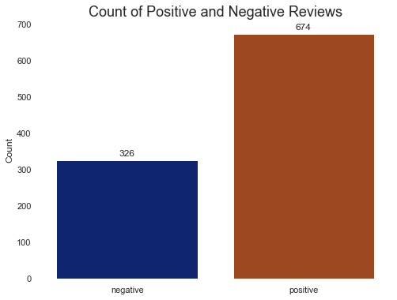
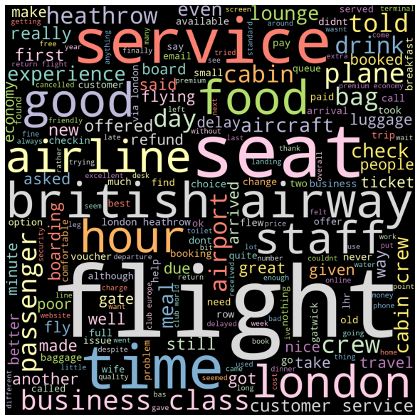
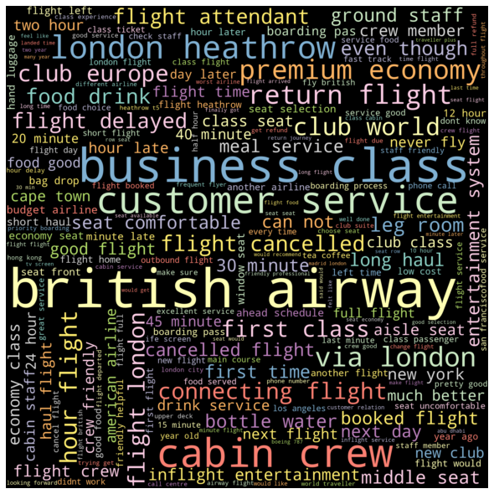
INSIGHTS
Positive reviews count are more than twice the count of negative reviews
WORDS MOST MENTIONED
Positive reviews: london, cabin crew, business class, customer service, time, food, seat, premium economy
Negative reviews: london, seat, staff, hours, business class, customer service, flight delayed, connecting flight
MOST COMMON TOPICS
all reviews: conditions in flight (i.e. seat, cabin crew, food), interaction with customer service
positive reviews: conditions in flight (i.e. food, cabin crew), time, and boarding situation
negative reviews: conditions in flight (i.e. seat, food, cabin crew), and interaction with customer service at the airport
Most common words in all reviews
One-word
Two-word

