Slide 1
Tramadol and Lyrica Drugs Adverse Effects Comparison
Task 5 PwC Digital Intelligence Virtual Case Experience
By Nugroho Budianggoro
15/05/2023
Github: https://github.com/nug1209/PwC_Switzerland_Digital_Intelligence_Virtual_Case_Experience

Slide 2
About the analysis
To compare the adverse effects of Tramadol and Lyrica drugs, adverse effects cases of both drugs were obtained from FAERS database. The cases were from 2019.

Slide 3
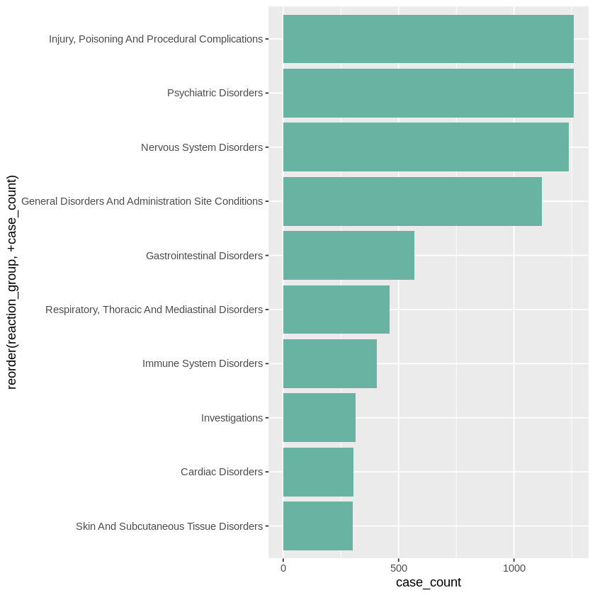
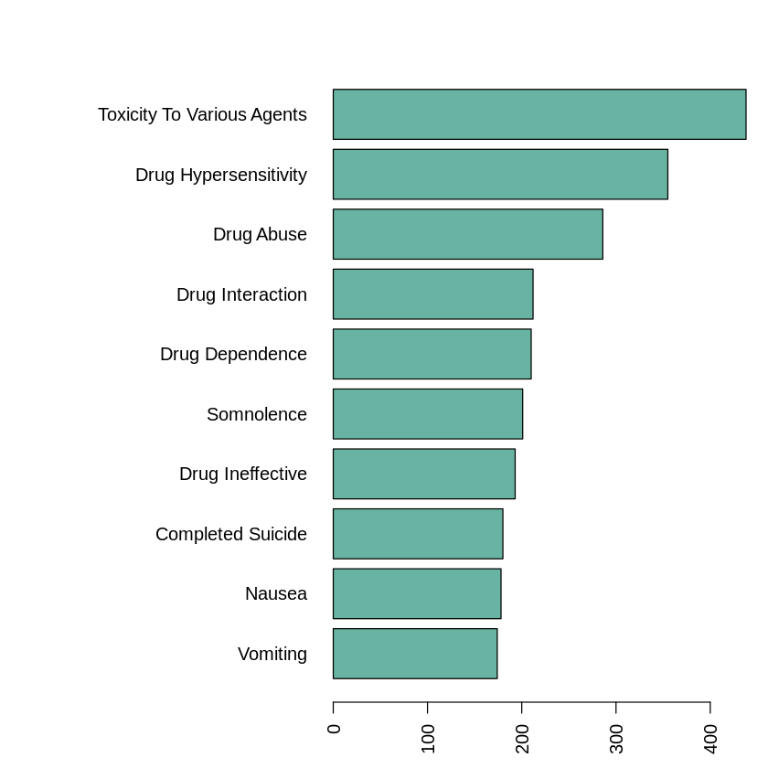
Tramadol
Adverse effects by reaction group
Adverse effects by individual cases

Slide 4
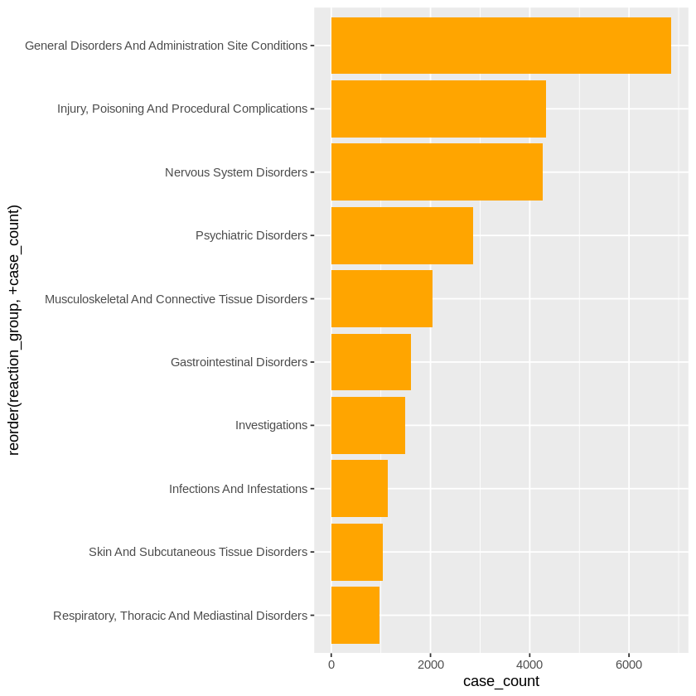
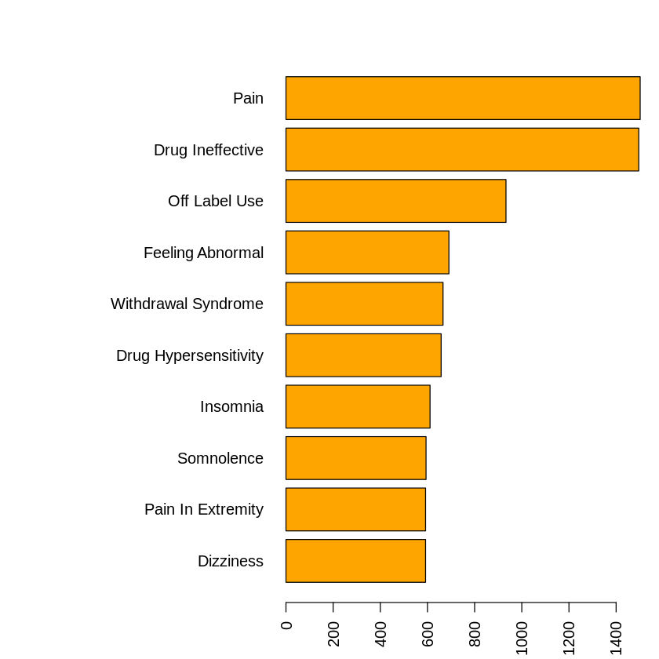
Lyrica
Adverse effects by reaction group
Adverse effects by individual cases

Slide 5
Further research suggestions
To get reliable adverse effects comparison between the two drugs, the sales volume of the two drugs must be obtained.

