Slide 1
model eXplainability for retail banking marketing prediction
Task 1 PwC Digital Intelligence Virtual Case Experience
By Nugroho Budianggoro
12/05/2023
Github: https://github.com/nug1209/PwC_Switzerland_Digital_Intelligence_Virtual_Case_Experience

Slide 2
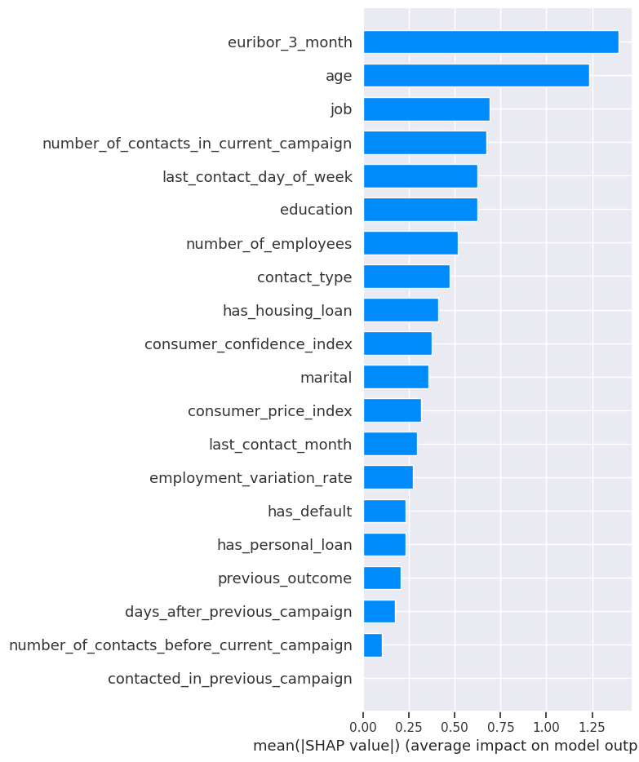
Problem Statement
Suppose there is a model that predicts whether a customer would subscribe to term deposit based on the customer data. What would be the characteristics of the customer that have most contribution to the model’s prediction?
The Model
From the customer data, I built an XGBoost classification model. The model’s performance is not great but it is better than random guess (AUC score 0.64).
General Important Customer Characteristics
Four most important customer characteristics for prediction are:
Euribor 3 month when the customer was contacted
Customer’s age
Customer’s job
Number of contacts made in the current campaign
Specific Important Customer Characteristics
For customer no. 4, most important characteristics that predicted her/his decision (not to buy) were: customer’s age, number of contacts in the current campaign, number of contacts before current campaign.
For customer no. 20, most important characteristics that predicted her/his decision (not to buy) were: number of contacts in the current campaign, customer’s age, number of contacts before current campaign, Euribor 3 month.
The important customer characteristics were evaluated using SHAP and LIME frameworks.
General Important Customer Characteristics

Slide 3
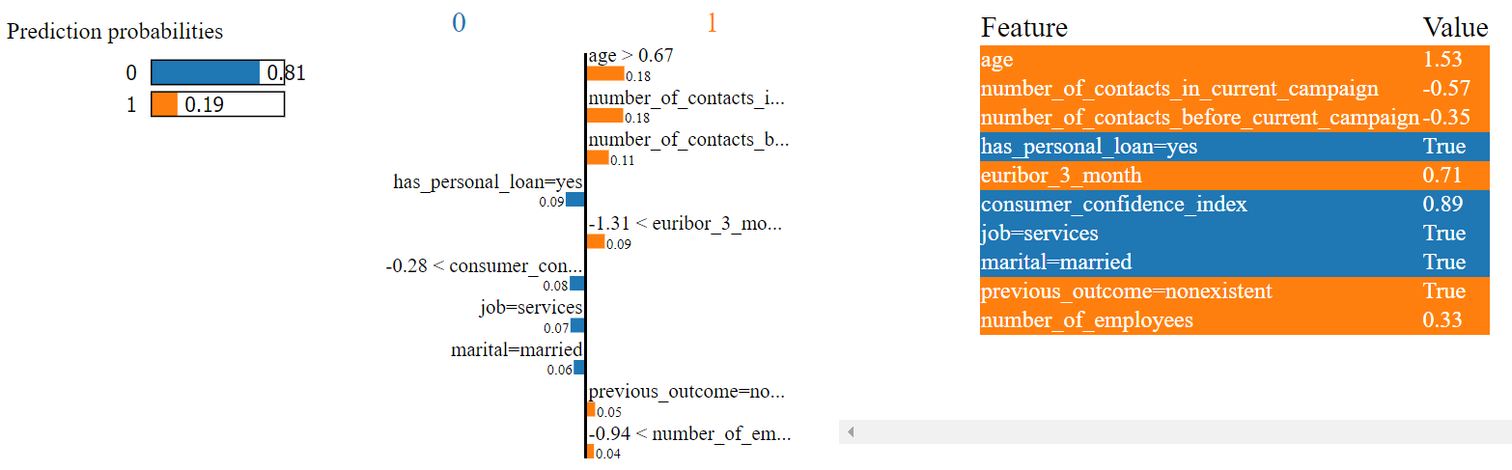
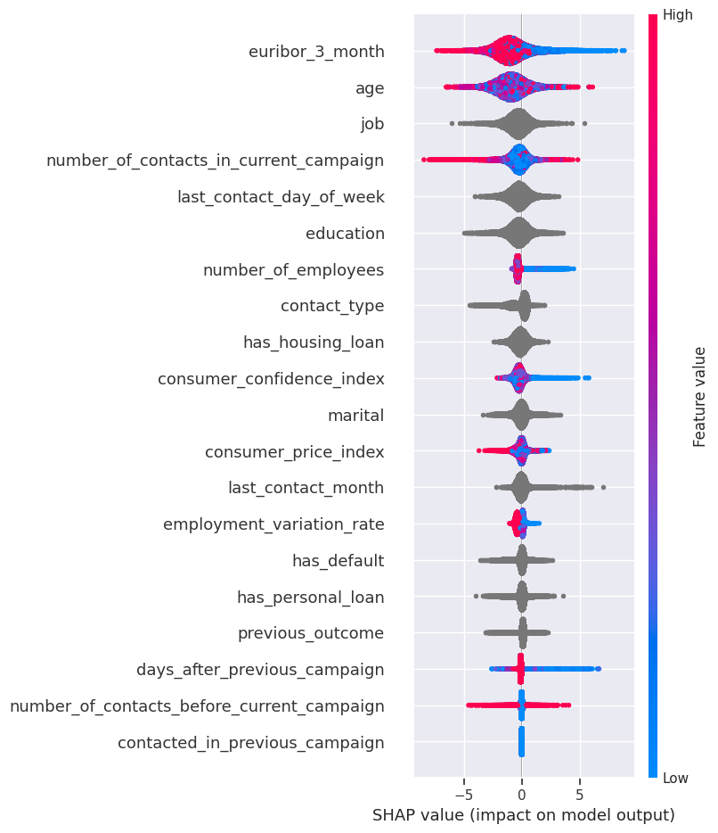
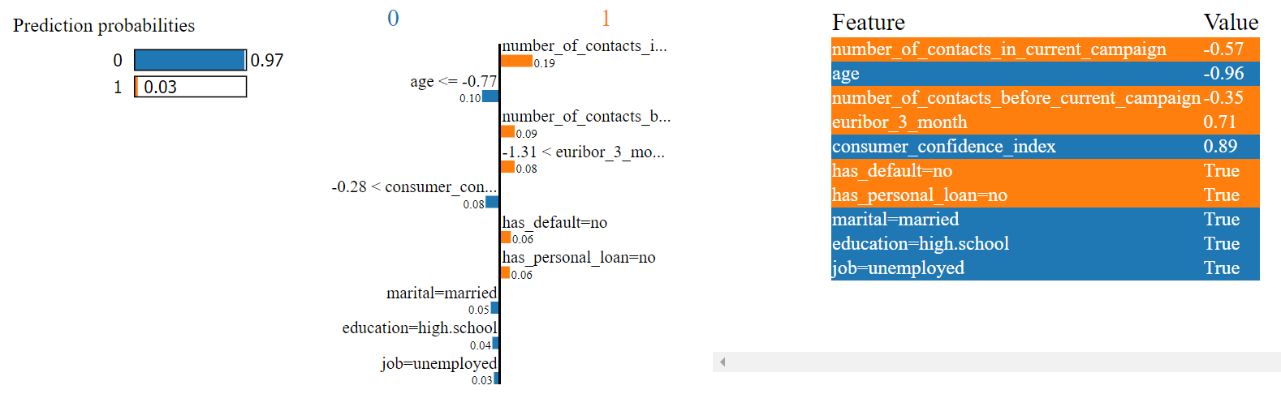
Important Customer Characteristics for Customer no. 4
General Important Customer Characteristics
with Direction of the Contribution
Important Customer Characteristics for Customer no. 20

