Slide 1
SQL Joins: Left & Right
By: Michael Nugent

Slide 2
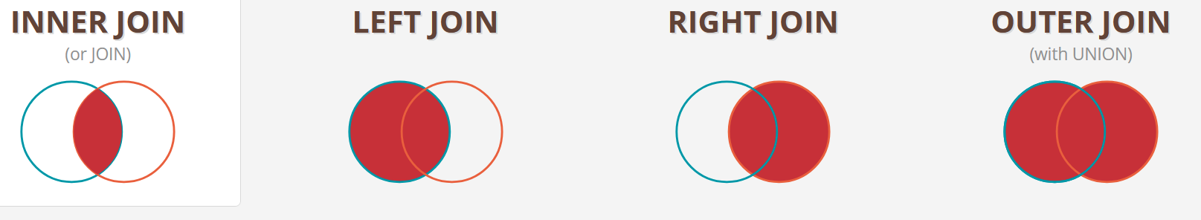
Theme: Unmatched Data
https://joins.spathon.com/

Slide 3
What is a Left Join?
A Left Join (LEFT OUTER JOIN) returns all records from the left table and only matching records from the right table.
If no match is found, NULL values are placed for columns from the right table.
💡 Key takeaway: Left Join keeps all records from the left table, even if there’s no match in the right table.

Slide 4
Formal Definition: LEFT JOIN
Let R and S be two relations (tables), where R is the left table and S is the right table. A LEFT JOIN between R and S returns all tuples from R, and the matching tuples from S. If no match is found in S, NULL values are returned for columns from S.
Mathematically:
R LEFT JOIN S ON R.A = S.B = { (r, s) | r in R, s in S, if r.A = s.B, otherwise (r, NULL) }
A and B are the join keys from R and S, respectively.
If there is no matching row in S, the result includes r with NULL values for attributes from S.

Slide 5
What is a Right Join?
A Right Join (RIGHT OUTER JOIN) returns all records from the right table and only matching records from the left table.
If no match is found, NULL values appear in the columns from the left table.
💡 Key takeaway: Right Join keeps all records from the right table, even if there’s no match in the left table.

Slide 6
Formal Definition: RIGHT JOIN
A RIGHT JOIN is the mirror image of a LEFT JOIN. It returns all tuples from S, and the matching tuples from R. If no match is found in R, NULL values are returned for columns from R.
Mathematically:
R RIGHT JOIN S ON R.A = S.B = { (r, s) | r in R, s in S, if r.A = s.B, otherwise (NULL, s) }
If there is no matching row in R, the result includes s with NULL values for attributes from R.

Slide 7
-- Left Join --
SELECT
a.first_name as "First Name",
a.last_name as "Last Name",
m.title as "Title",
m.released as "Release Date"
FROM
actors a
LEFT JOIN
actors_movies am
ON
a.id=am.actor_id
LEFT JOIN
movies m
ON
am.movie_id=m.id
-- Right Join --
SELECT
a.first_name as "First Name",
a.last_name as "Last Name",
m.title as "Title",
m.released as "Release Date"
FROM
actors a
RIGHT JOIN
actors_movies am
ON
a.id=am.actor_id
RIGHT JOIN
movies m
ON
am.movie_id=m.id

Slide 8
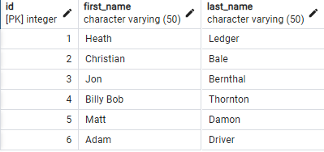
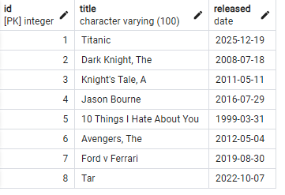
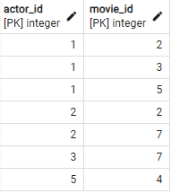
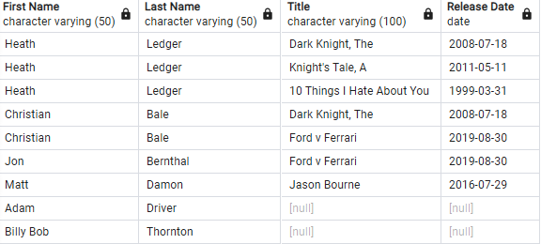
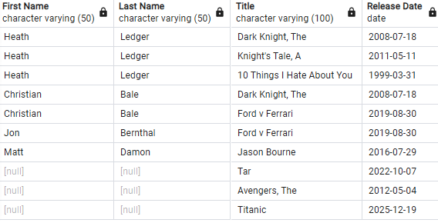
Favorite Actors
Favorite Movies
Actors_Movies
Left Join
Right Join

Slide 9
Real-World Use Cases
Show all students and their assigned classes. If a student isn't enrolled, still display their name.
Used in CRM software to show all customers, even those without orders.
Used in inventory management to ensure all products from the supplier appear, even if none are sold yet.

