Slide 1

Automated IT Infrastructure Monitoring with Log Scraping Using Ansible,
Prometheus, Grafana, Python, and MySQL
By Anand Mure, Michael Nugent, and Artan Plaku

Slide 2
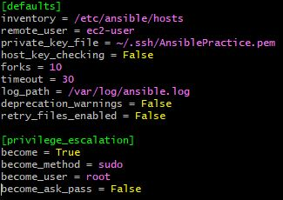


Setup Ansible for Automation
sudo yum update –y
sudo yum install –y ansible
/etc/ansible/ansible.cfg
/etc/ansible/hosts
/etc/hosts

Slide 3
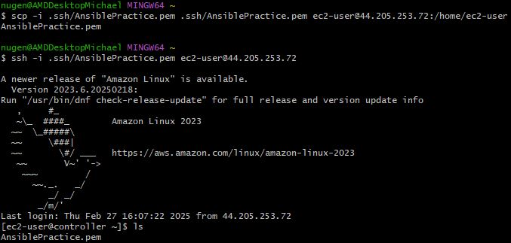
Copy private key file to instance

Slide 4
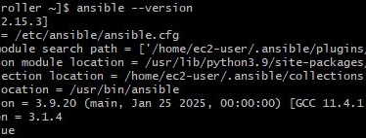
Verify Ansible Installation
ansible --version

Slide 5
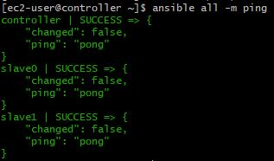
Verify Ansible Installation
ansible all –m ping

Slide 6
2. Install Python and MySQL Using Ansible

Slide 7
3. Deploy Prometheus with Ansible

Slide 8
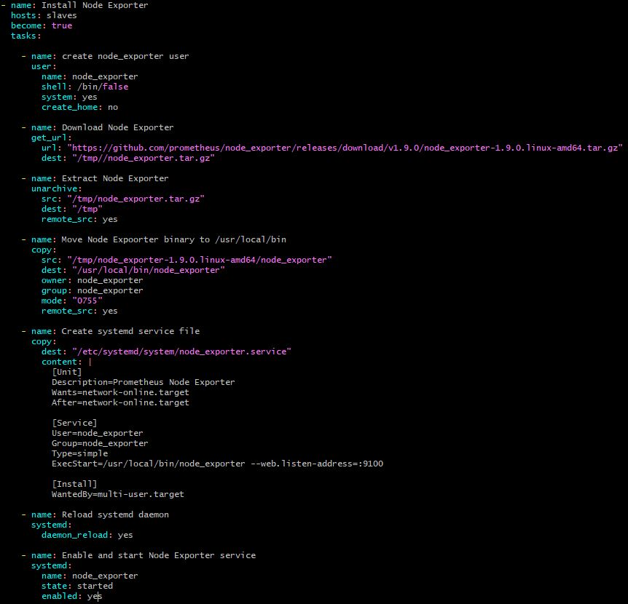
4. Install Node Exporter on Target Servers Using Ansible
Create Ansible Playbook

Slide 9
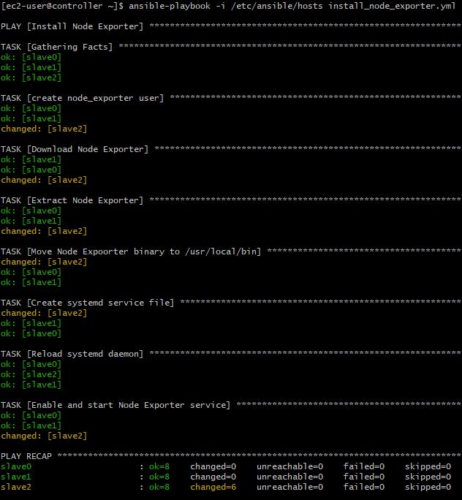
4. Install Node Exporter on Target Servers Using Ansible
Use Ansible Playbook

Slide 10
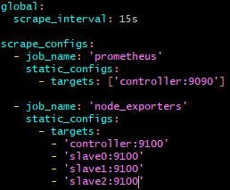
5. Configure Prometheus to Scrape Node Exporter
Add a job to /etc/prometheus/prometheus.yml
Restart prometheus

Slide 11
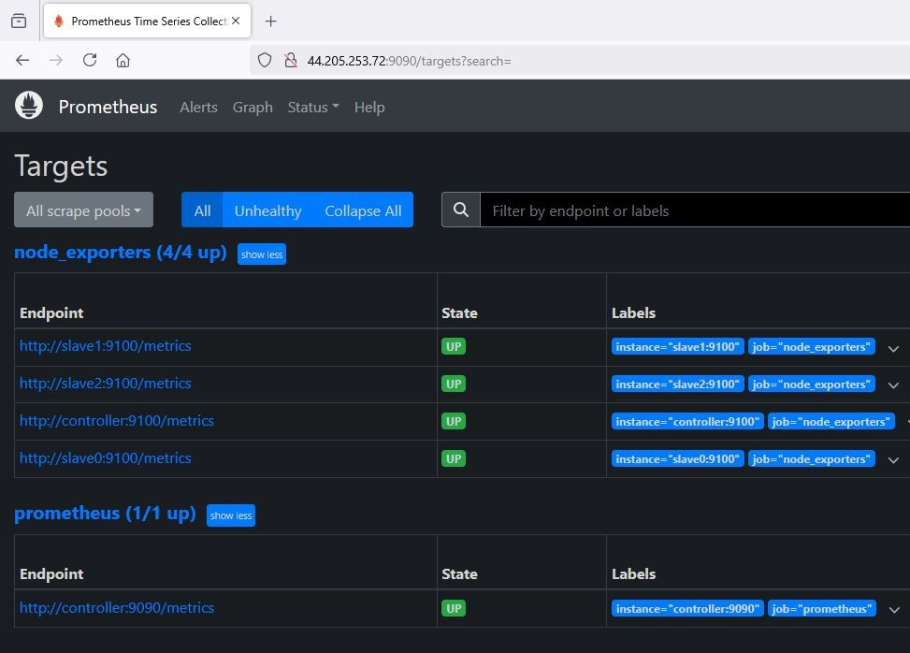
5. Configure Prometheus to Scrape Node Exporter
Verify success

Slide 12
6. Install and Configure Grafana

Slide 13
7. Implement Log Scraping Using Python

Slide 14
8. Configure Alerting in Prometheus

