Slide 1
Branching Strategies

Slide 2



Welches Bier ist das beste ?

Slide 4
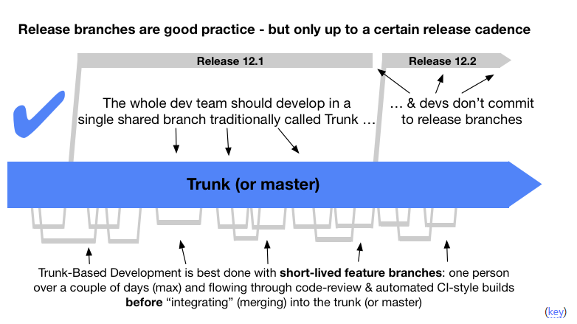
Trunk Based Development
https://trunkbaseddevelopment.com/

Slide 5
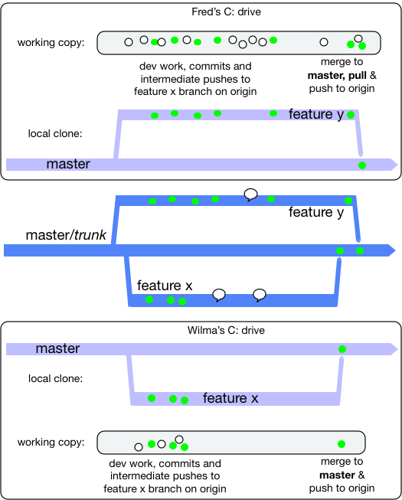
Feature Branches
https://trunkbaseddevelopment.com/short-lived-feature-branches/

Slide 6
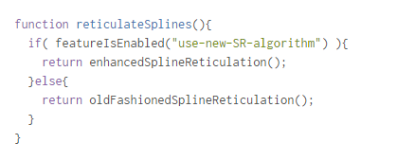
Feature Toggles
https://martinfowler.com/articles/feature-toggles.html Vorteile: - Gesamter code verfügbar - Switchable fürs Testing Nachteile: - code schlummert im Main Repo

Slide 7
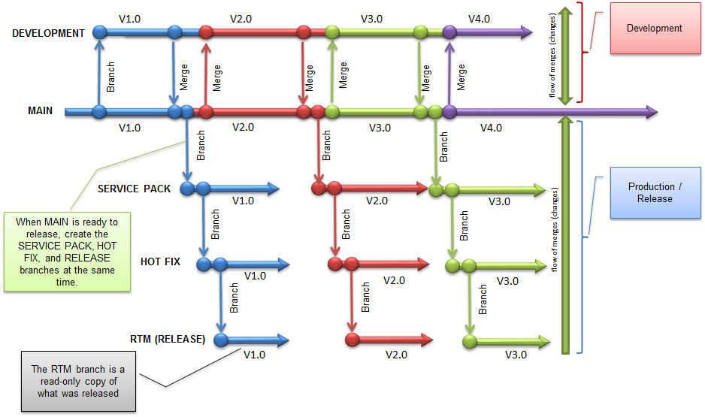
Release Branches
https://blogs.msdn.microsoft.com/willy-peter_schaub/2011/12/21/alm-rangers-visual-studio-11-readiness-part-2-a-small-peek-at-the-upcoming-tfs-branching-and-merging-guidance/

Slide 8
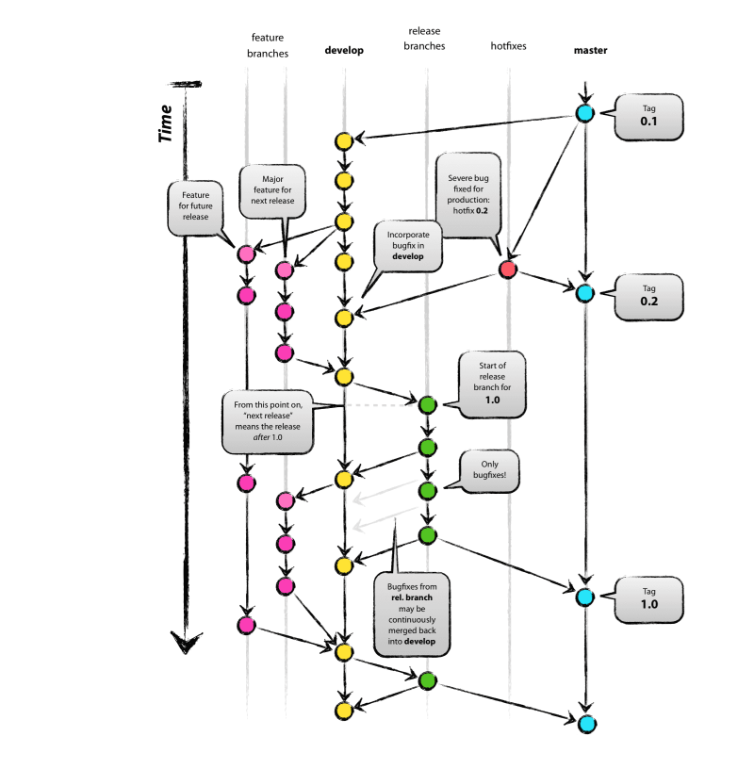
A Sucessfull git Branching Model
https://github.com/nvie/gitflow
https://danielkummer.github.io/git-flow-cheatsheet/
http://nvie.com/posts/a-successful-git-branching-model/

Slide 9
A successful branching Model Harmful ?
https://barro.github.io/2016/02/a-succesful-git-branching-model-considered-harmful/

Slide 10
Git Flow
https://github.com/nvie/gitflow
https://danielkummer.github.io/git-flow-cheatsheet/
http://nvie.com/posts/a-successful-git-branching-model/

Slide 11
Informations
https://docs.microsoft.com/en-us/vsts/git/concepts/git-branching-guidance
Git Flow: http://nvie.com/posts/a-successful-git-branching-model/
https://martinfowler.com/bliki/FeatureBranch.html
https://trunkbaseddevelopment.com/

