Slide 1
GIT „Special Moves“

Slide 2
Git reset
-- soft (default) dies not change staging index or working directory
-- mixed default() -changes staging index to match repository
-dies not change working directory
-- hard reset - changes staging index and working directory to match repository

Slide 3
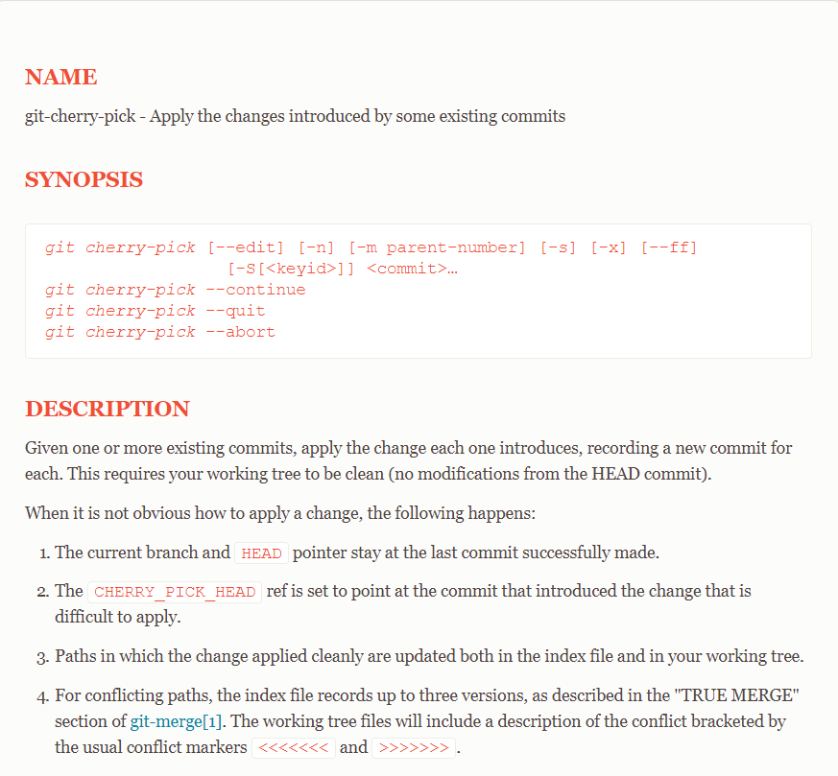
Git cherry pick
https://git-scm.com/docs/git-cherry-pick

Slide 4
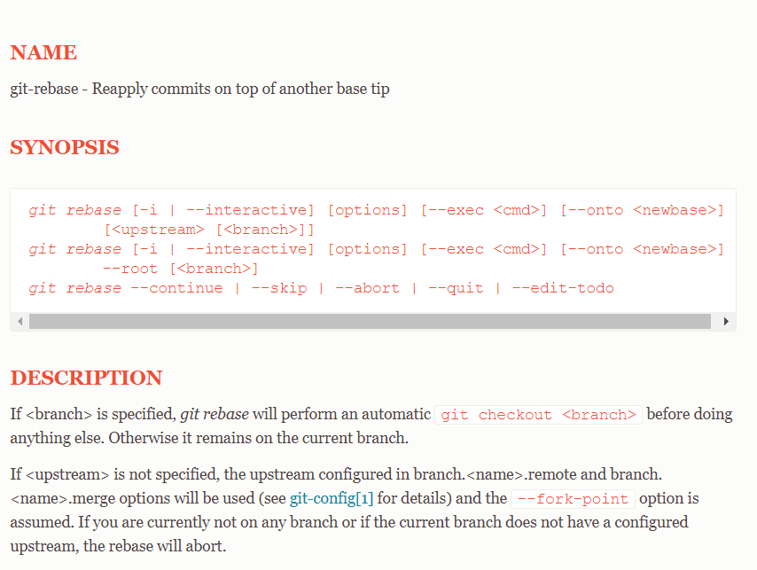
Git rebase
https://git-scm.com/docs/git-rebase
https://git-scm.com/book/en/v2/Git-Branching-Rebasing
https://www.atlassian.com/git/tutorials/merging-vs-rebasing

Slide 5
Git an Jira binden
Git –commit –m ‚[Tticket-id] formular umgesetzt‘
https://confluence.atlassian.com/jirasoftwarecloud/referencing-issues-in-your-development-work-777002789.html

