Slide 1
GIT config

Slide 2
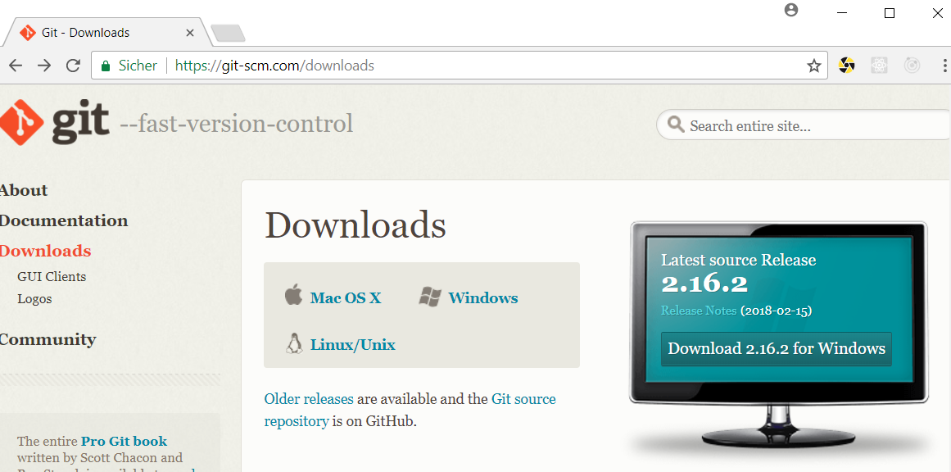
Download GIT
http://git-scm.com/downloads

Slide 3

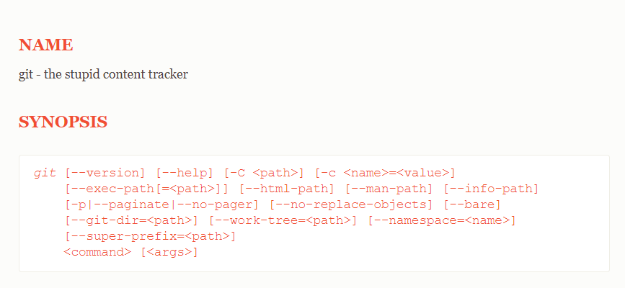
Is GIT Installed

Slide 4

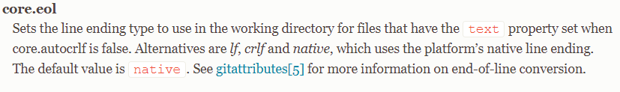
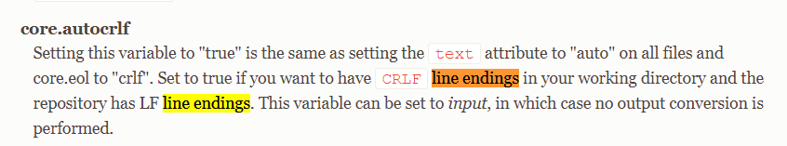
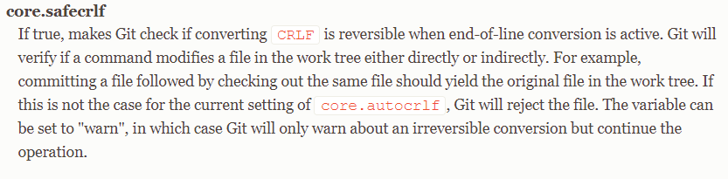
Git line endings handle
Line endings have different signs on LINUX, MAC, Windows

Slide 5
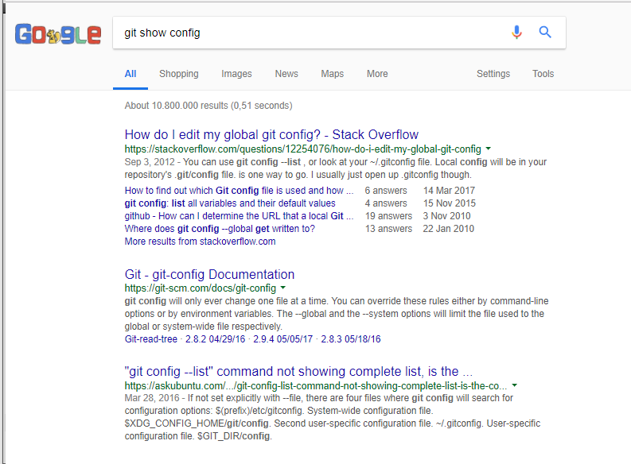
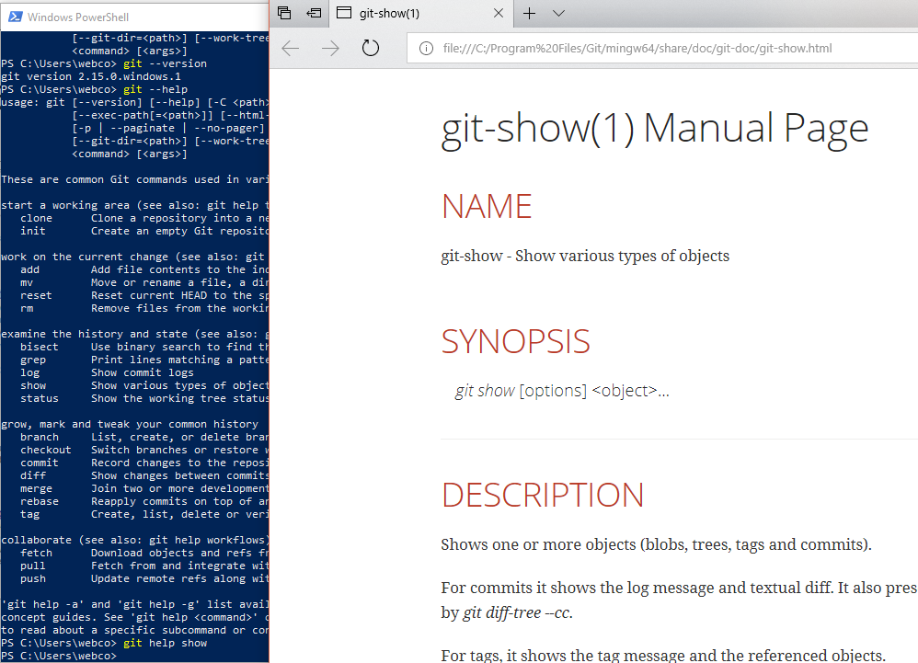
Finding Help

Slide 6
Git auto complete
Braucht man für Linux und Mac https://github.com/bobthecow/git-flow-completion/wiki/Install-Bash-git-completion

Slide 7
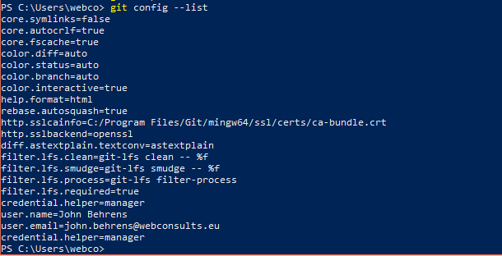

Git config

Slide 8
Git color
http://www.translationdata.com/2015/05/how-to-fix-git-powershell-colours/

