Slide 1
GIT Architektur

Slide 2
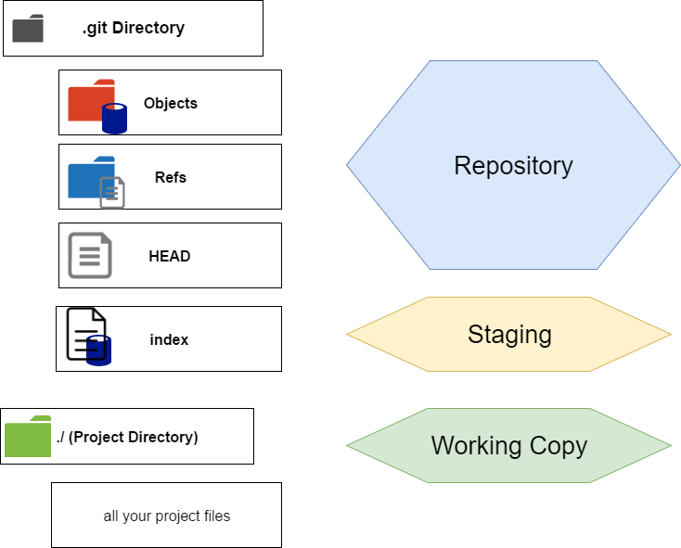

Slide 3
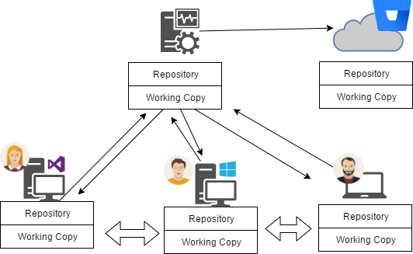

Slide 4

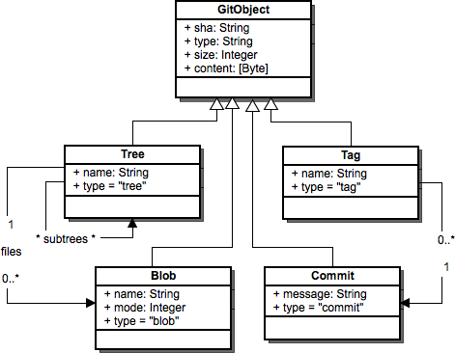
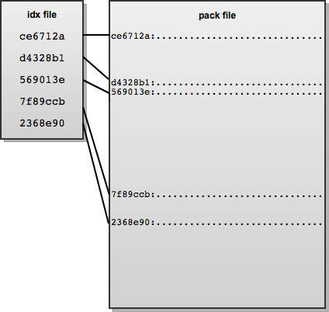
Object Database
Graphik: http://www.aosabook.org/en/git.html

Slide 5
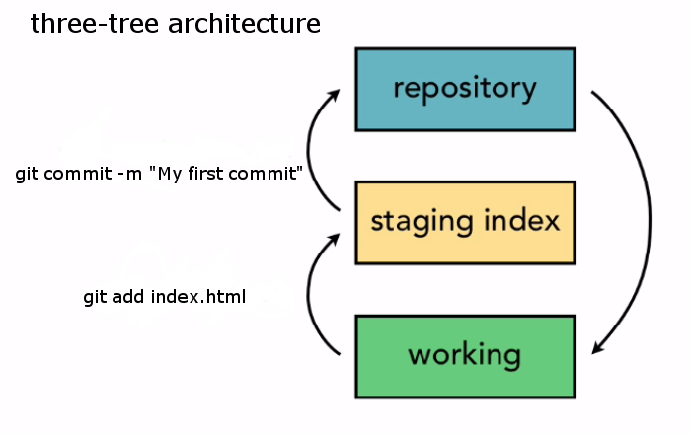
https://surya2in1.wordpress.com/2016/06/30/git-architecture/

Slide 6
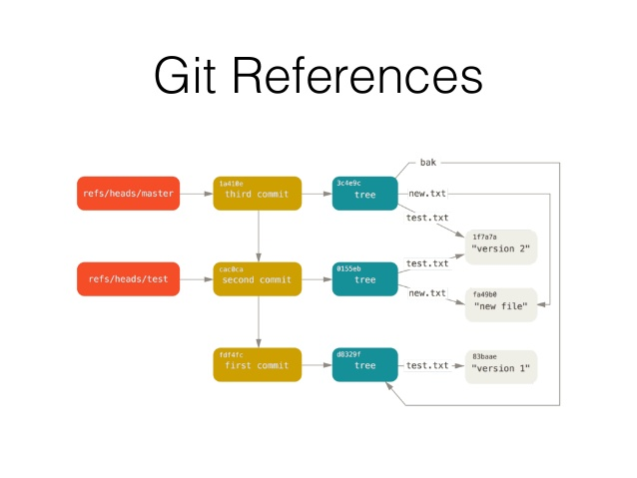
GIT Architecture
https://www.slideshare.net/alexprut/git-architecture
Slice Sources on Alex PRUT Github https://github.com/webisart/Events/ slides source code

Slide 7
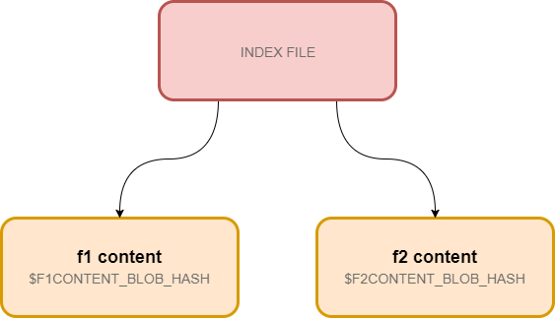
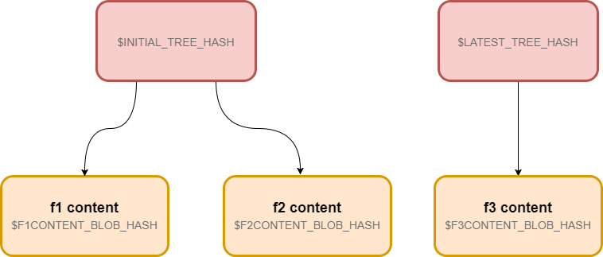
Comitting Files

Slide 8
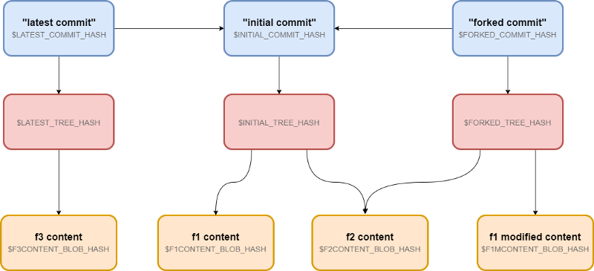
Modified files Only
Become a GIT pro by learning GIT architecture in 15 minutes
https://blog.angularindepth.com/become-a-git-pro-by-learning-git-architecture-in-15-minutes-9c995db6faeb

