Slide 1
Remotes

Slide 2
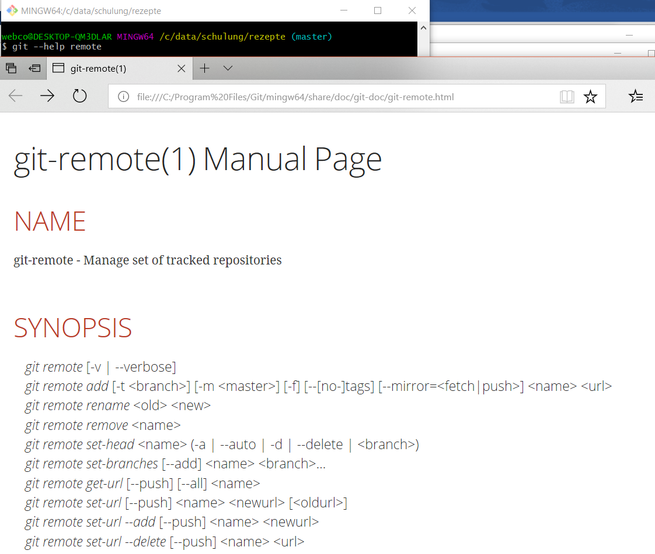
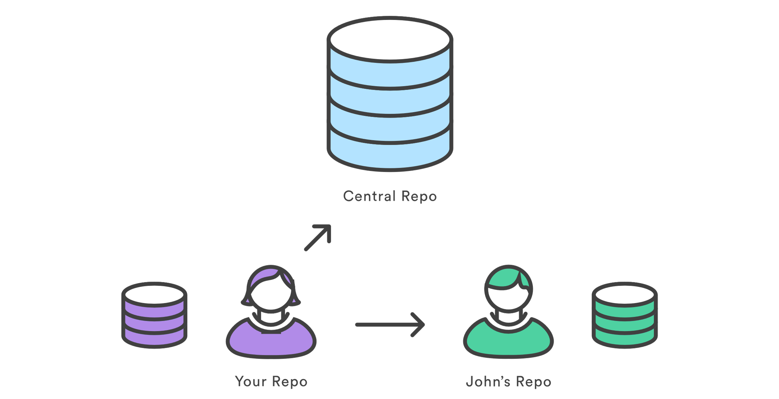
Remotes
Bilder Atlassian GIT Tutorial: https://www.atlassian.com/git/tutorials/syncing

Slide 3
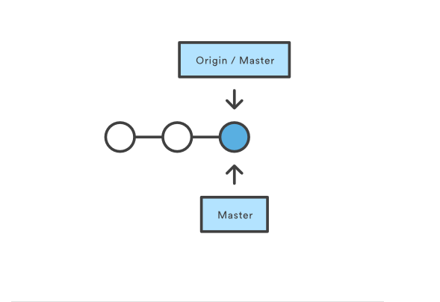
Set Remote

Slide 4
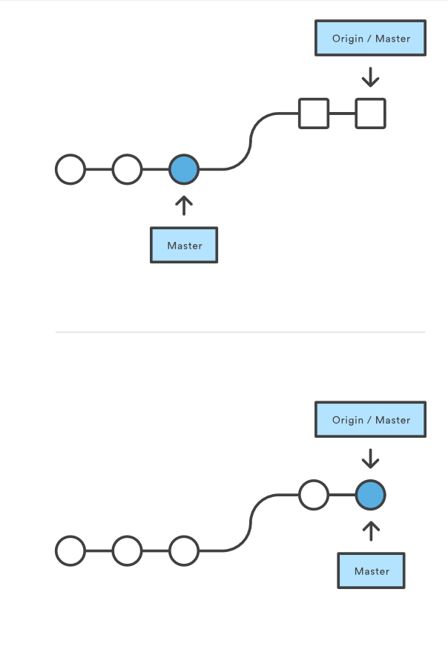
GIT Pull

Slide 5
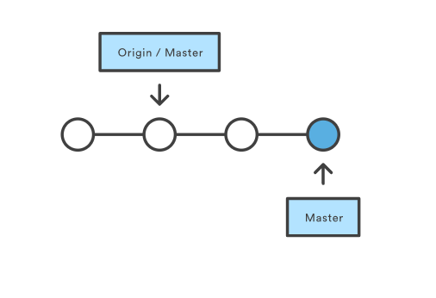
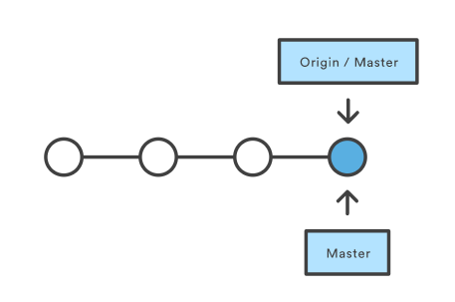
GIT push

Slide 6
Git Clone –Mirror / --Bare
-- bare
copy all branches
Copy all commits
https://help.github.com/articles/duplicating-a-repository/

Slide 7
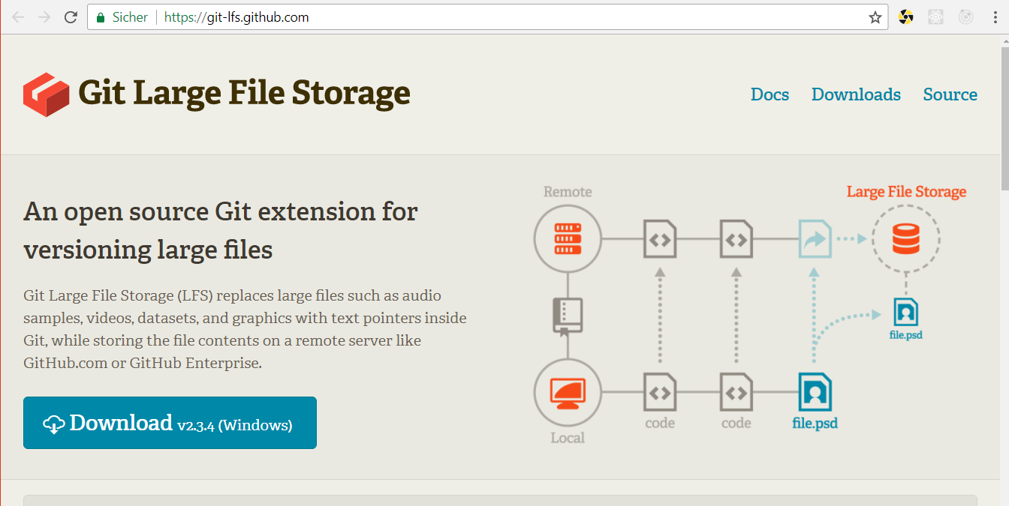
Git Large File Storage

