Slide 1
Github Archologie

Slide 3

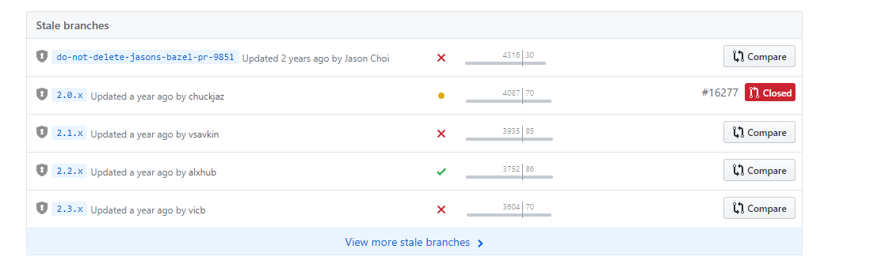
Angular on Github

Slide 4
Branches
https://github.com/angular/angular/tree/do-not-delete-jasons-bazel-pr-9851

Slide 5
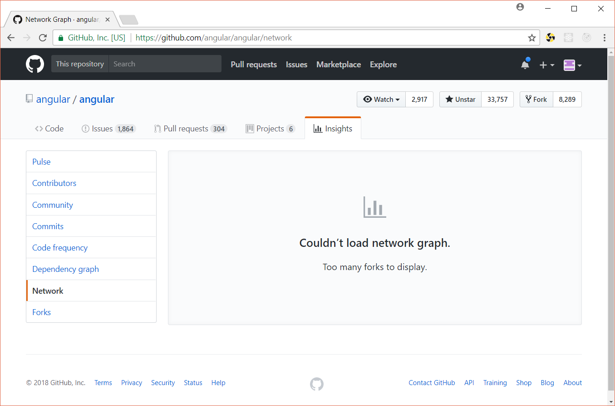
Forks
Eine abspaltung eines Public Read Only Repositories unter anderen Schreibrechten

Slide 6
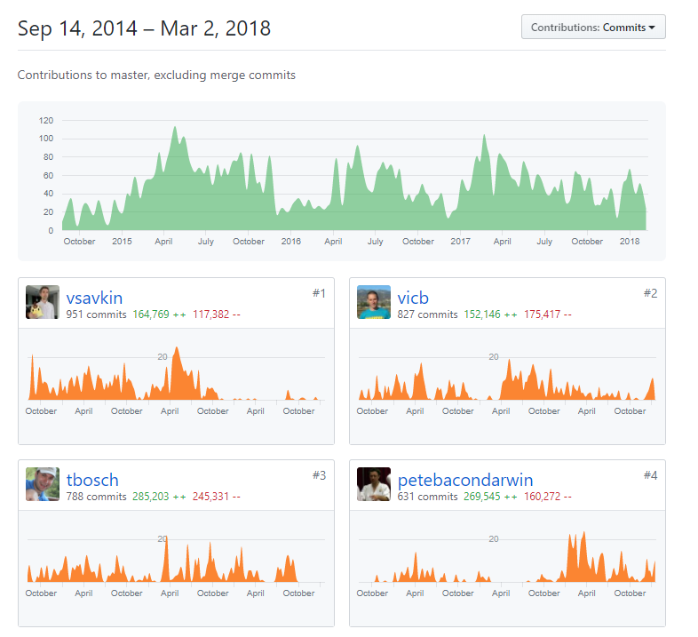
Contributors
https://github.com/angular/angular/graphs/contributors

Slide 7
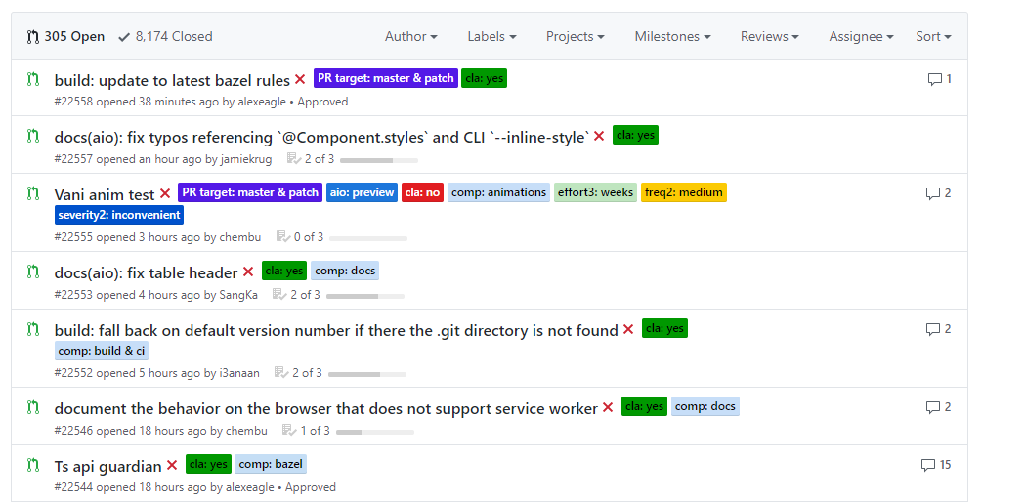
Pull Requests
https://github.com/angular/angular/pulls

Slide 8
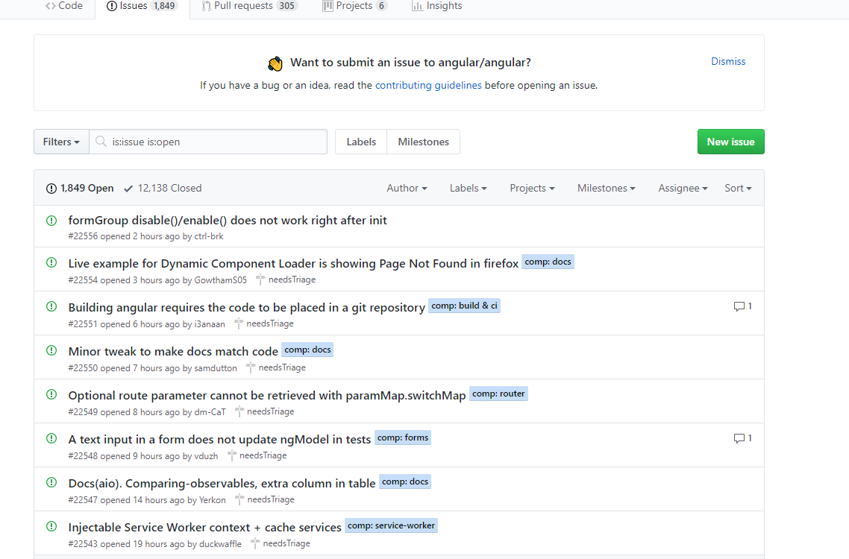
Issues
https://github.com/angular/angular/issues

Slide 9
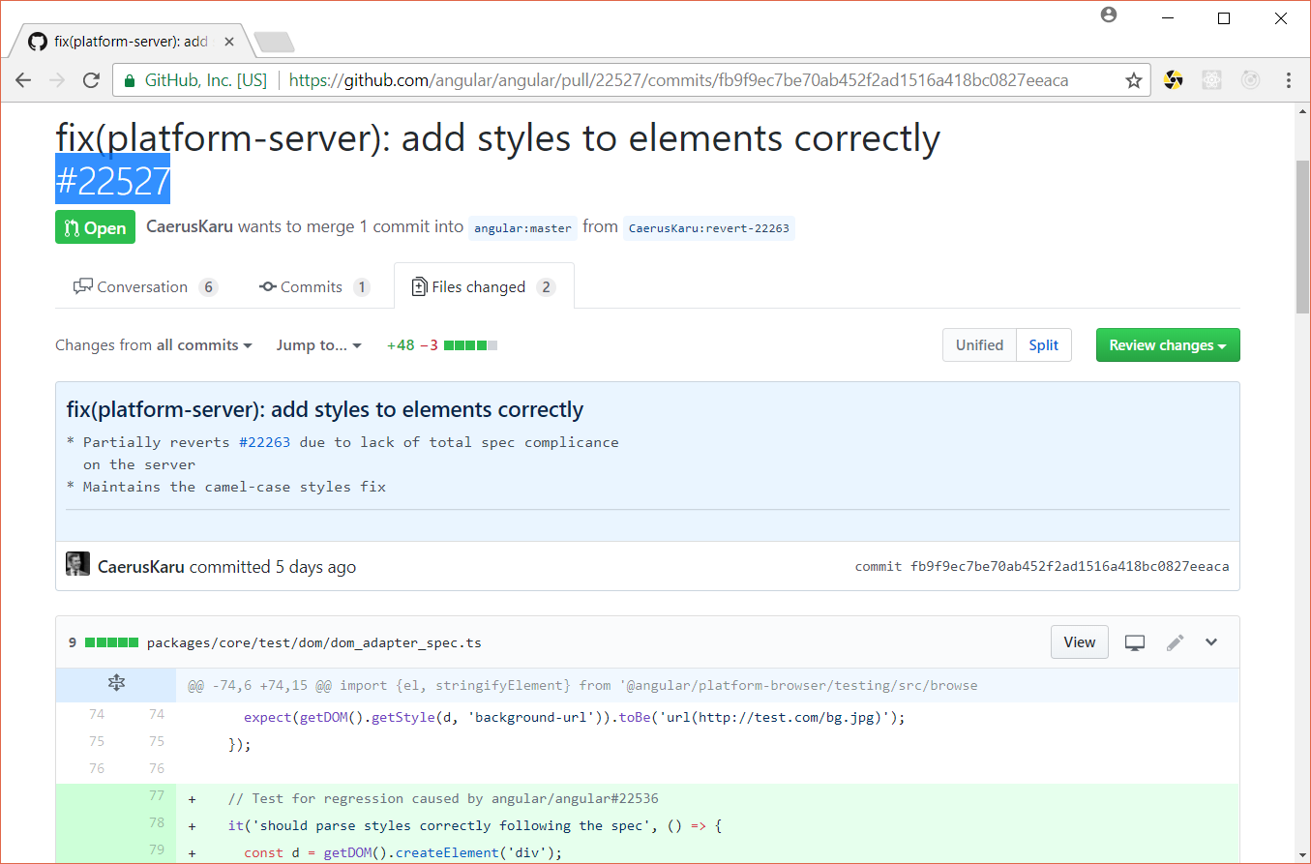
Bugfixes
https://github.com/angular/angular/pull/22527
Fixes https://github.com/angular/angular/issues/19235

Slide 10
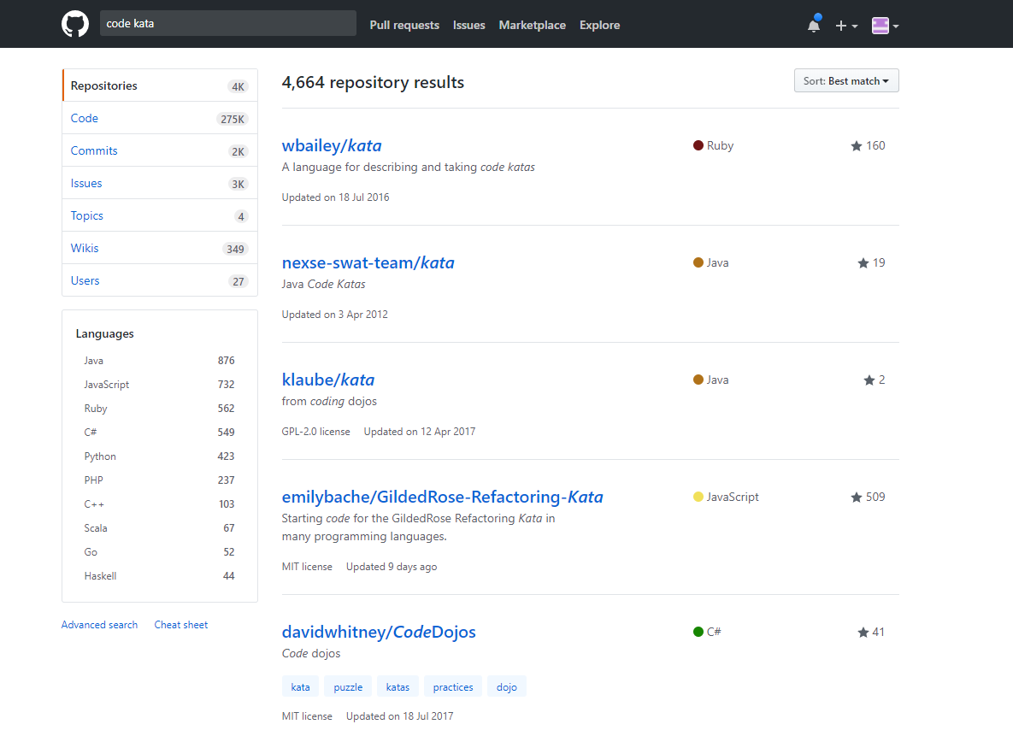
Searching Git

Slide 11




Your favorite open source software
https://github.com/eclipse
https://github.com/NativeScript/NativeScript
https://github.com/topics/spring-boot
https://github.com/Microsoft/vscode

