Slide 1
Tree-ish

Slide 2
Tree ish
https://github.com/janosgyerik/cheatsheets/blob/master/Git-cheat-sheet.md
https://www.kernel.org/pub/software/scm/git/docs/gitrevisions.html#_specifying_revisions
git log HEAD # the current checkout points to this commit
git log HEAD^ # previous commit
git log HEAD^^ # 2 commits ago
git log HEAD~5 # 5 commits ago
git log treeish^ # the commit before "treeish": branch / tag / SHA
git log treeish^^ # 2 commits before treeish
git log treeish~5 # 5 commits before treeish

Slide 3
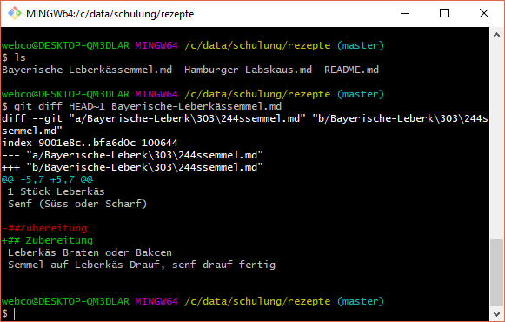
Aktuell gegen vorherige

Slide 4
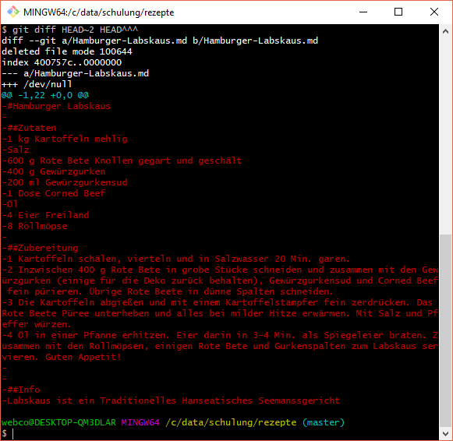
Vorletze version anzeigen
Zwei Versionen miteinander vergleichen

