Slide 1
Hypertable
Doug Judd
Zvents, Inc.

Slide 2
Background

Slide 3
Google Scalable Computing Infrastructure
Google File System (GFS)
Map-reduce
Bigtable
Notes:
Before this infrastructure, many homegrown systems …

Slide 4
Why Google is Winning
Ultimate data-driven company
They run 100,000 map-reduce jobs daily
Learning curve acceleration
  Success -> more data
  More data -> better decisions
  better decisions -> success

Slide 5
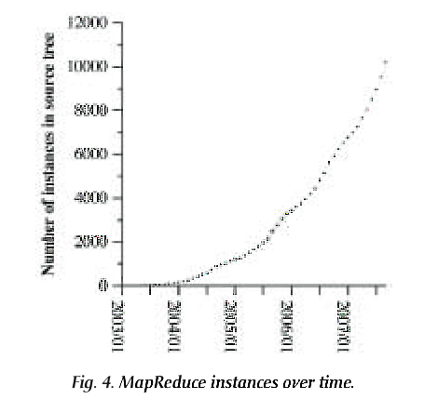
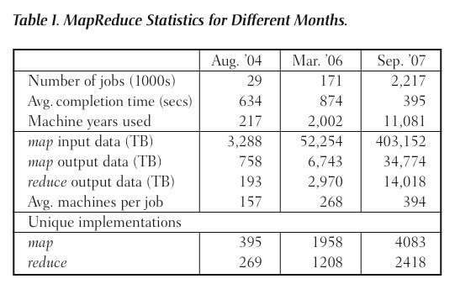
Hyper-Evolution

Slide 6
Why should we care about this technology?
In Web 2.0+, success ⇒ scale
Richer user-to-user and user-to-content interactions
High site usage generates lots of log data
Log data contains valuable behavioural information

Slide 7
Architectural Overview

Slide 8
What is Hypertable?
A high performance, scalable database
Modelled after Google's Bigtable
Open source
Notes:
Genesis crawl database
…

Slide 9
What Hypertable is not
Relational database
Transaction engine

Slide 10
Hypertable Improvements Over MySQL
Scalability
High random insert, update, and delete rate

Slide 11
Data Model
Sparse, multi(4)-dimensional table of information
Cells are identified by a 4-part key
  Row
  Column Family
  Column Qualifier
  Timestamp
Notes:
Spend some time

Slide 12
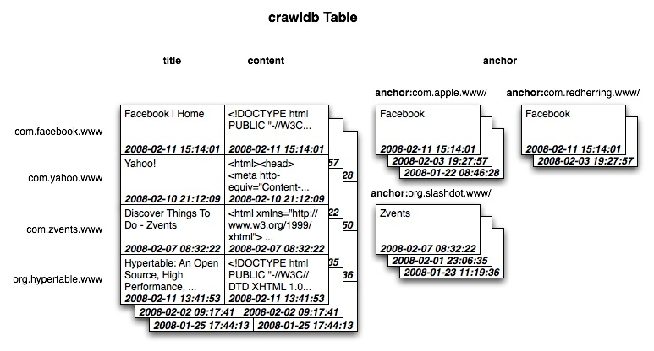
Table: Visual Representation
Notes:
Spend some time.

Slide 13
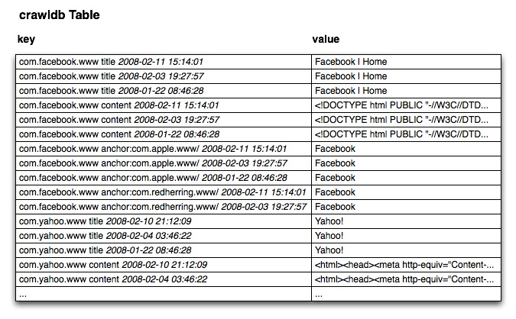
Table: Actual Representation

Slide 14
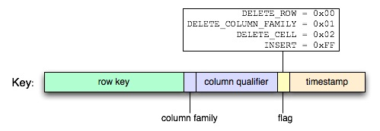
Anatomy of a Key
Row key is \0 terminated
Column Family is represented with 1 byte
Column qualifier is \0 terminated
Timestamp is stored big-endian ones-compliment

Slide 15
Concurrency
Bigtable uses copy-on-write
Hypertable uses a form of MVCC
(multi-version concurrency control)
  Deletes are carried out by inserting “delete” records

Slide 16
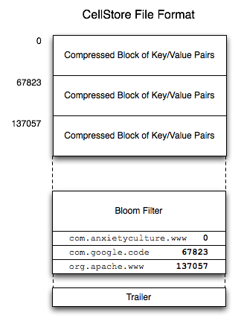
CellStore
Sequence of 65K blocks of compressed key/value pairs

Slide 17
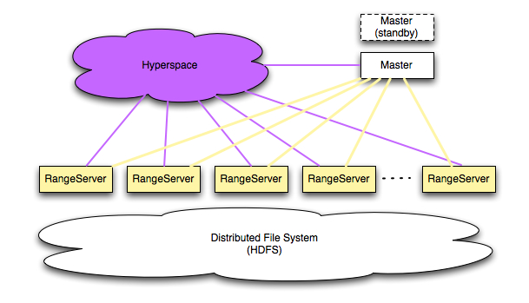
System Overview

Slide 18
Hyperspace
Chubby equivalent
  Distributed Lock Manager
  Filesystem for storing small amounts of metadata
  Highly available
“Root of distributed data structures”

Slide 19
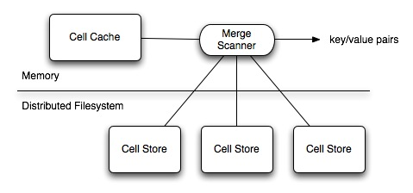
Range Server
Manages ranges of table data
Caches updates in memory (CellCache)
Periodically spills cached updates to disk (CellStore

Slide 20
Master
Single Master (hot standbys)
Directs meta operations
  CREATE TABLE
  DROP TABLE
  ALTER TABLE
Handles recovery of RangeServer
Manages RangeServer Load Balancing
Client data does not move through Master

Slide 21
Client API
class Client {
void create_table(const String &name,
const String &schema);
Table *open_table(const String &name);
String get_schema(const String &name);
void get_tables(vector<String> &tables);
void drop_table(const String &name,
bool if_exists);
};

Slide 22
Client API (cont.)
class Table {
TableMutator *create_mutator();
TableScanner *create_scanner(ScanSpec &scan_spec);
};
class TableMutator {
void set(KeySpec &key, const void *value, int value_len);
void set_delete(KeySpec &key);
void flush();
};
class TableScanner {
bool next(CellT &cell);
};

Slide 23
Language Bindings
Thrift Broker
Rice C++ extension for Ruby

Slide 24
Commit Log
Persists all modifications (inserts and deletes)
Written into underlying DFS

Slide 25
Range Meta-Operation Log
Facilitates Range meta operation
  Loads
  Splits
  Moves
Part of Master and RangeServer
Ensures Range state and location consistency

Slide 26
Compression
Cell Stores store compressed blocks of key/value pairs
Commit Log stores compressed blocks of updates
Supported Compression Schemes
  zlib (--best and --fast)
  lzo
  quicklz
  bmz
  none

Slide 27
Caching
Block Cache
  Caches CellStore blocks
  Blocks are cached uncompressed
Query Cache
  Caches query results
  TBD

Slide 28
Bloom Filter
Negative Cache
Probabilistic data structure
Indicates if key is not present

Slide 29
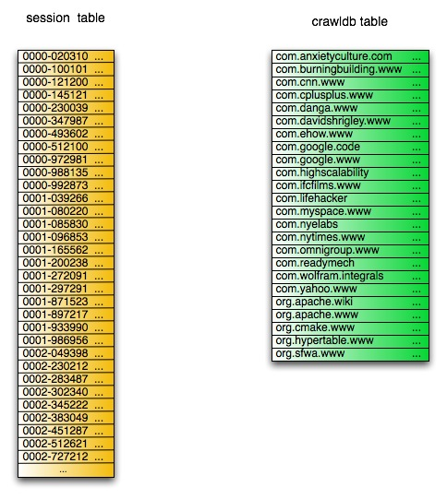
Scaling (part I)

Slide 30
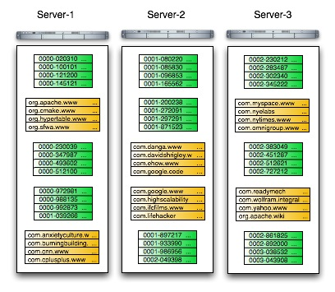
Scaling (part II)

Slide 31
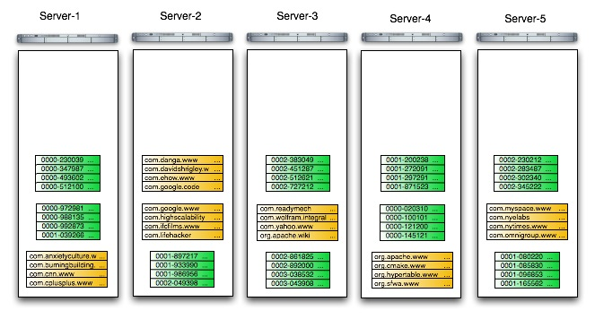
Scaling (part III)

Slide 32
Access Groups
Provides control of physical data layout -- hybrid row/column oriented
Improves performance by minimizing I/O
CREATE TABLE crawldb {
Title MAX_VERSIONS=3,
Content MAX_VERSIONS=3,
PageRank MAX_VERSIONS=10,
ClickRank MAX_VERSIONS=10,
ACCESS GROUP default (Title, Content),
ACCESS GROUP ranking (PageRank, ClickRank)
};
Notes:
Row-oriented
Column-oriented

Slide 33
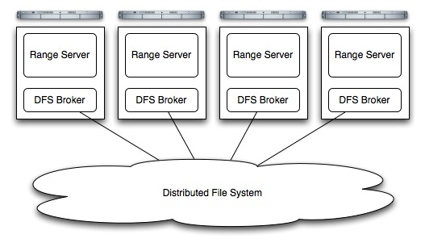
Filesystem Broker Architecture
Hypertable can run on top of any distributed filesystem (e.g. Hadoop, KFS, etc.)

Slide 34
Key To Performance
Asynchronous communication

Slide 35

C++ vs. Java
Hypertable is CPU intensive
  Manages large in-memory key/value map
  Alternate compression codecs (e.g. BMZ)
Hypertable is memory (alloc/free) intensive
  Java uses 2-3 times the amount of memory to manage large in-memory map (e.g. TreeMap)
  Poor processor cache performance
Notes:
Drop the graphic
Talk about tcmalloc

Slide 36
Performance Test
(AOL Query Logs)
75,274,825 inserted cells
8 node cluster
  1 1.8 GHz Dual-core Opteron
  4 GB RAM
  3 x 7200 RPM SATA drives
Average row key: 7 bytes
Average value: 15 bytes
500K random inserts/s
680K scanned cells/s

Slide 37
Weaknesses
Range data managed by a single range server
  Though no data loss, can cause periods of unavailability
  Can be mitigated with client-side cache or memcached

Slide 38
Project Status
Currently in “alpha”
  About to release version 0.9.0.5
Will release “beta” version within a couple of months
Waiting on Hadoop JIRA 1700

Slide 39
License
GPL 2.0
Why not Apache?

Slide 40
Help Wanted

Slide 41
Questions?
http://code.google.com/p/hypertable/
#hypertable @ irc.freenode.net
Doug Judd <doug@zvents.com>
Luke Lu <hypertable@vicaya.com>
Gordon Rios <gordon.rios@zvents.com>
Naveen Koorakula <naveen@cs.unc.edu>

