Slide 1

50.012 Networks Lecture 5: Reliable Data Transfer – Part I
2021 Term 6
Assoc. Prof. CHEN Binbin

Slide 2
Learning Goal
Understand principles behind reliable data transfer
Read textbook Section 3.4
Gentle reminder:
Lab 1 due 28 Sep (Tue) 23:59
Quiz 1: this Friday 1 Oct 9am
Cover the topics from week 1 and 2
True/false and MCQ
25 minutes
Open book, but no peer-to-peer discussion

Slide 3
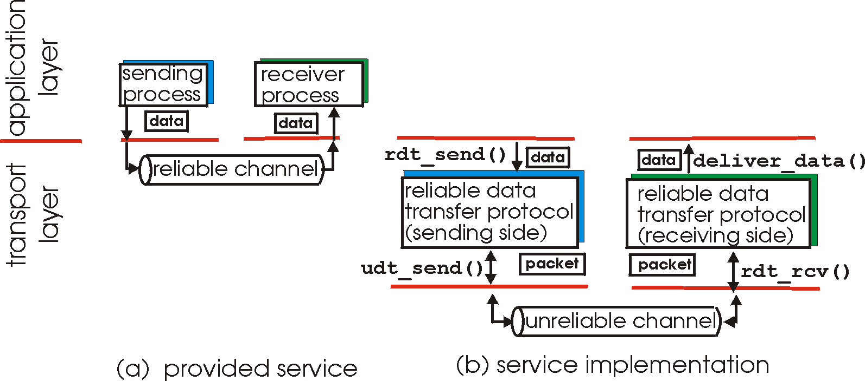
Principles of reliable data transfer
important in application, transport, link layers
top-10 list of important networking topics!
characteristics of unreliable channel will determine complexity of reliable data transfer protocol (rdt)

Slide 4
Principles of reliable data transfer
important in application, transport, link layers
top-10 list of important networking topics!
characteristics of unreliable channel will determine complexity of reliable data transfer protocol (rdt)

Slide 5
Principles of reliable data transfer
important in application, transport, link layers
top-10 list of important networking topics!
characteristics of unreliable channel will determine complexity of reliable data transfer protocol (rdt)

Slide 6
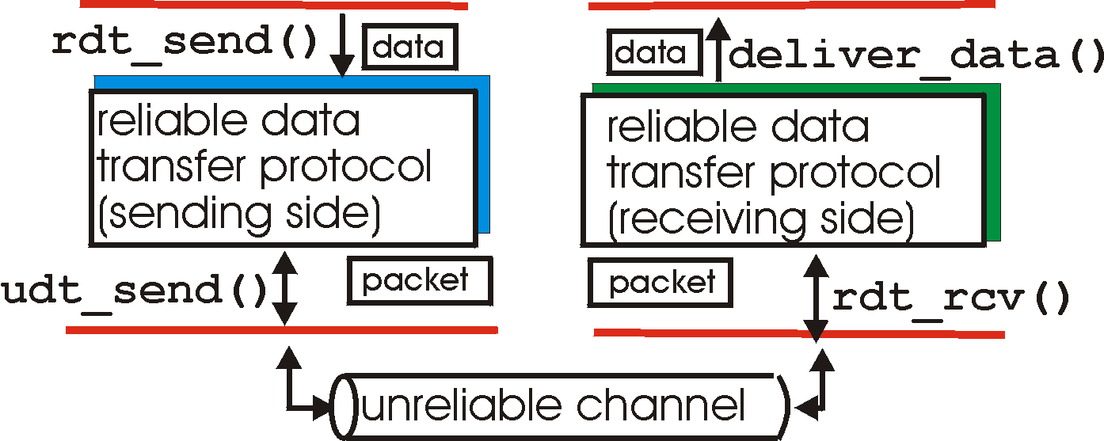
Reliable data transfer: getting started
rdt_send(): called from above, (e.g., by app.). Passed data to
deliver to receiver upper layer
deliver_data(): called by rdt to deliver data to upper
send
side
receive
side
udt_send(): called by rdt,
to transfer packet over
unreliable channel to receiver
rdt_rcv(): called when packet arrives on rcv-side of channel

Slide 7
Reliable data transfer: getting started
we’ll:
incrementally develop sender, receiver sides of reliable data transfer protocol (rdt)
consider only unidirectional data transfer
but control info will flow on both directions!
use finite state machines (FSM) to specify sender, receiver
event causing state transition
actions taken on state transition
state: when in this “state” next state uniquely determined by next event
state
1
state
2
event
actions

Slide 8
Reliable data transfer: roadmap
rdt | Assumptions about underlying channel | #State (sender/ receiver) | Mechanism
1.0 | perfectly reliable | 1 / 1
2.0 | Data packet corrupted with bit errors | 2 / 1 | Checksum ACK/NAK
2.1 | Both data & ACK corrupted with bit errors | 4 / 2 | Seq. #
2.2 | Same as 2.1 | 4 / 2 | Remove NAK
3.0 | With both error and loss | 4 / 2 | Countdown timer

Slide 9
rdt1.0: reliable transfer over a reliable channel
underlying channel perfectly reliable
no bit errors
no loss of packets
separate FSMs for sender, receiver:
sender sends data into underlying channel
receiver reads data from underlying channel
Wait for call from above
rdt_send(data)
Wait for call from below
rdt_rcv(packet)
extract (packet,data)
deliver_data(data)
packet = make_pkt(data)
udt_send(packet)
sender
receiver

Slide 10
rdt2.0: channel with bit errors
underlying channel may flip bits in packet
checksum to detect bit errors
the question: how to recover from errors:
acknowledgements (ACKs): receiver explicitly tells sender that pkt received OK
negative acknowledgements (NAKs): receiver explicitly tells sender that pkt had errors
sender retransmits pkt on receipt of NAK
new mechanisms in rdt2.0 (beyond rdt1.0):
error detection
receiver feedback: control msgs (ACK,NAK) rcvr->sender
How do humans recover from “errors”
during conversation?

Slide 11
rdt2.0: channel with bit errors
underlying channel may flip bits in packet
checksum to detect bit errors
the question: how to recover from errors:
acknowledgements (ACKs): receiver explicitly tells sender that pkt received OK
negative acknowledgements (NAKs): receiver explicitly tells sender that pkt had errors
sender retransmits pkt on receipt of NAK
new mechanisms in rdt2.0 (beyond rdt1.0):
error detection
feedback: control msgs (ACK,NAK) from receiver to sender

Slide 12
rdt2.0: FSM specification
rdt_send(data)
sndpkt = make_pkt(data, checksum)
udt_send(sndpkt)
receiver
rdt_rcv(rcvpkt) &&
isNAK(rcvpkt)
Wait for call from above
Wait for ACK or NAK
rdt_rcv(rcvpkt) &&
corrupt(rcvpkt)
udt_send(sndpkt)
udt_send(NAK)
rdt_rcv(rcvpkt) && isACK(rcvpkt)
Λ
Wait for call from below
sender
rdt_rcv(rcvpkt) &&
notcorrupt(rcvpkt)
extract(rcvpkt,data)
deliver_data(data)
udt_send(ACK)

Slide 13
rdt2.0: operation with no errors
rdt_send(data)
snkpkt = make_pkt(data, checksum)
udt_send(sndpkt)
rdt_rcv(rcvpkt) &&
isNAK(rcvpkt)
Wait for call from above
Wait for ACK or NAK
rdt_rcv(rcvpkt) &&
corrupt(rcvpkt)
udt_send(sndpkt)
udt_send(NAK)
rdt_rcv(rcvpkt) && isACK(rcvpkt)
Wait for call from below
Λ
rdt_rcv(rcvpkt) &&
notcorrupt(rcvpkt)
extract(rcvpkt,data)
deliver_data(data)
udt_send(ACK)

Slide 14
rdt2.0: error scenario
rdt_send(data)
snkpkt = make_pkt(data, checksum)
udt_send(sndpkt)
rdt_rcv(rcvpkt) &&
isNAK(rcvpkt)
Wait for call from above
Wait for ACK or NAK
rdt_rcv(rcvpkt) &&
corrupt(rcvpkt)
udt_send(sndpkt)
udt_send(NAK)
rdt_rcv(rcvpkt) && isACK(rcvpkt)
Wait for call from below
Λ
rdt_rcv(rcvpkt) &&
notcorrupt(rcvpkt)
extract(rcvpkt,data)
deliver_data(data)
udt_send(ACK)

Slide 15
rdt2.0 has a fatal flaw!
What is that?

Slide 16
rdt2.0 has a fatal flaw!
what happens if ACK/NAK corrupted?
sender doesn’t know what happened at receiver!
can’t just retransmit: possible duplicate
handling duplicates:
sender retransmits current pkt if ACK/NAK corrupted
sender adds sequence number to each pkt
receiver discards (doesn’t deliver up) duplicate pkt
stop and wait
sender sends one packet,
then waits for receiver
response

Slide 17
rdt2.1: sender, handles garbled ACK/NAKs
rdt_send(data)
sndpkt = make_pkt(0, data, checksum)
udt_send(sndpkt)
rdt_rcv(rcvpkt) &&
( corrupt(rcvpkt) ||
isNAK(rcvpkt) )
Wait for call 0 from above
Wait for ACK or NAK 0
udt_send(sndpkt)
rdt_rcv(rcvpkt)
&& notcorrupt(rcvpkt)
&& isACK(rcvpkt)
rdt_rcv(rcvpkt)
&& notcorrupt(rcvpkt)
&& isACK(rcvpkt)
Λ
Λ
Wait for ACK or NAK 1
Wait for
call 1 from above
rdt_rcv(rcvpkt) &&
( corrupt(rcvpkt) ||
isNAK(rcvpkt) )
rdt_send(data)
udt_send(sndpkt)
sndpkt = make_pkt(1, data, checksum)
udt_send(sndpkt)

Slide 18
rdt2.1: receiver, handles garbled ACK/NAKs
rdt_rcv(rcvpkt) && notcorrupt(rcvpkt)
&& has_seq0(rcvpkt)
extract(rcvpkt,data)
deliver_data(data)
sndpkt = make_pkt(ACK, chksum)
udt_send(sndpkt)
rdt_rcv(rcvpkt) && (corrupt(rcvpkt)
rdt_rcv(rcvpkt) && (corrupt(rcvpkt)
sndpkt = make_pkt(NAK, chksum)
udt_send(sndpkt)
sndpkt = make_pkt(NAK, chksum)
udt_send(sndpkt)
Wait for
0 from below
Wait for
1 from below
rdt_rcv(rcvpkt) &&
not corrupt(rcvpkt) &&
has_seq1(rcvpkt)
rdt_rcv(rcvpkt) &&
not corrupt(rcvpkt) &&
has_seq0(rcvpkt)
sndpkt = make_pkt(ACK, chksum)
udt_send(sndpkt)
sndpkt = make_pkt(ACK, chksum)
udt_send(sndpkt)
rdt_rcv(rcvpkt) && notcorrupt(rcvpkt)
&& has_seq1(rcvpkt)
extract(rcvpkt,data)
deliver_data(data)
sndpkt = make_pkt(ACK, chksum)
udt_send(sndpkt)

Slide 19
rdt2.1: discussion
sender:
seq # added to pkt
two seq. #’s (0,1) will suffice. Why?
must check if received ACK/NAK corrupted
twice as many states
state must “remember” whether “expected” pkt should have seq # of 0 or 1
receiver:
must check if received packet is duplicate
state indicates whether 0 or 1 is expected pkt seq #
note: receiver cannot know if its last ACK/NAK received OK at sender

Slide 20
rdt2.2: a NAK-free protocol
same functionality as rdt2.1, using ACKs only
instead of NAK, receiver sends ACK for last pkt received OK
receiver must explicitly include seq # of pkt being ACKed
duplicate ACK at sender results in same action as NAK: retransmit current pkt

Slide 21
rdt2.2: sender, receiver fragments
rdt_send(data)
sndpkt = make_pkt(0, data, checksum)
udt_send(sndpkt)
rdt_rcv(rcvpkt) &&
( corrupt(rcvpkt) ||
isACK(rcvpkt,1) )
Wait for call 0 from above
Wait for ACK
0
udt_send(sndpkt)
sender FSM
fragment
rdt_rcv(rcvpkt)
&& notcorrupt(rcvpkt)
&& isACK(rcvpkt,0)
rdt_rcv(rcvpkt) &&
(corrupt(rcvpkt) ||
has_seq1(rcvpkt))
Λ
Wait for
0 from below
receiver FSM
fragment
udt_send(sndpkt)
rdt_rcv(rcvpkt) && notcorrupt(rcvpkt)
&& has_seq1(rcvpkt)
extract(rcvpkt,data)
deliver_data(data)
sndpkt = make_pkt(ACK1, chksum)
udt_send(sndpkt)

Slide 22
rdt3.0: channels with errors and loss
new assumption: underlying channel can also lose packets (data, ACKs)
checksum, seq. #, ACKs, retransmissions will be of help … but not enough
approach: sender waits “reasonable” amount of time for ACK
retransmits if no ACK received in this time
if pkt (or ACK) just delayed (not lost):
retransmission will be duplicate, but seq. #’s already handles this
receiver must specify seq # of pkt being ACKed
requires countdown timer

Slide 23
rdt3.0 sender
rdt_send(data)
rdt_rcv(rcvpkt) &&
( corrupt(rcvpkt) ||
isACK(rcvpkt,1) )
sndpkt = make_pkt(0, data, checksum)
udt_send(sndpkt)
start_timer
rdt_rcv(rcvpkt)
Λ
Λ
Wait for
call 0from above
Wait for ACK0
timeout
udt_send(sndpkt)
start_timer
rdt_rcv(rcvpkt)
&& notcorrupt(rcvpkt)
&& isACK(rcvpkt,1)
rdt_rcv(rcvpkt)
&& notcorrupt(rcvpkt)
&& isACK(rcvpkt,0)
stop_timer
stop_timer
Wait for ACK1
Wait for
call 1 from above
timeout
udt_send(sndpkt)
start_timer
rdt_rcv(rcvpkt)
rdt_send(data)
Λ
rdt_rcv(rcvpkt) &&
( corrupt(rcvpkt) ||
isACK(rcvpkt,0) )
sndpkt = make_pkt(1, data, checksum)
udt_send(sndpkt)
start_timer
Λ

Slide 24

rdt3.0 in action
sender
receiver
sender
receiver
send pkt0
pkt0
send pkt0
pkt0
rcv pkt0
rcv pkt0
ack0
send ack0
ack0
send ack0
rcv ack0
rcv ack0
send pkt1
pkt1
send pkt1
pkt1
rcv pkt1
X
ack1
send ack1
loss
rcv ack1
send pkt0
pkt0
rcv pkt0
timeout
resend pkt1
ack0
send ack0
pkt1
rcv pkt1
ack1
send ack1
rcv ack1
send pkt0
pkt0
(a) no loss
rcv pkt0
ack0
send ack0
(b) packet loss

Slide 25
rdt3.0 in action
sender
receiver
sender
receiver
send pkt0
pkt0
send pkt0
pkt0
rcv pkt0
rcv pkt0
ack0
send ack0
send ack0
rcv ack0
ack0
send pkt1
pkt1
rcv ack0
rcv pkt1
send pkt1
pkt1
send ack1
rcv pkt1
ack1
send ack1
ack1
X
loss
timeout
resend pkt1
pkt1
rcv pkt1
timeout
resend pkt1
rcv ack1
pkt1
rcv pkt1
pkt0
(detect duplicate)
send pkt0
send ack1
ack1
(detect duplicate)
ack1
rcv pkt0
rcv ack1
send ack1
rcv ack1
ack0
send ack0
pkt0
send pkt0
pkt0
send pkt0
rcv pkt0
rcv pkt0
ack0
(detect duplicate)
ack0
send ack0
send ack0
(c) ACK loss
(d) premature timeout/ delayed ACK

Slide 26
Performance of rdt3.0
rdt3.0 is correct, but performance stinks
e.g.: 1 Gbps link, 15 ms prop. delay, 8000-bit packet:
L
8000 bits
D_{trans} =
=
=
8 microsecs
R
10⁹ bits/sec
U _{sender}: utilization – fraction of time sender busy sending
if RTT=30 msec, 1KB pkt every 30 msec: 33kB/sec thruput over 1 Gbps link
network protocol limits use of physical resources!

Slide 27
rdt3.0: stop-and-wait operation
sender
receiver
first packet bit transmitted, t = 0
last packet bit transmitted, t = L / R
first packet bit arrives
RTT
last packet bit arrives, send ACK
ACK arrives, send next
packet, t = RTT + L / R

Slide 28
Reliable data transfer: summary
rdt | Assumptions about underlying channel | #State (sender/ receiver) | Mechanism
1.0 | perfectly reliable | 1 / 1
2.0 | Data packet corrupted with bit errors | 2 / 1 | Checksum ACK/NAK
2.1 | Both data & ACK corrupted with bit errors | 4 / 2 | Seq. #
2.2 | Same as 2.1 | 4 / 2 | Remove NAK
3.0 | With both error and loss | 4 / 2 | Countdown timer

