Slide 1
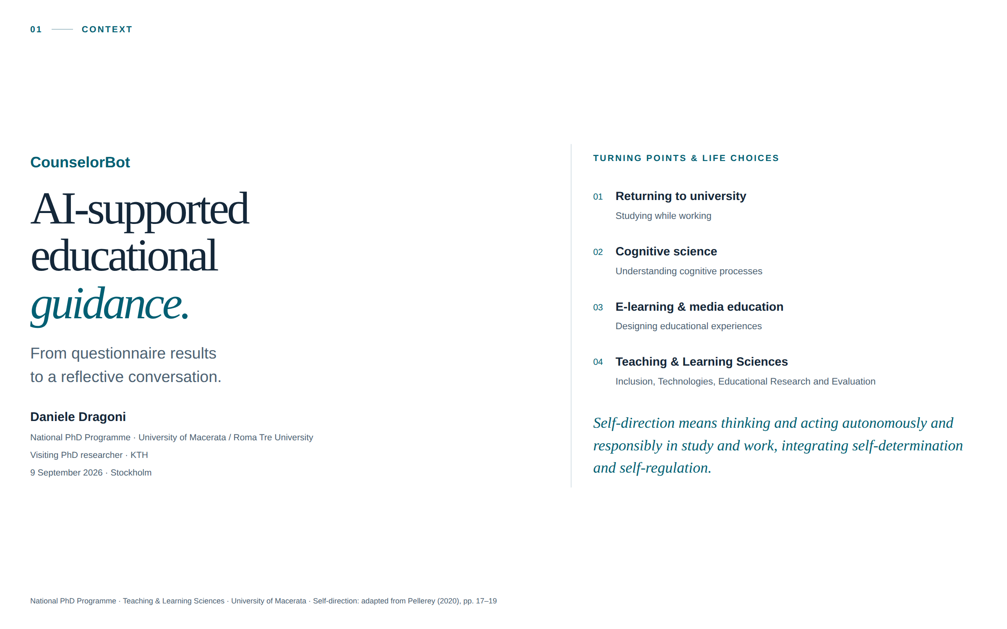
Notes:
Good morning, everyone. My name is Daniele Dragoni. I am a visiting PhD researcher, currently enrolled in a national PhD programme coordinated by the University of Macerata, with my research activities based at Roma Tre University. My research stay here lasts from May 1st to October 31st. My doctoral research concerns AI and education, and today I will present CounselorBot: a system developed to support reflection in educational and career guidance. My interest in this subject also has a personal dimension. I returned to university while working, to complete a bachelor's degree I had left unfinished. With the support of people who encouraged me to continue, I went on to complete two master's degrees, one in Cognitive Sciences and Communication and another in E-learning and Media Education, and eventually began my PhD, which I am now close to completing. That experience made the relationship between learning, personal choices and human support very concrete for me. In Italy we say, “it is never too late to learn”. The project I will discuss today asks how AI might contribute to that process, and how we can investigate the quality of its contribution.

Slide 2
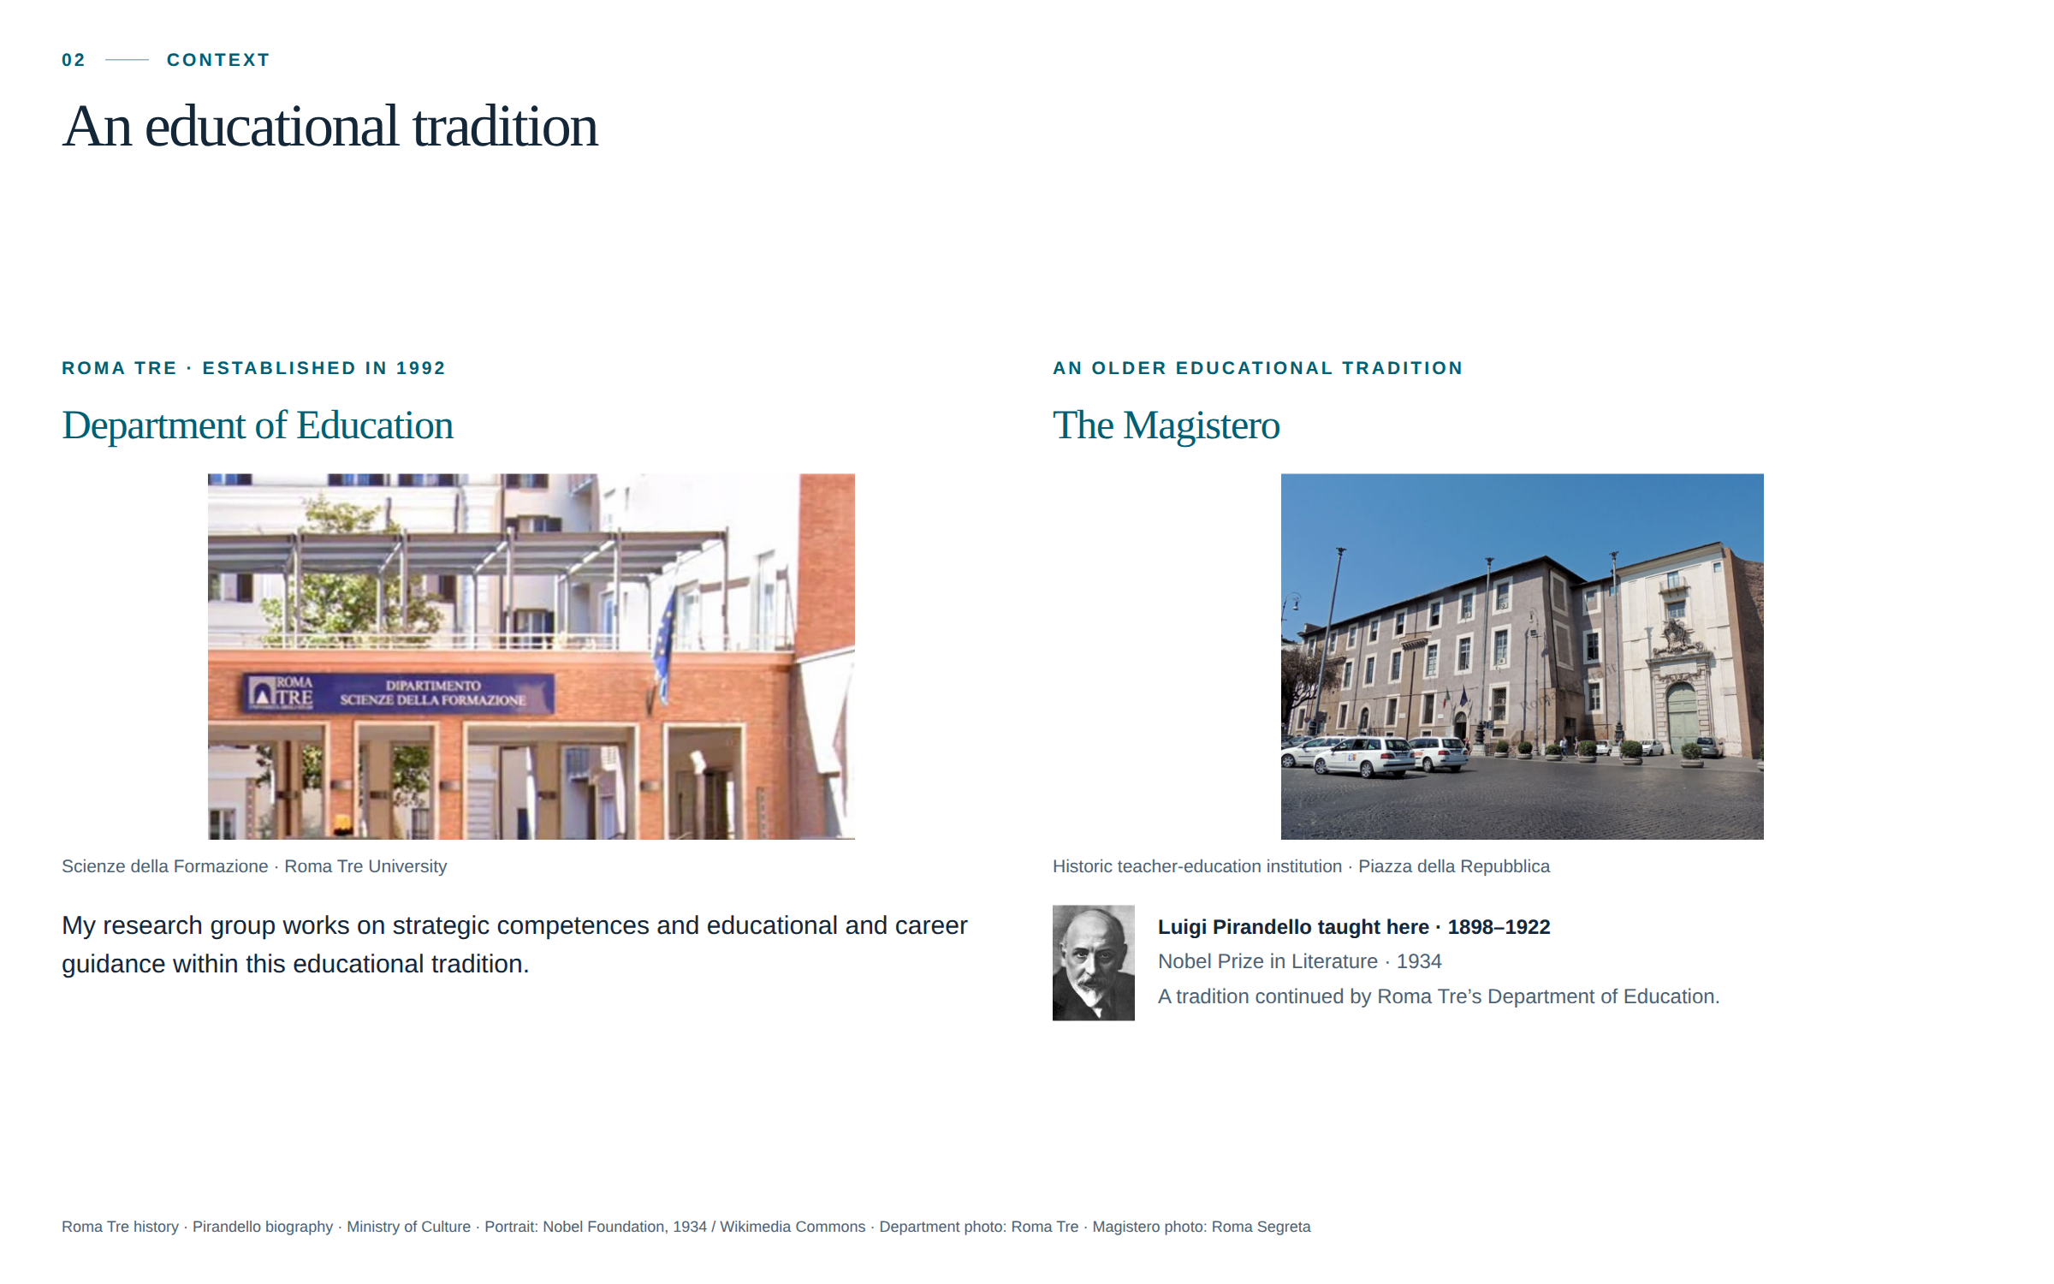
Notes:
A few words about the context of this work. As I mentioned earlier, I’m from the Department of Education at Roma Tre University. The university carries on the tradition of Rome’s Magistero, an institution dedicated to teacher education. Among the distinguished scholars who taught there was Luigi Pirandello, the Italian writer and playwright who later received the Nobel Prize in Literature. Roma Tre has also helped revitalise Ostiense, a former industrial district of Rome where disused factories and neglected spaces have been transformed into university buildings. By bringing students, teaching and research into the neighbourhood, the university has contributed to giving the area new life. This reminds me of places here in Stockholm, such as Fotografiska, where I see a similar connection between the reuse of older buildings, culture and urban renewal. My project develops within this educational context, through the work of my research group on strategic competences and guidance.

Slide 3
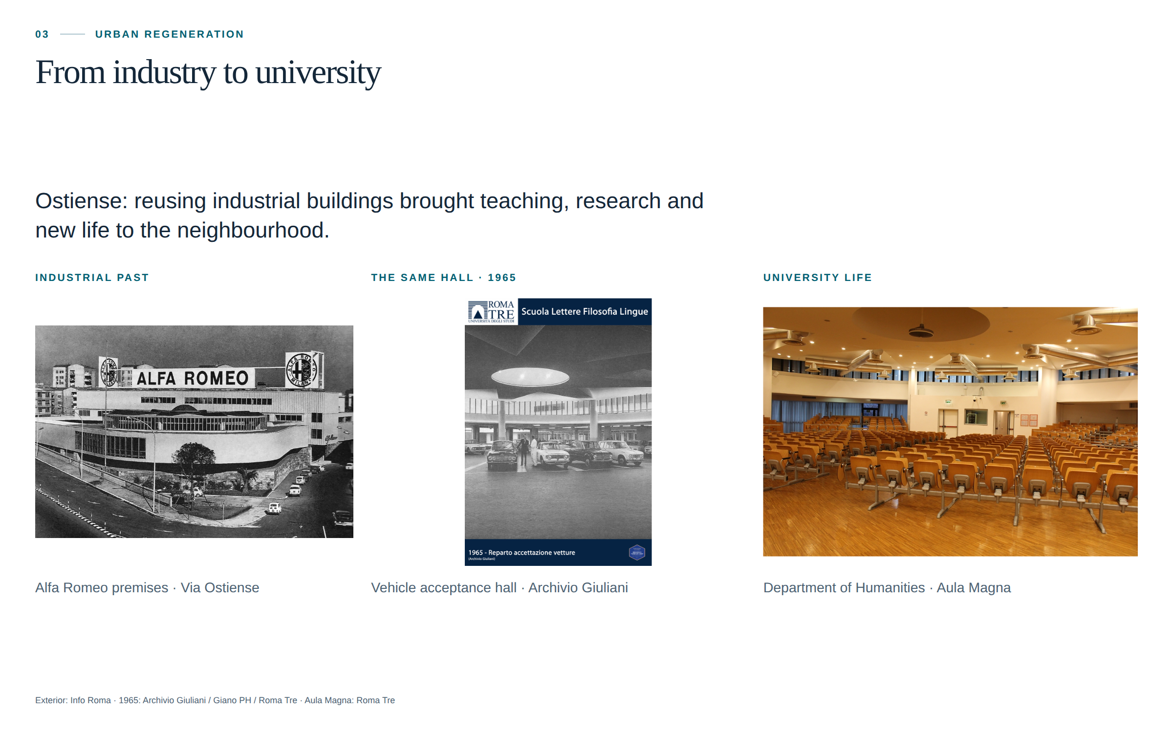
Notes:
Visual slide — no prepared spoken text.

Slide 4
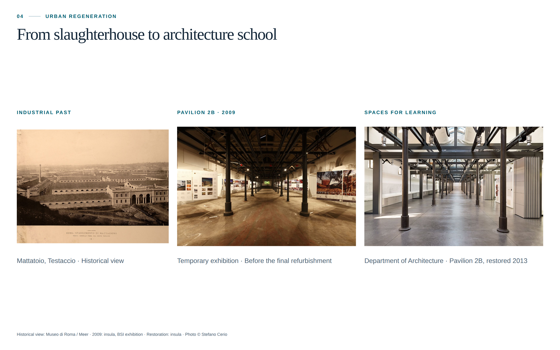
Notes:
Visual slide — no prepared spoken text.

Slide 5
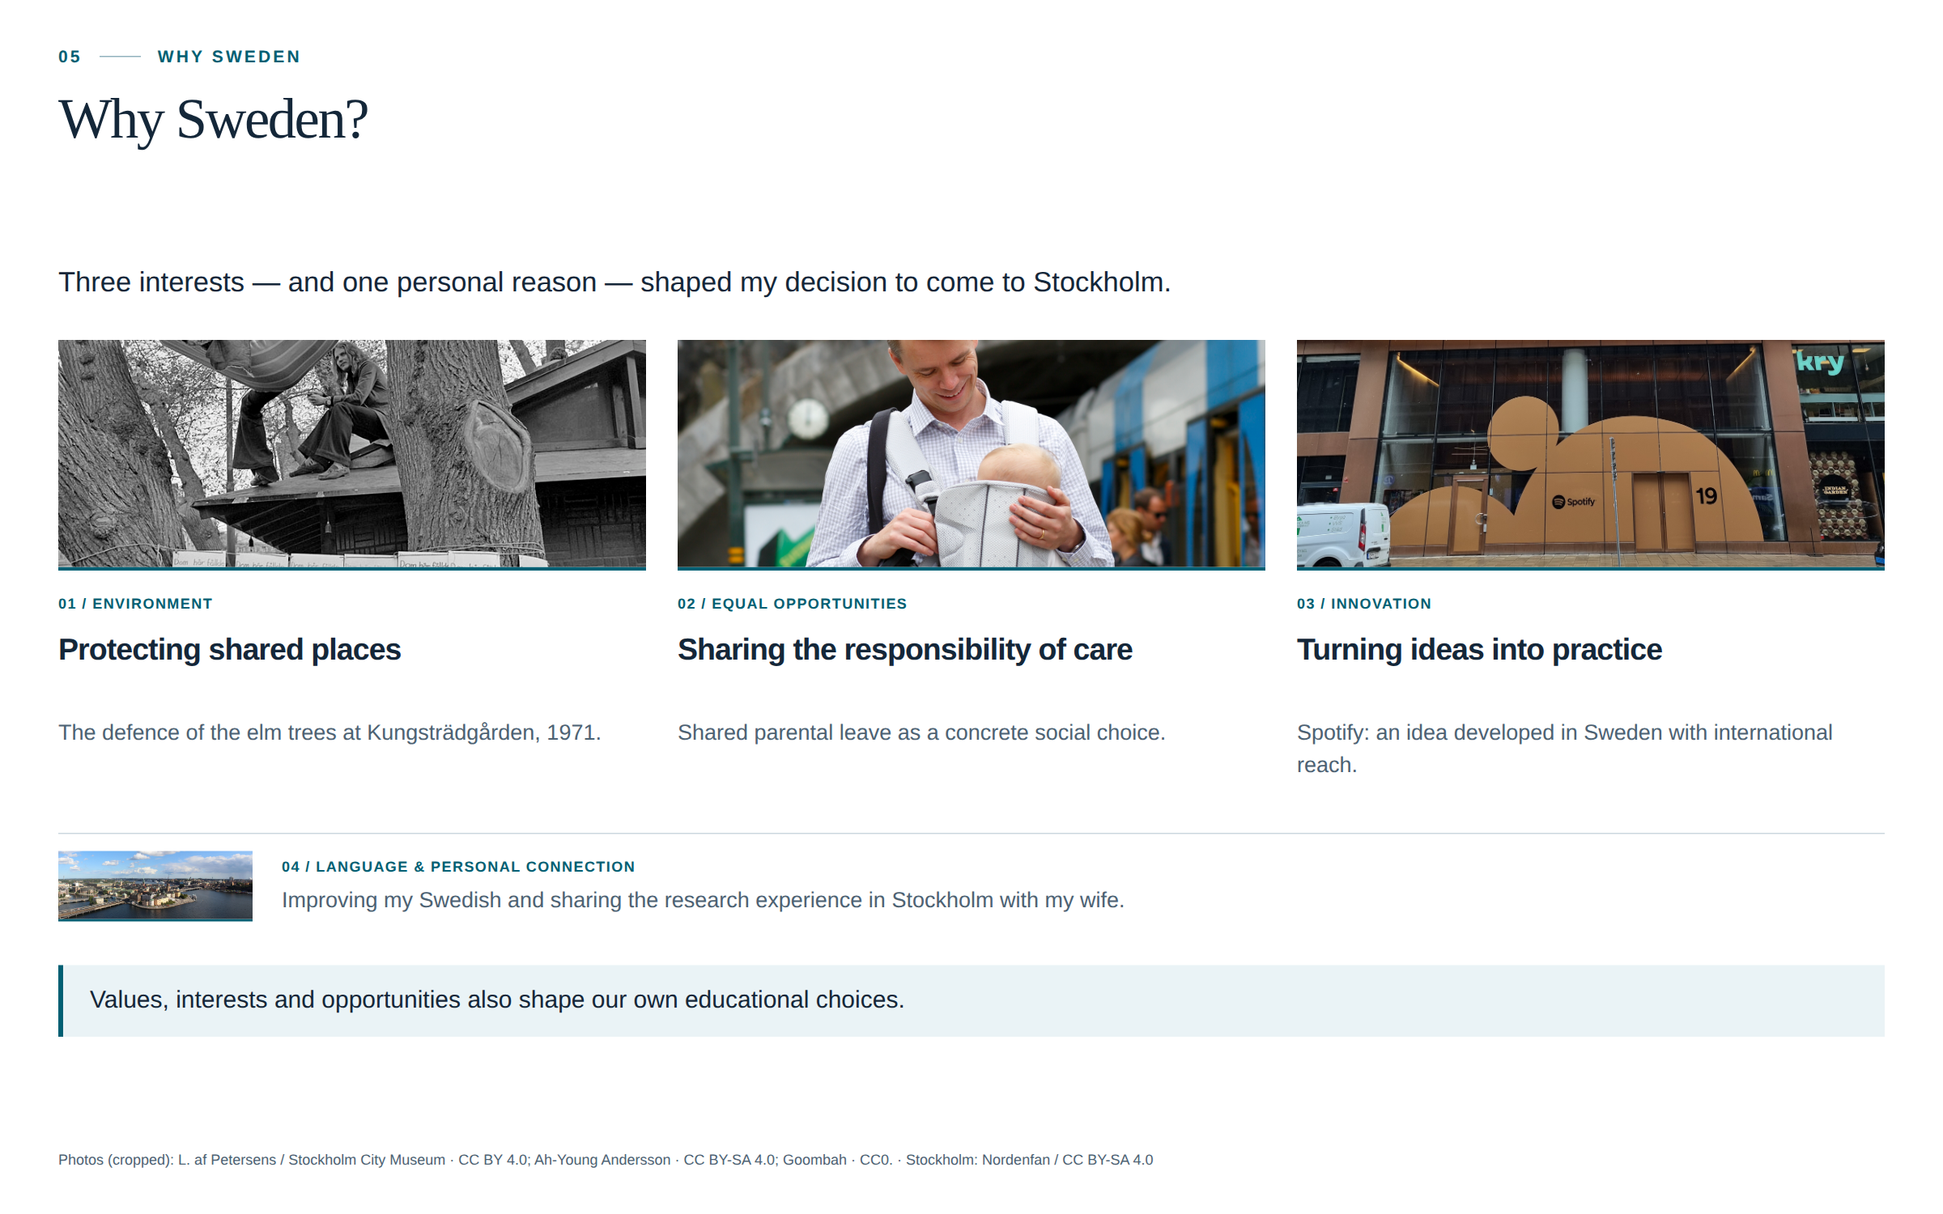
Notes:
I would also like to explain why I chose Sweden for my research stay. Three aspects particularly interested me: its environmental engagement, its commitment to equal opportunities, and its capacity for innovation. The defence of the elm trees in Kungsträdgården is an example of citizens taking action to protect their environment. Shared parental leave reflects a commitment to making equal opportunities part of everyday family life. And Spotify is an example of how an idea can develop into an innovation with international reach. There was also a more personal reason. I wanted to improve my Swedish, which I started learning several years ago together with my wife. She is also doing a research stay here in Stockholm, so coming here gave us the opportunity to continue this experience together. These aspects made me curious about Sweden and Stockholm. I thought this would be a stimulating place to spend six months, complete my doctoral research and work on my thesis.

Slide 6
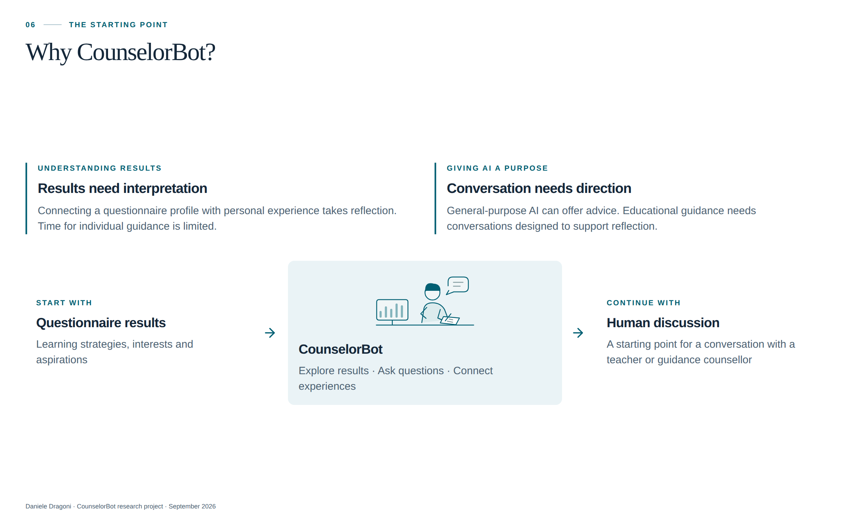
Notes:
And now, after this brief introduction, let us come to the heart of the presentation. One of my PhD projects concerns the use of AI to support students in the guidance process. It is in this context that I developed CounselorBot. The starting point is a concrete problem. We have various guidance tools, such as self-assessment questionnaires, that help students explore learning strategies, abilities, interests and aspirations. But receiving questionnaire results does not necessarily mean understanding them or knowing how to connect them to one's own experience. Usually, a teacher, tutor or guidance counsellor supports this step: they help the student read the results, ask themselves whether they recognise themselves in them, and reflect on concrete situations. The time available, however, does not always allow every student to have an in-depth individual discussion. There is a second motivation as well. Students use AI to look for information and study, but also to ask for advice about study choices, work and aspects of their lives. General-purpose systems can answer these questions, but they are not specifically designed for educational guidance. Their ability to sustain a conversation could support educational guidance. The question is how to design that conversation so that it helps students understand their results and reflect on their own experiences. CounselorBot helps students explore their questionnaire results and connect them with their own experiences. They can ask questions, reflect on what the results mean to them, and use what emerges as a starting point for a conversation with a teacher or guidance counsellor.

Slide 7
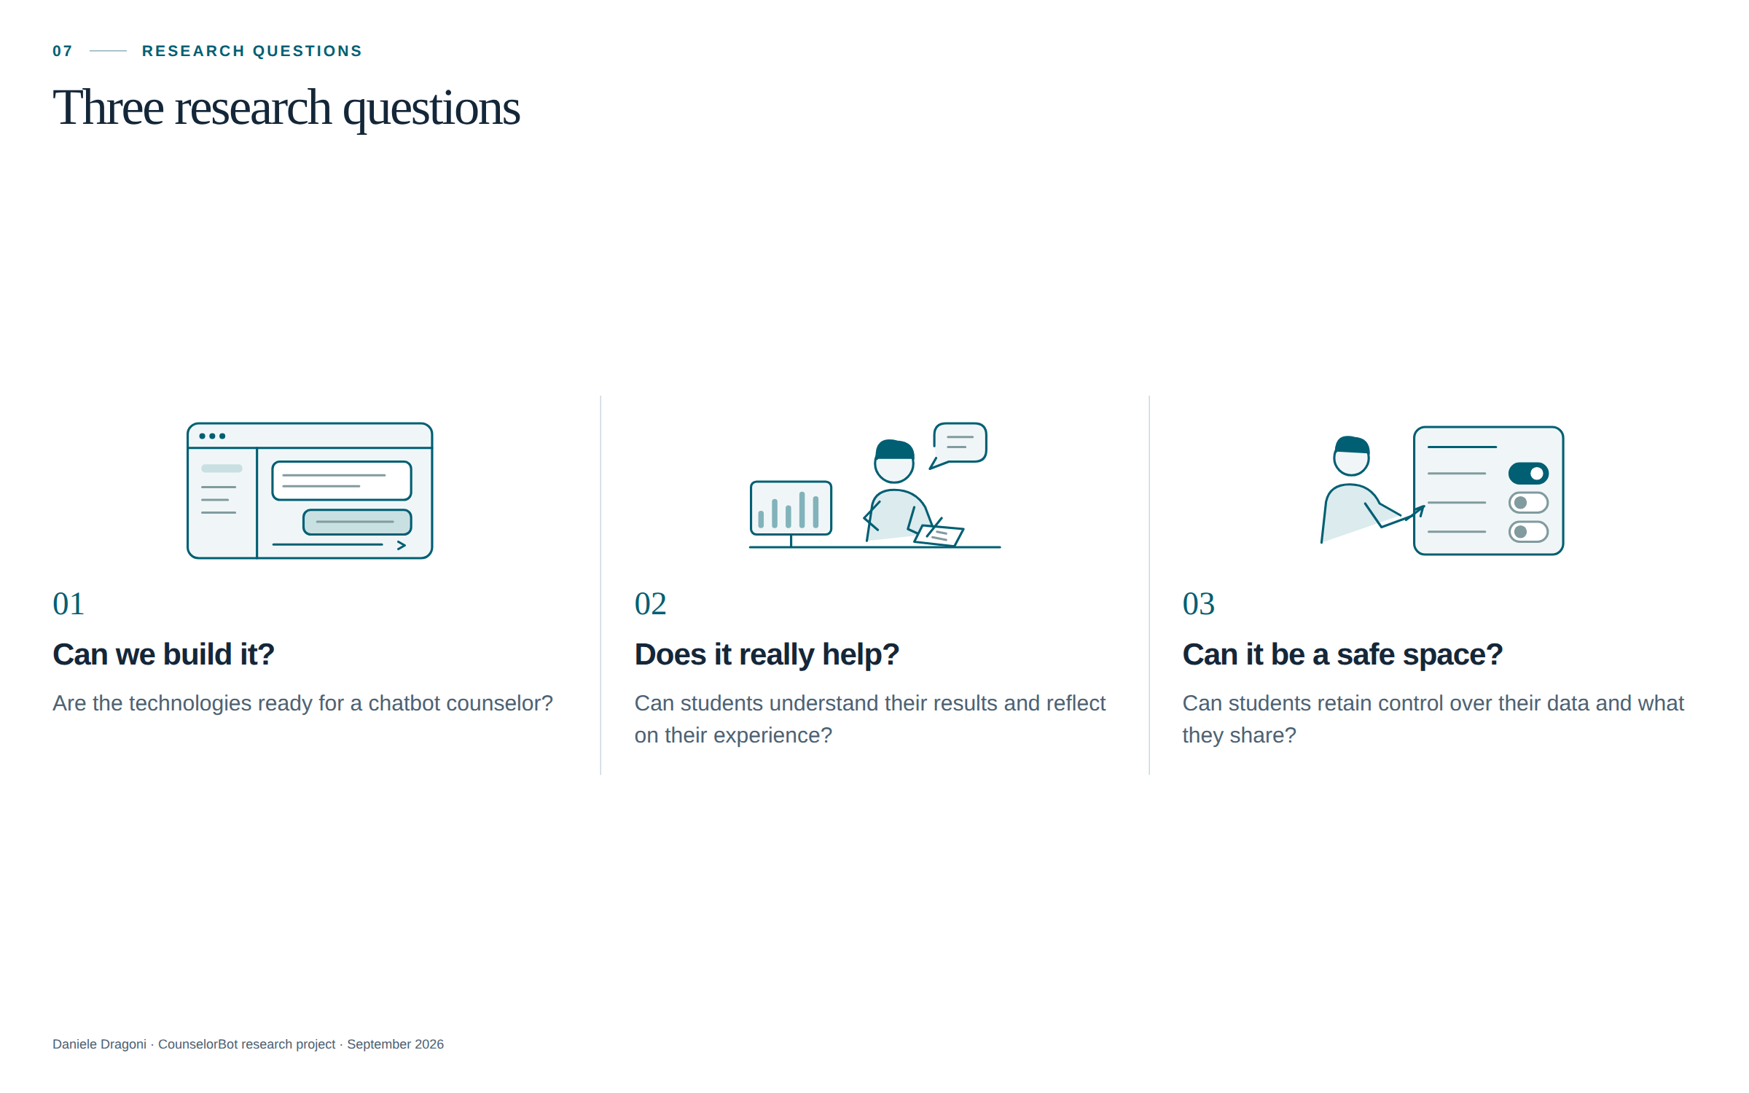
Notes:
Together with my research group and my supervisor Massimo Margottini, we asked ourselves three questions. The first: is it possible to build a chatbot that plays a counselling role in guidance? Do we already have the necessary technologies? Are they mature enough to support this kind of interaction? The second: can it really help students read and interpret questionnaire results? Can it help them connect those results to their own experience? Do the questions it asks stimulate reflection? Can it support them in exploring their choices, leaving them room to reach their own conclusions? The third: can we create a safe space where students can store their data and reflect on their experiences? How can we protect this information and leave students in control of what they share? I will briefly explain the pedagogical framework and then show you how CounselorBot works. My aim today is to invite your help in improving the conversation it offers students.

Slide 8
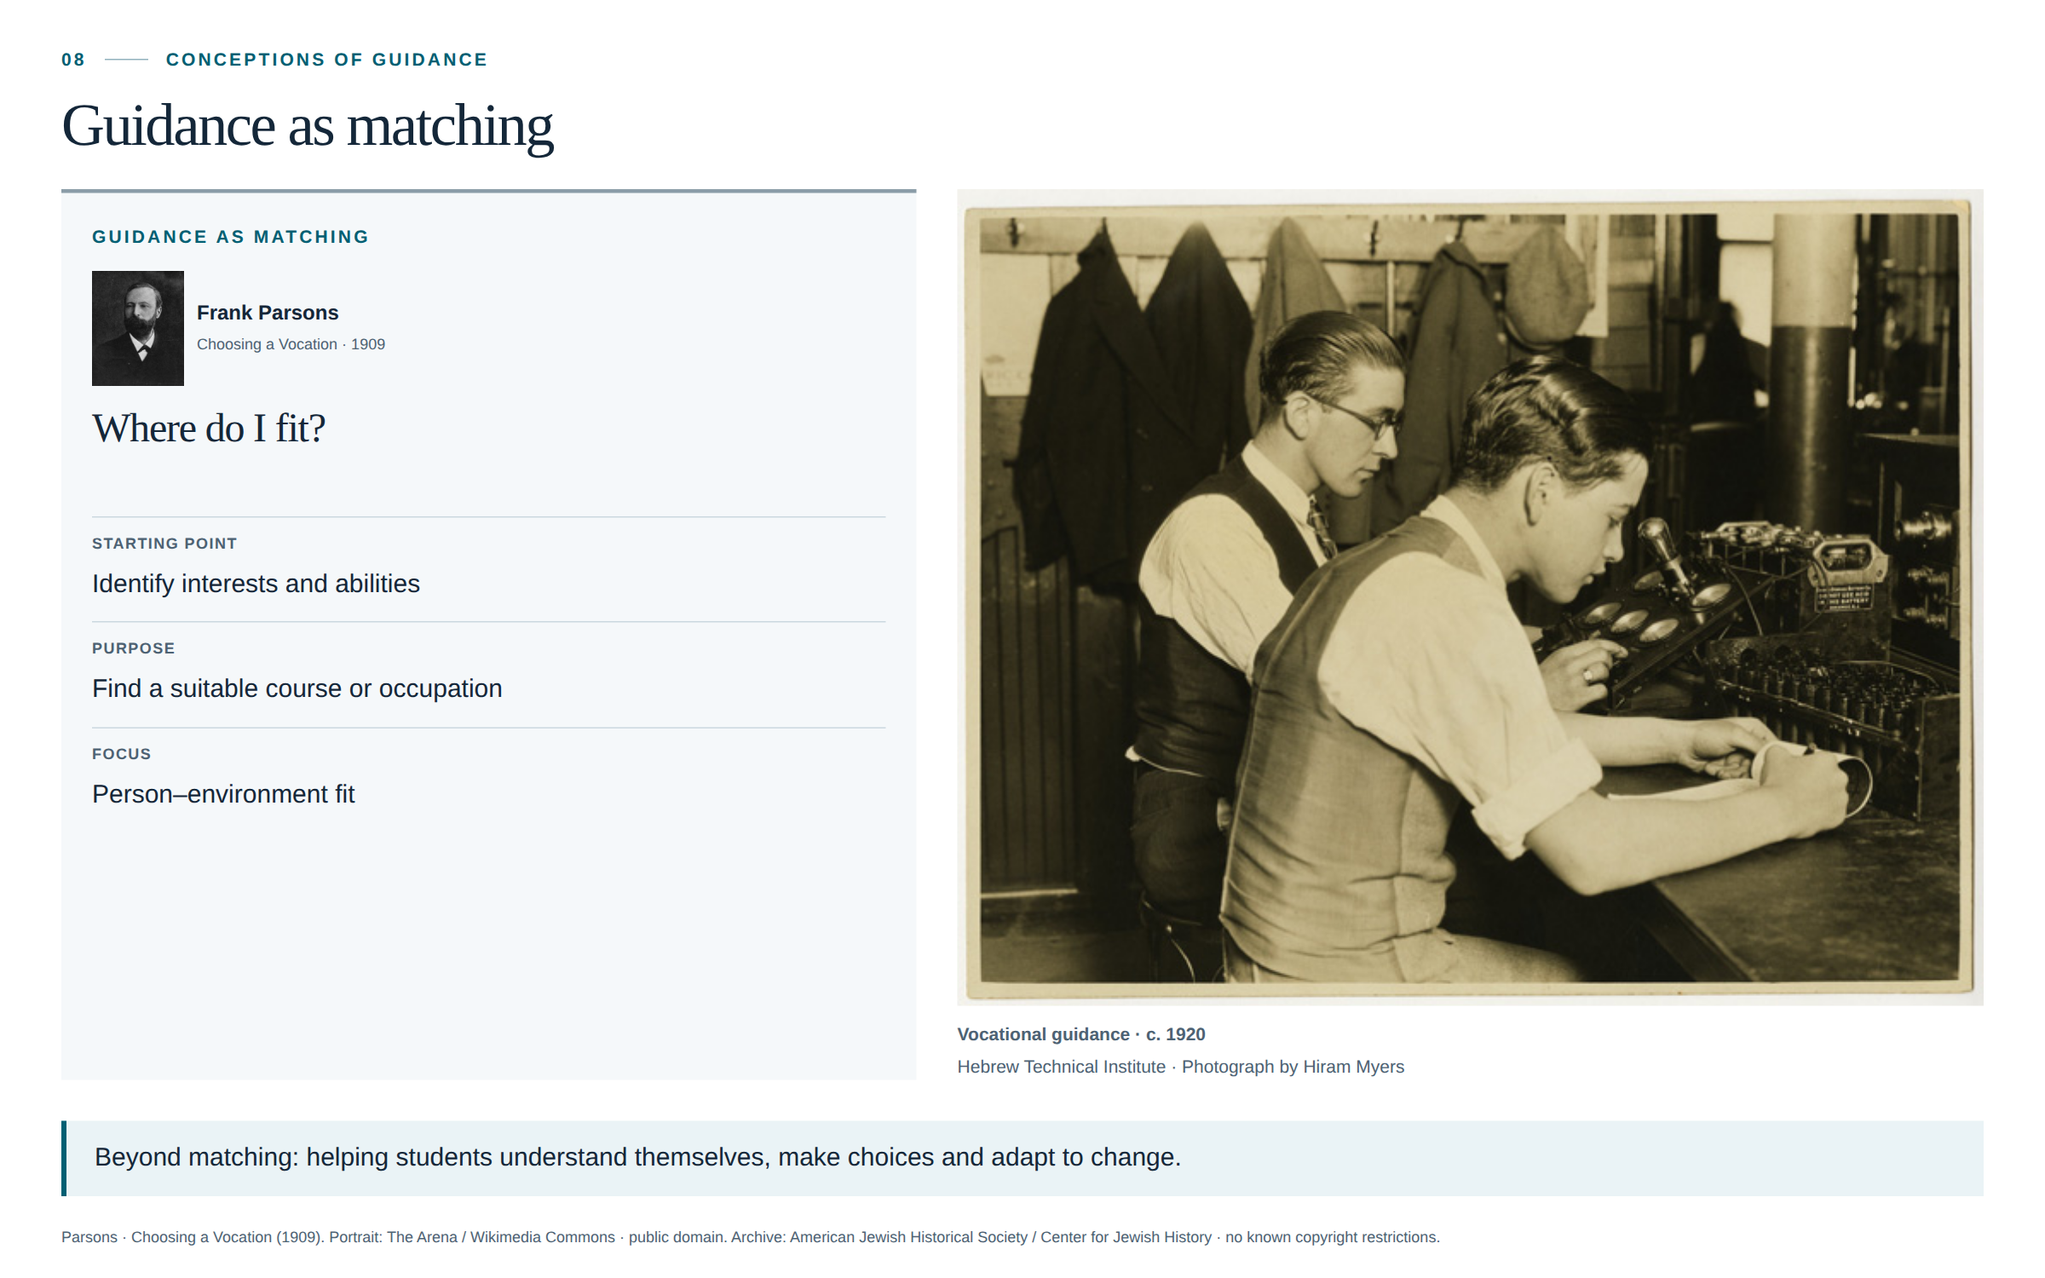
Notes:
At this point, it is useful to clarify what we mean by guidance. For a long time, guidance has been associated with matching a person's interests and abilities to a job or a course of study. Frank Parsons was one of the founders of this tradition in the early twentieth century. Knowing ourselves and understanding the opportunities available to us are still important. But, as Michele Pellerey points out, both the person and the labour market change over time. Young people develop new interests, abilities and aspirations. Technologies such as AI also change jobs and the skills they require. For this reason, matching a student’s current profile with today’s job opportunities is not enough. Guidance should also help students understand themselves, make choices and adapt as their lives and circumstances change.

Slide 9
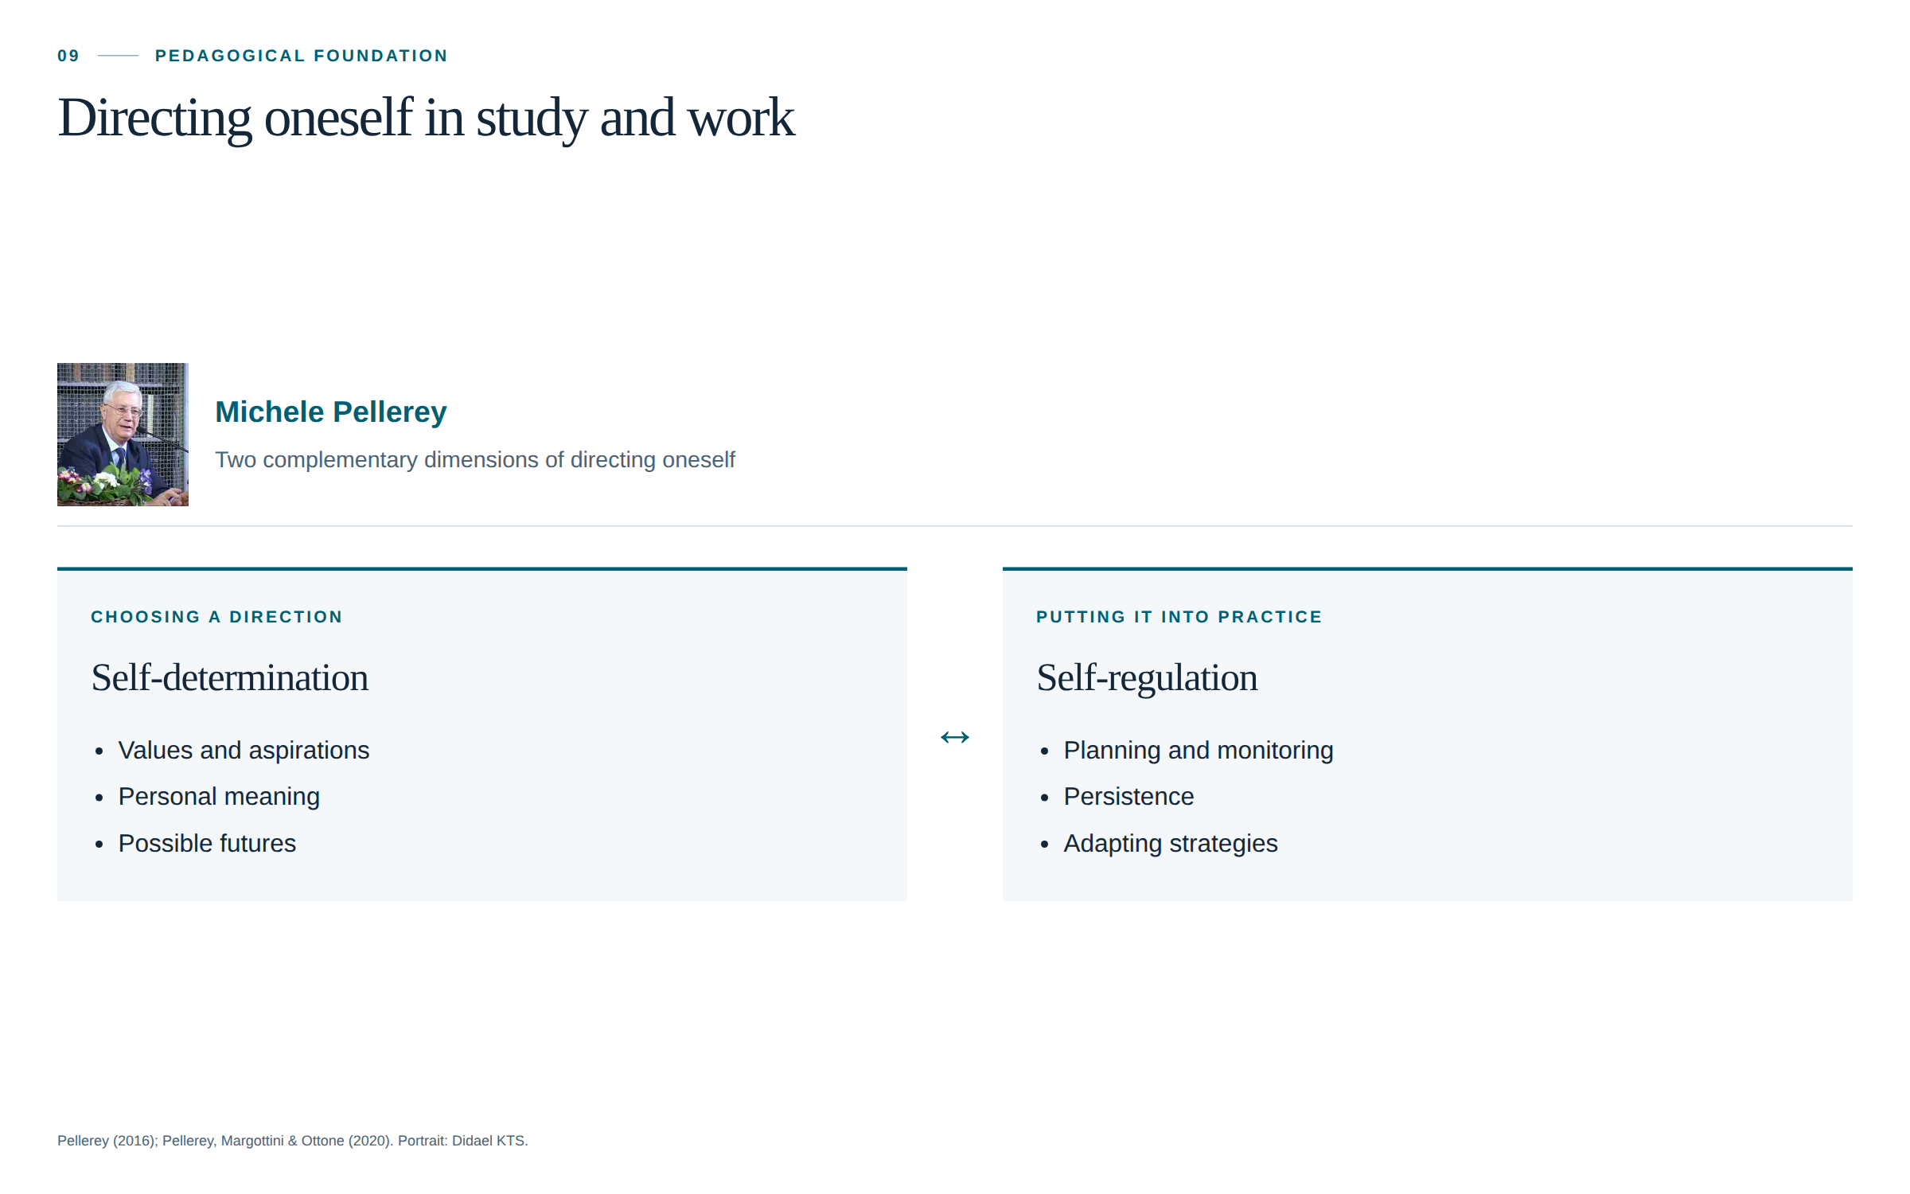
Notes:
What replaces it? Two complementary answers. The first is Pellerey's: guidance as the ability to **direct oneself**. Not a moment, but a competence, with two pillars. The first is self-determination: the strategic component, the ability to choose where to go — values, motives, ideals, and a sense of one's own life, an existential perspective. Without that, no amount of career information helps, because there is no "you" making the choice. The second pillar is self-regulation: the operational component. Once you have a direction, you need to manage the journey — plan, monitor, persist, and above all attribute causes correctly. Did I fail because I am incapable, or because I studied using the wrong strategy? That attribution determines whether a student tries again.

Slide 10
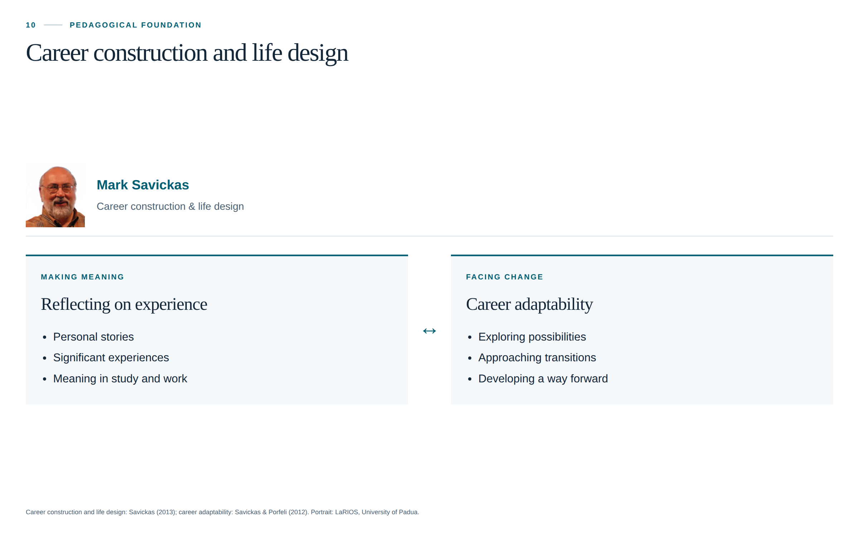
Notes:
The second answer is Mark Savickas's: *career construction*, *life designing*. A career is not the discovery of a fit that already existed; it is something a person constructs, a story they tell and revise, in which work is one chapter. The key construct becomes adaptability, not fit. This raises an educational question: how can we help students develop self-regulation? The transition to university, for example, requires them to organise their studies more independently. Supporting this transition means helping students recognise their strategies, evaluate them and change them when they do not work. Notice what changes. The goal is no longer the right answer, but the right process. And the right process consists of conversation and reflection. Which is exactly what conversational AI could support — if it is built to support that process, rather than to sell answers.

Slide 11
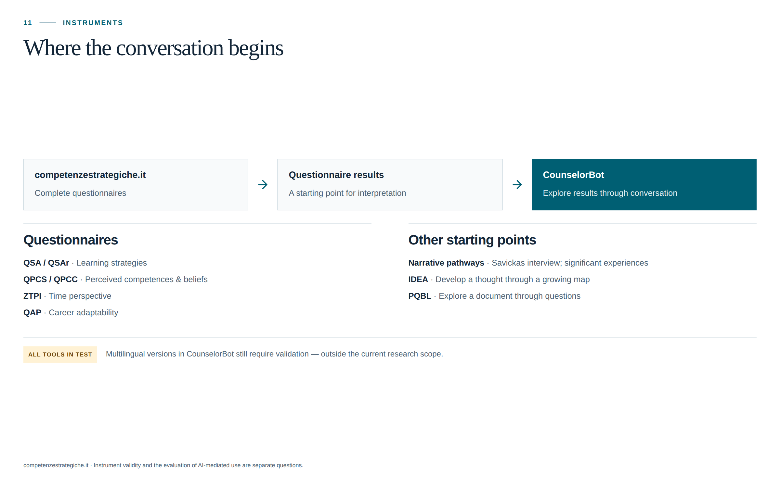
Notes:
Let me now show you how CounselorBot works from the student's point of view. A student can begin with questionnaire results from competenzestrategiche.it. These questionnaires concern areas such as learning strategies, perceived competences, time perspective and career adaptability. CounselorBot uses the results as a starting point for a conversation. I have also translated the questionnaires into several languages, and students can complete these versions directly within CounselorBot. However, the translated versions still need to be validated. That is a separate research project—and probably a topic for another seminar. During the conversation, students can ask what a result means and connect it with their own experience. For example: “Does this describe how I study? Can I think of a situation in which this happens?” The aim is to help students reflect on their results and connect them with their own experiences. The results are not set in stone: they can change as students learn, develop and gain new experiences. Students can also start from a significant study or work experience, an idea they want to develop, or a document they want to explore through questions.

Slide 12
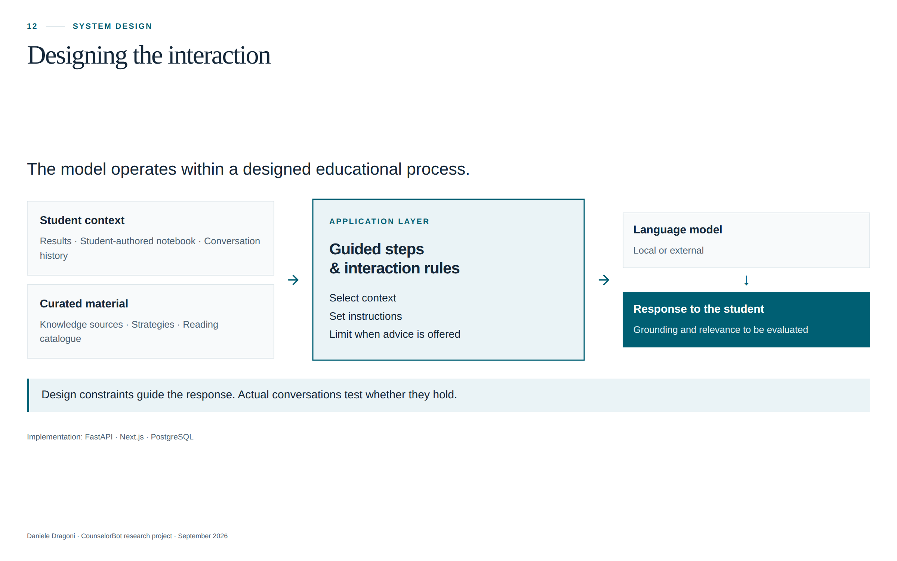
Notes:
Each time a student sends a message, CounselorBot prepares the information the language model needs to reply. This includes the student’s message, relevant questionnaire results, earlier parts of the conversation, and information the student has shared about themselves. The model also receives selected educational material and instructions for the current step. These instructions explain what to focus on, what kind of questions to ask, and when it is appropriate to offer advice. Using this information, the model produces a reply. The student can then answer, add an example or ask another question. CounselorBot prepares the context again for the next exchange. The aim is to keep the conversation connected to the student’s experience and give them space to think. The model can run on the institution’s server or through an external service.

Slide 13
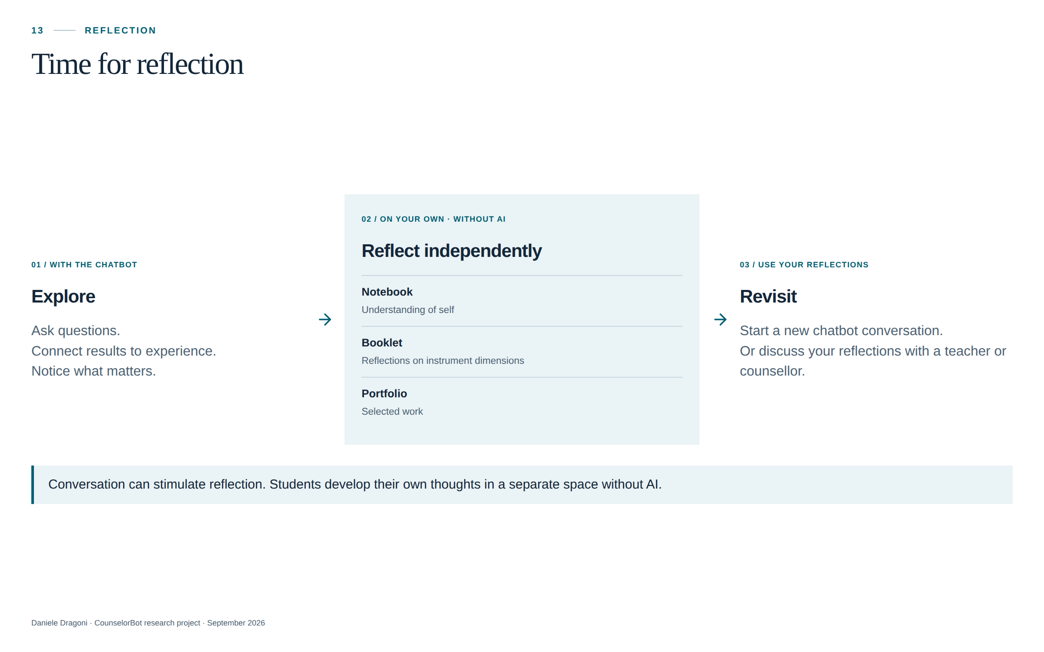
Notes:
Reflection does not end when the conversation with the chatbot stops. CounselorBot also provides a separate space where students can pause and reflect on their own, without interacting with the AI. Here, they write in their own words what they have understood, what matters to them and what they want to explore further. This space includes a Notebook for reflections about themselves, a Booklet for reflections on the questionnaire dimensions, and a Portfolio for selected work. Students can later use this material to begin a new conversation with the chatbot or as a starting point for a discussion with a teacher or guidance counsellor. These are two distinct activities: interacting with the chatbot and reflecting independently. The conversation can stimulate reflection, but students need time to develop their own thoughts.

Slide 14
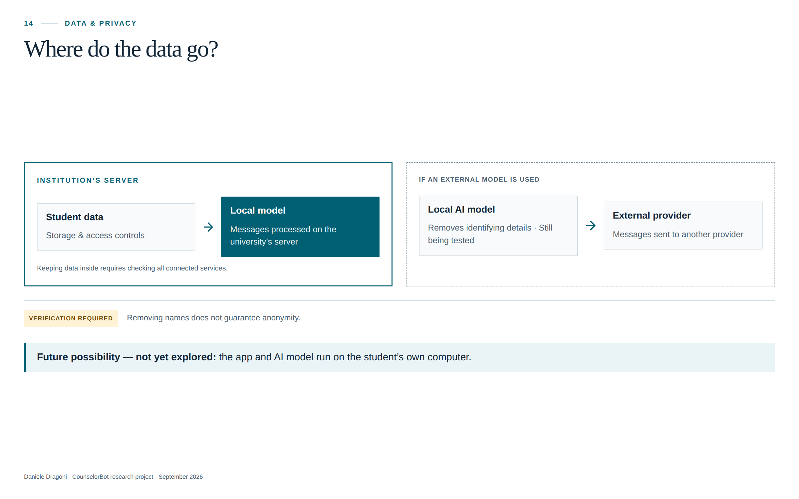
Notes:
There is one more practical question: where do students’ messages go? If the AI model runs on the university’s server, it can process the conversation there. If we use an external AI provider, the messages are sent to that provider. We also need to check the other services connected to the application, because they may receive data too. Before messages are sent to an external AI server, a local AI model removes information that could identify the student. We are still testing how well it works. Removing names alone does not guarantee anonymity: details about someone’s life may still reveal who they are. In the future, we could explore running both the application and the AI model on the student’s own computer. We have not explored this option yet.

Slide 15
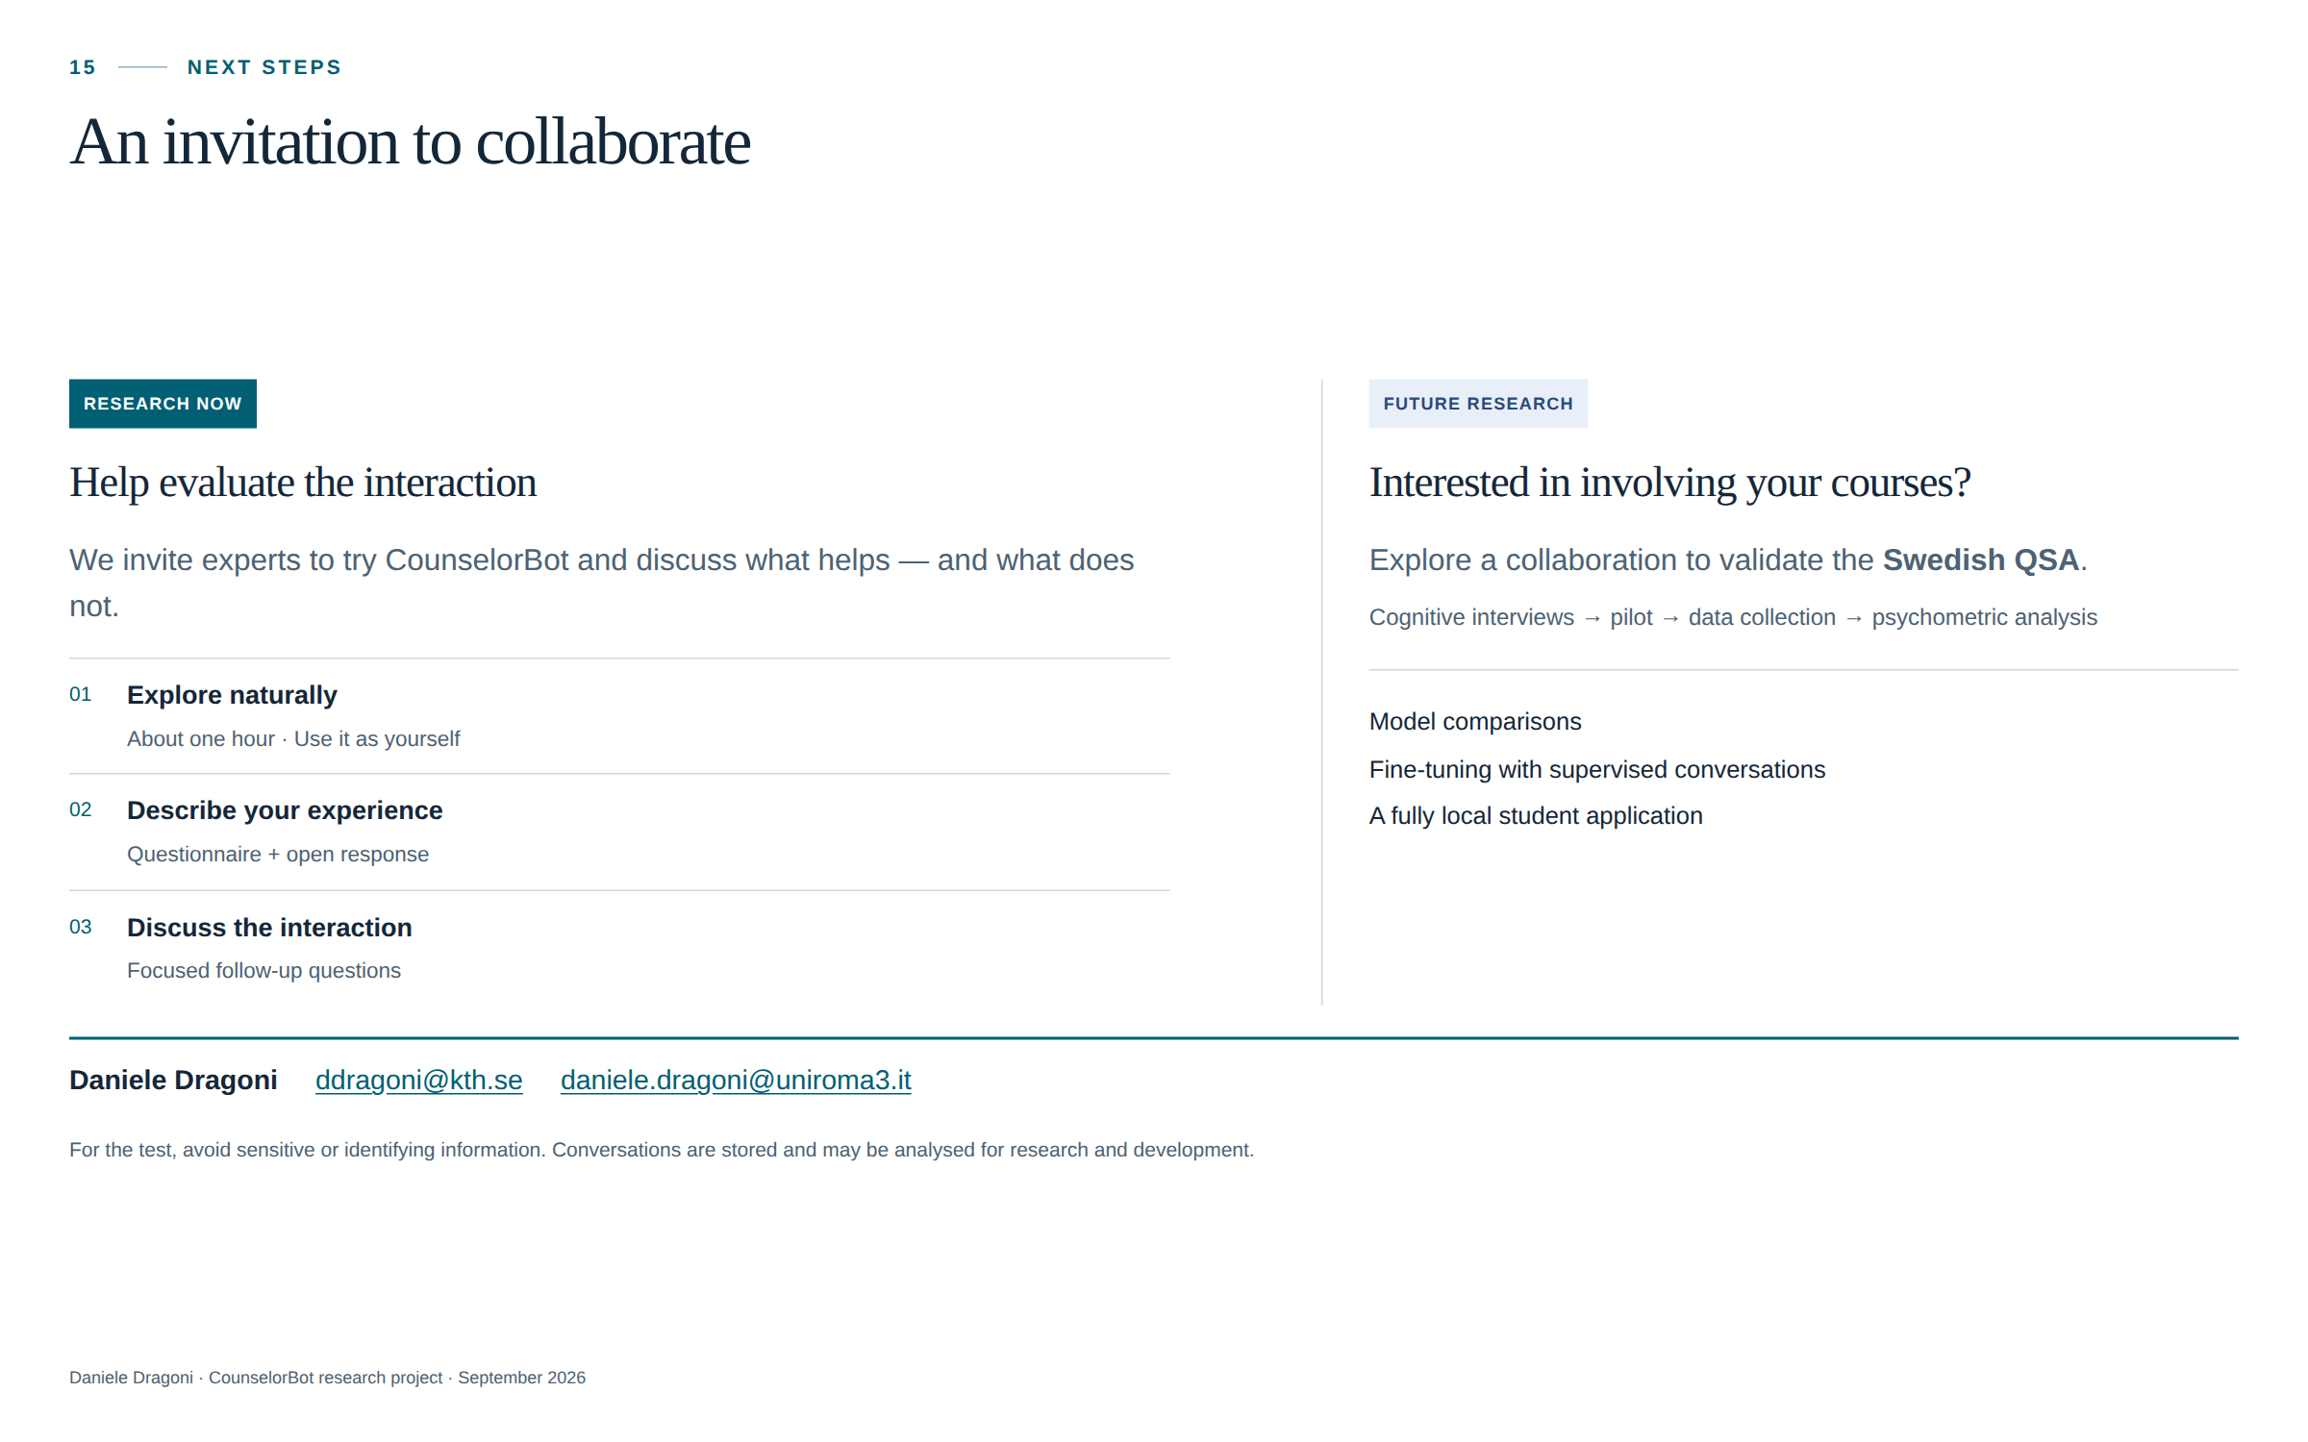
Notes:
I would like to close with an invitation. I am looking for colleagues who would be willing to try CounselorBot and help me improve it. You do not need a technical background. I would value your perspective as teachers, researchers and people with your own learning experiences. Does the conversation help you reflect? Are the questions useful? Is anything unclear, repetitive or too directive? If you can spend about an hour exploring the system and then share your feedback, that would be a valuable contribution. Please come and talk to me afterwards, or contact me by email. I would also be happy to discuss future collaboration on the Swedish version of the QSA. Thank you for your time. I would be very interested to hear your questions and suggestions.

