Slide 1
William Stallings
Computer Organization and Architecture
6th Edition
Chapter 6
External Memory

Slide 2
Types of External Memory
Magnetic Disk
  RAID
  Removable
Optical
  CD-ROM
  CD-Recordable (CD-R)
  CD-R/W
  DVD
  Blue Ray
Magnetic Tape

Slide 3
Magnetic Disk
Disk substrate coated with magnetizable material (iron oxide…rust)
Substrate used to be aluminium
Now glass
  Improved surface uniformity
    Increases reliability
  Reduction in surface defects
    Reduced read/write errors
  Lower flight heights (See later)
  Better stiffness
  Better shock/damage resistance

Slide 4
Read and Write Mechanisms
Recording and retrieval via conductive coil called a head
May be single read/write head or separate ones
During read/write, head is stationary, platter rotates
Write
  Current through coil produces magnetic field
  Pulses sent to head
  Magnetic pattern recorded on surface below
Read (traditional)
  Magnetic field moving relative to coil produces current
  Coil is the same for read and write
Read (contemporary)
  Separate read head, close to write head
  Partially shielded magneto resistive (MR) sensor
  Electrical resistance depends on direction of magnetic field
  High frequency operation
    Higher storage density and speed

Slide 5
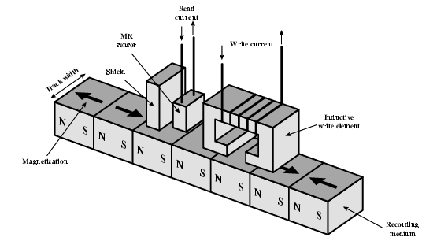
Inductive Write MR Read

Slide 6
Data Organization and Formatting
Concentric rings or tracks
  Gaps between tracks
  Reduce gap to increase capacity
  Same number of bits per track (variable packing density)
  Constant angular velocity
Tracks divided into sectors
Minimum block size is one sector
May have more than one sector per block

Slide 7
Characteristics
Fixed (rare) or movable head
Removable or fixed
Single or double (usually) sided
Single or multiple platter
Head mechanism
  Contact (Floppy)
  Fixed gap
  Flying (Winchester)

Slide 8
Fixed/Movable Head Disk
Fixed head
  One read write head per track
  Heads mounted on fixed ridged arm
Movable head
  One read write head per side
  Mounted on a movable arm

Slide 9
Removable or Not
Removable disk
  Can be removed from drive and replaced with another disk
  Provides unlimited storage capacity
  Easy data transfer between systems
Nonremovable disk
  Permanently mounted in the drive

Slide 10
Multiple Platter
One head per side
Heads are joined and aligned
Aligned tracks on each platter form cylinders
Data is striped by cylinder
  reduces head movement
  Increases speed (transfer rate)

Slide 11
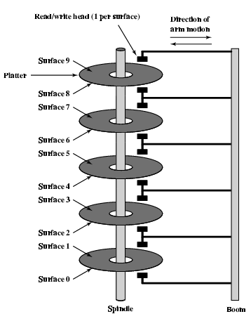
Multiple Platters

Slide 12
RAID
Redundant Array of Independent Disks
Redundant Array of Inexpensive Disks
7 levels (0 through 6)
Not a hierarchy
Set of physical disks viewed as single logical drive by O/S
Data distributed across physical drives
Can use redundant capacity to store parity information

Slide 13
Optical Storage CD-ROM
Originally for audio
650Mbytes giving over 70 minutes audio
Polycarbonate coated with highly reflective coat, usually aluminium
Data stored as pits
Read by reflecting laser
Constant packing density
Constant linear velocity

Slide 14
Random Access on
CD-ROM
Difficult
Move head to rough position
Set correct speed
Read address
Adjust to required location
(Yawn!)

Slide 15
CD-ROM for & against
Large capacity (?)
Easy to mass produce
Removable
Robust
Expensive for small runs
Slow
Read only

Slide 16
Other Optical Storage
CD-Recordable (CD-R)
  WORM
  Now affordable
  Compatible with CD-ROM drives
CD-RW
  Erasable
  Getting cheaper
  Mostly CD-ROM drive compatible
  Phase change
    Material has two different reflectivities in different phase states

Slide 17
DVD - what’s in a name?
Digital Video Disk
  Used to indicate a player for movies
    Only plays video disks
Digital Versatile Disk
  Used to indicate a computer drive
    Will read computer disks and play video disks
Dogs Veritable Dinner
Officially - nothing!!!

Slide 18
DVD - technology
Multi-layer
Very high capacity (4.7G per layer)
Full length movie on single disk
  Using MPEG compression
Finally standardized (honest!)
Movies carry regional coding
Players only play correct region films
Can be “fixed”

Slide 19
DVD – Writable
Loads of trouble with standards
First generation DVD drives may not read first generation DVD-W disks
First generation DVD drives may not read CD-RW disks
Wait for it to settle down before buying!

Slide 20
Magnetic Tape
Serial access
Slow
Very cheap
Backup and archive

Slide 21
Digital Audio Tape (DAT)
Uses rotating head (like video)
High capacity on small tape
  4Gbyte uncompressed
  8Gbyte compressed
Backup of PC/network servers

