Slide 1
Coprocessor

Slide 2
History Of Coprocessor
Coprocessors for floating-point arithmetic first appeared in desktop computers in the 1970s and became common throughout the 1980s and into the early 1990s. Early 8-bit and 16-bit processors used software to carry out
floating-point arithmetic operations.

Slide 3
What is Coprocessor
A coprocessor is a special set of circuits in a microcomputer that is designed to manipulate numbers or perform some other specialized function more quickly than the basic microprocessor circuits could perform the same task.

Slide 4
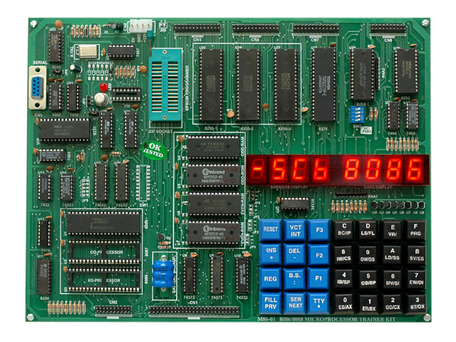
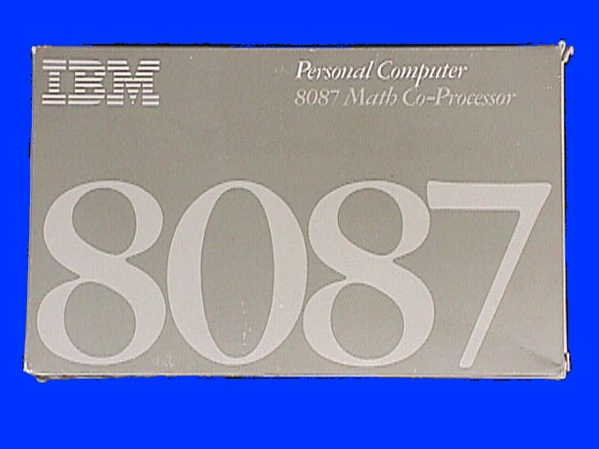
Coprocessor
Processor
Coprocessor

Slide 5
Coprocessor
**Not only extends the capabilities of the host computer but also increases the processing rate of the system
**The Coprocessor concept is widely used with typical 32-bit microprocessor such as Motorola 68020 and Intel 80386

Slide 6
Why Coprocessor is used?
The large calculation computation is not possible by 8085,8086…..
For Example:
*Floating point arithmetic, graphics, signal =====processing, string processing ……..
* Such functions as square root, sine, cosine, and ===logarithms are not directly available in a ===general purpose processor
To eliminate this problem Coprocessor is =====used

Slide 7
How Coprocessor is interface with main processor ?
There are two process
1. Intelligent monitor interface
2 . Special signal interface

Slide 8
Intelligent monitor interface
When instruction is flow to main processor by BUS , the Coprocessor monitoring the instruction. Some operation will be failed in this operation is performed by Coprocessor

Slide 9
Special signal interface
User
data
input
De-code

Slide 10
Int. mon. interface
User
data
input
De-code

Slide 11
Special signal interface
When the main processor executes a instruction, it decodes the instruction and write a command in the command register specifying the operation required by the Coprocessor. Coprocessor performed operation this operation and provide this result

Slide 12
Special signal interface
User
data
input
De-code

Slide 13
Special signal interface
User
data
input
De-code
Command

Slide 14
Coprocessor and Peripherals
*A Coprocessor is a device that has the capability communicating with the main processor.
*The Coprocessor also adds additional instructions , registers, and data types that are not directly supported by the main processor.
*The Coprocessor provide capabilities to the user.

Slide 15
Coprocessor and Peripherals
*On the other hand it communicate throw the use of interface resistance
*It is not possible to calculate computation
*It is only used i/o operation

Slide 16
Types of Coprocessor
Each processor in the 8086 family has a
corresponding coprocessor with which
it is compatible
Math Coprocessor
Numeric Coprocessor
Numeric data Coprocessor
Floating point unit Coprocessor

Slide 17
Compatible Processor and Coprocessor
Processors | Coprocessors
1. 8086 & 8088 2. 80286 | 8087 80287,80287XL
3. 80386DX | 3. 80287,80387DX
4. 80386SX | 4. 80387SX
5. 80486DX | 5. It is Inbuilt
6. 80486SX | 6.80487SX

Slide 18
INTERFACING OF main processor AND coprocessor
○ Multiplexed address-data bus lines are connected directly from main processor to coprocessor.
○ The status lines and the queue status lines are connected directly from main processor to coprocessor.
○ BUSY signal of coprocessor is connected to TEST pin of main processor .

Slide 19
Architecture of 8087
** Control Unit
** Execution Unit

Slide 20
Control Unit
○ It interfaces coprocessor to the microprocessor system bus.
○ It also synchronize the operation of the
coprocessor and the microprocessor.

Slide 21
Numeric Execution Unit
○ This unit is responsible for executing all
coprocessor instructions.
○ It has an 8 register stack that holds the operands for instructions and result of instructions.
○ The stack contains 8 registers that are
80-bits wide.

Slide 22
About 8087 Coprocessor
*When an 8087 is present in a microcomputer system, it adds 68 numeric processing instructions and 80 bit register to the microprocessor’s register set.
*Bus support 7 data types which include 16,32 and 64 bit integer 32,64, and 80 bit floating point and 18-digit BCD operands.
*It includes several arithmetic, trigonometric ,exponential , and algorithmic instruction etc.

Slide 23
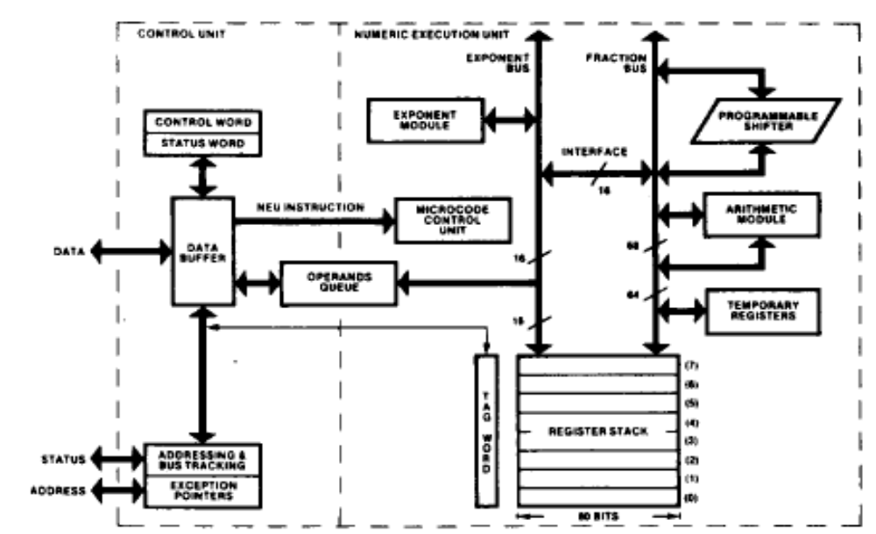
Internal Architecture of 8087

Slide 24
About 80287 Coprocessor
**80287 is an enhanced 8087 that extends the 80286 microprocessor.
**It is designed using HMOS technology.
**The 80287 expands the 80286 data types to include 32,64, and 80 bit floating point 32,64 integer and 18 digit BCD operands.

Slide 25
About 80287 Coprocessor
* Upon reset, it operates in real address mode.
* It can be placed in protected address mode and cannot be placed back to real address mode unless reset.

Slide 26
About 80387 Coprocessor
*80387 is a numeric coprocessor that extends the 80386 processor with floating-point, extended integer, and BCD data types. The 80387 includes 32, 64 and 80 bit floating point, and 64-bit integers, and 18-digit BCD operands.
*The 80387 includes three functional units that can operate in parallel.
*All communication between the 80386 and 80387 is transparent to application software

