Slide 1

Chapter 14
User Datagram
Program
(UDP)
TCP/IP Protocol Suite
Copyright © The McGraw-Hill Companies, Inc. Permission required for reproduction or display.

Slide 2
14-1 INTRODUCTION
Figure 14.1 shows the relationship of the User Datagram Protocol (UDP) to the other protocols and layers of the TCP/IP protocol suite: UDP is located between the application layer and the IP layer, and serves as the intermediary between the application programs and the network operations.
TCP/IP Protocol Suite

Slide 3
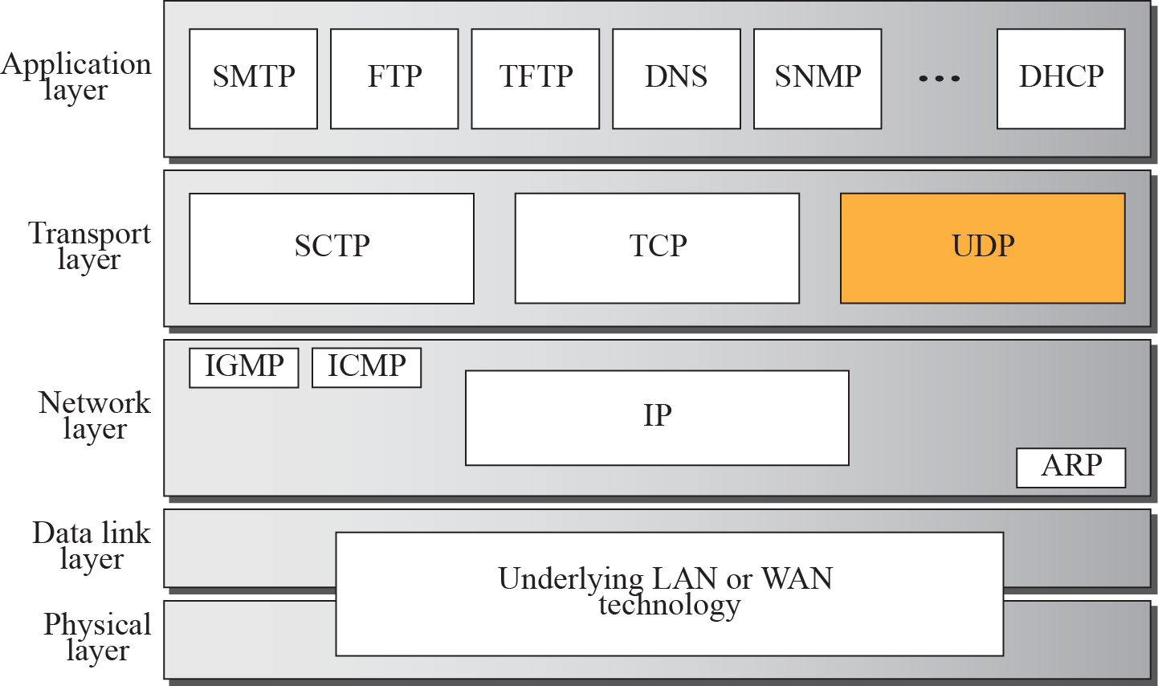
Figure 14.1 Position of UDP in the TCP/IP protocol suite
TCP/IP Protocol Suite

Slide 4
14-2 USER DATAGRAM
UDP packets, called user datagrams, have a fixed-size header of 8 bytes. Figure 14.2 shows the format of a user datagram.
TCP/IP Protocol Suite

Slide 5
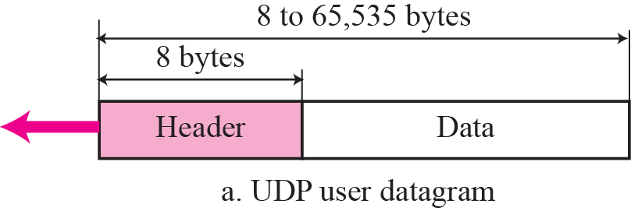
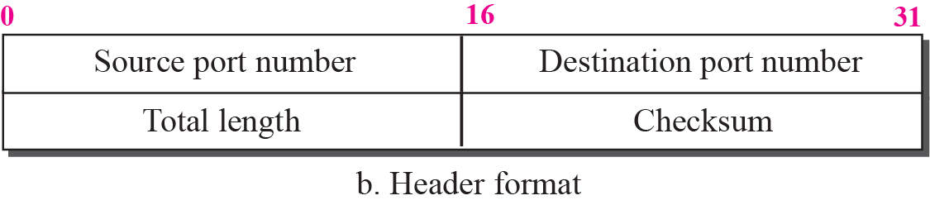
Figure 14.2 User datagram format
TCP/IP Protocol Suite

Slide 6
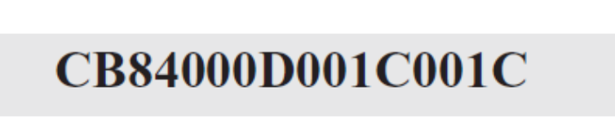
Example 14.1
The following is a dump of a UDP header in hexadecimal format.
a. What is the source port number?
b. What is the destination port number?
c. What is the total length of the user datagram?
d. What is the length of the data?
e. Is the packet directed from a client to a server or vice versa?
f. What is the client process?
TCP/IP Protocol Suite

Slide 7
Example 14.1 Continued
Solution
a. The source port number is the first four hexadecimal digits (CB84)₁₆ or 52100.
b. The destination port number is the second four hexadecimal digits (000D)₁₆ or 13.
c. The third four hexadecimal digits (001C)₁₆ define the length of the whole UDP packet as 28 bytes.
d. The length of the data is the length of the whole packet
minus the length of the header, or 28 – 8 = 20 bytes.
e. Since the destination port number is 13 (well-known port), the packet is from the client to the server.
f. The client process is the Daytime (see Table 14.1).
TCP/IP Protocol Suite

Slide 8
14-3 UDP Services
We discussed the general services provided by a transport layer protocol in Chapter 13. In this section, we discuss what portions of those general services are provided by UDP.
TCP/IP Protocol Suite

Slide 9
Topics Discussed in the Section
Process-to-Process Communication
Connectionless Service
Flow Control
Error Control
Congestion Control
Encapsulation and Decapsulation
Queuing
Multiplexing and Demultiplexing
Comparison between UDP and Generic Simple
Protocol
TCP/IP Protocol Suite

Slide 10
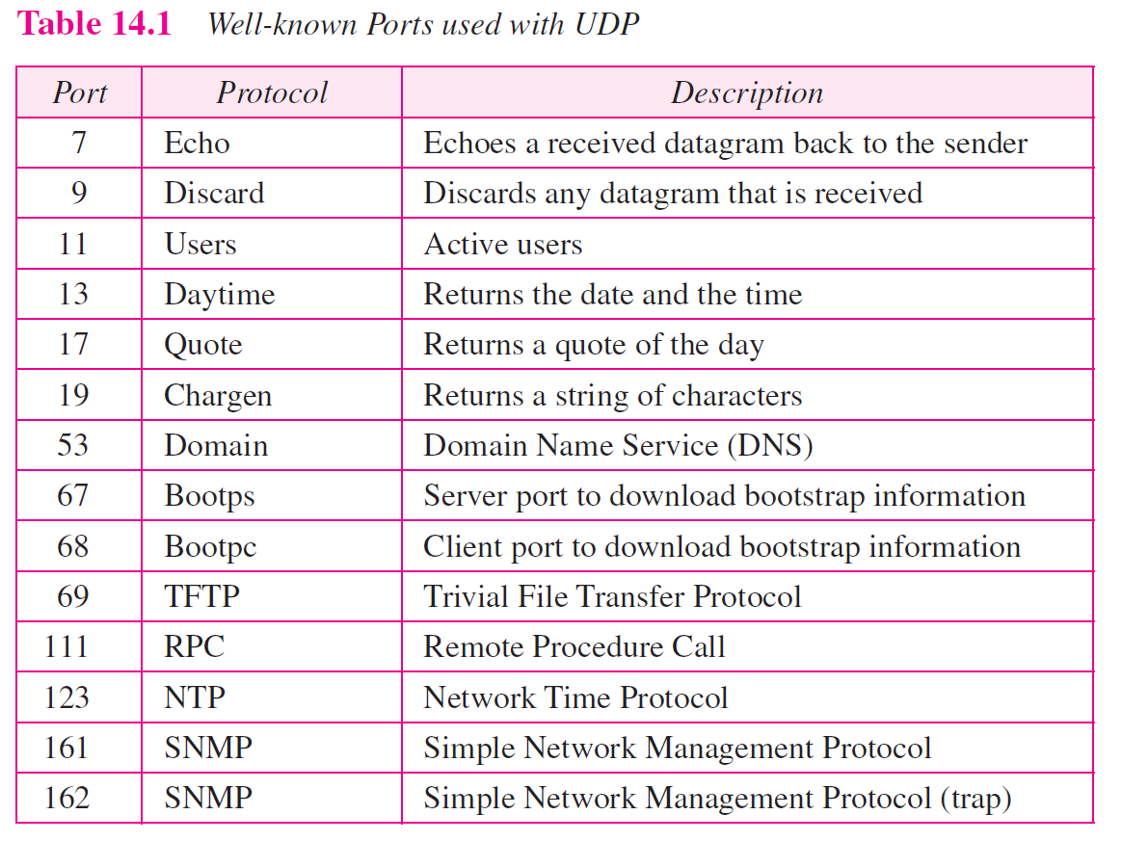
TCP/IP Protocol Suite

Slide 11
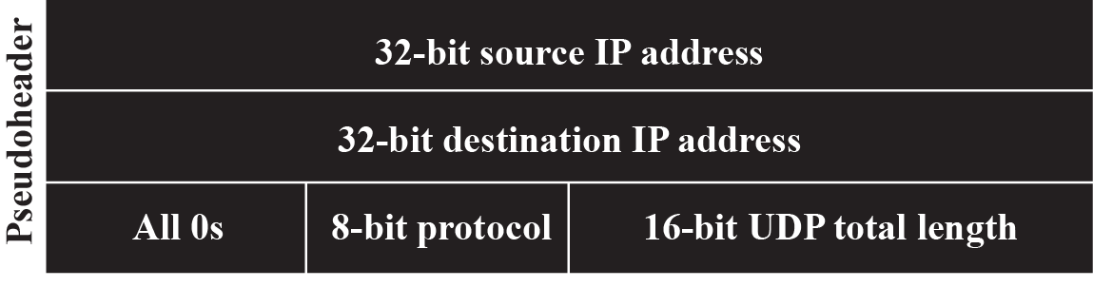
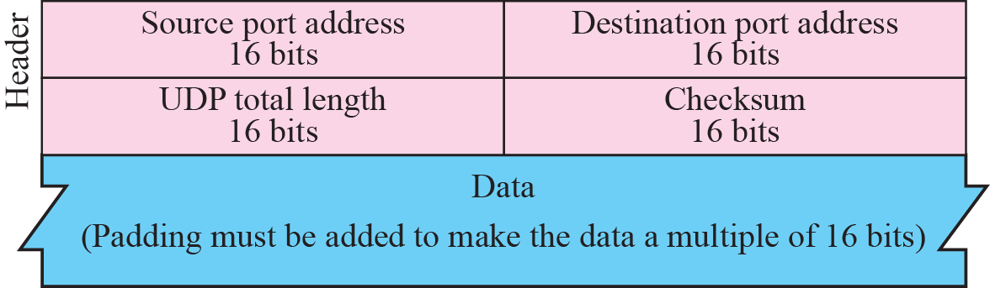
Figure 14.3 Pseudoheader for checksum calculation
TCP/IP Protocol Suite

Slide 12
Example 14.2
Figure 14.4 shows the checksum calculation for a very small user datagram with only 7 bytes of data. Because the number of bytes of data is odd, padding is added for checksum calculation. The pseudoheader as well as the padding will be dropped when the user datagram is delivered to IP (see Appendix F).
TCP/IP Protocol Suite

Slide 13
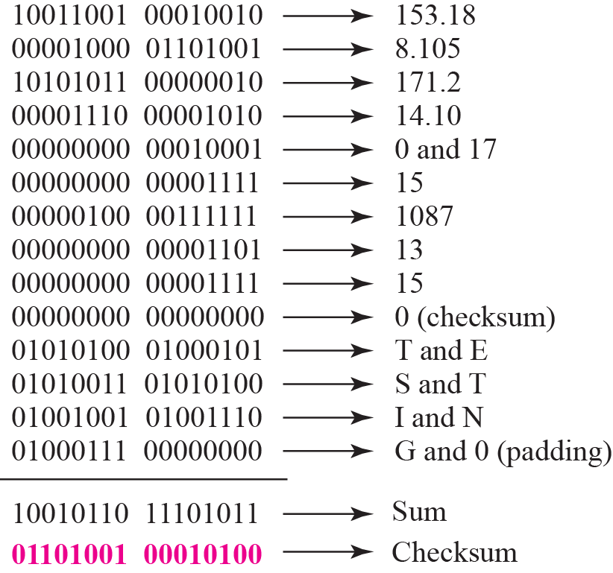
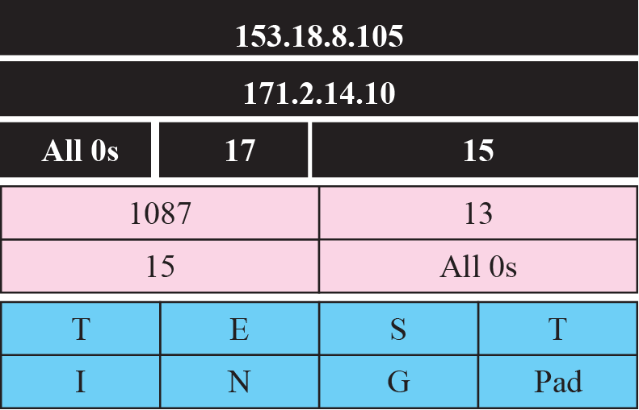
Figure 14.4 Checksum calculation for a simple UDP user datagram
TCP/IP Protocol Suite

Slide 14
Example 14.3
What value is sent for the checksum in one of the following hypothetical situations?
a. The sender decides not to include the checksum.
b. The sender decides to include the checksum, but the value of the sum is all 1s.
c. The sender decides to include the checksum, but the value of the sum is all 0s.
TCP/IP Protocol Suite

Slide 15
Example 14.3 Continued
Solution
a. The value sent for the checksum field is all 0s to show that the checksum is not calculated.
b. When the sender complements the sum, the result is all 0s; the sender complements the result again before sending. The value sent for the checksum is all 1s. The second complement operation is needed to avoid confusion with the case in part a.
c. This situation never happens because it implies that the value of every term included in the calculation of the sum is all 0s, which is impossible; some fields in the pseudoheader have nonzero values (see Appendix D).
TCP/IP Protocol Suite

Slide 16
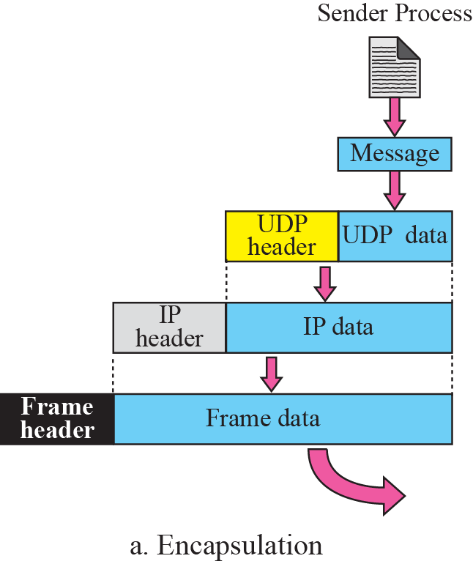
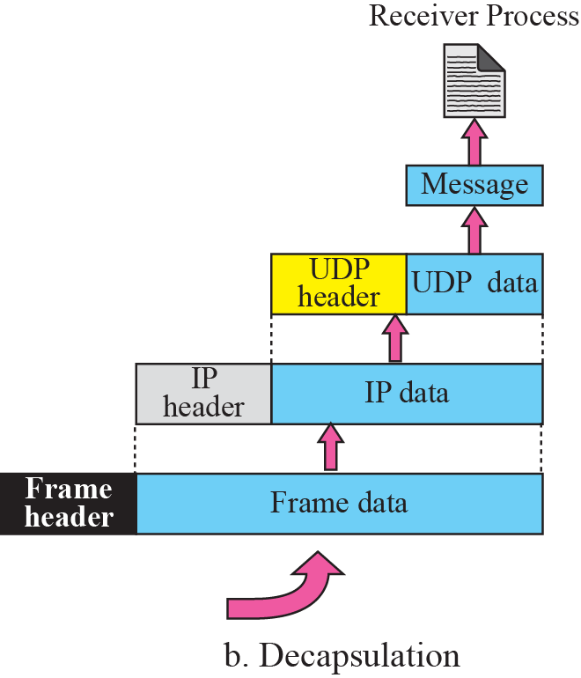

Figure 14.5 Encapsulation and decapsulation
TCP/IP Protocol Suite

Slide 17
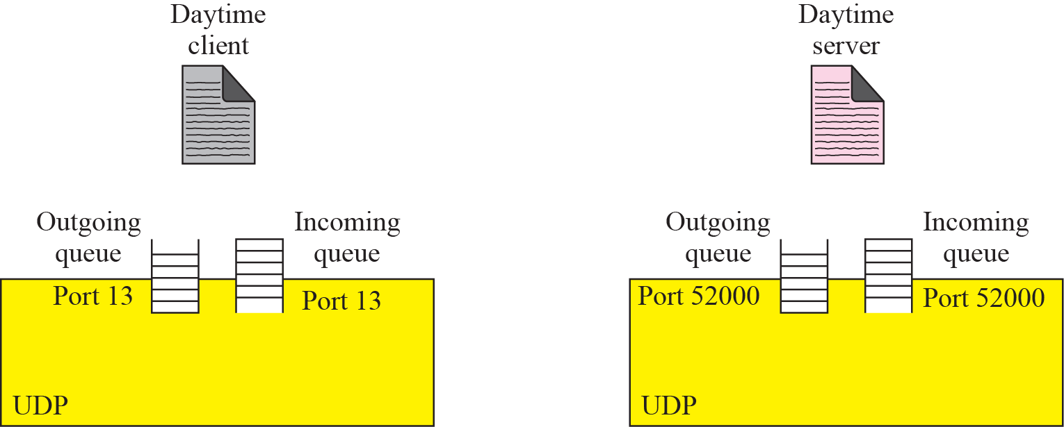





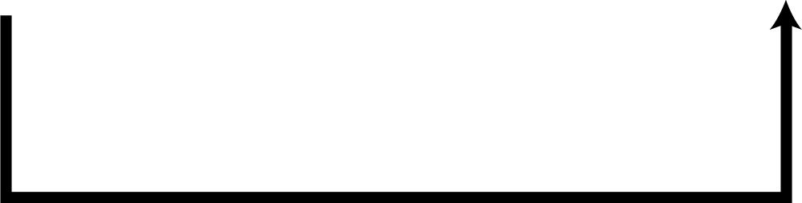
Figure 14.6 Queues in UDP
TCP/IP Protocol Suite

Slide 18
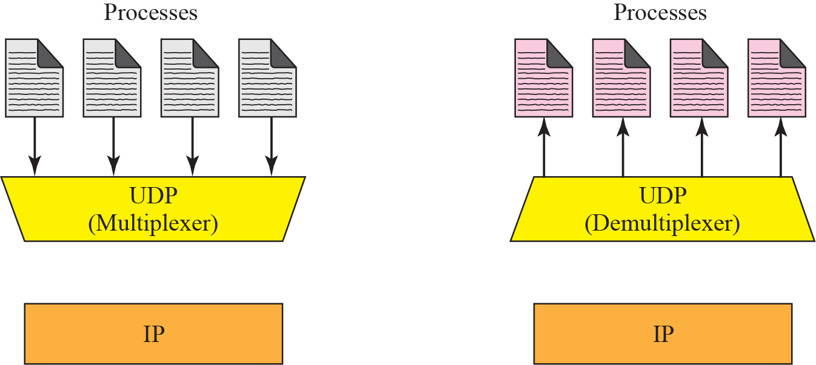





Figure 14.7 Multiplexing and demultiplexing
TCP/IP Protocol Suite

Slide 19

Note
UDP is an example of the connectionless simple protocol we discussed in Chapter 13 with the exception of an optional checksum added to packets for error detection.
TCP/IP Protocol Suite

Slide 20
14-4 UDP APPLICATION
Although UDP meets almost none of the criteria we mentioned in Chapter 13 for a reliable transport-layer protocol, UDP is preferable for some applications. The reason is that some services may have some side effects that are either unacceptable or not preferable. An application designer needs sometimes to compromise to get the optimum.
TCP/IP Protocol Suite

Slide 21
Topics Discussed in the Section
UDP Features
Typical Applications
TCP/IP Protocol Suite

Slide 22
Example 14.4
A client-server application such as DNS (see Chapter 19) uses the services of UDP because a client needs to send a short request to a server and to receive a quick response from it. The request and response can each fit in one user datagram. Since only one message is exchanged in each direction, the connectionless feature is not an issue; the client or server does not worry that messages are delivered out of order.
TCP/IP Protocol Suite

Slide 23
Example 14.5
A client-server application such as SMTP (see Chapter 23), which is used in electronic mail, cannot use the services of UDP because a user can send a long e-mail message, which may include multimedia (images, audio, or video). If the application uses UDP and the message does not fit in one single user datagram, the message must be split by the application into different user datagrams. Here the connectionless service may create problems. The user datagrams may arrive and be delivered to the receiver application out of order. The receiver application may not be able to reorder the pieces. This means the connectionless service has a disadvantage for an application program that sends long messages.
TCP/IP Protocol Suite

Slide 24
Example 14.6
Assume we are downloading a very large text file from the Internet. We definitely need to use a transport layer that provides reliable service. We don’t want part of the file to be missing or corrupted when we open the file. The delay created between the delivery of the parts are not an overriding concern for us; we wait until the whole file is composed before looking at it. In this case, UDP is not a suitable transport layer.
TCP/IP Protocol Suite

Slide 25
Example 14.7
Assume we are watching a real-time stream video on our computer. Such a program is considered a long file; it is divided into many small parts and broadcast in real time. The parts of the message are sent one after another. If the transport layer is supposed to resend a corrupted or lost frame, the synchronizing of the whole transmission may be lost. The viewer suddenly sees a blank screen and needs to wait until the second transmission arrives. This is not tolerable. However, if each small part of the screen is sent using one single user datagram, the receiving UDP can easily ignore the corrupted or lost packet and deliver the rest to the application program. That part of the screen is blank for a very short period of the time, which most viewers do not even notice. However, video cannot be viewed out of order, so streaming audio, video, and voice applications that run over UDP must reorder or drop frames that are out of sequence.
TCP/IP Protocol Suite

Slide 26

Chapter 15
Transmission
Control
Protocol
(TCP)
TCP/IP Protocol Suite
Copyright © The McGraw-Hill Companies, Inc. Permission required for reproduction or display.

Slide 27
15-1 TCP SERVICES
Figure 15.1 shows the relationship of TCP to the other protocols in the TCP/IP protocol suite. TCP lies between the application layer and the network layer, and serves as the intermediary between the application programs and the network operations.
TCP/IP Protocol Suite

Slide 28
Topics Discussed in the Section
Process-to-Process Communication
Stream Delivery Service
Full-Duplex Communication
Multiplexing and Demultiplexing
Connection-Oriented Service
Reliable Service
TCP/IP Protocol Suite

Slide 29
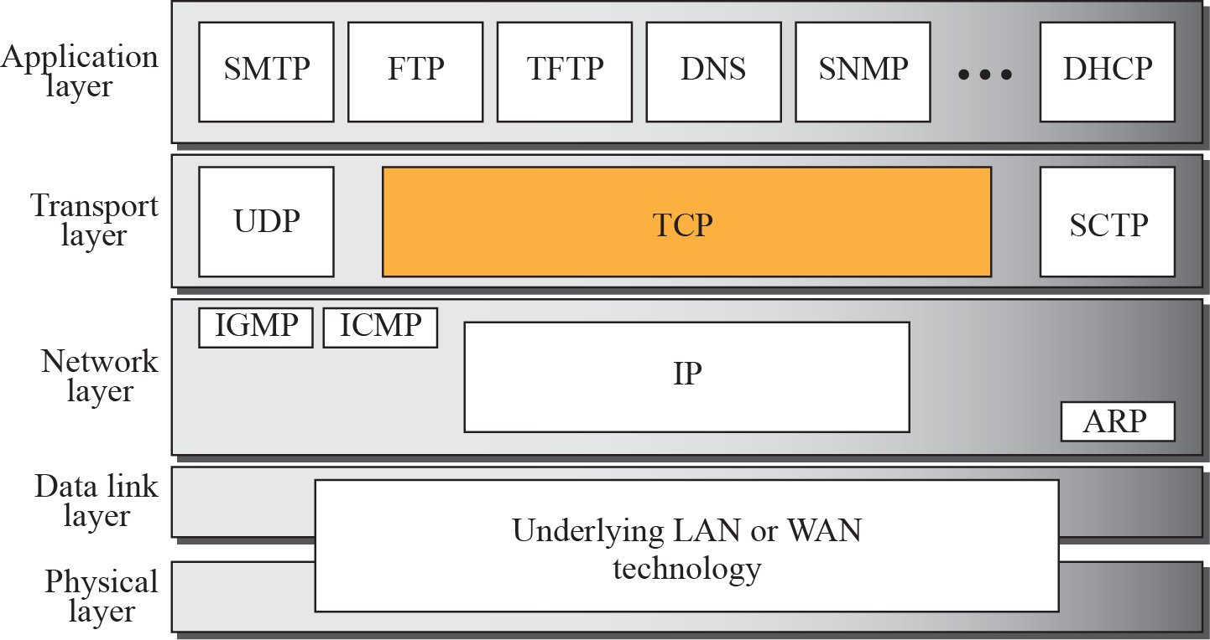
Figure 15.1 TCP/IP protocol suite
TCP/IP Protocol Suite

Slide 30
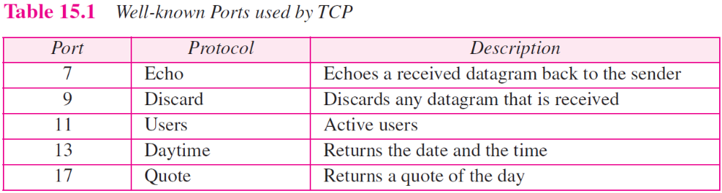
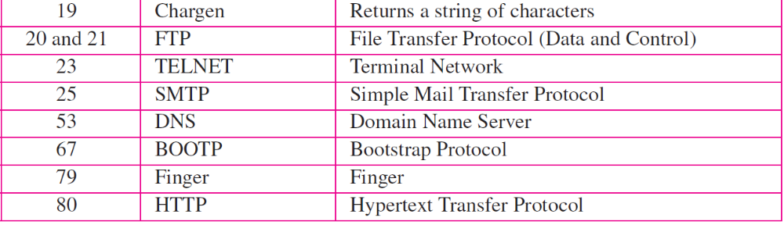
TCP/IP Protocol Suite

Slide 31
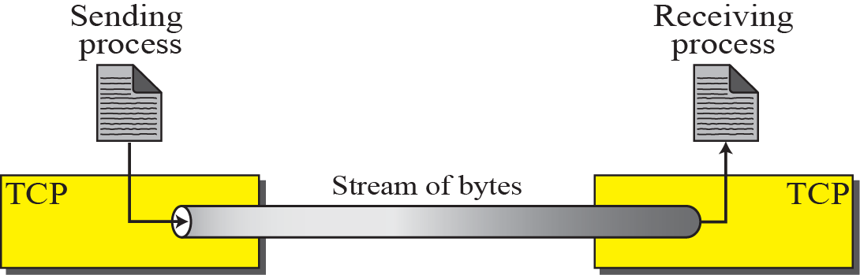
Figure 15.2 Stream delivery
TCP/IP Protocol Suite

Slide 32
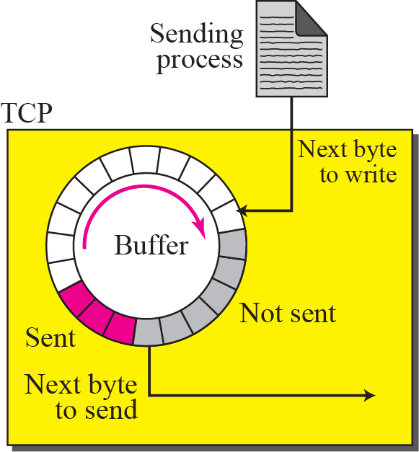
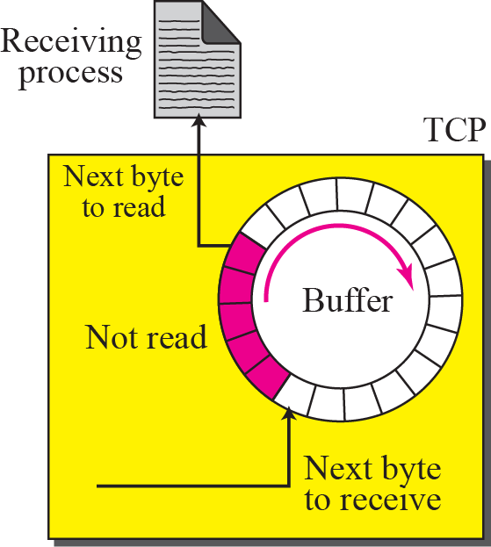
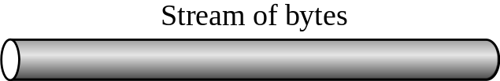
Figure 15.3 Sending and receiving buffers
TCP/IP Protocol Suite

Slide 33
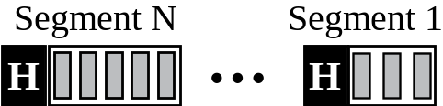
Figure 15.4 TCP segments
TCP/IP Protocol Suite

Slide 34
15-2 TCP FEATURES
To provide the services mentioned in the previous section, TCP has several features that are briefly summarized in this section and discussed later in detail.
TCP/IP Protocol Suite

Slide 35
Topics Discussed in the Section
Numbering System
Flow Control
Error Control
Congestion Control
TCP/IP Protocol Suite

Slide 36
Note
The bytes of data being transferred in each connection are numbered by TCP.
The numbering starts with an arbitrarily generated number.
TCP/IP Protocol Suite

Slide 37
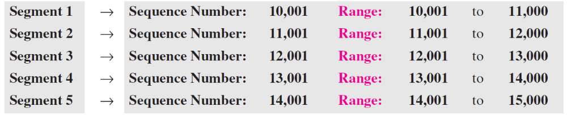
Example 15.1
Suppose a TCP connection is transferring a file of 5,000 bytes. The first byte is numbered 10,001. What are the sequence numbers for each segment if data are sent in five segments, each carrying 1,000 bytes?
Solution
The following shows the sequence number for each segment:
TCP/IP Protocol Suite

Slide 38
Note
The value in the sequence number
field of a segment defines the number assigned to the first data byte
contained in that segment.
TCP/IP Protocol Suite

Slide 39
Note
The value of the acknowledgment field in a segment defines the number of the next byte a party expects to receive.
The acknowledgment number is cumulative.
TCP/IP Protocol Suite

Slide 40
15-3 SEGMENT
Before discussing TCP in more detail, let us discuss the TCP packets themselves. A packet in TCP is called a segment.
TCP/IP Protocol Suite

Slide 41
Topics Discussed in the Section
Format
Encapsulation
TCP/IP Protocol Suite

Slide 42
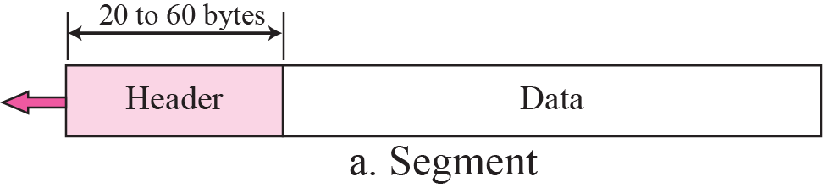
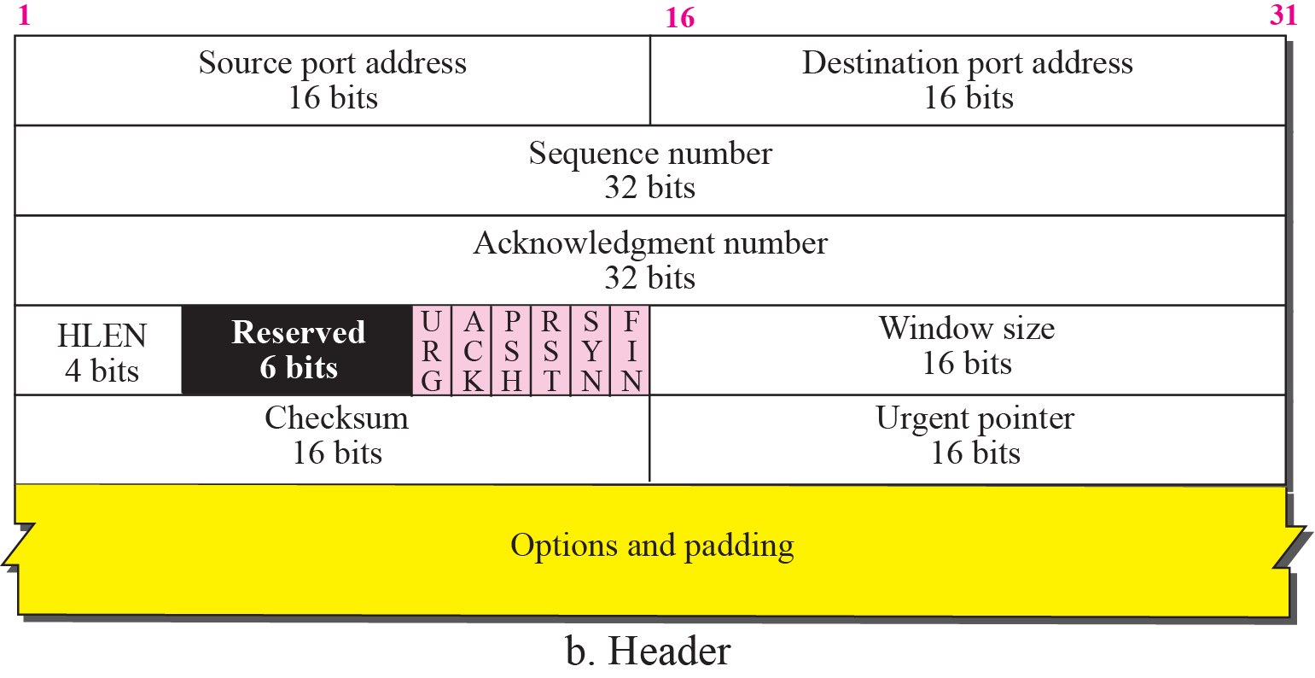
Figure 15.5 TCP segment format
TCP/IP Protocol Suite

Slide 43
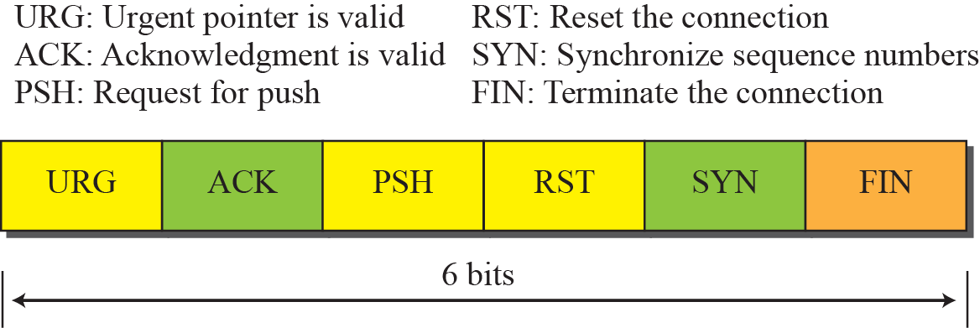
Figure 15.6 Control field
TCP/IP Protocol Suite

Slide 44
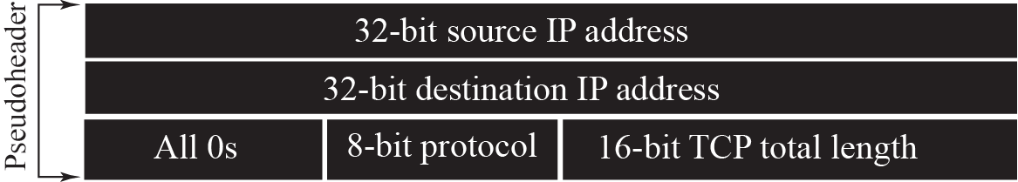
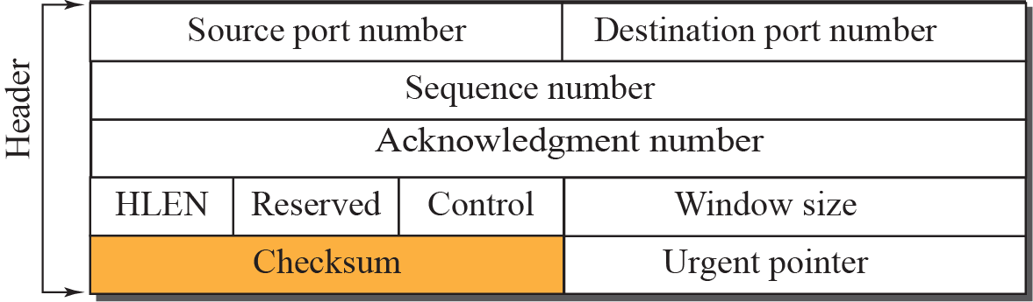

Figure 15.7 Pseudoheader added to the TCP segment
TCP/IP Protocol Suite

Slide 45
Note
The use of the checksum in TCP is mandatory.
TCP/IP Protocol Suite

Slide 46
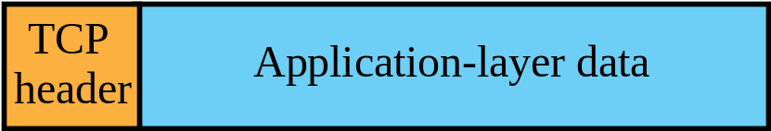
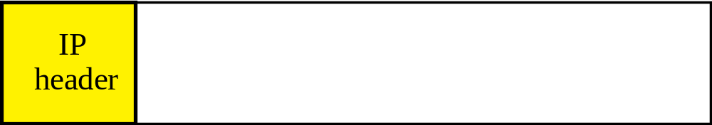
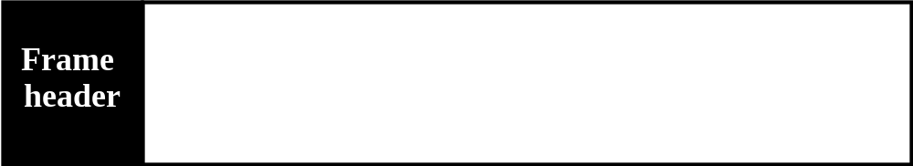
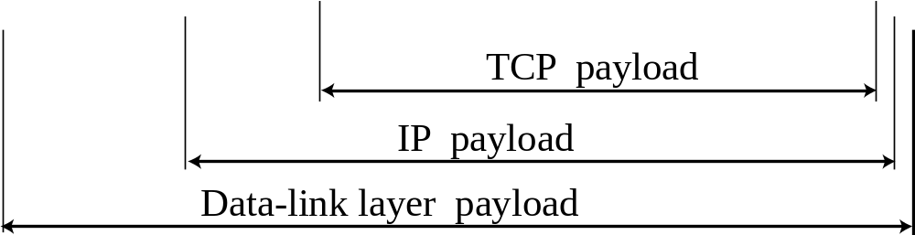
Figure 15.8 Encapsulation
TCP/IP Protocol Suite

Slide 47
15-4 A TCP CONNECTION
TCP is connection-oriented. It establishes a virtual path between the source and destination. All of the segments belonging to a message are then sent over this virtual path. You may wonder how TCP, which uses the services of IP, a connectionless protocol, can be connection-oriented. The point is that a TCP connection is virtual, not physical. TCP operates at a higher level. TCP uses the services of IP to deliver individual segments to the receiver, but it controls the connection itself. If a segment is lost or corrupted, it is retransmitted.
TCP/IP Protocol Suite

Slide 48
Topics Discussed in the Section
Connection Establishment
Data Transfer
Connection Termination
Connection Reset
TCP/IP Protocol Suite

Slide 49
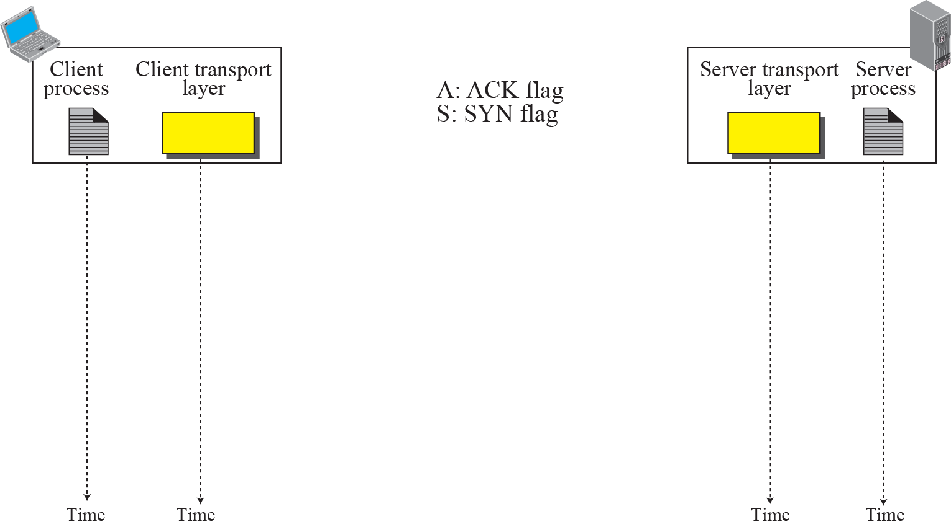
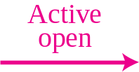
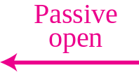
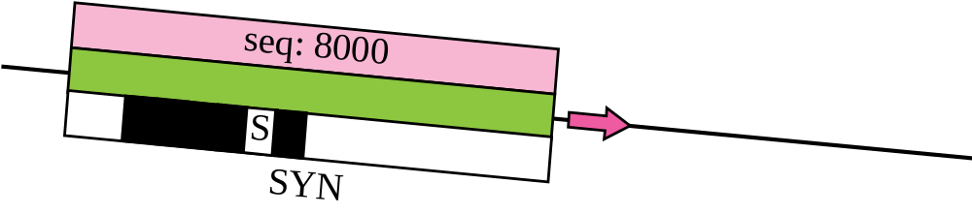
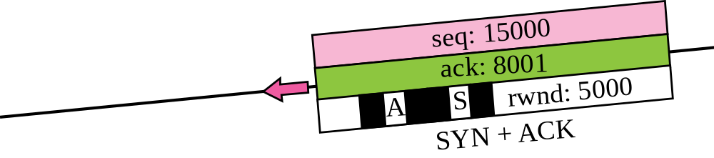
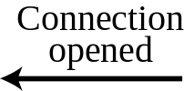
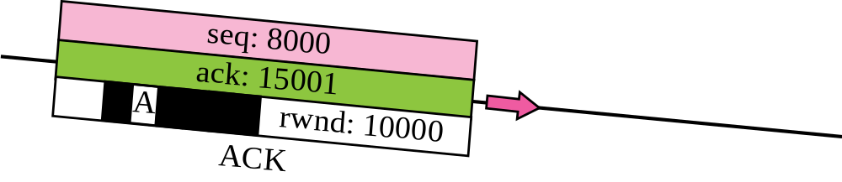

Figure 15.9 Connection establishment using three-way handshake
Means “no data” !
seq: 8001 if piggybacking
TCP/IP Protocol Suite

Slide 50
Note
A SYN segment cannot carry data, but it consumes one sequence number.
TCP/IP Protocol Suite

Slide 51
Note
A SYN + ACK segment cannot carry data, but does consume one
sequence number.
TCP/IP Protocol Suite

Slide 52
Note
An ACK segment, if carrying no data, consumes no sequence number.
TCP/IP Protocol Suite

Slide 53
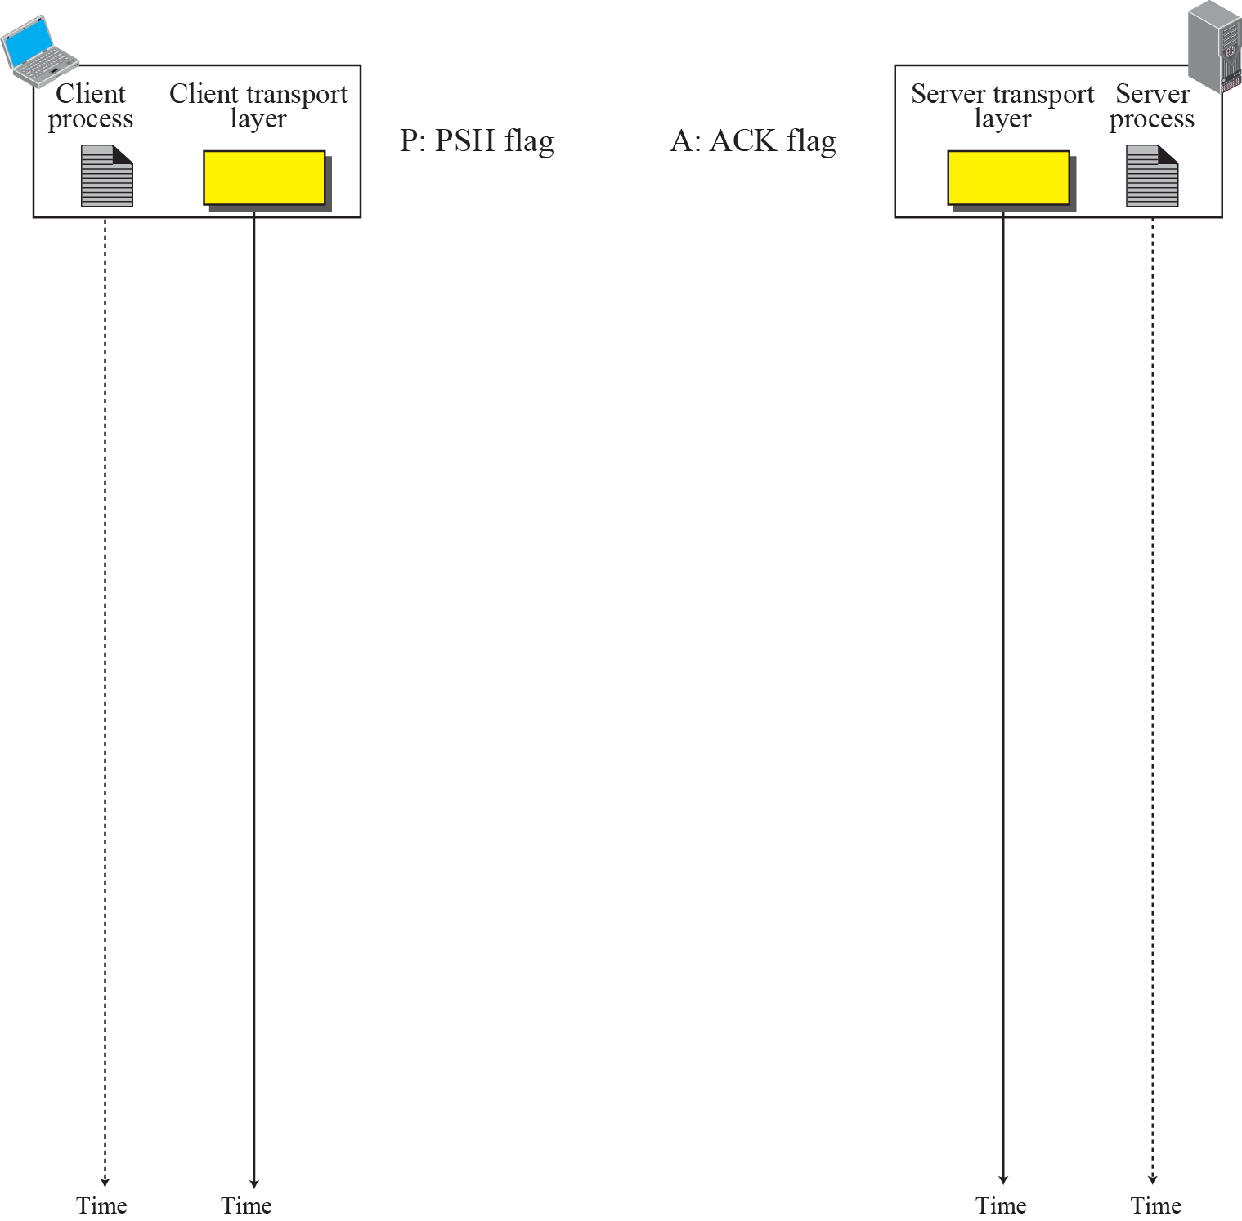
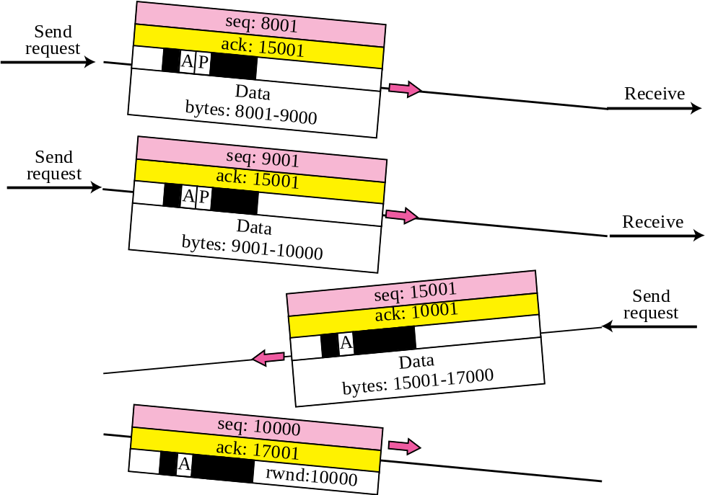

Figure 15.10 Data Transfer
TCP/IP Protocol Suite

Slide 54
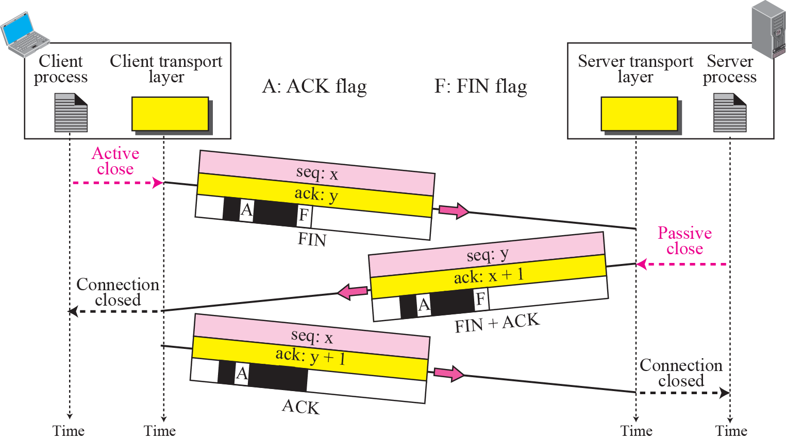
Figure 15.11 Connection termination using three-way handshake
TCP/IP Protocol Suite

Slide 55
Note
The FIN segment consumes one sequence number if it does
not carry data.
TCP/IP Protocol Suite

Slide 56
Note
The FIN + ACK segment consumes one sequence number if it does
not carry data.
TCP/IP Protocol Suite

Slide 57
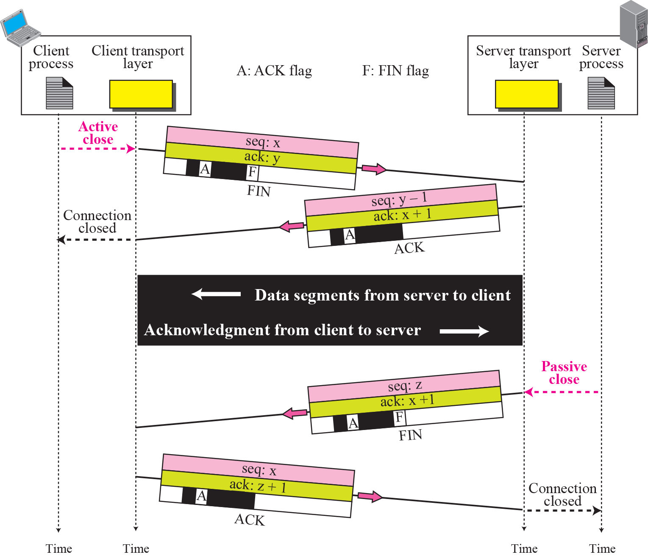
Figure 15.12 Half-Close
TCP/IP Protocol Suite

Slide 58
15-6 WINDOWS IN TCP
Before discussing data transfer in TCP and the issues such as flow, error, and congestion control, we describe the windows used in TCP. TCP uses two windows (send window and receive window) for each direction of data transfer, which means four windows for a bidirectional communication. To make the discussion simple, we make an assumption that communication is only unidirectional; the bidirectional communication can be inferred using two unidirectional communications with piggybacking.
TCP/IP Protocol Suite

Slide 59
Topics Discussed in the Section
Send Window
Receive Window
TCP/IP Protocol Suite

Slide 60
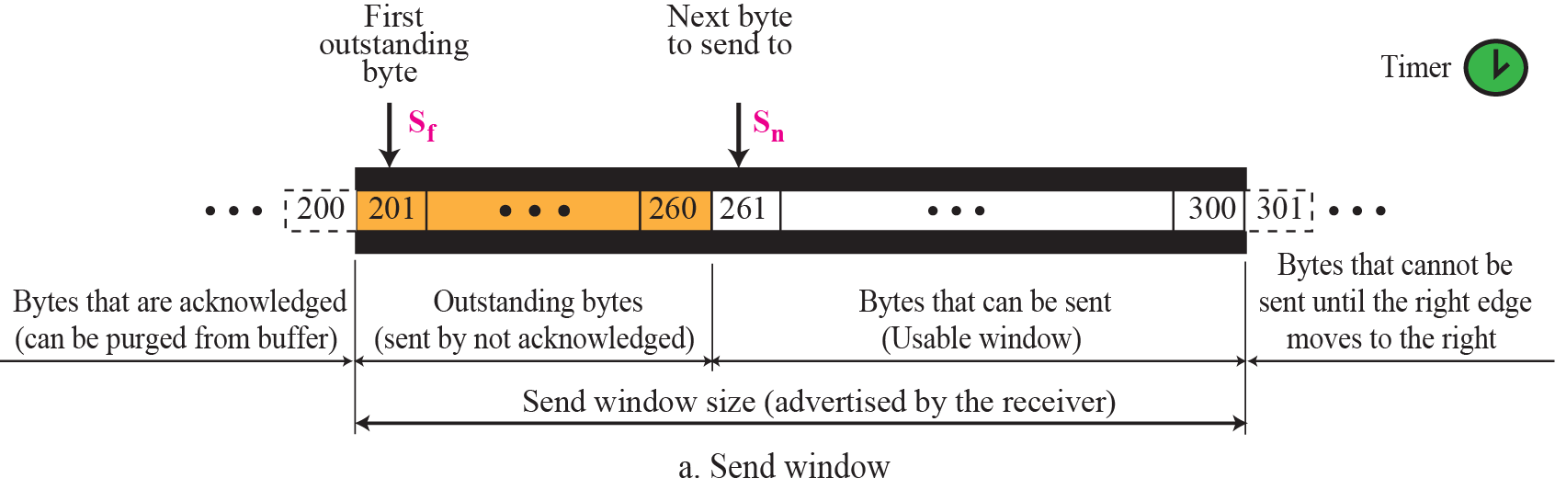
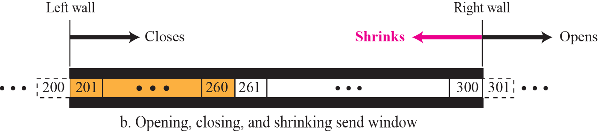
Figure 15.22 Send window in TCP
TCP/IP Protocol Suite

Slide 61
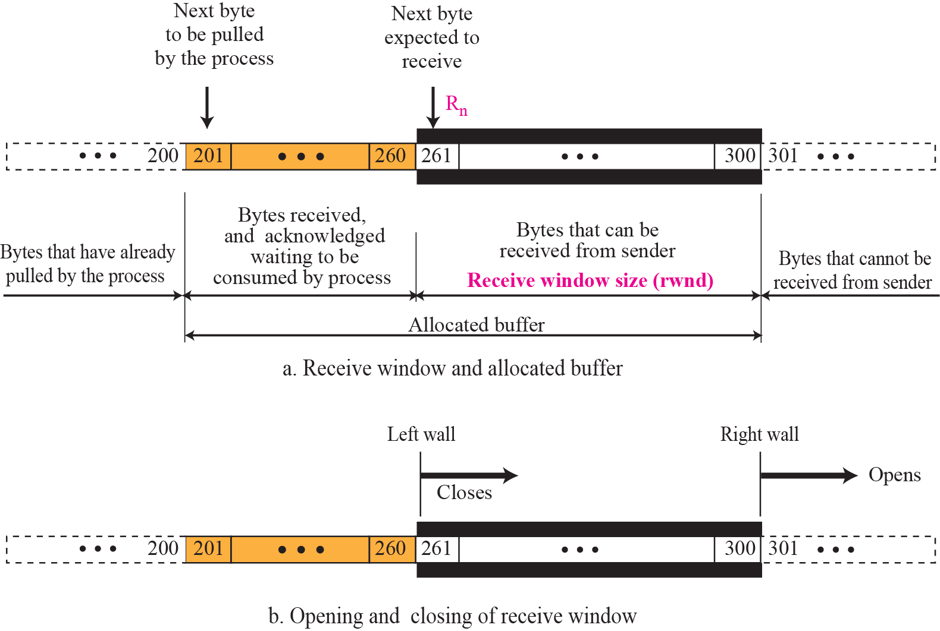
Figure 15.23 Receive window in TCP
TCP/IP Protocol Suite

Slide 62
15-7 FLOW CONTROL
As discussed in Chapter 13, flow control balances the rate a producer creates data with the rate a consumer can use the data. TCP separates flow control from error control. In this section we discuss flow control, ignoring error control. We temporarily assume that the logical channel between the sending and receiving TCP is error-free. Figure 15.24 shows unidirectional data transfer between a sender and a receiver; bidirectional data transfer can be deduced from unidirectional one as discussed in Chapter 13.
TCP/IP Protocol Suite

Slide 63
Topics Discussed in the Section
Opening and Closing Windows
Shrinking of Windows
TCP/IP Protocol Suite

Slide 64
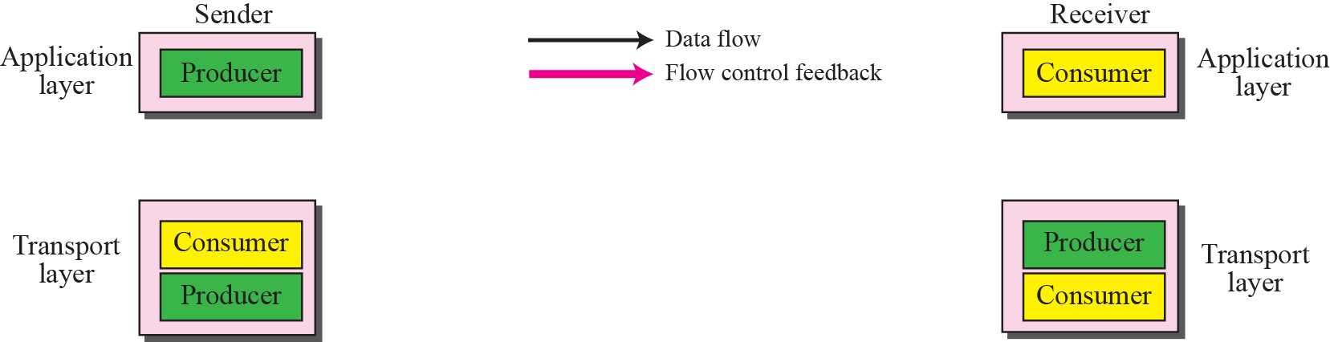
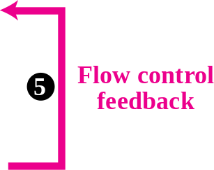
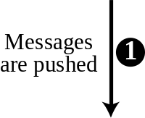
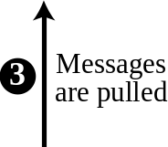

Figure 15.24 TCP/IP protocol suite
TCP/IP Protocol Suite

Slide 65

Figure 15.25 An example of flow control
TCP/IP Protocol Suite

Slide 66
Example 15.2
Figure 15.26 shows the reason for the mandate in window shrinking. Part a of the figure shows values of last acknowledgment and rwnd. Part b shows the situation in which the sender has sent bytes 206 to 214. Bytes 206 to 209 are acknowledged and purged. The new advertisement, however, defines the new value of rwnd as 4, in which 210 + 4 < 206 + 12. When the send window shrinks, it creates a problem: byte 214 which has been already sent is outside the window. The relation discussed before forces the receiver to maintain the right-hand wall of the window to be as shown in part a because the receiver does not know which of the bytes 210 to 217 has already been sent. One way to prevent this situation is to let the receiver postpone its feedback until enough buffer locations are available in its window. In other words, the receiver should wait until more bytes are consumed by its process.
TCP/IP Protocol Suite

Slide 67


Figure 15.26 Example 15.2
TCP/IP Protocol Suite

Slide 68
15-8 ERROR CONTROL
TCP is a reliable transport layer protocol. This means that an application program that delivers a stream of data to TCP relies on TCP to deliver the entire stream to the application program on the other end in order, without error, and without any part lost or duplicated.
Error control in TCP is achieved through the use of three tools: checksum, acknowledgment, and time-out.
TCP/IP Protocol Suite

Slide 69

Figure 15.29 Normal operation
TCP/IP Protocol Suite

Slide 70

Figure 15.30 Lost segment
TCP/IP Protocol Suite

Slide 71
Note
The receiver TCP delivers only ordered data to the process.
TCP/IP Protocol Suite

Slide 72

Figure 15.31 Fast retransmission
TCP/IP Protocol Suite

Slide 73

Figure 15.32 Lost acknowledgment
TCP/IP Protocol Suite

Slide 74

Figure 15.33 Lost acknowledgment corrected by resending a segment
TCP/IP Protocol Suite

Slide 75
Note
Lost acknowledgments may create deadlock if they are not
properly handled.
TCP/IP Protocol Suite

Slide 76
15-9 CONGESTION CONTROL
We discussed congestion control in Chapter 13. Congestion control in TCP is based on both open loop and closed-loop mechanisms. TCP uses a congestion window and a congestion policy that avoid congestion and detect and alleviate congestion after it has occurred.
TCP/IP Protocol Suite

Slide 77
15-11 OPTIONS
The TCP header can have up to 40 bytes of optional information. Options convey additional information to the destination or align other options. We can define two categories of options: 1-byte options and multiple-byte options. The first category contains two types of options: end of option list and no operation. The second category, in most implementations, contains five types of options: maximum segment size, window scale factor, timestamp, SACK-permitted, and SACK (see Figure 15.41).
TCP/IP Protocol Suite

Slide 78

Figure 15.41 Options
TCP/IP Protocol Suite

