Slide 1
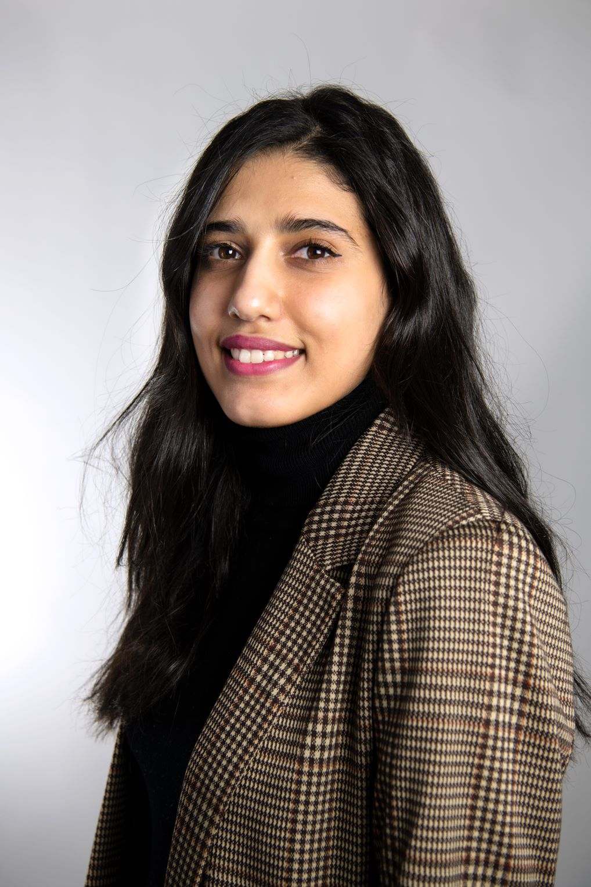
Abount Me
Skills
Imane is a consultant specializing in Salesforce and MuleSoft. She joined Deloitte Digital in February 2021 as an intern, where she discovered Salesforce and then MuleSoft. Imane has a strong technical background that allows her to address various technical requests and quickly develop new skills when needed. She also has functional expertise, enabling her to support her clients from the design phase through to solution implementation.
Technical Skills:
Apex Development (Classes, Triggers, Test Classes)
Salesforce Administration (Flow Creation, Salesforce Platform Customization)
API Development with MuleSoft on Anypoint Studio
APIManagement on API Manager (RAML Design, Security, Access Management, etc.)
Development of MUnit Unit Tests
Technical Performance Testing
Git: Deployment with Pipelines
Kafka
Functional Skills:
Supporting clients in defining their needs
Conducting functional testing and identifying pain points
Creating technical specifications
Defining use cases, prioritization, and estimation
Photo
Career Path and Education
Since February 8, 2021: Technical Consultant in Salesforce/MuleSoft at Deloitte Digital
2021: Engineering degree in Software Engineering – ENSIIE
2018: two years degree in Systems and Network Administration – ESTO
Certification
Mulesoft certified developer – level 1
Mulesoft certified developer – level 2
Associate Salesforce and Mulesoft.
Salesforce Associsate IA.
Imane
EL MOUL
Mulesoft/Salesforce
Consultant
Principal Clients
Deloitte Digital
+33 6 05 67 5118
ielmoul@deloitte.fr
    Boulanger
    Olympic/Paralympic Games Paris 2024
    Toray
    Vallourec
langages
    Frensh – English - Arabic

