Slide 1


PRIMARY LOGO · LIGHT
PRIMARY LOGO · DARK

Slide 2
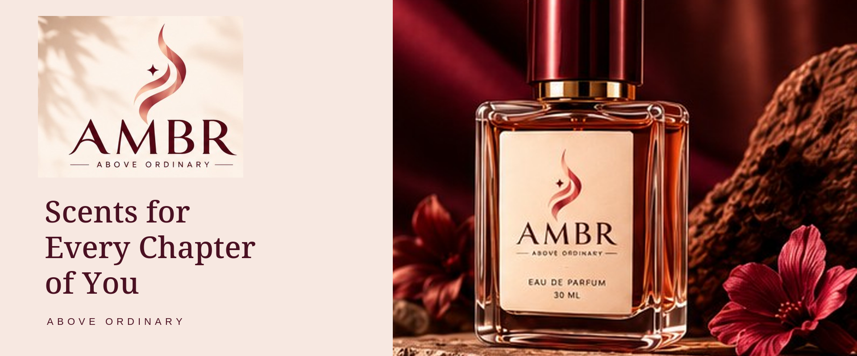
WEBSITE HERO · 1920 × 800

Slide 3
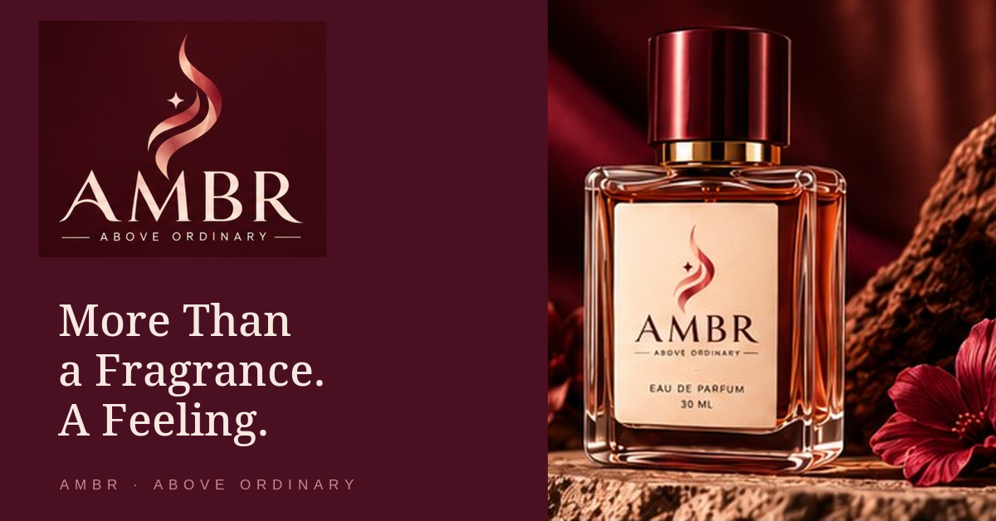
SOCIAL BANNER · 1200 × 628

Slide 4
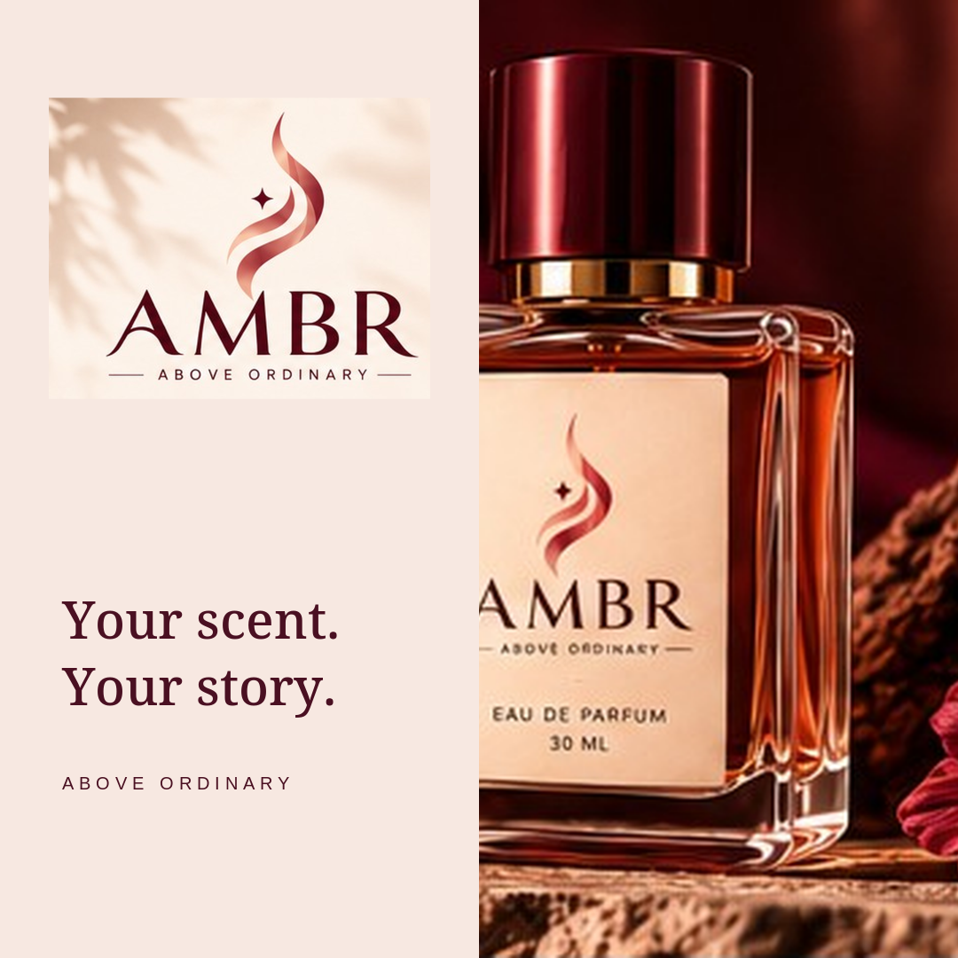
INSTAGRAM POST · 1080 × 1080

Slide 5
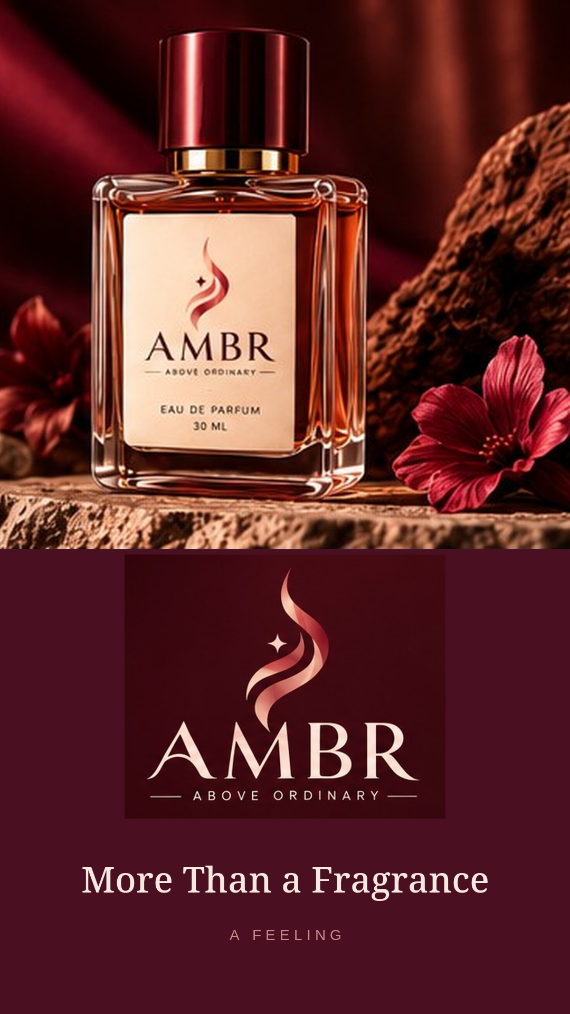
INSTAGRAM STORY · 1080 × 1920

Slide 6
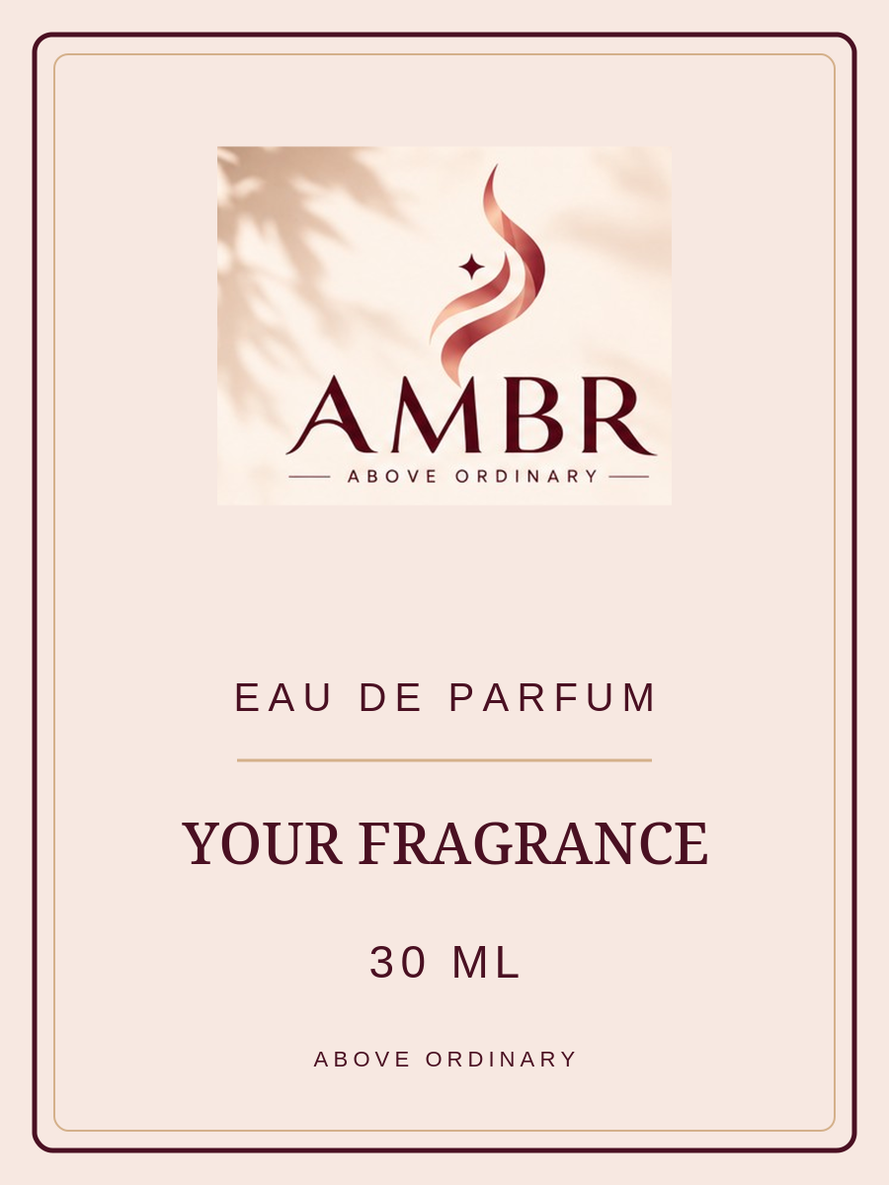


PRODUCT LABEL TEMPLATES

Slide 7
AMBR · BRAND COLOUR SYSTEM
Deep Burgundy
Dusty Rose
Blush Cream
#4A1022
#C9888B
#F7E8E1
Warm Beige
Champagne Gold
Charcoal Brown
#E6D3C7
#D4B08A
#3A2A28

