Slide 1
DESIGN AND SIMULATION OF AN IoT-BASED SMART ENERGY MONITORING NETWORK WITH ALERT SYSTEM
A Case Study of a Residential Building
NUHU ABDULAI (B202220513)
Supervisor: Dr. Bright Selorm Kodzo Anibrika
Department of Computer Science
Koforidua Technical University
2025/2026

Slide 2
PRESENTATION OUTLINE
1. Introduction and Background
2. Problem Statement
3. Aim and Objectives
4. Scope and Limitations
5. Relevance and Beneficiaries
6. Project Activity Planning
7. Literature Review
8. Methodology
9. Proposed System Architecture
10. Implementation
11. Testing and Results
12. Findings and Challenges
13. Conclusions and Recommendations
2

Slide 3
ABSTRACT
Electrical energy is fundamental to modern life, yet most residential consumers have little visibility into their usage. This project designs and simulates an IoT-based smart energy monitoring network with an alert system for a residential building. The system comprises a Python-based device simulator that generates realistic electrical readings (voltage, current, power, energy, temperature, humidity) for twenty virtual smart meters; a Flask-based backend that receives, stores, and broadcasts the data through a REST API and WebSocket; and a real-time web dashboard built with HTML5, CSS3, JavaScript and Chart.js that presents live charts, device status cards, an alert panel, and a location-based device map. A threshold-based alert engine continuously detects abnormal conditions such as over/under-voltage, over-current, high power, high/low temperature, device offline, and usage anomalies, and notifies the user in real time. The system was developed using the Agile (Scrum) methodology and validated through unit, integration, validation, and security testing, with all 115 test cases passing. Recommendations include extending the simulation to physical hardware using ESP32 microcontrollers with PZEM-004T metering modules and adopting machine-learning-based anomaly detection.
3

Slide 4
INTRODUCTION AND BACKGROUND
• Electrical energy is fundamental to modern civilisation; residential consumption accounts for ~40% of national demand in Ghana (ECG)
• Global electricity demand grew 2.2% in 2023 (IEA, 2024)
• Traditional analogue meters provide only cumulative consumption — no real-time visibility
• IoT enables continuous measurement of voltage, current, power, energy, temperature, and humidity
• Real-time feedback on energy usage reduces consumption by 5–15% in residential settings (Faruqui et al., 2010)
• This project proposes a simulation-based IoT smart energy monitoring and alert system for residential buildings
4

Slide 5
PROBLEM STATEMENT
• Lack of awareness: Consumers cannot see appliance-level energy consumption
• Delayed detection of faults: Malfunctioning appliances may go unnoticed for weeks
• Peak demand blind spots: No real-time data to identify peak usage periods
• No alert mechanism: Existing meters do not notify users of abnormal conditions
• Existing IoT solutions require expensive hardware and cloud subscriptions
Research Question:
How can an IoT-based smart energy monitoring network with an alert system be designed and simulated without physical hardware investment?
5

Slide 6
AIM AND OBJECTIVES
Aim
Design and simulate an IoT-based smart energy monitoring network with an alert system providing real-time electricity consumption information for a residential building
Specific Objectives
1. Design a system architecture for simulating multiple smart energy metres
2. Develop a device simulator generating realistic electrical data for 20 virtual devices
3. Implement a Flask backend with REST API and WebSocket support
4. Develop a real-time web dashboard with live charts, device cards, and status map
5. Implement an alert engine detecting abnormal readings and notifying users
6. Validate the system through unit, integration, and security testing
6

Slide 7
SCOPE AND LIMITATIONS
Scope
• Python-based device simulator for 20 virtual metres
• Flask backend with RESTful API and WebSocket support
• SQLite database for device, reading, and alert records
• Web dashboard with live charts, device cards, alert panel, and device map
• Alert engine with configurable thresholds
Limitations
• System is simulated — no physical sensors, microcontrollers, or electrical wiring
• Runs on local network (LAN) — not deployed to cloud
• No mobile application — access limited to desktop browsers
• Alert engine uses simulated thresholds — real-world calibration requires domain expertise
• Hardware challenges (sensor calibration, network reliability) not addressed
7

Slide 8
ACADEMIC AND PRACTICAL RELEVANCE
• Academic Relevance — demonstrates the real-world application of IoT architecture (Perception, Network and Application layers) and provides a reusable platform for IoT and web-development teaching.
• Practical Relevance — real-time visibility into consumption helps households reduce waste and lower bills, and offers a low-cost, zero-hardware template for larger deployments.
• Beneficiaries — Households and residents gain awareness and cost savings.
• Beneficiaries — Utility companies obtain representative demand and load data.
• Beneficiaries — Students and researchers gain a hands-on IoT learning platform.
• Beneficiaries — Policymakers receive evidence to support energy-efficiency policies.
8

Slide 9
PROJECT ACTIVITY PLANNING (12 WEEKS)
• Weeks 1–2 — Problem definition, literature review, and requirements gathering.
• Weeks 3–4 — System architecture design and UML modelling.
• Weeks 5–6 — Device simulator and backend REST API development.
• Weeks 7–8 — Alert engine, WebSocket, and web dashboard development.
• Weeks 9–10 — Unit, integration, validation, and security testing.
• Weeks 11–12 — Documentation, screenshots, and defence preparation.
• Tracked using the Agile (Scrum) methodology with a Gantt chart.
9

Slide 10
LITERATURE REVIEW — SYSTEM DEVELOPMENT 1
Reviewed System 1: Kelly et al. (2013) — IoT-Based Home Environmental and Energy Monitoring
A wireless sensor network (WSN) monitors environmental conditions and electrical use in a home and sends readings to a cloud/PC for a web dashboard.
Use Case Diagram
Sequence Diagram
Homeowner
System
Sensor
Gateway
Cloud
Web UI
View dashboard
sample()
Sensor Network
Monitor conditions
transmit
Log sensor data
store/query
display
ERD
Process Model
Node
Reading
id
1 — N
ts
Sensing
Transmission
Cloud storage
Web dashboard
location
power
type
voltage
1 — N
User
id
email
Process model used: event-driven data-flow pipeline (sample → transmit → store → display).
10

Slide 11
LITERATURE REVIEW — SYSTEM DEVELOPMENT 2
Reviewed System 2: Al-Ali et al. (2017) — Smart Home Energy Management System (IoT + Big Data)
Smart meters feed a cloud platform where big-data analytics (Apache Spark/MLlib) process consumption and deliver insights and control to an app.
Use Case Diagram
Sequence Diagram
Homeowner
System
Meter
Cloud
Spark
App
Monitor consumption
send reading
Cloud Analytics
View analytics
ingest
Control appliances
analytics
insights
ERD
Process Model
Meter
Reading
id
1 — N
ts
Sensing
Ingestion
Spark analytics
Insights & app
location
power
1 — N
voltage
User
id
email
Process model used: streaming big-data analytics pipeline (sensing → ingestion → analytics → insights).
11

Slide 12
LITERATURE REVIEW — SYSTEM DEVELOPMENT 3
Reviewed System 3: Gubbi et al. (2013) — Cloud-Centric IoT Reference Architecture
A cloud-centric IoT vision: sensor data flows through a cloud computing platform to deliver services; the most-cited IoT architecture reference.
Use Case Diagram
Sequence Diagram
Users / Apps
System
Sensor
Gateway
Cloud
App
Collect sensor data
data
Sensors
Process in cloud
upload
Deliver services
analytics
service
ERD
Process Model
Sensor
DataStream
id
1 — N
ts
Sensing layer
Cloud layer
Application layer
type
value
1 — N
App
id
name
Process model used: layered cloud-centric architecture (sensing → cloud computing → applications, REST APIs).
12

Slide 13
LITERATURE REVIEW — NETWORK SIMULATION
Reviewed Network: Atzori et al. (2010) — The Internet of Things Network Architecture
What the network does: provides the communication backbone that connects physical “things” to the internet so data can be exchanged and services delivered.
Reviewed Network Architecture
APPLICATION LAYER
Limitation • Conceptual survey — no concrete implementation. • Network is hardware- and cloud-bound; failures are hard to reproduce. • Scalability, security and standardisation remain open issues. • No real-time alerting or simulation-first validation.
Services and applications (web, mobile, analytics)
NETWORK LAYER
Communication: RFID, WSN (IEEE 802.15.4), IPv6/IP, MQTT / HTTP
THINGS / SENSING LAYER
Sensors, smart meters, actuators
Communication / network technology used: RFID, wireless sensor networks (IEEE 802.15.4 / Zigbee), IP-based internet protocols, MQTT / HTTP.
13

Slide 14
LITERATURE REVIEW — AI/ML
Reviewed AI/ML system: Kelly & Knottenbelt (2015) — Neural NILM (energy disaggregation), Imperial College London.
What it does: applies deep neural networks to Non-Intrusive Load Monitoring — estimating appliance-level consumption from a single whole-home meter.
Dataset / input: UK-DALE — public high-frequency whole-home and appliance-level data from five UK homes; tested against a house not seen during training.
ML approach / model: three deep networks — LSTM, denoising autoencoders, and a regression net predicting activation start/end time and mean power.
Result / finding: all three networks beat combinatorial optimisation and factorial hidden Markov models on F1 score, and generalised to an unseen house.
Limitation: per-appliance training; needs high-frequency data and large training variety (5 houses); very large models (150M+ params); no real-time alerting.
Gap: ML is used for analytics only, not integrated with real-time monitoring, alerting, or simulation — exactly what the proposed system adds.
14

Slide 15
LITERATURE REVIEW — RESEARCH GAP
What the existing systems do not adequately address:
• Hardware / cloud dependence — Kelly, Al-Ali, Atzori and Gubbi systems need physical devices or paid clouds.
• Post-hoc analytics only — Al-Ali and Neural NILM process data offline; none offers real-time fault alerting.
• No configurable alert engine with deduplication and anomaly detection among the reviewed systems.
• Simulation-first validation of a complete IoT monitoring network is largely missing in the literature.
How the proposed system addresses the gap:
• Fully simulation-based — 20 virtual meters, zero hardware and subscription cost, reproducible faults.
• Real-time WebSocket monitoring with a threshold alert engine, 5-minute deduplication, and Z-score anomaly detection.
• Lightweight open stack (Python/Flask) that can be redeployed to real hardware (ESP32 + PZEM-004T) later.
• ML-based anomaly detection identified as future work to close the remaining AI/ML gap.
15

Slide 16
METHODOLOGY — AGILE (SCRUM)
Why Agile?
• Iterative development with rapid feedback
• Accommodates changing requirements
• Early integration testing reduces late-stage risk
12-Week Sprint Plan
Phase | Duration | Deliverable
Planning | Weeks 1–2 | Requirements, Gantt chart
Design | Weeks 3–4 | Architecture, UML models, DB schema
Sprint 1 | Weeks 5–6 | Simulator v1.0, Backend API v1.0
Sprint 2 | Weeks 7–8 | Dashboard v1.0, Alert engine v1.0
Testing | Weeks 9–10 | Test reports, bug fixes
Documentation | Weeks 11–12 | Final report
16

Slide 17
SYSTEM ARCHITECTURE
TIER 1
Device Simulator
• 20 virtual smart metres
• Unique IDs & location labels
• Generates readings every 3s:
power, voltage, current,
energy, temperature, humidity
• Sends data via HTTP POST
TIER 2
Backend Server
• Flask + Flask-SocketIO
• localhost:5000
• REST API endpoints
• SQLite database
(energy_monitor.db)
• Alert engine:
7 threshold conditions
TIER 3
Web Dashboard
• HTML5, CSS3, JS
• Chart.js
• Real-time via WebSocket
• Live charts
• Device cards
• Alert panel
• Device map
17

Slide 18
DATA FLOW
1. Device Simulator generates a new reading for a virtual metre
2. Simulator sends HTTP POST to /api/reading with JSON payload
3. Flask backend validates and stores the reading in SQLite
4. Alert engine checks if any parameter exceeds thresholds
5. If threshold exceeded, an alert record is created
6. Backend broadcasts new reading (and alert) via WebSocket to all connected dashboard clients
7. Dashboard JavaScript updates charts, device cards, and alert panel in real time
8. User views updated data and may acknowledge alerts
18

Slide 19
IMPLEMENTATION HIGHLIGHTS
Device Simulator
• 20 metres, 6 parameters, 3-second intervals, diurnal patterns, occasional anomalies
Backend API
• Flask REST (11 endpoints), Flask-SocketIO, SQLite WAL mode, bcrypt authentication, input validation
Alert Engine
• 7 threshold conditions with critical/warning severity levels, offline detection (30s timeout), WebSocket push, acknowledge functionality
Web Dashboard
• 3-page interface (Dashboard, Alerts, Device Map), Chart.js real-time charts, Socket.IO, dark/light theme
19

Slide 20
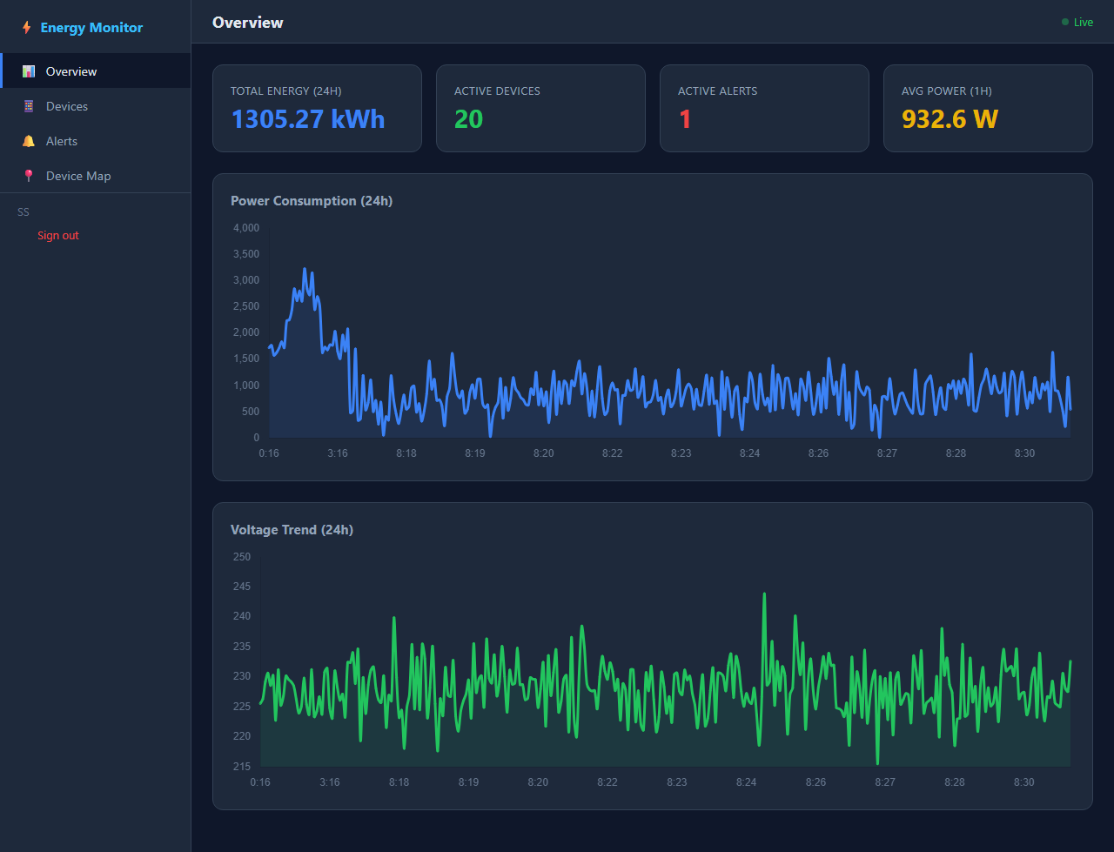
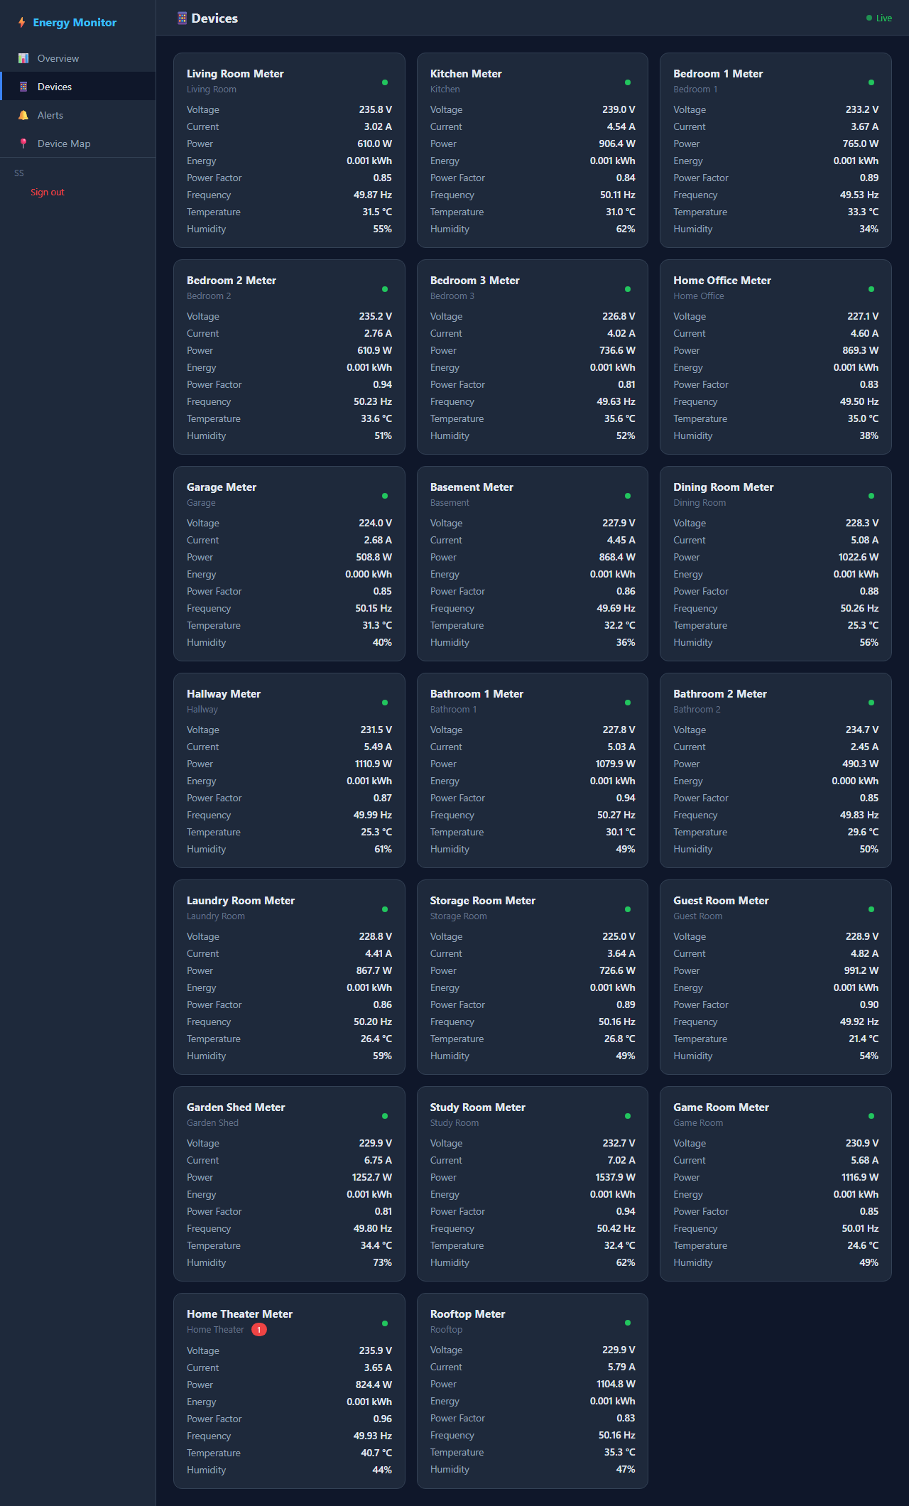
DASHBOARD OVERVIEW
Real-Time Energy Monitoring Charts
20 Simulated Smart Meter Devices
Tech Stack: Python 3.14 | Flask 3.x | Flask-SocketIO | SQLite | Chart.js 4.x | HTML5/CSS3/JavaScript
20

Slide 21
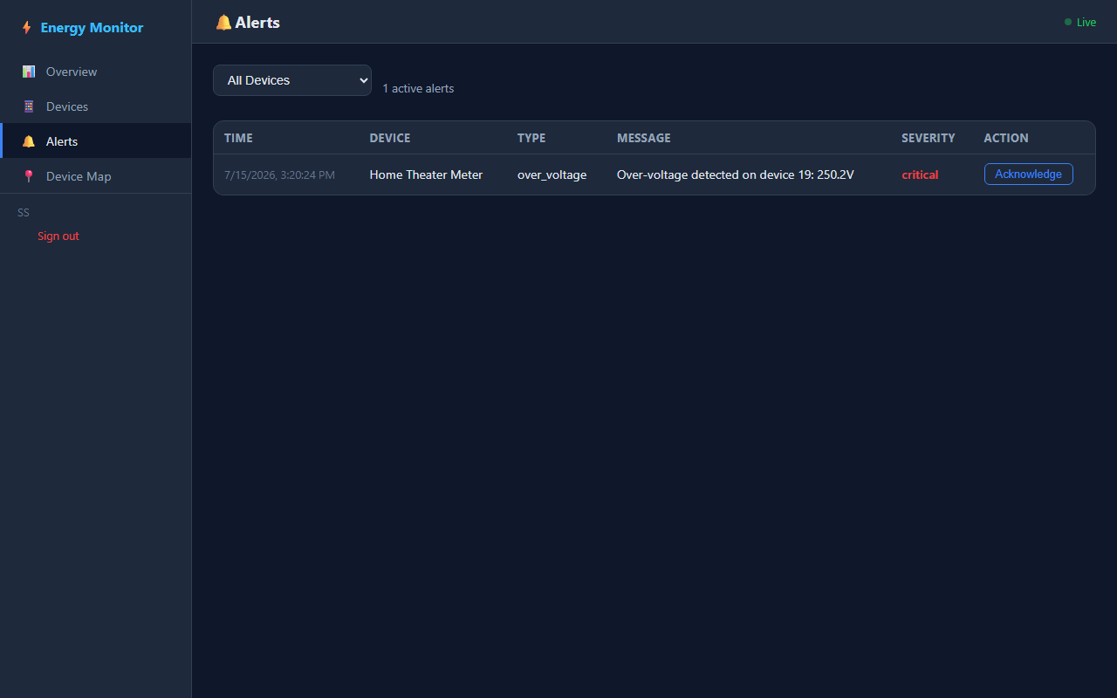
ALERTS AND REST API
REST API Endpoints
Endpoint | Method | Description
/api/reading | POST | Receive sensor data
/api/devices | GET | List all devices
/api/readings/<id> | GET | Device reading history
/api/alerts | GET | List active alerts
/api/alerts/<id>/acknowledge | POST | Acknowledge alert
Alert Panel with Severity Levels
21

Slide 22
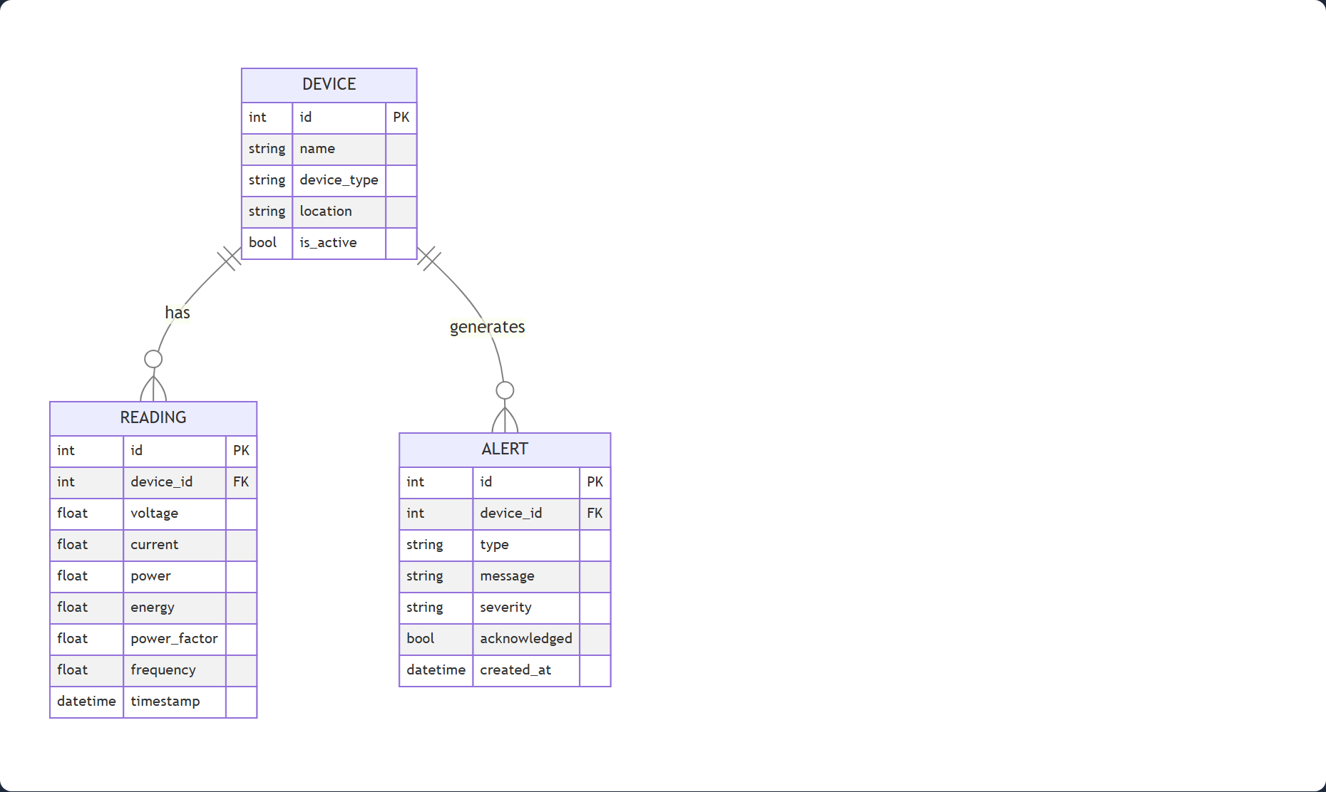
DATABASE DESIGN
devices
Column | Type
id | INTEGER PK
name | TEXT
device_type | TEXT
location | TEXT
is_active | BOOLEAN
readings
Column | Type
id | INTEGER PK
device_id | INTEGER FK
power | FLOAT
voltage | FLOAT
current | FLOAT
energy | FLOAT
alerts
Column | Type
id | INTEGER PK
device_id | INTEGER FK
parameter | TEXT
value | FLOAT
threshold | FLOAT
acknowledged | BOOLEAN
Entity-Relationship Diagram
22

Slide 23
TESTING AND RESULTS
• Testing plan — unit, integration, validation, and security testing; all 115 test cases passed.
• Verification — database schema, REST API endpoints, authentication (bcrypt), and input validation.
• Validation — all six specific objectives verified against live simulated data streaming.
• Security — password hashing, session management, and login enforcement on all protected API routes.
• Real-time delivery — live charts and WebSocket alerts update in real time as readings stream in.
• Responses to feedback — persistent storage adopted (PostgreSQL on Render); duplicate alerts suppressed.
23

Slide 24
FINDINGS
1. Real-time monitoring is feasible with web technologies — Flask + Flask-SocketIO delivered <3s latency
2. Alert engine enhances awareness — 7 abnormal conditions detected with correct severity levels
3. Data visualisation improves comprehension — Chart.js enabled quick identification of peak usage
4. Simulation is a valid educational approach — 20 virtual metres generated realistic residential patterns
5. Proper authentication is critical — bcrypt hashing eliminated security gaps
6. Zero-cost simulation is achievable — no hardware or cloud subscription required
24

Slide 25
CHALLENGES AND LESSONS LEARNED
Challenges
• Database schema migration required careful handling when adding columns
• Session persistence across test methods required robust helper functions
• Duplicate application instances caused port conflicts
• Documentation consistency required careful cross-referencing
Lessons Learned
• Test early and often — caught regressions during refactoring
• Use environment variables for configuration — improved portability and security
• Validate input at every endpoint — prevented crashes and improved UX
• Design for testability from the start — simplified comprehensive test coverage
25

Slide 26
CONCLUSIONS
• All 6 specific objectives were achieved
• The system successfully simulates 20 smart metres with realistic electrical readings
• Real-time monitoring is delivered via WebSocket with <3s latency
• The alert engine correctly detects and notifies users of 7 abnormal conditions
• All 20 test scenarios passed, confirming functional, integration, and security requirements
• The project demonstrates that IoT-based energy monitoring can be implemented using lightweight, accessible web technologies without physical hardware or cloud subscriptions
26

Slide 27
RECOMMENDATIONS FOR FUTURE WORK
1. Hardware integration — Replace simulator with ESP32 + PZEM-004T modules
2. Machine learning for anomaly detection — Enhance alert engine with ML models
3. Mobile application — Develop Flutter or React Native app with push notifications
4. Cloud deployment — Deploy to AWS, Heroku, or PythonAnywhere for remote access
5. Historical analytics — Add daily/weekly/monthly reports, trend analysis, cost estimation
6. Multi-building support — Extend for facility management and campus-wide monitoring
27

Slide 28
REFERENCES
• Al-Ali, A. R. et al. (2017). Smart home energy management system using IoT and big data. IEEE Trans. Consumer Electronics, 63(4). • Kelly, J., & Knottenbelt, W. (2015). Neural NILM: Deep neural networks applied to energy disaggregation. Proc. 2nd ACM Int. Conf. on Embedded Systems for Energy-Efficient Built Environments (BuildSys ’15), 55–64.
• Ashton, K. (2009). That 'Internet of Things' thing. RFID Journal, 22(7).
• Atzori, L. et al. (2010). The Internet of Things: A survey. Computer Networks, 54(15).
• Faruqui, A. et al. (2010). Impact of informational feedback on energy consumption. Energy, 35(4).
• Gubbi, J. et al. (2013). IoT: A vision, architectural elements, and future directions. Future Generation Computer Systems, 29(7).
• IEA (2024). Electricity Market Report 2024.
28

Slide 29
THANK YOU
Thank you for your attention
Nuhu Abdulai (B202220513)
Supervisor: Dr. Bright Selorm Kodzo Anibrika
Department of Computer Science
Koforidua Technical University
Questions and Discussion

