Slide 1
Get ready, we'll start at 09:35
Have your laptop ready for exercises!
GitHub repo with resources:
https://github.com/nuitrcs/AI_Week_Topic_Modeling
You may want a pen and paper to take notes

Slide 2


AI for Researchers:
Topic Modeling to Categorize Text Documents
Aaron Geller
John Lee
Yangyang Li

Slide 3
This workshop is brought to you by:
Northwestern IT Research Computing and Data Services
Need help?
AI, Machine Learning, Data Science
Statistics
Visualization
Data Collection, Cleaning​, Analysis, Management ...
Scraping, Text Analysis, Computing, Reproducibility ...
R, Python, SQL, MATLAB, Stata, SPSS, SAS, etc.
Request a FREE consultation at bit.ly/rcdsconsult.
Notes:
Don't go through bullets, just remind that we are here to help.

Slide 4
Collaborative project support
If you're a faculty (or postdoc, research staff, or graduate student with faculty sponsorship), we can provide longer-term support in your project.
We can help from exploration (is this idea possible?) to concrete outcomes (e.g., data collection, cleaning, analysis or visualization for a publication).
Find more information at bit.ly/collaborative_project_support

Slide 5
Bring Your Own Data (BYOD)
Do you have research data waiting to be collected, cleaned, analyzed or visualized? Come to BYOD.
BYOD is a weekly working group that provides structure, guidance, and accountability to help you make progress on your research project in a supportive and stress-free environment.
Find more information at bit.ly/byod_groups

Slide 6
What’s next?
Wednesday, September 3: Fine-Tuning LLMs for Text Analysis
Thursday, September 4: Retrieval-Augmented Generation: Enhancing LLM Systems with Research Data

Slide 7
AI Impact
AI has an environmental impact.
AI can rely on objectionable labor conditions.
AI can exhibit and reinforce biases.

Slide 8
AI has an environmental impact 🌍
Carbon footprint due to energy consumption both during model training and usage.
Fresh water evaporated to cool servers.
E-waste containing hazardous substances generated with the production of hardware.
A query to ChatGPT consumes about 10 times more electricity than a Google search.💡
Generating images is even more energy intensive than generating text... generating just one image can take as much energy as fully charging a smartphone.📱
Notes:
Short overview: https://www.unep.org/news-and-stories/story/ai-has-environmental-problem-heres-what-world-can-do-about
2024 report by the International Energy Agency: https://iea.blob.core.windows.net/assets/6b2fd954-2017-408e-bf08-952fdd62118a/Electricity2024-Analysisandforecastto2026.pdf
MIT Technology Review article: https://www.technologyreview.com/2023/12/01/1084189/making-an-image-with-generative-ai-uses-as-much-energy-as-charging-your-phone/

Slide 9
Warning!
Google Colab sends your data to Google’s servers.
Don’t upload any information you wouldn’t publicly share!
This includes data, code, API keys, people’s names, etc. It is OK to use Google Collab for today’s workshop.

Slide 10
Outline
Presentation (~1hr)
Overview of topic modeling concepts
“Classical” methods
AI-enabled methods, with code
Group exercises (remainder of day, with breaks)
Part 1 : same data, different model components
Part 2 : different data
Present your findings after Part 1 and Part 2

Slide 11









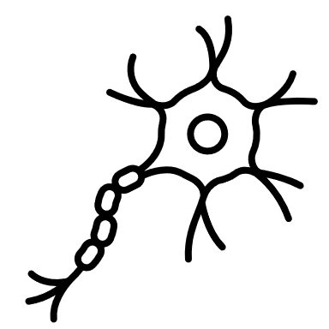


Topic Modeling Conceptual Overview
slide by efrén cruz cortés

Slide 12
Topic Modeling Conceptual Overview
DNA
virus
doctor
soccer
music
dancing
slide by efrén cruz cortés

Slide 13
Topic Modeling Conceptual Overview
slide by efrén cruz cortés

Slide 14
Topic Modeling Conceptual Overview
slide by efrén cruz cortés

Slide 15



Topic Modeling Conceptual Overview
Medical
Sports
Arts
slide by efrén cruz cortés

Slide 16
Topic Modeling Conceptual Overview
slide by efrén cruz cortés

Slide 17
Research Motivation for Topic Modeling
You have many responses from a survey, and you want to categorize the responses into (a prior unknown) themes and determine how often participants answered with each theme.
You have a collection of notes about patients in your clinic who all have a particular ailment, and you want to identify common attributes that were written across all these patients.
You want to analyze decades of telescope observation logs and other notes to identify emerging research topics and track their relevance over time.
You have many interview transcripts and want to uncover themes in public opinion about a particular federal policy.

Slide 18
“Classical” Topic Modeling Methods
Word Frequencies
Counts how often each word appears
Often uses TF-IDF (Term Frequency – Inverse Document Frequency) to highlight “important” words
Helps find the most common words but doesn't group them into topics
Latent Semantic Analysis (LSA)
Finds patterns in how words appear together across documents
Groups similar words and documents based on these patterns
Uses linear algebra (matrix decomposition) to uncover hidden “topics”
Latent Dirichlet Allocation (LDA)
A (Bayesian) probabilistic model that assumes each document is a mix of topics
Each topic is a mix of words that often appear together
Automatically assigns topic proportions to documents

Slide 19
AI-Enabled Topic Modeling Methods
Using GAI
BERTopic
If context window (LLM memory) is large enough, could feed entire set of documents into LLM and ask for topics in prompt
Could combine with “classical” method to use LLM to label clusters
If using LLM, there may be privacy concerns
Can you verify/repeat the results?
Convert sentences and/or documents into vectors using a transformer (embedding)
Dimension reduction (e.g., UMAP)
Clustering (e.g., HDBSCAN, k-means) to identify “topics”
Generate a label for each topic (e.g., using an extension of TF-IDF)

Slide 20

BERTopic Overview
https://maartengr.github.io/BERTopic/index.html
Wraps all steps in previous slide in an easy-to-use Python library
Very flexible with many different techniques (e.g., hierarchical, time-series dynamic, multimodal, etc.)
Built-in visualization options
Finding topics can be as simple as 1 line of code…
In our experience, it usually takes a lot of hand-holding to identify reasonable topics (as is true for most methods of topic modeling)
Notes:
talk about how you don't always need to be perfect for topic modeling -- e.g., if you just want to get an sense of what is there, it is OK if the clusters aren't perfect.

Slide 21
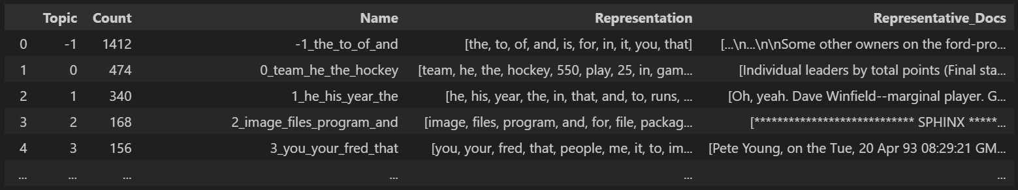
BERTopic Demo : The Simplest Case
from bertopic import BERTopic
# initialize the model topic_model = BERTopic()
# fit the model to the data (docs was defined in a previous step)
topic_model.fit(docs)
# get the topic information
topic_model.get_topic_info()

Slide 22
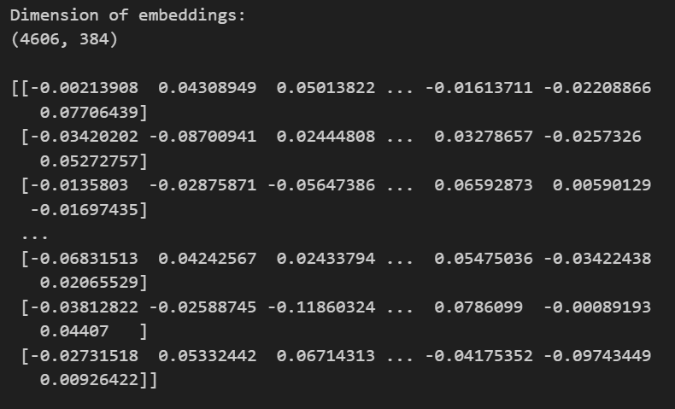
BERTopic Demo : 1. Embeddings
from sentence_transformers import SentenceTransformer
# initialize model
# all-MiniLM-L6-v2 is the name of a pretrained model
embedding_model = SentenceTransformer("all-MiniLM-L6-v2")
# encode the texts into embeddings
embeddings = embedding_model.encode(docs)

Slide 23
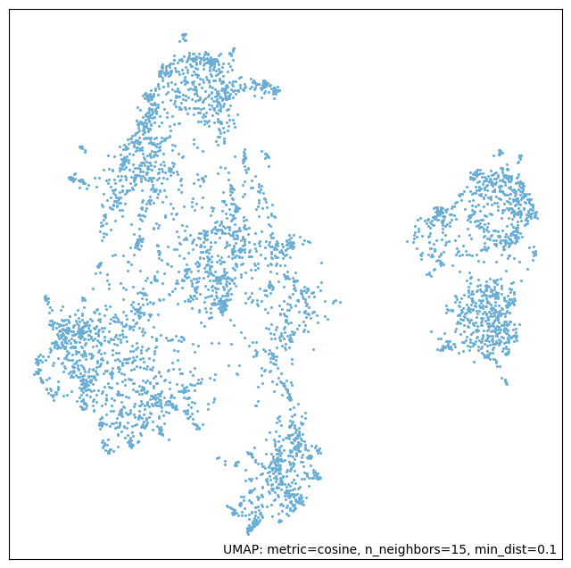

BERTopic Demo : 2. Dimension Reduction
from umap import UMAP
# set a random seed for reproducibility
seed = 54382
# initialize the UMAP model
umap_model = UMAP(n_components=2, n_neighbors = 15,
metric="cosine", random_state=seed)
# fit the UMAP model to find the best 2D
# representation of the embeddings
umap_model.fit(embeddings)

Slide 24
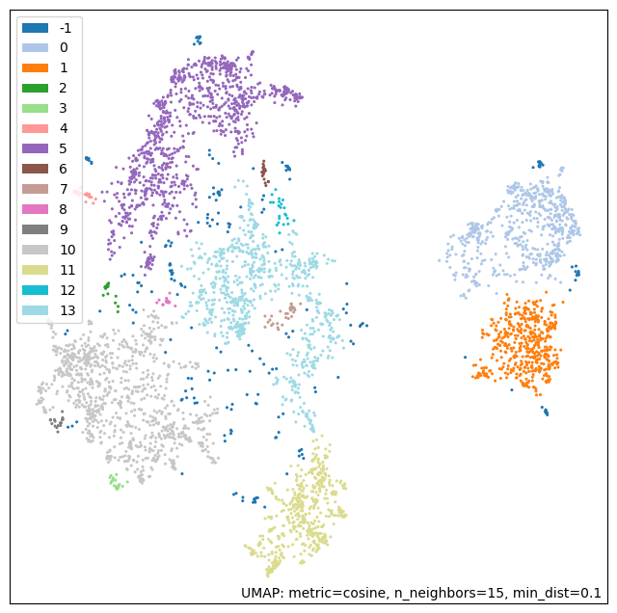
BERTopic Demo : 3. Clustering
from hdbscan import HDBSCAN
# initialize the HDBSCAN model
hdbscan_model = HDBSCAN(min_cluster_size=15, min_samples=1, cluster_selection_epsilon=0.165)
# identify clusters on the 2D representation of embeddings generated by UMAP, and plot the result
hdbscan_model.fit(umap_model.embedding_)
umap.plot.points(umap_model,
labels=hdbscan_model.labels_,
theme="blue")

Slide 25
BERTopic Demo : 4. Labeling
from keybert import KeyBERT
import numpy as np
# initialize the model; can use the same LM as we used for embeddings
rep_model = KeyBERT(model='all-MiniLM-L6-v2')
# loop through the clusters and get the labels (as BERTopic would do)
for label in np.unique(hdbscan_model.labels_):
# Get docs in this cluster
cluster_docs = [doc for doc, c in zip(docs, hdbscan_model.labels_) if c == label]
# Combine documents into a single string
combined_text = ' '.join(cluster_docs)
# Extract keywords
keywords = rep_model.extract_keywords(combined_text, top_n=5)
# print the results
# Note: KeyBERT returns a tuple with the (word, number), where the number is:
# the relevance score, i.e., the cosine similarity between the embedding of the keyword and the original doc
print(label, [kw[0] for kw in keywords])

Slide 26
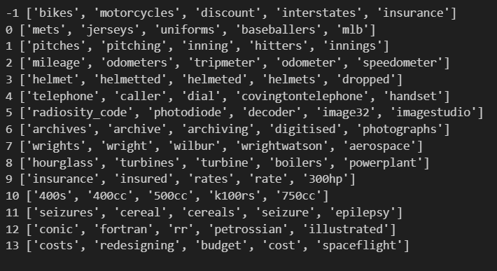
BERTopic Demo : 4. Labeling
from keybert import KeyBERT
import numpy as np
# initialize the model; can use the same LM as we used for embeddings
rep_model = KeyBERT(model='all-MiniLM-L6-v2')
# loop through the clusters and get the labels (as BERTopic would do)
for label in np.unique(hdbscan_model.labels_):
# Get docs in this cluster
cluster_docs = [doc for doc, c in zip(docs, hdbscan_model.labels_) if c == label]
# Combine documents into a single string
combined_text = ' '.join(cluster_docs)
# Extract keywords
keywords = rep_model.extract_keywords(combined_text, top_n=5)
# print the results
# Note: KeyBERT returns a tuple with the (word, numer), where the number is:
# the relevance score, i.e., the cosine similarity between the embedding of the keyword and the original doc
print(label, [kw[0] for kw in keywords])

Slide 27
BERTopic Demo : Combine steps in BERTopic
# set random seed for reproducibility
seed = 54382
# embedding model
embedding_model = SentenceTransformer("all-MiniLM-L6-v2") # all-MiniLM-L6-v2 is name of pretrained model
# umap model
umap_model = UMAP(n_components=2, n_neighbors = 15, metric="cosine", random_state=seed)
# initialize HDBSCAN model
hdbscan_model = HDBSCAN(min_cluster_size=15, min_samples=1, cluster_selection_epsilon=0.165)
# representation model
representation_model = KeyBERTInspired()
# define the BERTopic model using the models above
topic_model = BERTopic(
embedding_model=embedding_model,
umap_model=umap_model,
hdbscan_model=hdbscan_model,
representation_model=representation_model,
verbose=True
)
# fit the model to the data
topic_model.fit(docs)
# get the topic information
topic_model.get_topic_info()

Slide 28
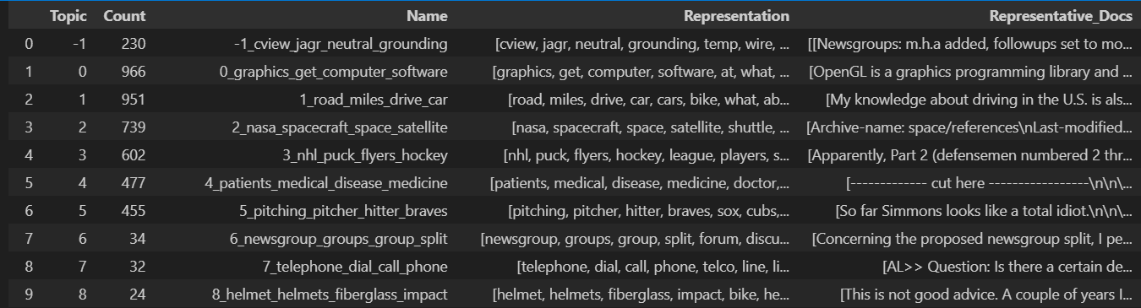
BERTopic Demo : Combine steps in BERTopic
# set random seed for reproducibility
seed = 54382
# embedding model
embedding_model = SentenceTransformer("all-MiniLM-L6-v2") # all-MiniLM-L6-v2 is name of pretrained model
# umap model
umap_model = UMAP(n_components=2, n_neighbors = 15, metric="cosine", random_state=seed)
# initialize HDBSCAN model
hdbscan_model = HDBSCAN(min_cluster_size=15, min_samples=1, cluster_selection_epsilon=0.165)
# representation model
representation_model = KeyBERTInspired()
# define the BERTopic model using the models above
topic_model = BERTopic(
embedding_model=embedding_model,
umap_model=umap_model,
hdbscan_model=hdbscan_model,
representation_model=representation_model,
verbose=True
)
# fit the model to the data
topic_model.fit(docs)
# get the topic information
topic_model.get_topic_info()

Slide 29
Your turn! (Part 1)
Group 1: Embeddings
Group 2: Dimension Reduction
Group 3: Clustering
Group 4: Labelling
Instructions are on our GitHub repo: https://github.com/nuitrcs/AI_Week_Topic_Modeling
We will work for 60 minutes, and then each group will give a 10-minute presentation on their findings.

Slide 30





Your turn! (Part 2)
Dataset 1: Laws Dataset
Dataset 2: Hotel Reviews
Dataset 3: Product Classification
Dataset 4: 20 Newsgroups
Choose your own dataset!
Instructions are on our GitHub repo: https://github.com/nuitrcs/AI_Week_Topic_Modeling
We will work for 2 hrs , and then each group will give a 10-minute presentation on their process and findings.
Notes:
Note that people can change groups if they want, but should spend enough time with a given dataset to become familiar with it and generate topics (and apply necessary tweaks to parameters to get the best result possible)

