Slide 1

Researcher’s Toolkit
OpenMP/MPI
Pascal Paschos (pascal.paschos@northwestern.edu) & Alper Kinaci (akinaci@northwestern.edu) &
Information Technology
Research Computing Services

Slide 2
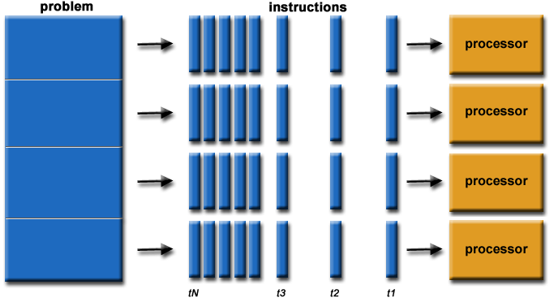
What is parallel computing
Simultaneous use of multiple computing resources to execute code
The set of instructions is broken into pieces and processed concurrently
Requires control and coordination to synchronize execution

Slide 3
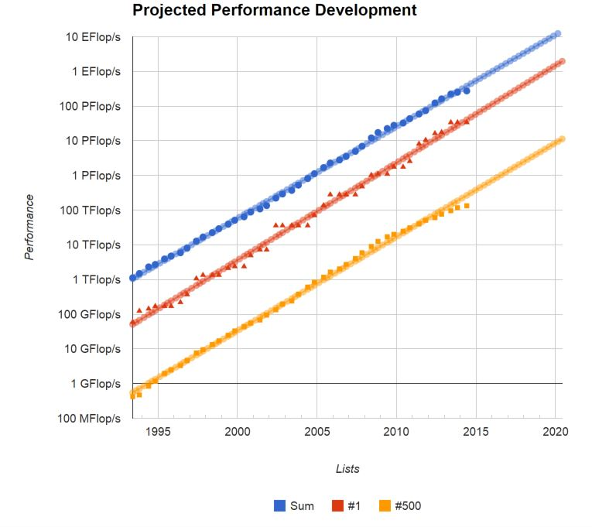
Importance of Parallel computing
The real world is massively parallel
Parallel computing better emulates the real world processes
Cost effectiveness
Scale to larger and more complex problems
Meet the need for concurrency
Expand beyond local resources
Take advantage of parallel hardware

Slide 4
Objectives of parallelization
Less time to solution for fixed size problems or similar time to solution with bigger size problems
Bigger size problems are better representations of physical systems (e.g. higher resolution simulations) or relevant to real world demands (e.g. larger volumes of data)
Bigger size problems that do not fit on a single machine need to be distributed across a networked collection of computers (cluster)
Leverage multi-processor computer architectures that allows for multiple concurrent processes or networked computers (nodes) in a cluster which offers extensible memory and processing power (number of cores)

Slide 5
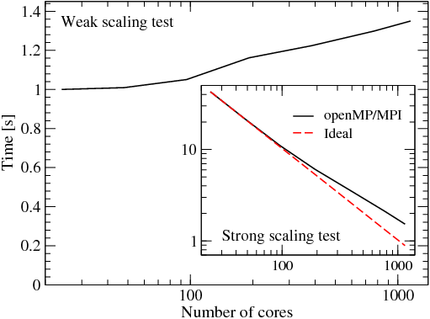
Scaling & Performance

Slide 6
Threads vs. Tasks
Threads are lightweight execution processes
They are ‘created/ by the main (heavy) process – the ‘executable’
Threads all share the memory address space of the main process.
A task is main (heavy) process
They are ‘clones’ of a main (heavy) process – the ‘executable’
Each tasks has it’s own memory address
Tasks/threads are not the ‘cores/CPUs’. They are processes that bind to the hardware

Slide 7
Partitioning Work in Parallel Programs
Breaking the problem into chunks to be distributed in each task
Domain Decomposition. Input data of the problem is decomposed and each task works on a portion of the data
Functional Decomposition. Each tasks performs a different function in the work flow.

Slide 8
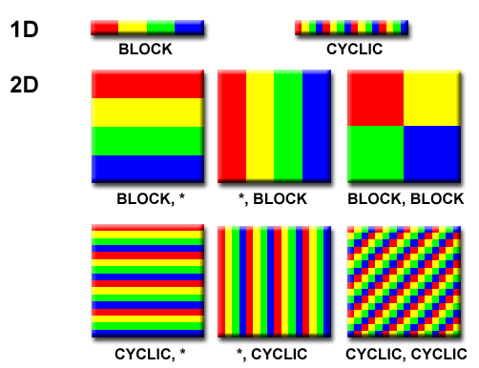
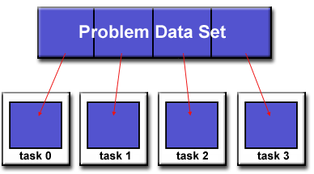
Domain Decomposition

Slide 9
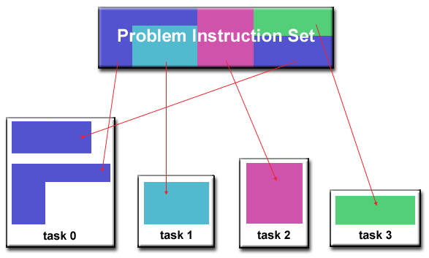
Functional Decomposition

Slide 10
Communications in Parallel Programs
Communication depends on your problem
No need: Problem is called embarrassingly parallel. Example, processing the pixel content of an image.
There is some need: A domain decomposition problem that requires communication across boundaries. (example: PDEs on a mesh)
There is great need: The solution domain requires contributions from the entire input domain (example: FFTs)

Slide 11
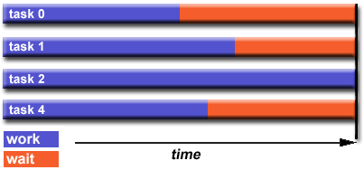
Load Balancing
Distribute equal amount of work between the parallel processes to minimize idle
The slowest processes determine time to execution and inhibit performance

Slide 12
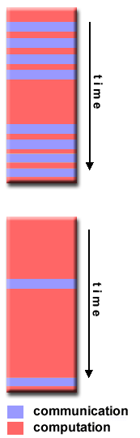
Granularity
G=Computation/Communication ratio
Fine grain parallelism
Relatively small amounts of computational work are done between communication events
Good for load balancing
High communication overhead
Coarse grain parallelism
Relatively large amounts of computational work are done between communication/synchronization events
Scalable to higher core counts
Bad for load balancing

Slide 13
I/O
I/O typically is a parallelization inhibitor
I/O operations are slower
Parallel I/Os are not readily available
There are parallel I/O routines within common APIs, for example MPI-IO or HDF5 parallel IO
Tips:
Reduce frequency of I/O ops
Write large chunks of data
Do I/O in serial portions if there is no parallel I/O API routines available
Aggregate I/O tasks to the master thread or task

Slide 14
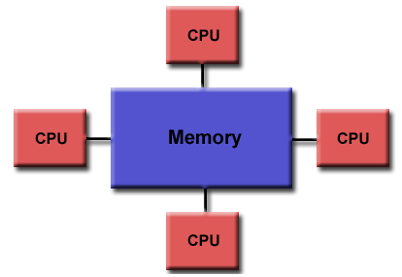
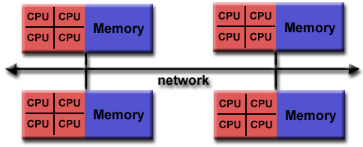
Shared Memory (SM)
Distributed Memory (DM)
All processors have direct access to the physical memory
Not scalable (extensible) in memory and cores
Network based memory access. Processors have direct access only to local machine memory
Scalable (extensible) in memory and cores

Slide 15
SM Architecture
Shared Memory (SM)
Distributed Memory (DM)
DM Architecture
SM Programming Model
DM Programming Model
Hybrid Programming
The programmer uses an API to synchronize the access of the shared memory by the parallel processes to avoid a) conflicting access of the same memory address (race conditions) b) consistent memory view
The programmer uses an API to explicitly manage the communication and synchronization between the parallel processes to avoid deadlocks, distribute data and perform collective operations
Implicit Parallelism
Multiple threads
Explicit Parallelism
Multiple Tasks
Processes (threads) do not “talk” to each other
Processes (tasks) “talk” to each other

Slide 16


Introduction to Shared Memory Computing using OpenMP

Slide 17

OpenMP Overview
OpenMP is an API that supports multithreaded, shared memory parallelization
Simple to use
Minimally invasive to parallelize serial program
Cross platform
Supports Fortran, C/C++

Slide 18
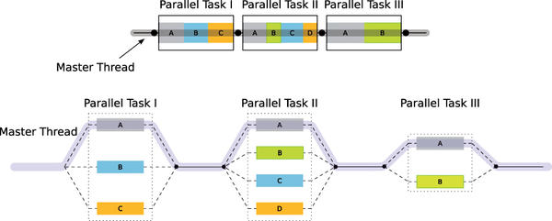
Fork/join parallelism

Slide 19
Invoking OpenMP extensions at compilation
GNU: gcc -fopenmp <sourcecode>
Intel: icc -openmp <sourcecode>
Must #include <omp.h> header file in C/C++ codes
In a Makefile typically insert in:
CFLAGS="$CFLAGS -fopenmp"

Slide 20
Components of OpenMP API
Compiler Directives
Runtime Library Routines
Environmental Variables

Slide 21
OpenMP computing stack
stdin/stdout
User Layer
Code/Application
Directives
Runtime Libraries
Environmental Variables
API Layer
OpenMP Runtime Library
System Layer
Operating System
Shared Memory
Infrastructure
C1
C2
C3
…..
CN

Slide 22
Compiler Directives
Define parallel regions
Use constructs for:
Work distribution – loops, blocks of code – to threads
Synchronization of work among threads
Serialization when imperative
Use clauses to provide tuning and customization

Slide 23
Generic Compiler Directive Structure
#pragma omp parallel default(shared)
{
#pragma omp for private (var_a) reduction(+:var_b)
{
for loops
}
}
Sentinel
Construct
-what do do-
Static Extent
Clauses
-how to do-

Slide 24
Defining a parallel region
#pragma omp parallel
{
...
...
...
Threaded code here
...
...
}
<Clauses>
if (scalar_expr)
private (list)
shared (list)
default (shared|none)
firstprivate (list)
reduction(operator:list)
copyin (list)
num_threads (int)
End of parallel region

Slide 25
All variables defined outside parallel regions are shared by default
private variables in parallel regions
Each thread has it’s own copy of the variable and it’s own value. The context is hidden from other threads
shared variables in parallel regions
The values of shared variables are visible and accessible by all threads
Programmer is responsible for avoiding race conditions

Slide 26
Core Constructs in a Parallel Region C/C++
Work-sharing Constructs
Synchronization Constructs
Barrier
For - loops
Ordered
Flush
Sections
Critical
Single
Task
ThreadPrivate

Slide 27
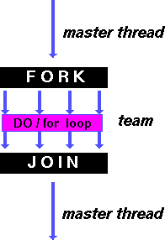
for worksharing construct
#pragma omp for
{
for_loop
...
...
...
...
...
}
<Clauses>
schedule(type,[chunk])
ordered
private (list)
shared (list)
firstprivate (list)
lastprivate (list)
reduction(operator:list)
collapse (n)
nowait

Slide 28
The reduction clause creates private copies
of the shared variable list. Private copies are then ‘reduced’, i.e. summed, and the answer is returned back to the global variable
#pragma omp parallel for private(i) reduction(+:result)
{
for (i=0; i < n; i++)
result = result + i*i;
}

Slide 29
The schedule(type,chunk) clause instructs on
how to distribute the loop iterations among the threads.
static: fixed assignment of loop segments (of size chunk)
to threads
dynamic: variable assignment of loop segments to threads
10
thread 0
10
thread 0
10
thread 1
10
thread 1
…
…
100
100

Slide 30
The ordered clause must be followed by the ordered
construct. Loop operations are executed sequentially.
#pragma omp for ordered schedule(dynamic)
for(int n=0; n<100; ++n)
{
files[n].compress();
#pragma omp ordered
send(files[n]);
}
Done in parallel
Done sequentially

Slide 31
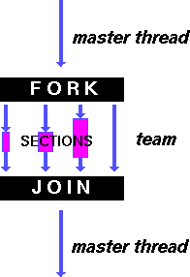
sections worksharing construct
#pragma omp sections
{
#pragma omp section
{
...
}
#pragma omp section
{
...
}
}
<Clauses>
private (list)
shared (list)
firstprivate (list)
lastprivate (list)
reduction(operator:list)
nowait

Slide 32
At the end of ‘for’, ‘sections’ & ‘single’ constructs, threads by default are synchronized - they can not proceed unless all threads report at the same point in the instruction set.
The nowait clause allows for asynchronous threads.
Bypassing default synchronization points can lead to incorrect updating of shared(global) variables
#pragma omp parallel shared(a,b,c,d) private(i)
{
#pragma omp sections nowait
{
#pragma omp section
for (i=0; i < N; i++)
c[i] = a[i] + b[i];
#pragma omp section
for (i=0; i < N; i++)
d[i] = a[i] * b[i];
} /* end of sections */
…. more code …..
} /* end of parallel section */

Slide 33
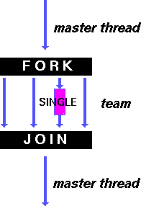
single “worksharing” construct
#pragma omp single
{
…
block_of_code
…
}
<Clauses>
private (list)
firstprivate (list)
nowait
Only a single thread executes code

Slide 34
Core synchronization directives
#pragma omp barrier
Barrier synchronizes all threads
at that point
#pragma omp flush (list)
Flush synchronizes all thread-visible (shared)
values from local CPU registers to memory.
It re-establishes a consistent view of memory
across all threads. It is implied upon exiting in:
barrier for
parallel sections
critical single
ordered

Slide 35
#pragma omp critical [name]
structured_block
The critical directive/construct allows access to a code
segment one thread at a time. It aims in protecting
simultaneous updates to memory locations of shared variables
by threads – before threads are made aware of other updates,
i.e. race conditions

Slide 36
#include <omp.h>
main()
{
int x;
x = 0;
#pragma omp parallel shared(x)
{
#pragma omp critical
x = x + 1;
} /* end of parallel section */
}
register
memory
register
0
0
0
x+1
1
0
1
x+1
time
1
1
1
register
memory
register
0
0
0
Critical region
1
1
1
x+1
time
x+1
2
2
1

Slide 37
#pragma omp threadprivate (list)
The threadprivate directive/construct allows private
variables to retain their thread specific values across
parallel regions
Does not apply in dynamic schedules
Number of threads between parallel regions must be the same
Defined outside the extend of the parallel regions

Slide 38
Run-time Library Routines
Explicit management of threads
Setting & polling threads
Querying thread IDs
Querying levels of parallelism (nested threads)
Manage thread locking
Querying wall clock

Slide 39
Runtime routines
Can be executed outside parallel regions
Routines are hardcoded
Most frequent examples:
tid = omp_get_thread_num()
Query the numeric id number of a thread
nthreads = omp_get_num_threads()
Query the number of available threads

Slide 40
Advantages
Disadvantages
Using runtime routines to capture the thread ID allows for:
Detailed management of thread work and thread synchronization
Assists in code debugging
Can emulate practices from distributed computing, i.e. MPI and SPMD (single program multiple data)
Inserts non-pragma source code in the form of runtime routines that prevents code from reverting to pure serial
Use of SPMD practices requires to significantly alter source code
Some runtime routines, i.e. omp_set_num_threads(), remove code flexibility at execution

Slide 41
Environmental Variables
Pass information to the executable at runtime, i.e. number of threads or the method of partitioning loop iterations
Provide an alternative to many runtime routines
Allows for flexibility at execution time

Slide 42
Environmental Variable Examples
Setting the number of threads
export OMP_NUM_THREADS=4
Setting the thread stack size
export OMP_STACKSIZE=“1G”
Binding threads to processors (thread affinity)
export OMP_PROC_BIND=TRUE
Specifying how loop operations are partitioned across threads
export OMP_SCHEDULE=“static”

Slide 43
Calculating Pi

Slide 44
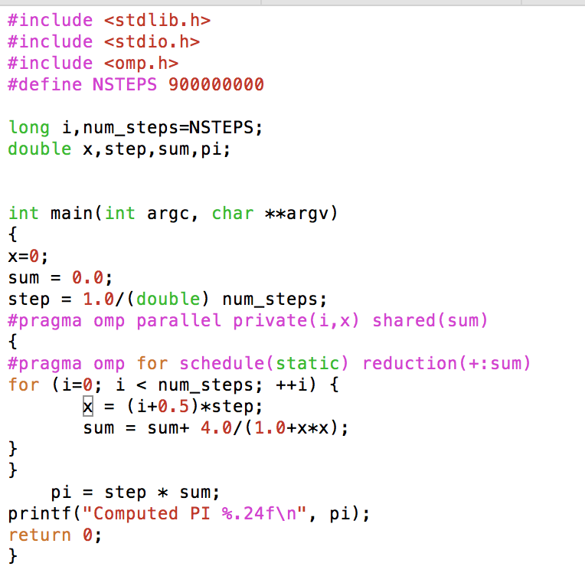
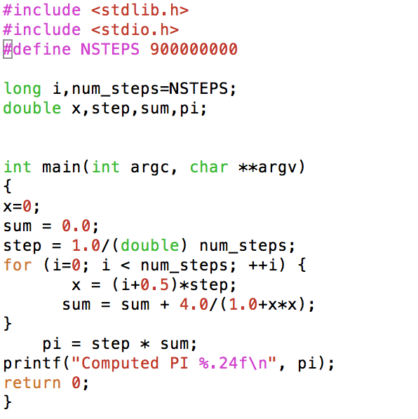
Example OpenMP vs.
serial

Slide 45
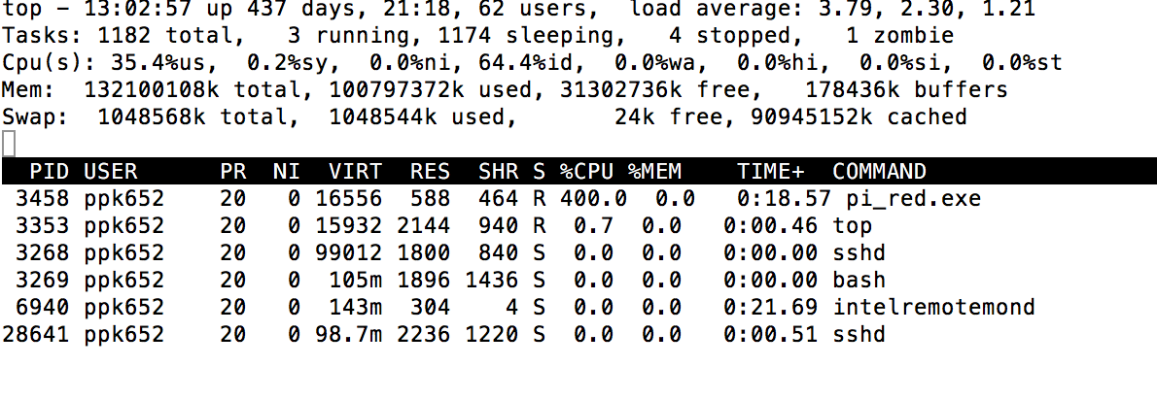
[ppk652@quser12 openmp_source]$ time ./pi.exe
Computed PI 3.141592653590016936959728
real 1m12.981s
user 1m13.010s
sys 0m0.004s
[ppk652@quser12 openmp_source]$ gcc -o pi_red.exe -fopenmp pi_red.c
[ppk652@quser12 openmp_source]$ time ./pi_red.exe
Computed PI 3.141592653589826422688702
real 0m19.349s
user 1m15.619s
sys 0m0.086s
Running parallel job on 4 cores ( 4 threads)

Slide 46
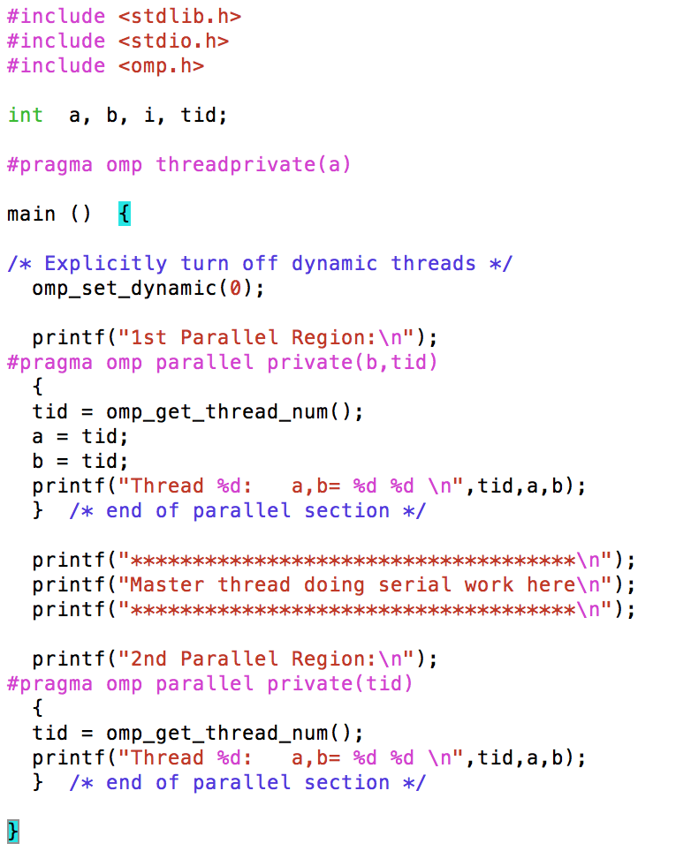
Example of building and running
an OpenMP C program
- threadprivate directive
[ppk652@quser12 openmp_source]$ gcc -fopenmp -o thrpv.exe thrpv.c
[ppk652@quser12 openmp_source]$ export OMP_NUM_THREADS=4
[ppk652@quser12 openmp_source]$ ./thrpv.exe
1st Parallel Region:
Thread 2: a,b= 2 2
Thread 3: a,b= 3 3
Thread 0: a,b= 0 0
Thread 1: a,b= 1 1
************************************
Master thread doing serial work here
************************************
2nd Parallel Region:
Thread 2: a,b= 2 0
Thread 3: a,b= 3 0
Thread 1: a,b= 1 0
Thread 0: a,b= 0 0

Slide 47
Introduction to Message Passing Interface (MPI)

Slide 48
Message Passing Interface (MPI)
A standard library interface for coding on distributed memory systems
Only message passing library that can be considered a standard
It is supported on virtually all HPC platforms
C, C++, Fortran and Python bindings
Different implementations exist: OpenMPI, MPICH, Intel MPI etc.
The programmer is responsible for correctly identifying parallelism and implementing parallel algorithms

Slide 49
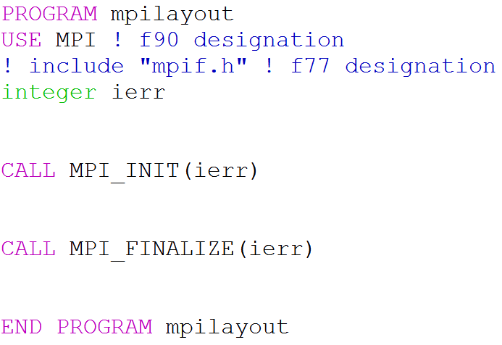
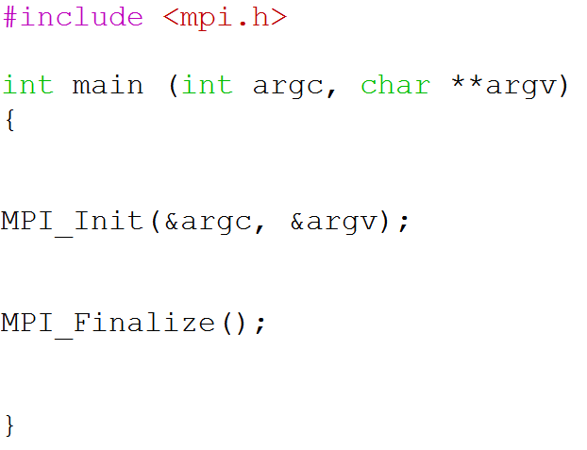
Layout of an MPI Code
FORTRAN
C
NON-MPI
MPI CALL
NON-MPI

Slide 50
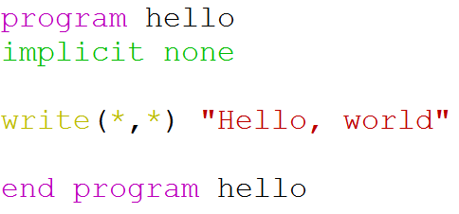
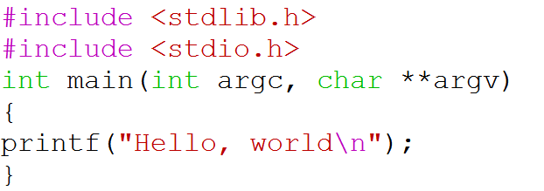
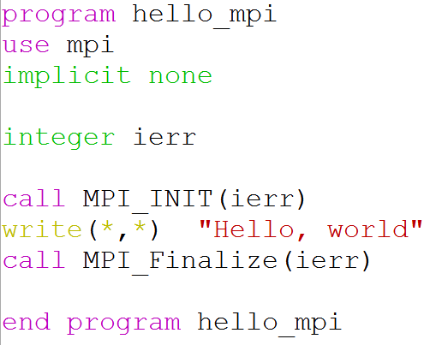
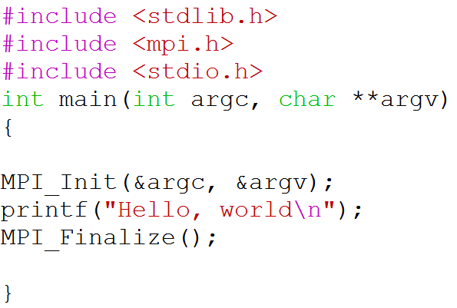
Hello World
FORTRAN
C
MPI parallelized
MPI parallelized

Slide 51
Compilation/Running on Quest
Check available MPI modules
> module avail mpi
Load MPI module
> module load mpi/openmpi-1.8.6-gcc-4.8.3
Compile using MPI
> mpif90 <source.f90> -o <binary.exe>
Run the MPI code
> mpirun -np 2 <binary.exe>

Slide 52
Compilation on Quest
Compiling with MPI
Fortran
> mpif90 <source.f90> -o <binary.exe>
C
> mpicc <source.c> -o <binary.exe>
C++
> mpic++ <source.cpp> -o <binary.exe>

Slide 53
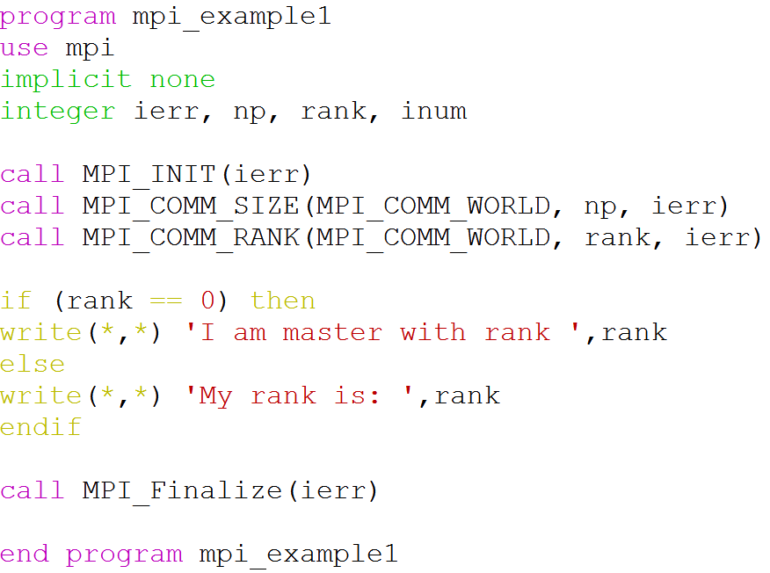
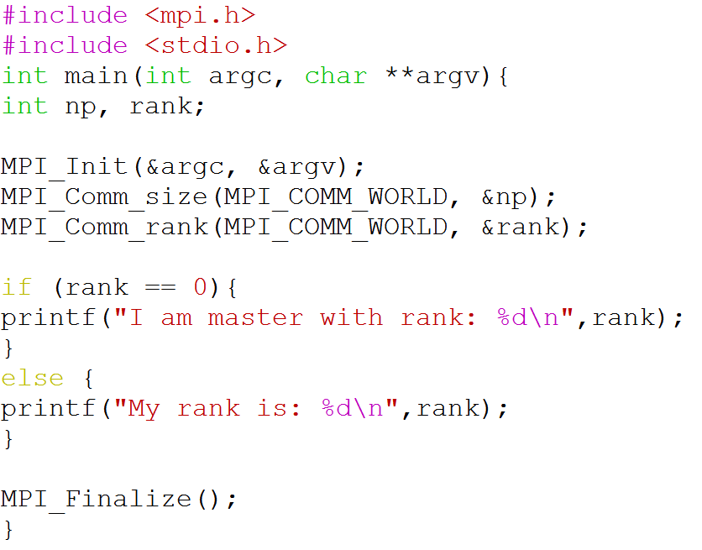
A Simple MPI Code
This code illustrates how to initialize & finalize the MPI environment and gain access to environmental variables.
FORTRAN
C

Slide 54
Initializing MPI
MPI_Init
C: MPI_Init(&argc,&argv)
Fortran: MPI_INIT(ierr)
Initializes MPI environment
Must be called only once before any other MPI commands
C | FORTRAN
argc : pointer to the number of arguments (IN) | ierr : error return (OUT)
argv : pointer to the argument vector (IN)

Slide 55

MPI Environment
C | MPI_Comm_size(MPI_COMM_WORLD, &size)
Fortran | MPI_COMM_SIZE (MPI_COMM_WORLD, size, ierr)
Communicator: a structure in which we identify a group of processes
Size: number of processes in a communicator
MPI_COMM_WORLD: constant which includes the whole activated communicator processes in an instance
7
1
5
0
6
8
4
2
3
MPI_COMM_WORLD

Slide 56
MPI Environment
C | MPI_Comm_rank(MPI_COMM_WORLD, &rank)
Fortran | MPI_COMM_RANK(MPI_COMM_WORLD, rank, ierr)
Rank: Within the communicator, each processes is assigned to an integer from 0 to size-1
C | MPI_Finalize()
Fortran | MPI_FINALIZE(ierr)
Terminates MPI environment
Last MPI routine to be called

Slide 57
Language Differences
Syntax for commands are not unified among different languages
Fortran has all uppercase (e.g., MPI_INIT) MPI commands, whereas C MPI routines have upper and lowercase (e.g., MPI_Init).
Error codes are returned in a separate argument for Fortran as opposed to the return value for C functions.
The arguments of some C MPI routines have specific data types such as MPI_Comm and MPI_Status whereas Fortran has integers.
The include files are different: in C, mpi.h, in Fortan, mpif.h.
The arguments to MPI_Init are different, so that a C program can take advantage of command-line arguments.
In Fortran MPI routines are subroutines and are invoked with call statement.

Slide 58
MPI Communication
As understood from the name, MPI processes communicate by passing messages
Message
Sender
Receiver
Point-to-Point Communication

Slide 59
MPI Communication
Message
(data+envelope)
A message contains the data and its envelope
DATA | ENVELOPE
Buffer, initial address | Communicator
Count | Source
Data type | Destination
 | Tag

Slide 60
MPI Communication
Point-to-Point
Communication
Collective
Communication
Message is passed from one process to another
Message passes to all processes in a communicator
Blocking
(MPI_Send, MPI_Receive)
Non-blocking
(MPI_Isend, MPI_Irecv)
Send&Receive
(MPI_Sendrecv)

Slide 61
Point-to-Point Communication
Blocking versus non-blocking:
Blocking routines do not return until it is safe to use the routine’s buffer (i.e. variables)
safe: the buffer has been copied to system or receiver buffer
Non-blocking routines do not wait for communication to complete
Non-blocking routines allow the overlap of computation and communication in order to gain performance

Slide 62


Point-to-Point Communication
Deadlock: Message passing cannot be completed.
if (rank == 0) { MPI_Send(..., 1, tag, MPI_COMM_WORLD); MPI_Recv(..., 1, tag, MPI_COMM_WORLD, &status); } else if (rank == 1) { MPI_Send(..., 0, tag, MPI_COMM_WORLD); MPI_Recv(..., 0, tag, MPI_COMM_WORLD, &status); }
if (rank == 0) { MPI_Send(..., 1, tag, MPI_COMM_WORLD); MPI_Recv(..., 1, tag, MPI_COMM_WORLD, &status); } else if (rank == 1) { MPI_Recv(..., 0, tag, MPI_COMM_WORLD, &status); MPI_Send(..., 0, tag, MPI_COMM_WORLD); }

Slide 63
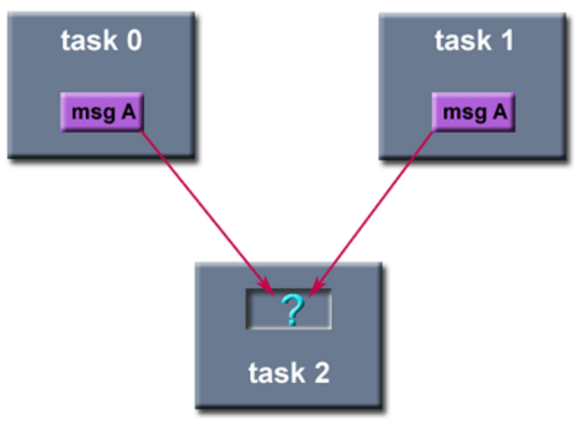
Point-to-Point Communication
Order and Fairness
MPI keeps the order of send (or receive) requests from the same routine
MPI does not guarantee fairness
If 2 different tasks send messages that match another tasks receive, only one send will be complete

Slide 64
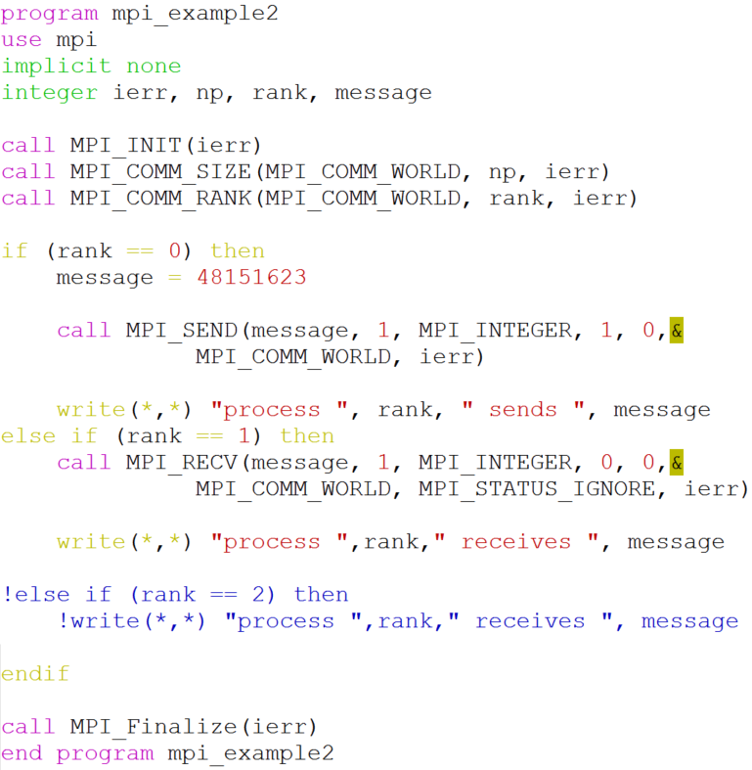
Point-to-Point Communication
A blocking communication
between 2 processes

Slide 65
Point-to-Point Communication
MPI_SEND(buf,count,datatype,dest,tag,comm,ierr)
MPI_Send(&buf,count,datatype,dest,tag,comm)
Data
Envelope
Variable |  | Definition
buf | IN | Address of send buffer
count | IN | Number of elements in buf
datatype | IN | MPI data type of send buffer
dest | IN | Rank of destination
tag | IN | Message tag
comm | IN | Communicator
ierr | OUT | Return code
Mpi_example2
message
1
MPI_INTEGER
1
0
MPI_COMM_WORLD
ierr

Slide 66
Point-to-Point Communication
MPI_RECV(buf,count,datatype,source,tag,comm,ierr)
MPI_Recv(&buf,count,datatype, source,tag,comm,&status)
Data
Envelope
Variable |  | Definition
buf | OUT | Address of receive buffer
count | IN | Number of elements in buffer
datatype | IN | MPI data type of receive buffer
source | IN | Rank of source
tag | IN | Message tag
comm | IN | Communicator
ierr | OUT | Return code
status | OUT | Status object (sender rank, tag, length)
Mpi_example2
message
1
MPI_INTEGER
1
0
MPI_COMM_WORLD
ierr

Slide 67
MPI Data Types
Generally MPI data types and language types have one-to-one correspondence however in C, some MPI variables have their own data types such as MPI_Comm, MPI_Status etc.
Data type | C/C++
MPI_CHAR | char
MPI_SHORT | short int
MPI_INT | int
MPI_LONG | long int
MPI_FLOAT | float
MPI_DOUBLE | double
MPI_LONG_DOUBLE | long double
Data type | Fortran
MPI_CHARACTER | character
MPI_INTEGER | integer
MPI_REAL | Real*4
MPI_REAL8 | Real*8
MPI_COMPLEX | Complex
MPI_LOGICAL | logical

Slide 68
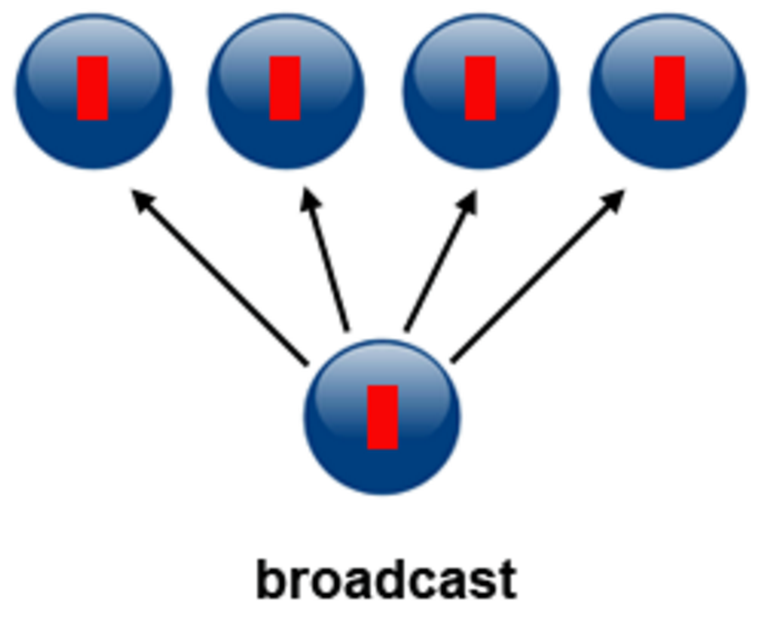
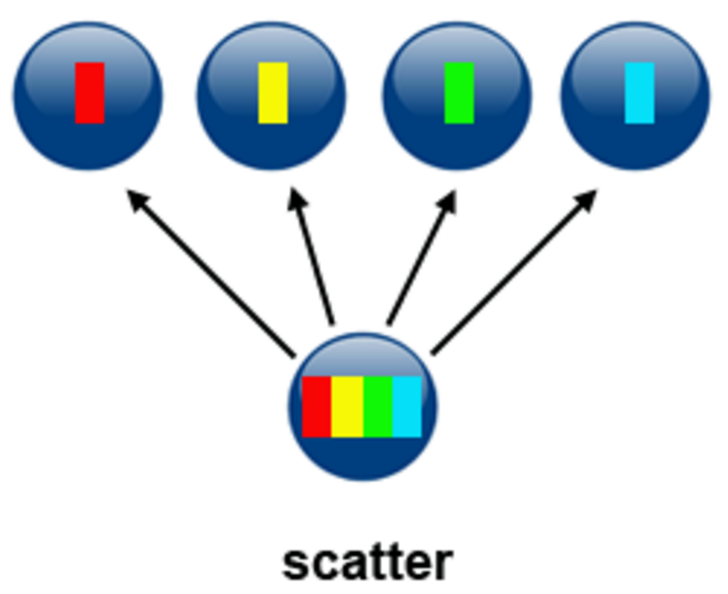
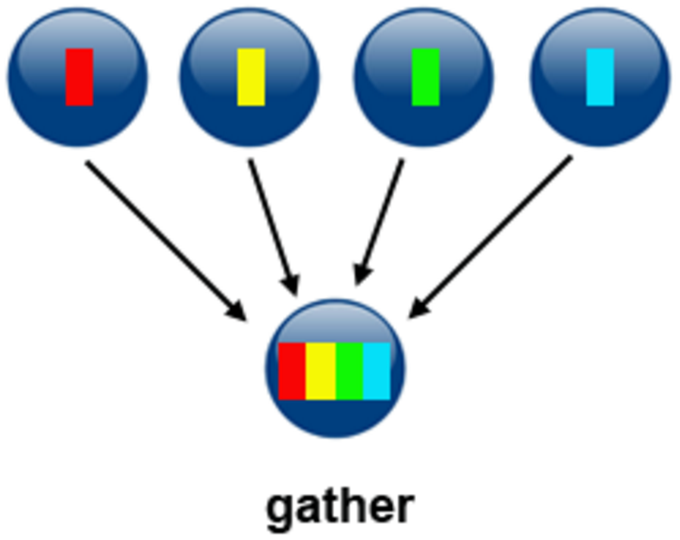
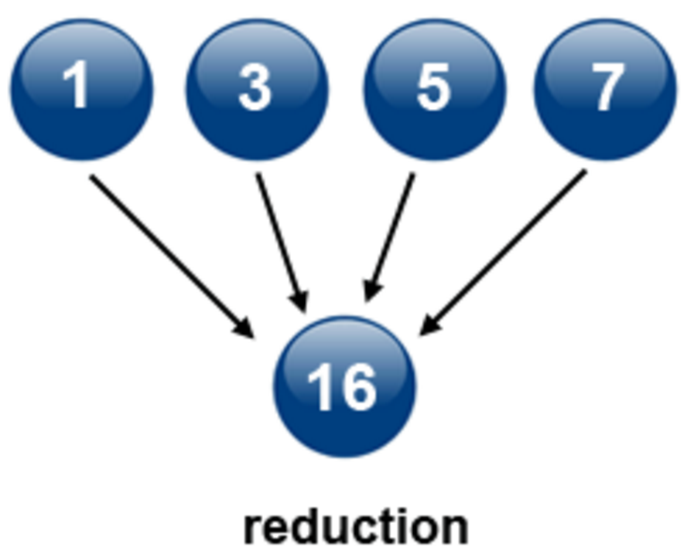
Collective Communication
Types of Collective Communications
Synchronization
Data Movement
Collective Compute

Slide 69
Collective Communication
MPI_BARRIER | All processes within a communicator will be blocked until all processes within the communicator have entered the call.
MPI_BCAST | Broadcasts a message from one process to members in a communicator.
MPI_REDUCE | Performs a reduction operation to the vector of elements in the sendbuf of the group members and places the result in recvbuf on root.
MPI_GATHER MPI_GATHERV | Collects data from the sendbuf of all processes in comm and place them consecutively to the recvbuf on root based on their process rank.
MPI_SCATTER MPI_SCATTERV | Distribute data in sendbuf on root to recvbuf on all processes in comm.
MPI_ALLREDUCE | Same as MPI_REDUCE, except the result is placed in recvbuf on all members in a communicator.
MPI_ALLGATHER MPI_ALLGATHERV | Same as GATHER/GATHERV, except now data are placed in recvbuf on all processes in comm.
MPI_ALLTOALL | The j-th block of the sendbuf at process i is send to process j and placed in the i-th block of the recvbuf of process j.

Slide 70
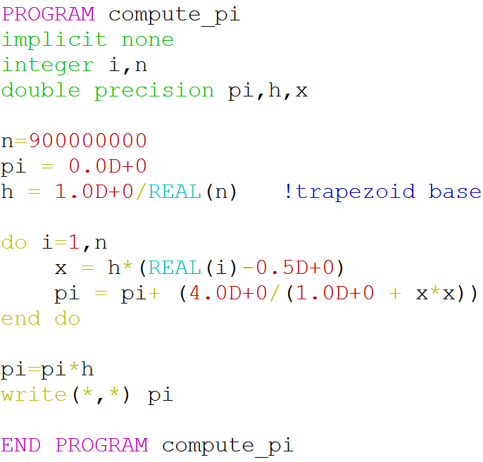
Calculating Pi (Serial)
Collective Communication

Slide 71
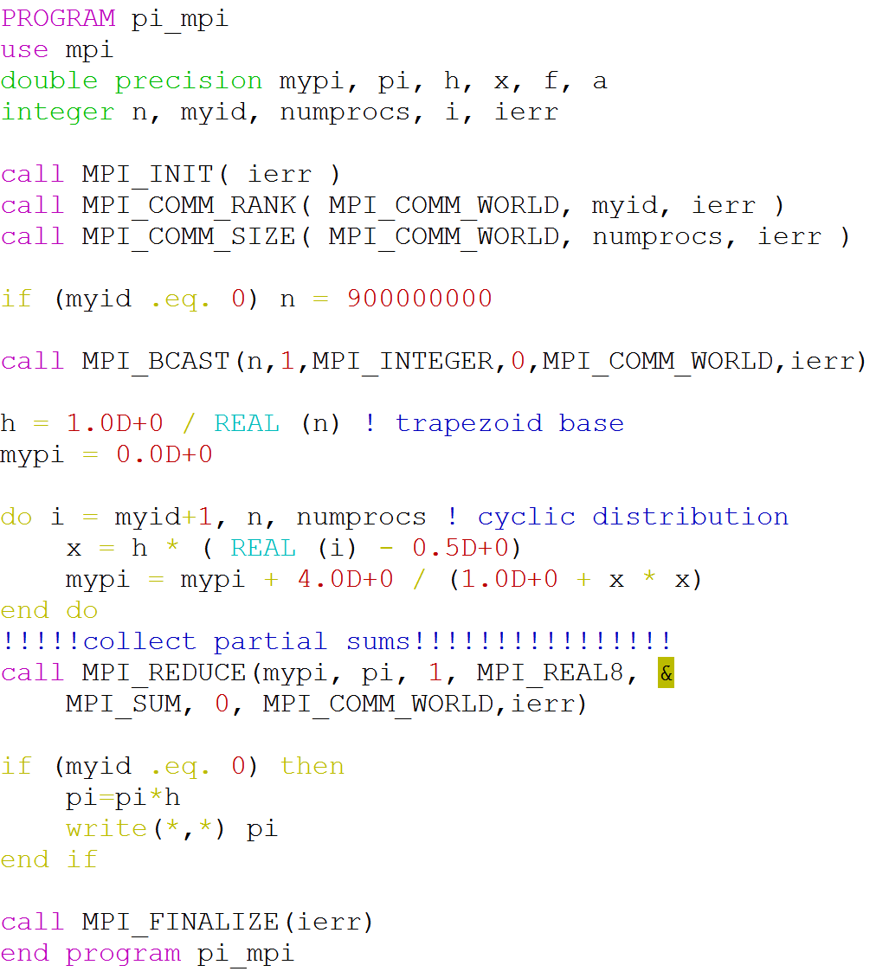
Calculating Pi (MPI)

Slide 72
Collective Communication
MPI_Bcast (&inbuf,count,datatype,root,comm)
MPI_BCAST(inbuf, incnt, intype, root, comm, ierr)
Broadcasts a message from one process to members in a communicator
Variable |  | Definition
inbuf | IN/OUT | Address of input buffer
incnt | IN | Number of elements in inbuf
intype | IN | MPI data type of inbuf
root | IN | Process id of root process
comm | IN | Communicator
Pi example
n
1
MPI_INTEGER
0
MPI_COMM_WORLD

Slide 73
Collective Communication
MPI_Reduce (&inbuf,&outbuf,count,datatype,op,root,comm)
MPI_REDUCE(inbuf, outbuf, count, datatype, op, root, comm, ierr)
Performs a reduction operation to the vector of elements in the sendbuf of the group members and places the result in recvbuf on root
Variable |  | Definition
inbuf | IN | Address of send buffer
outbuf | OUT | Address of receive buffer
count | IN | Number of elements in inbuf
type | IN | MPI data type of send buffer
op | IN | Operation (+,-,x,max,min, …)
root | IN | Process id of root process
comm | IN | Communicator
Pi example
mypi
pi
1
MPI_REAL8
MPI_SUM
0
MPI_COMM_WORLD

Slide 74
References
https://computing.llnl.gov/tutorials/mpi/
https://computing.llnl.gov/tutorials/openMP
http://sc.tamu.edu/shortcourses/SC-MPI/mpi_shortcourse_v4.pdf

Slide 75
Parallelizm with Python

Slide 76
MPI for Python MPI4PY

Slide 77
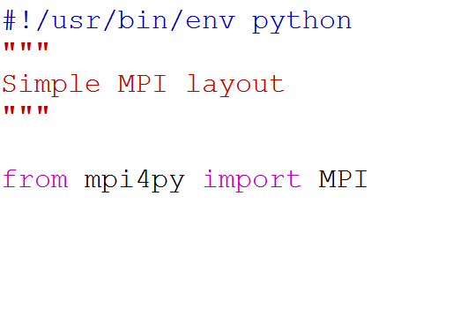
Layout of an Python Code with mpi4y
MPI module in mpi4py package contains the routines used for parallelization
MPI REGION
Load MPI module
> module load mpi4py
Run the MPI code
> mpirun -np 2 python <script.py>
Running on
Quest

Slide 78
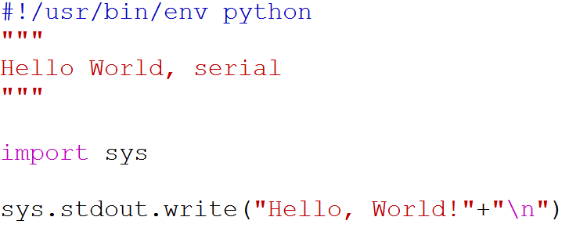
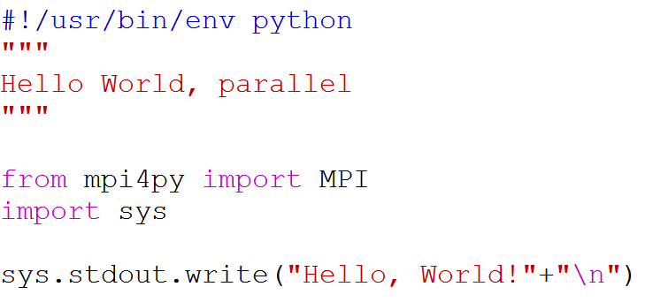
Hello World
MPI parallelized

Slide 79
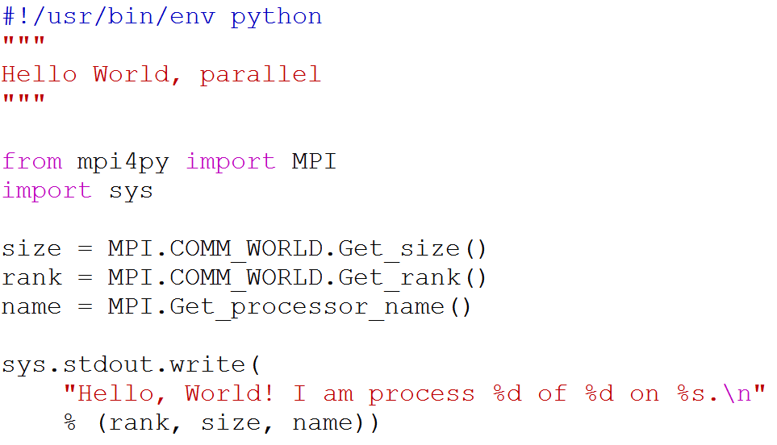
A Simple Python MPI Code

Slide 80
Point-to-Point Communication
Usual communication methods are included in Comm class of MPI module
Comm.send(buf,dest,tag)
Data
Envelope
Variable | Definition
buf | Address of send buffer
dest | Rank of destination
tag | Message tag

Slide 81
Point-to-Point Communication
Comm.recv(buf,source,tag,status)
Data
Envelope
Variable | Definition
buf | Address of receive buffer
source | Rank of source
tag | Message tag
status | Status object (sender rank, tag, length)

Slide 82
Communicating objects & arrays
mpi4py provides two sets of functions for communication:
All lower case methods (send, recv etc.) are for communicating generic python data objects. Can be slow.
Upper-case initial letter case (Send, Recv etc.) are for communicating array data (such as NumPy arrays) which occupies continuous memory blocks. Fast communication.

