Slide 1
Next Steps in Python
Bayesian Inference in STAN
Python
R
MATLAB
Julia
Stata
By: Samvardhan Vishnoi
TA: Efrén N. C. Cortés
Acknowledgements: John Lee

Slide 2
Frequentist vs.
Bayesian
“What is my model parameter, given the data?”
“What are the chances I see this data, given a value for my model parameter?”
likelihood
P(θ=t|y) ∝ P(y|θ=t) P(θ=t)
(Bayes Rule)
prior

Slide 3
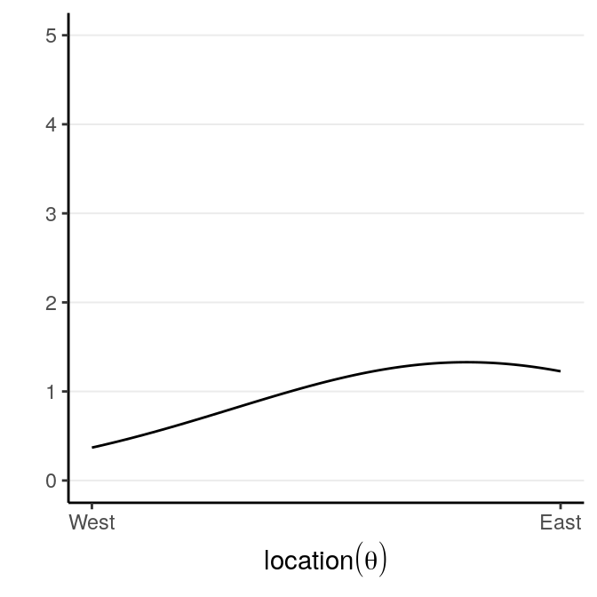
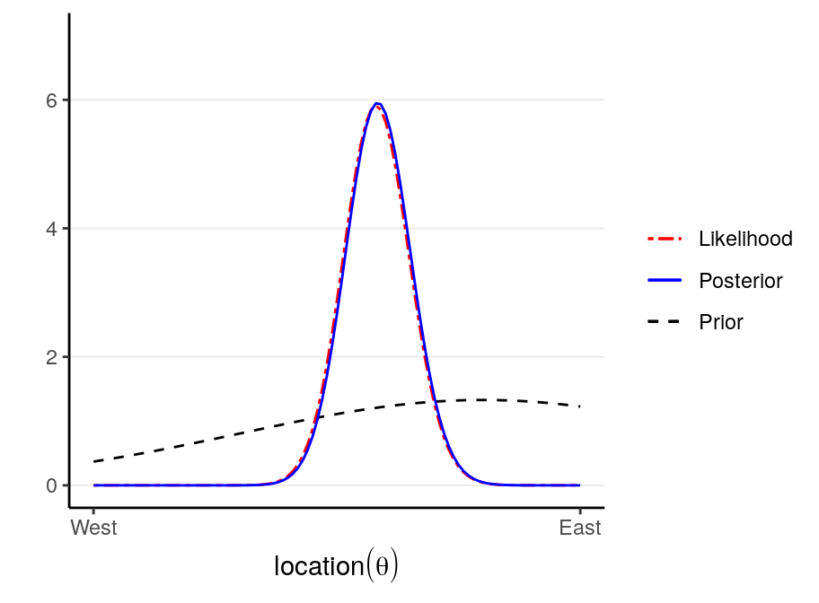
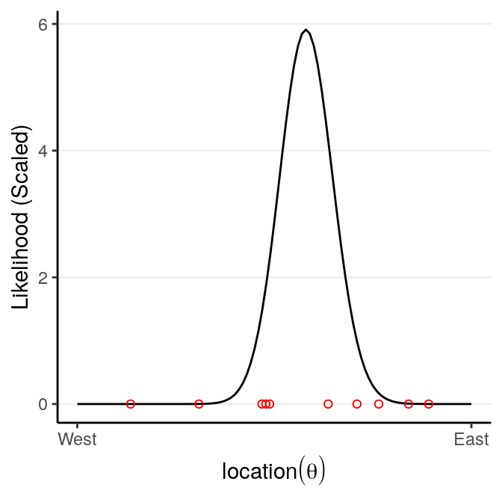
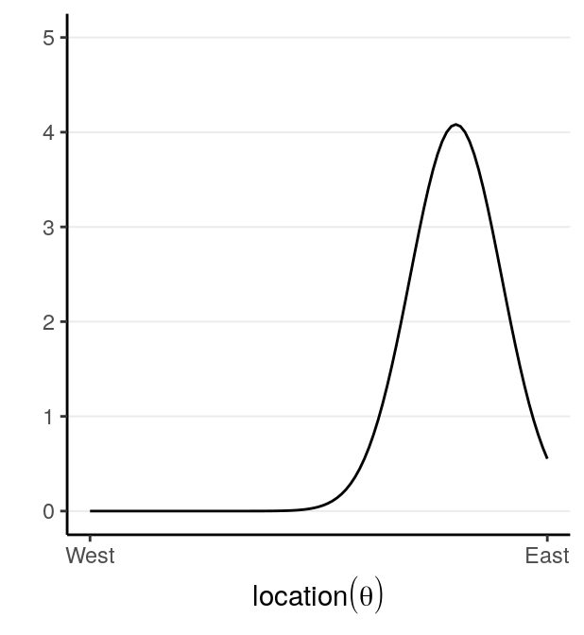
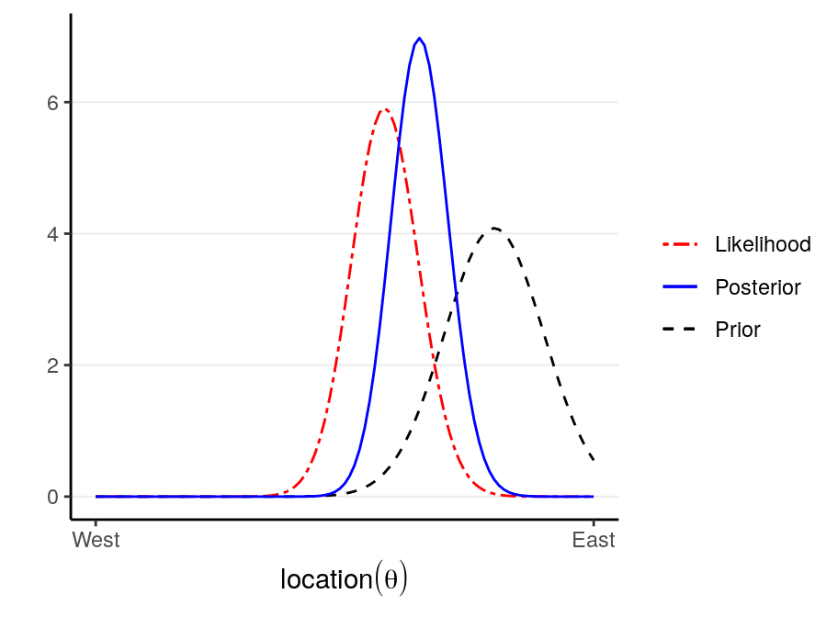
Prior Belief x Observation = Updated Belief
weak
strong

Slide 4
STAN
P(θ=t|y) ∝ P(y|θ=t) P(θ=t)
Grid Approximation
Laplace Approximation
Markov Chain Monte Carlo
Approximation algorithms
Metropolis-Hastings
Hamiltonian Monte Carlo (STAN)

Slide 5
Bayesian Workflow
collect Data
specify Model
choose Priors
check Convergence
“turn the crank”
obtain Posterior
IF converged
interpret Results
compare Models

