Slide 1
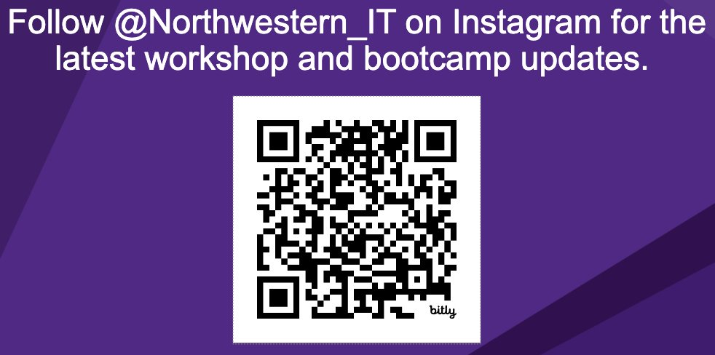
Next Steps in Python
Workshop starts at 12:02
Materials for today
To work on your computer.
Nothing
To work on the cloud.
Jupyter Notebook on Collab

Slide 2
Bayesian Inference in STAN
Python
R
MATLAB
Julia
Stata
By: Samvardhan Vishnoi
TA: John Lee

Slide 3
This workshop is brought to you by:
Northwestern IT Research Computing and Data Services
Need help?
AI, Machine Learning, Data Science
Statistics
Visualization
Collecting web data (scraping, APIs), text analysis, extracting information from text
Cleaning, transforming, reformatting, and wrangling data
Automating repetitive research tasks
Research reproducibility and replicability
Programming, computing, data management, etc.
R, Python, SQL, MATLAB, Stata, SPSS, SAS, etc.
Request a FREE consultation at bit.ly/rcdsconsult.

Slide 4
Logistics
Ask Questions [in the zoom chat].
If you know the answer, feel free to respond (we may politely clarify if needed).
If my internet goes out.
Take a 5 minute break, and we will meet back in the same zoom room.

Slide 5
Warning!
Google Colab sends your data to Google’s servers.
Don’t upload any information you wouldn’t publicly share!
This includes data, code, API keys, people’s names, etc. It is OK to use Google Colab for today’s workshop.

Slide 6
Frequentist vs.
Bayesian
“What is my model parameter, given the data?”
“What are the chances I see this data, given a value for my model parameter?”
likelihood
P(θ=t|y) ∝ P(y|θ=t) P(θ=t)
(Bayes Rule)
prior

Slide 7
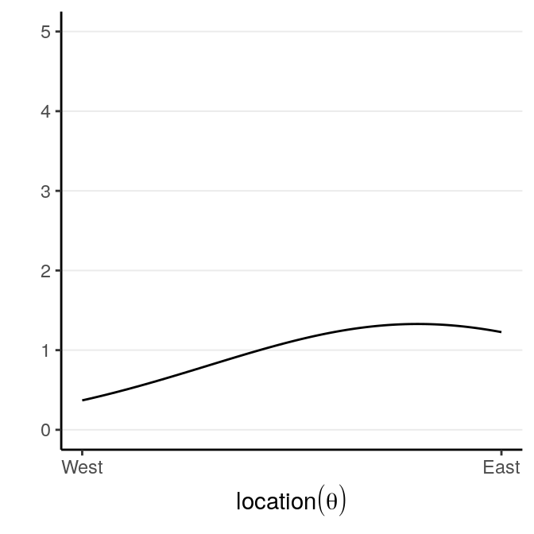
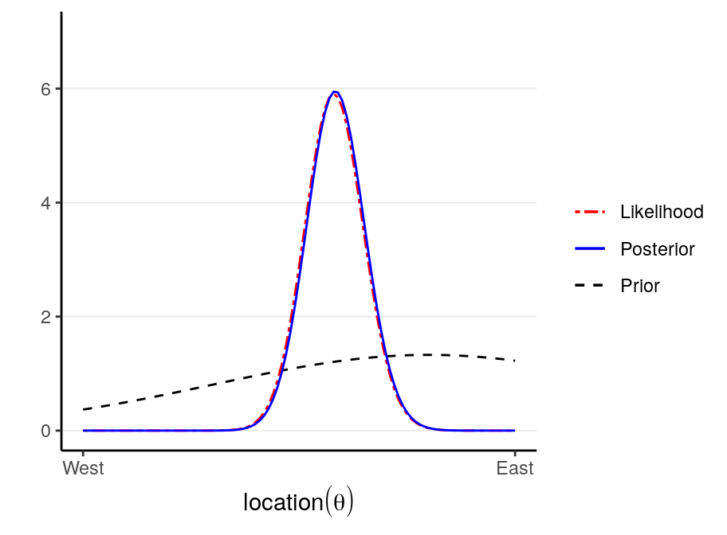
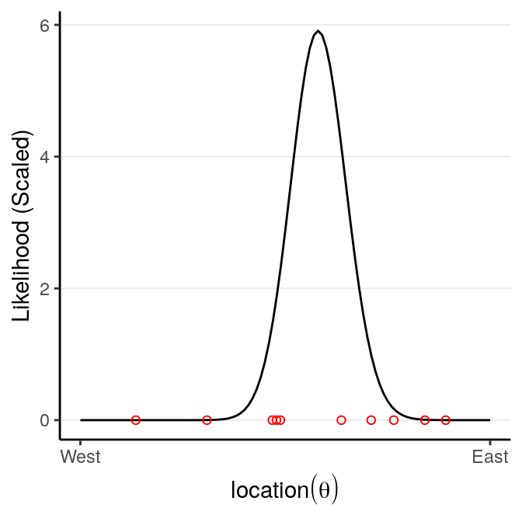
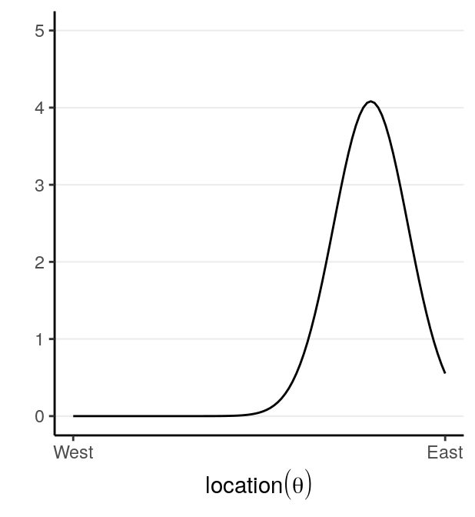
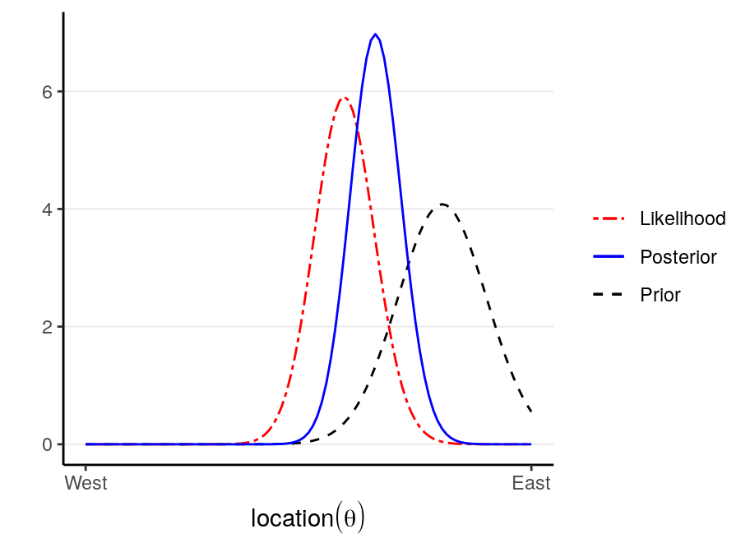
Prior Belief x Observation = Updated Belief
weak
strong

Slide 8
Prior Belief x Observation = Updated Belief
weak

Slide 9
STAN
P(θ=t|y) ∝ P(y|θ=t) P(θ=t)
Grid Approximation (brute force)
Laplace Approximation
Markov Chain Monte Carlo
Approximation algorithms
Metropolis-Hastings
Hamiltonian Monte Carlo (STAN)

Slide 10
Bayesian Workflow
collect Data
specify Model
choose Priors
check Convergence
“turn the crank”
obtain Posterior
IF converged
interpret Results
compare Models

