Slide 1
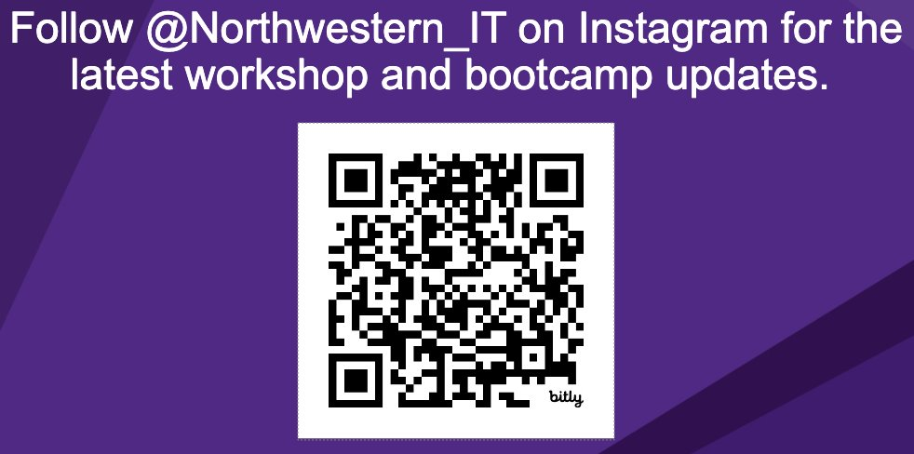
AI for Research
Workshop starts at 09:32
Materials for today
To work on your computer.
https://github.com/nuitrcs/coding_with_ai_assistance

Slide 2
Coding with AI Assistance
Ritika Giri
Emilio Lehoucq
Colby Witherup Wood

Slide 3
This workshop is brought to you by:
Northwestern IT Research Computing and Data Services
Need help?
AI, Machine Learning, Data Science
Statistics
Visualization
Collecting web data (scraping, APIs), text analysis, extracting information from text
Cleaning, transforming, reformatting, and wrangling data
Automating repetitive research tasks
Research reproducibility and replicability
Programming, computing, data management, etc.
R, Python, SQL, MATLAB, Stata, SPSS, SAS, etc.
Request a FREE consultation at bit.ly/rcdsconsult.

Slide 4
Agenda

Slide 5
What’s next?
Tomorrow: Get Started Safely with AI Coding Agents
Tomorrow: Linking VS Code to LLMs
Thursday: AI for Data Visualization
Thursday: Workflow Strategies for AI Agents
November 19: Using LLM APIs through Azure
November 19: Using LLMs on Quest
Talks about practical applications in the fall!

Slide 6
AI has an environmental impact 🌍
Carbon footprint due to energy consumption both during model training and usage.
Fresh water evaporated to cool servers.
E-waste containing hazardous substances generated with the production of hardware.
Notes:
Short overview: https://www.unep.org/news-and-stories/story/ai-has-environmental-problem-heres-what-world-can-do-about
2024 report by the International Energy Agency: https://iea.blob.core.windows.net/assets/6b2fd954-2017-408e-bf08-952fdd62118a/Electricity2024-Analysisandforecastto2026.pdf
MIT Technology Review article: https://www.technologyreview.com/2023/12/01/1084189/making-an-image-with-generative-ai-uses-as-much-energy-as-charging-your-phone/

Slide 7
What We Are Seeing

Slide 8
Key Best Practices

Slide 9
Exercise Kickoff

